Slide 1
Why Global Education?
Fernando Molina
Social Sciences Lead Teacher
Santee Education Complex

Slide 2

What is Global Education?
Global Education prepares our students for our complex world.
Emphasis on developing Global Competencies.
Global competence involves an ability to function in societies other than our own.*
Global education must prepare students to understand the perspectives of other peoples and cultures across all grade levels and disciplines so as to be able to solve common problems and develop better working relationships.*
*Global Education Advisory Council

Slide 3

Benefits of Global Education
Students become PROBLEM SOLVERS.
Students develop their research, writing, critical thinking, and presentation skills.
Students engage in relevant lessons of study that develop their global competencies.
Students develop their technology skills.
Students are better prepared for the challenges of a global economy.

Slide 4
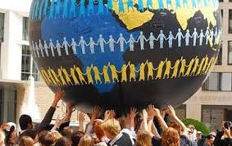
Additional Benefits of Global Education
Students engage in relevant lesson studies that tackle real world, global issues.
Students develop solutions to these real world, global issues.
Students make connections to their own lives and communities.
Students Take Action.
Students become global citizens.
Students develop a better understanding of themselves, and the world around them.

Slide 5

Globally Competent Students….
INVESTIGATE THE WORLD
RECOGNIZE PERSPECTIVES
COMMUNICATE IDEAS
TAKE ACTION

Slide 6


Slide 7
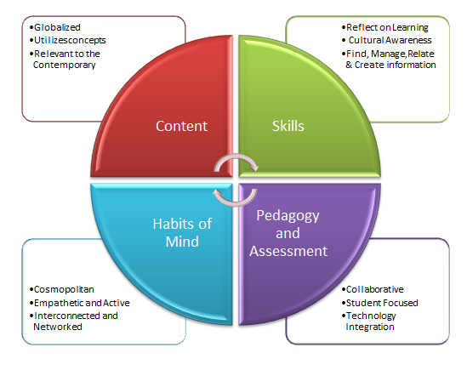

Slide 8
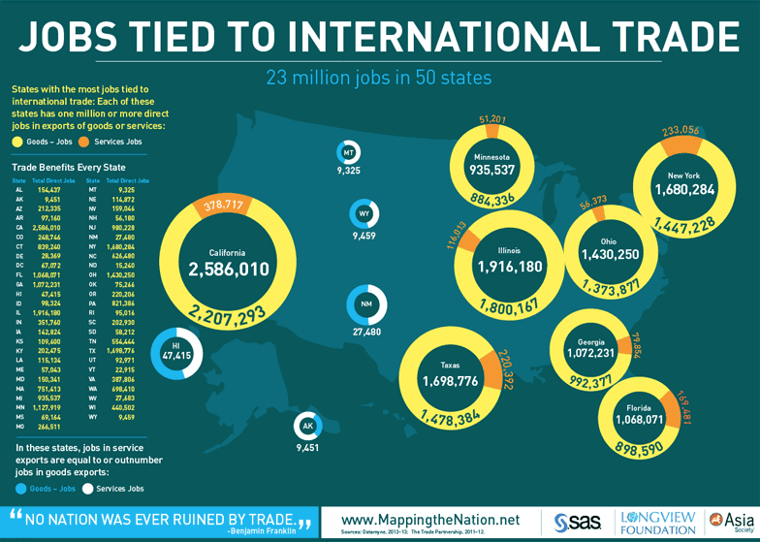

Slide 9
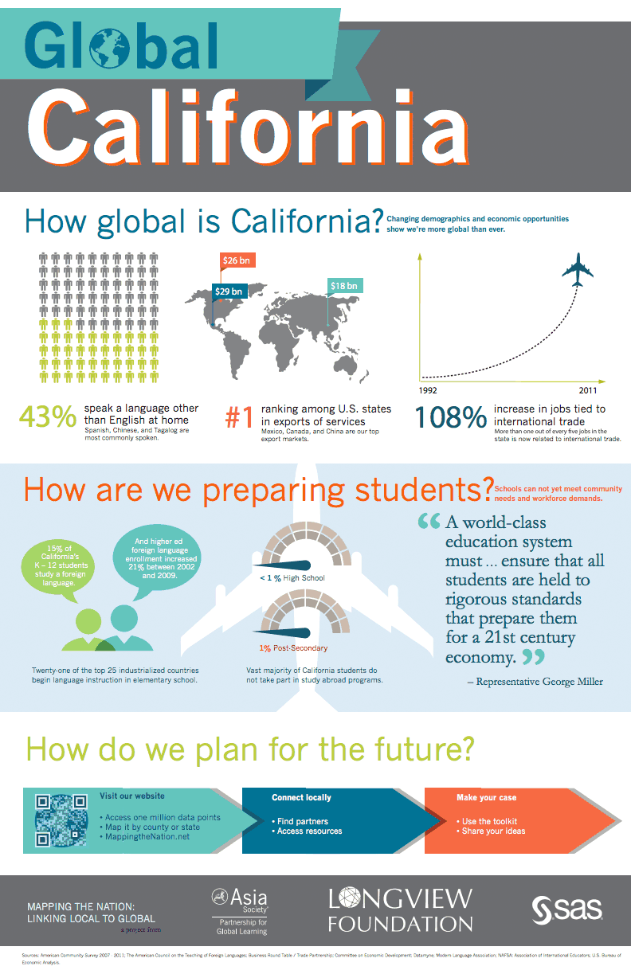
Global Education in California
California is increasingly tied to the rest of the world via commerce, trade, immigration, culture, media, film, politics and business.
Nevertheless, we must do better in preparing our students for a more global society.

Slide 10
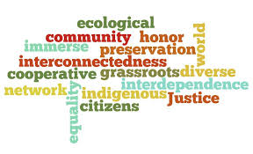
Global Education at Other Schools
Model United Nations
Global Education/Global Competencies imbedded in curriculum
Foreign Language Development
Project Based Learning
Global Studies Club
Links with students/educators abroad
Student Exchange Programs
Global Studies Issues and Action Steps / Service Learning Opportunities

Slide 11

The State of Global Education at Santee
Currently no Global Education Curriculum [either school wide or by department]
Currently no Global Studies Extracurricular Club/Activities
Currently no effort to develop our students’ Global Competency Skills

Slide 12
The State of Global Education at Santee
Only ONE foreign language [Spanish] option available to our students.
The majority of our students already speak Spanish.
  Great for developing globally competent students.
  Let’s take this a step further and ADD a second foreign language option.

Slide 13

Foreign Language Study
Twenty one of the top twenty five industrialized nations begin language instruction in the elementary schools.

Slide 14
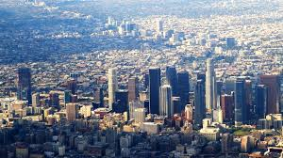
Los Angeles: A Dynamic, Globally Connected Metropolis
Leverage our city’s vast international resources
Business, commerce, and trade
Media, film, and pop culture
Immigrant communities, languages, & diversity

Slide 15
Global Education GOALS for Santee
Incorporate Global Education in Social Science Department
Global Studies Club
Participate in Los Angeles World Affairs Council
Develop minimum one Service Learning Project per/semester with a Global Studies Issues / POV

Slide 16
Global Education Resources
http://globaleducationicsd.weebly.com/index.html
http://ouressentialstory.weebly.com/international-pbl-opportunities.html
http://globalbluebirds.weebly.com
https://sites.google.com/a/hartdistrict.org/scv-global/building-global-comp-into-your-class/global-ed-content-standards
http://www.lawac.org/Default.aspx?tabid=92
http://cperrier.edublogs.org
http://tgcus.blogspot.com
http://teachingquality.org/blogs/NoahZeichner

