Slide 1
Chapter 4
American Life in the Seventeenth Century, 1607–1692

Slide 2
I. The Unhealthy Chesapeake
Life in the American wilderness:
  Was nasty, brutish, and short
  Malaria, dysentery, and typhoid took its toll
  Took ten years off expectancy of newcomers
  Half of the people born in early Virginia and Maryland died before their twentieth birthday
  Few lived to see their fiftieth birthday, sometimes even their fortieth, especially if they were women.

Slide 3
I. The Unhealthy Chesapeake
(cont.)
Settlements of the Chesapeake grew slowly, mostly by immigration:
  Most were single men in their late teens and early twenties
  Most died soon after arrival
  Extreme scarcity of women, usually six to one
  Families were few and fragile
  Most men could not find mates

Slide 4
I. The Unhealthy Chesapeake
(cont.)
    Most marriages were destroyed by death of a partner within seven years
    Scarcely any children reached adulthood and no one knew their grandparents
    Many pregnancies among unmarried young girls.
Yet the Chesapeake colonies struggled on.
By the end of the 17th century, the white population of the Chesapeake was growing.

Slide 5
II. The Tobacco Economy
The Chesapeake was immensely hospitable to tobacco cultivation:
  It quickly exhausted the soil
  Created an insatiable demand for new land
  Commercial growers plunged farther up the river valleys, provoking Indian attacks.
1630 shipped 1.5 million pounds of tobacco and by the end of the century almost 40 million.

Slide 6
II. The Tobacco Economy
(cont.)
More tobacco meant more labor, but where was it to come from?
  Families procreated too slowly
  Indians died too quickly on contact with whites
  African slaves cost too much money
  England still had a “surplus” of displaced workers and farmers desperate for employment
    Tenants forced from their land by landlords who “enclosed” more acreage.

Slide 7
II. The Tobacco Economy
(cont.)
Chesapeake planters recruited some 100,000 indentured servants to the region by 1700.
These “white slaves” represented more than three-quarters of all European immigrants.
  Indentured servants led a hard life
  They looked forward to becoming free and acquiring land
  Even after freedom they had to hire themselves for pitifully low wages.

Slide 8
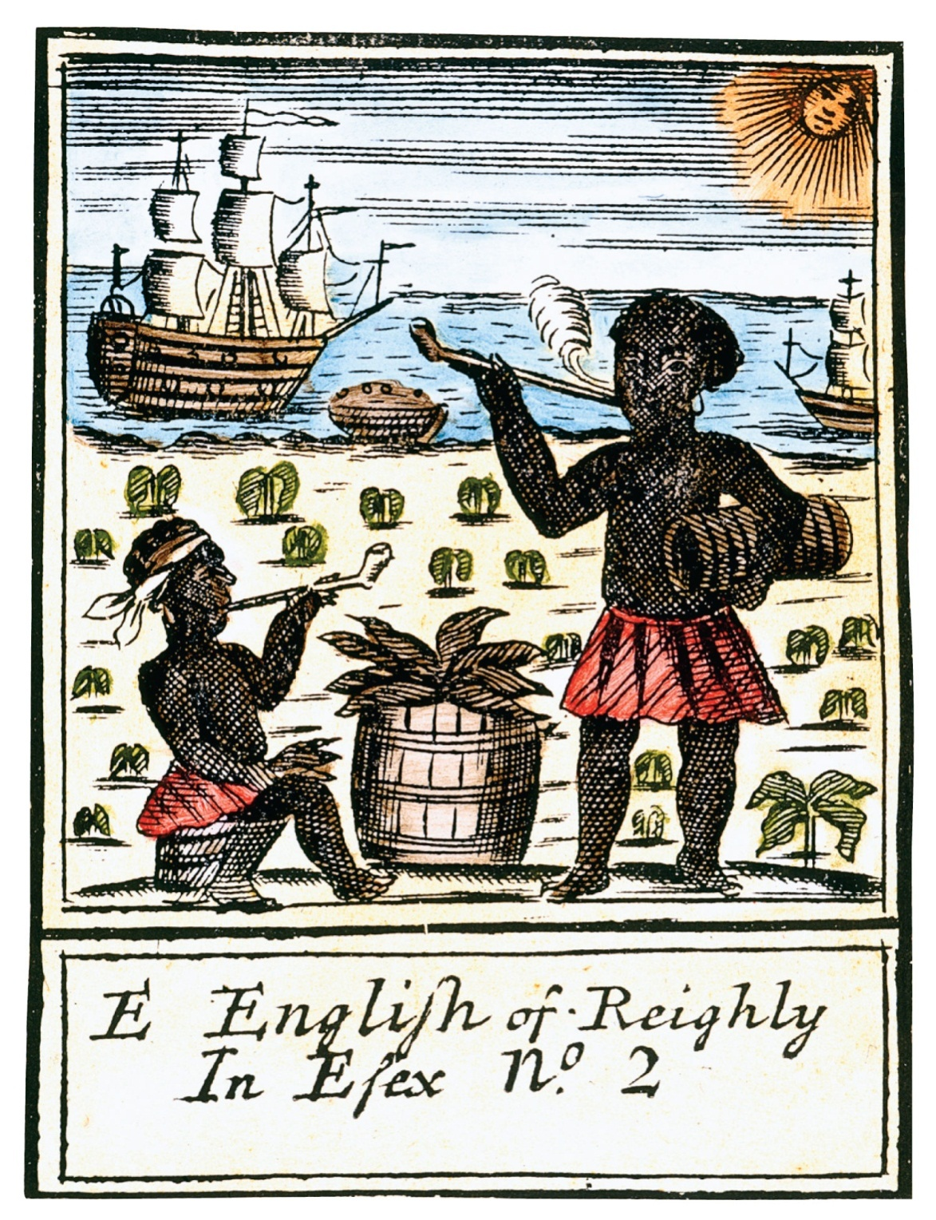
p61
Notes:
Early Tobacco Advertising Crude woodcuts like this one
were used to identify various “brands” of tobacco—one of
the first products to be sold by brand-name advertising.

Slide 9
III. Frustrated Freemen and Bacon’s Rebellion
Many impoverished freedmen were frustrated with broken hopes and failure to find single women to marry.
1670 the Virginia assembly disfranchised most of the landless knockabouts.
Virginia’s Governor Wm. Berkeley.
1676 the Bacon’s Rebellion led by Nathaniel Bacon broke out.

Slide 10
III. Frustrated Freemen and Bacon’s Rebellion (cont.)
Berkeley’s friendly policies toward the Indians caused him to refuse to retaliate against a series of brutal Indian attacks.
Bacon and his followers took matters into their own hands.
As the civil war continued, Bacon suddenly died from disease.
The rebellion was eventually suppressed.

Slide 11
IV. Colonial Slavery
1680s mass expansion of slavery in colonies:
  7 million came to the New World in three centuries
  400,000 to North America
  1619 Africans were brought to Jamestown
  Hard life for the white colonists; could not pay high prices for slaves
  White servants were far less costly.
  First legal slave-holder was Anthony Johnson—a black Angolan indentured servant who later held a black man who had committed no crime against his will

Slide 12
IV. Colonial Slavery
(cont.)
Mid-1680s black slaves outnumbered white servants among the plantation colonies.
1698 The Royal African Company lost its crown-granted monopoly for carrying slaves.
Rhode Islanders rushed to the lucrative slave trade.
Most African slaves came from the west coast of Africa, present-day Senegal to Angola.

Slide 13
IV. Colonial Slavery
(cont.)
Most came via the gruesome middle passage trip.
Auction blocks were used as a giant slave market trade in human misery.
1662 statutes defined the iron conditions of slavery for blacks.
“Slave codes” marked blacks and their children as property (“chattels”).

Slide 14
IV. Colonial Slavery
(cont.)
Some colonies made it a crime to teach a slave to read or white.
Not even conversion to Christianity could qualify a slave for freedom.
As the 1700s ended, it was clear that racial discrimination powerfully molded the American slave system.

Slide 15
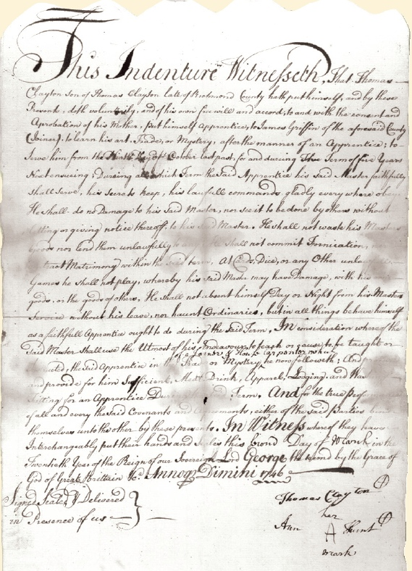
p63

Slide 16
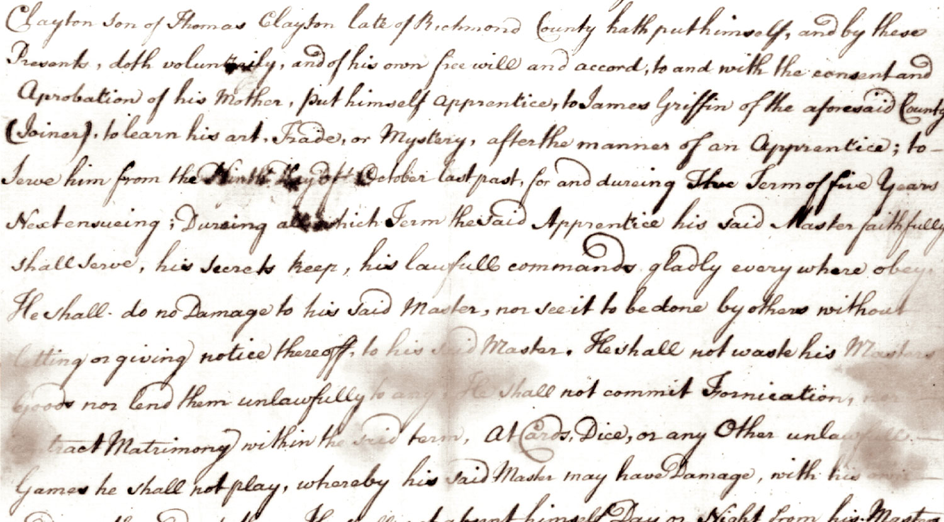
p63

Slide 17
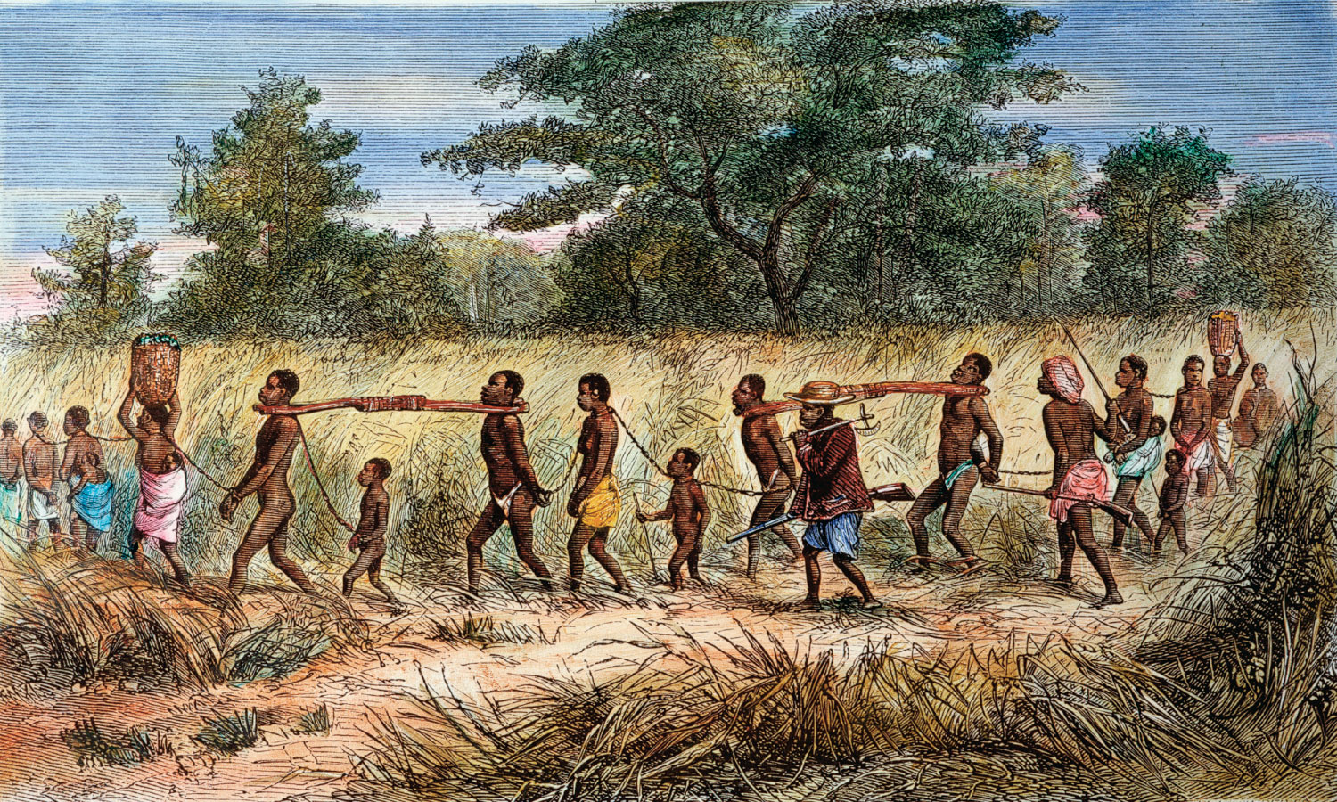
p64
Notes:
An African Slave Coffle Yoked and bound, these men, women, and children were on
their way to a coastal slave market, where they would be herded aboard ship for the
Americas.

Slide 18
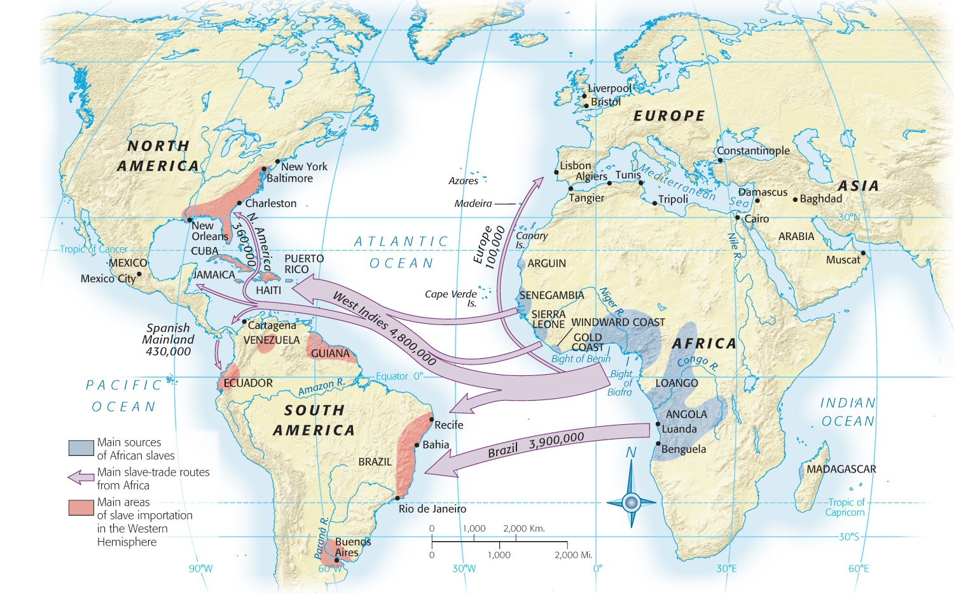
Map 4-1 p65
Notes:
Map 4.1 Main Sources and Destinations of African Slaves, ca. 1500–1860 More than
three centuries of the “African Diaspora” scattered blacks throughout the New World. Britain’s
North American colonies (the future United States) constituted the extreme northern
periphery of this system, receiving about 400,000 of the nearly 10 million arrivals, the
great majority of whom ended up in the West Indies and Brazil

Slide 19
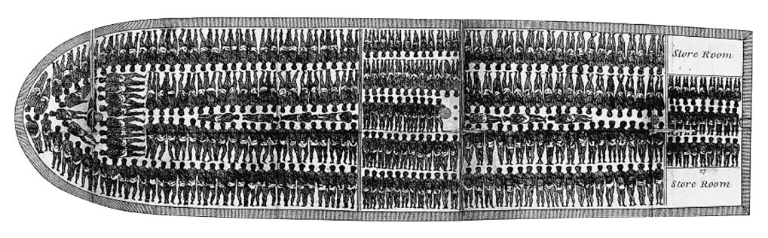
p65
Notes:
The “Middle Passage” The “middle passage” referred to the transatlantic sea voyage
that brought slaves to the New World—the long and hazardous “middle” segment of a
journey that began with a forced march to the African coast and ended with a trek into the
American interior.

Slide 20
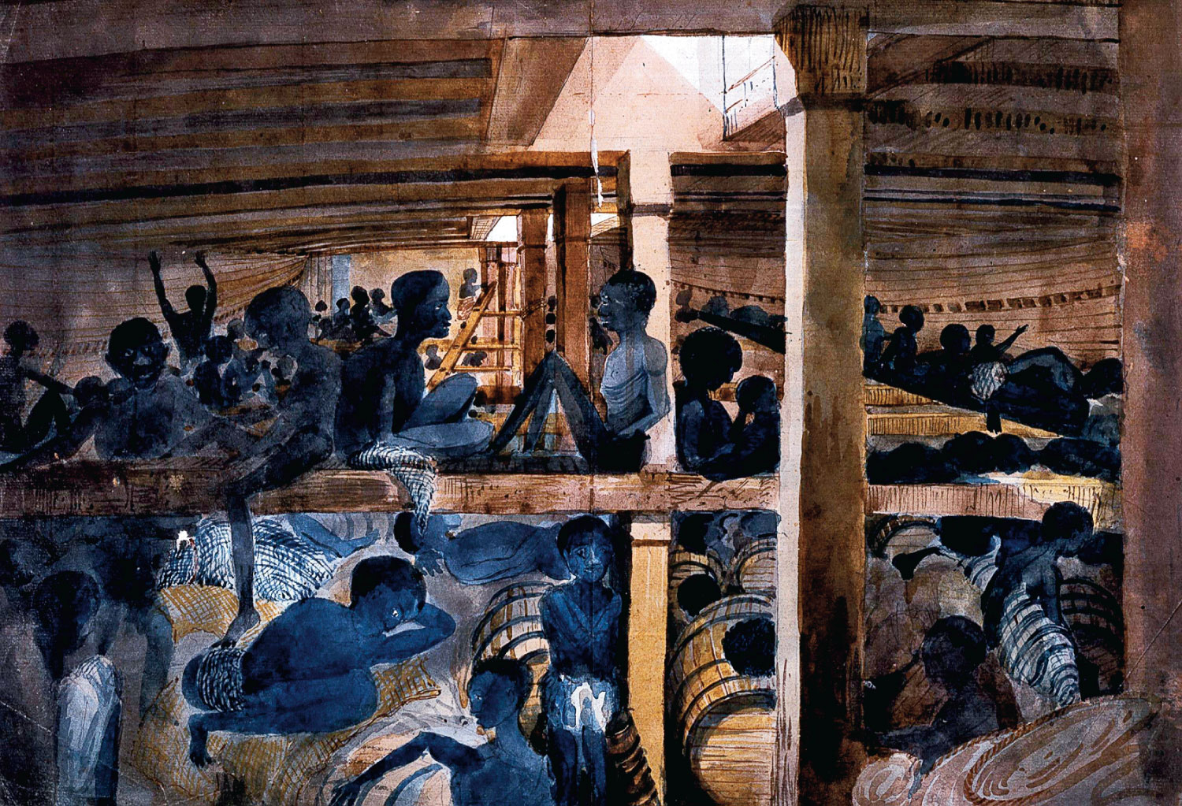
p66
Notes:
The Slave Ship
Albatross, 1846
This eyewitness
painting captures
the dankness,
gloom, and despair
that reigned in the
slaver’s cargo hold.

Slide 21
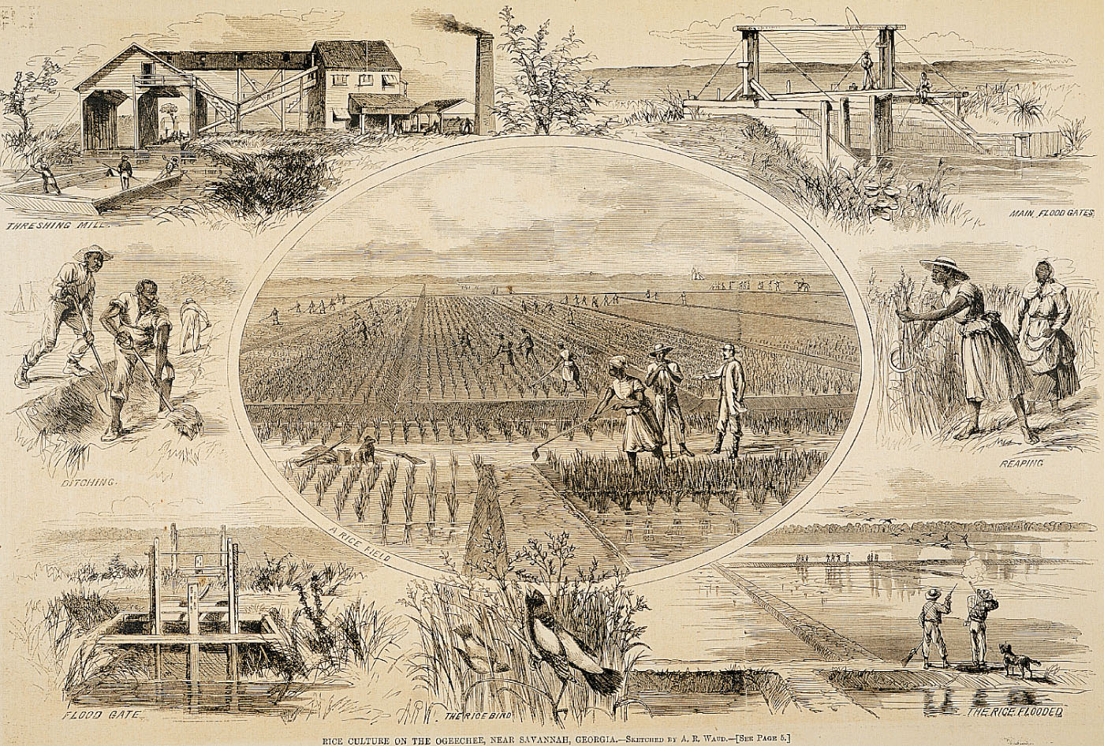
p67

Slide 22
V. Africans in America
In the deepest South, slave life was severe:
    The climate was hostile to health
    The labor was life-draining
    The rice and indigo plantations were lonely life.
  Blacks in the tobacco-growing Chesapeake region had a somewhat easier lot:
    Tobacco plantations were larger and closer to one another than rice plantations.

Slide 23
V. Africans in America
(cont.)
The size and proximity of these plantations permitted the slaves more frequent visits with friends and relatives.
1720 the proportion of females slave population rose and family life was possible.
Growth was now by new imports and fertility.
Native-born Americans contributed to growth.

Slide 24
V. Africans in America
(cont.)
The unique language Gullah evolved among the blacks.
Slaves helped mightily to build the country with their labor:
  Skilled artisans—carpenters, bricklayers, tanners
  Clearing swamps, grubbing out trees.
  1712 The New York slave revolt
  1739 A South Carolina slave revolt erupted.

Slide 25
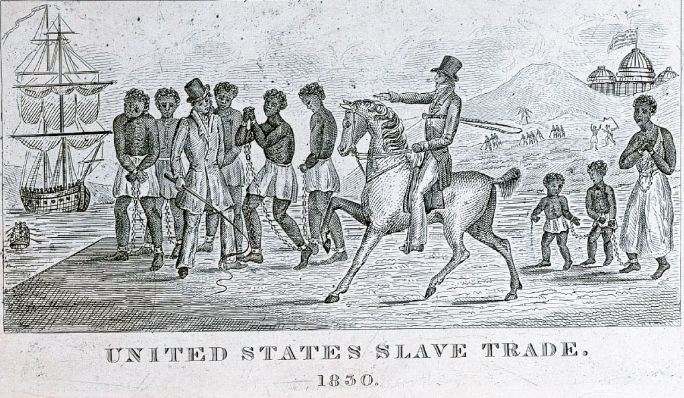
p68
Notes:
(above) Africans Destined for Slavery This engraving from 1830 is an
example of antislavery propaganda in the pre–Civil War era. It shows
hapless Africans being brought ashore in America under the whips of slave
traders and, ironically, under the figurative shadow of the national Capitol.
(right) Advertisements for Slave Sales in Charleston, South Carolina,
1753 Charleston had the largest slave market in the colonies.

Slide 26
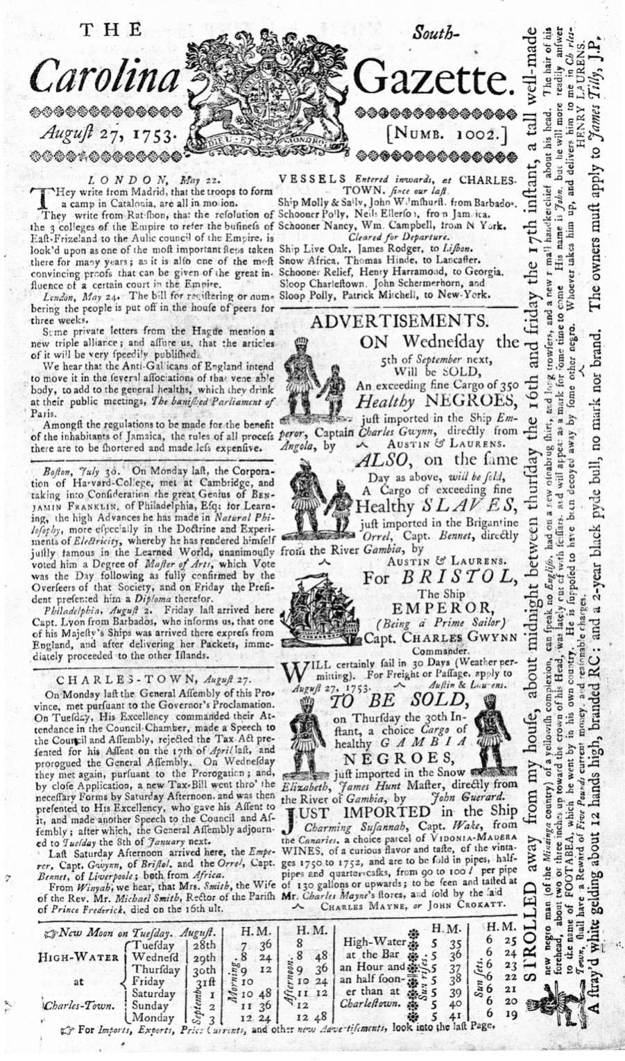
p68
Notes:
(above) Africans Destined for Slavery This engraving from 1830 is an
example of antislavery propaganda in the pre–Civil War era. It shows
hapless Africans being brought ashore in America under the whips of slave
traders and, ironically, under the figurative shadow of the national Capitol.
(right) Advertisements for Slave Sales in Charleston, South Carolina,
1753 Charleston had the largest slave market in the colonies.

Slide 27
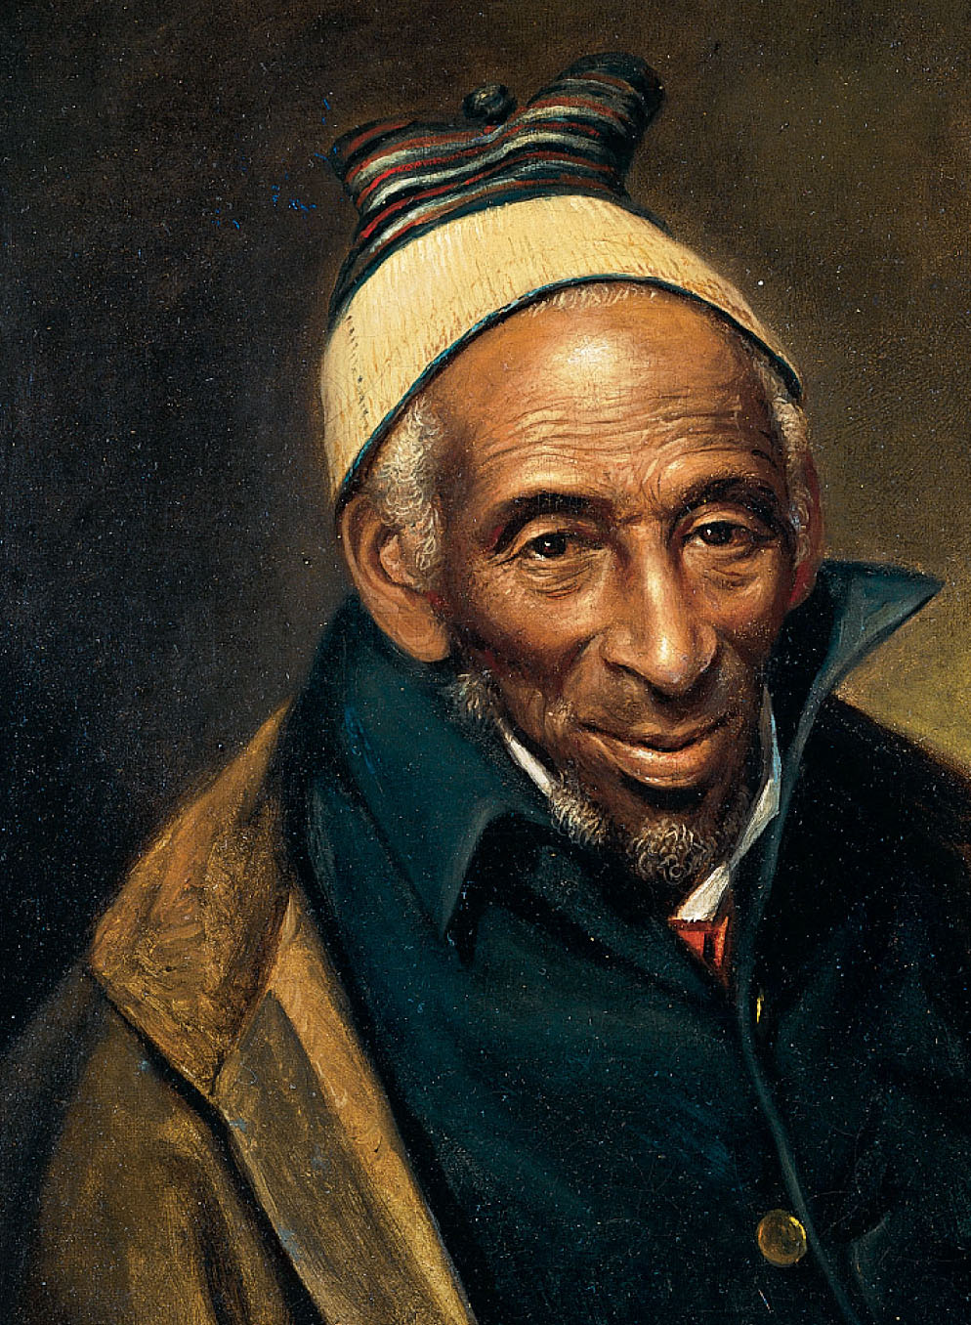
p69
Notes:
(left) Yarrow Mamout, by Charles Willson Peale, 1819 When Peale painted this
portrait, Mamout was over one hundred years old. A devout Muslim brought to Maryland
as a slave, he eventually bought his freedom and settled in Georgetown. (right) The
Emergence of an African American Culture In this scene from the mid-nineteenth
century, African Americans play musical instruments of European derivation, like the fiddle,
as well as instruments of African origin, like the bones and banjo—a vivid illustration of the
blending of the two cultures in the crucible of the New World.

Slide 28
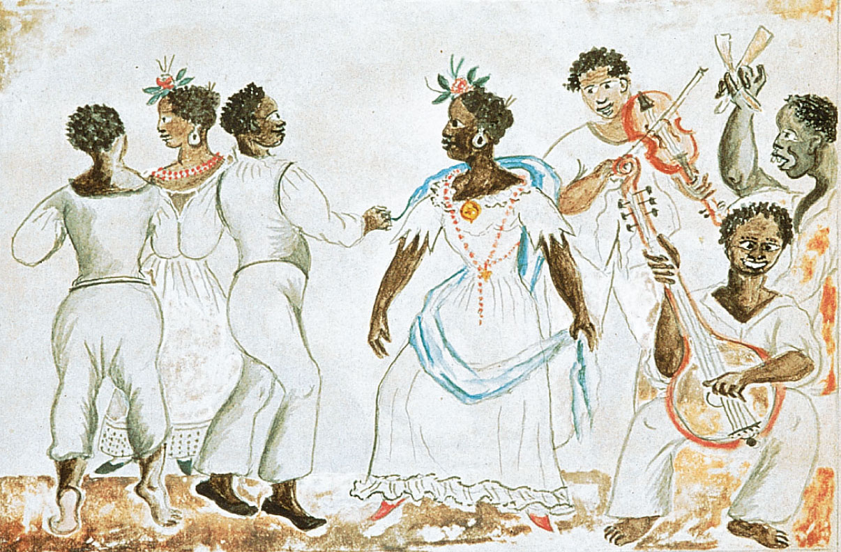
p69
Notes:
(left) Yarrow Mamout, by Charles Willson Peale, 1819 When Peale painted this
portrait, Mamout was over one hundred years old. A devout Muslim brought to Maryland
as a slave, he eventually bought his freedom and settled in Georgetown. (right) The
Emergence of an African American Culture In this scene from the mid-nineteenth
century, African Americans play musical instruments of European derivation, like the fiddle,
as well as instruments of African origin, like the bones and banjo—a vivid illustration of the
blending of the two cultures in the crucible of the New World.

Slide 29
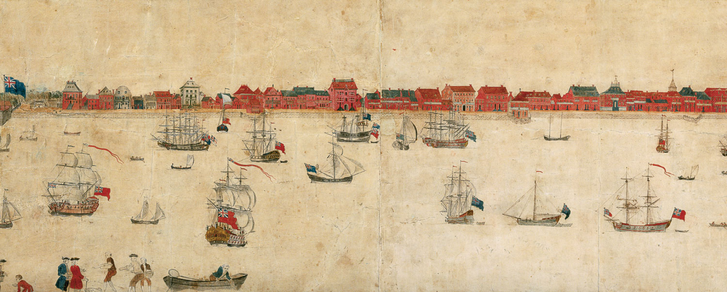
p70
Notes:
Charleston, South Carolina Founded in 1680, Charleston grew to become the
bustling seaport pictured in this drawing done in the 1730s. Charleston was by then the
largest city in the mostly rural southern colonies. It flourished as a seaport for the
shipment to England of slave-grown Carolina rice.

Slide 30
VI. Southern Society
As slavery spread, the gaps in the South’s social structure widened:
  A defined hierarchy of wealth and status
  At the top were the powerful great planters
  Clans—the Fitzhughs, Lees and Washingtons
  By the Revolutionary War, 70% of the leaders of the Virginia legislature came from established families in Virginia (“FFVS”) before 1690.

Slide 31
VI. Southern Society
(cont.)
Most of these leaders were a hard-working, business-like lot, laboring long hours.
Few problems were more vexatious than the unruly servants.
Beneath the planners were the small farmers, the largest social group.
Still lower were the landless whites.
Beneath them were the former indenturers.

Slide 32
VI. Southern Society
(cont.)
Few cities sprouted in the colonial South; thus an urban professional class, lawyers and financiers, were slow to emerge.
Southern life revolved around the great plantations.
Waterways were the principle means of transportation.
Roads were very wretched.

Slide 33
VII. The New England Family
  Contrasts in New England life:
  The settlers of 1600s New England added
  ten years to their life span
  First generations of Puritans averaged 70 years
  They tended to migrate not as single persons but as families and the family remained the center of New England life
  New England’s population grew from natural reproduction.

Slide 34
VII. The New England Family
(cont.)
Married life in New England
  Early marriage encouraged the booming birthrate
  Women generally married in their early twenties
  Produced babies every two years
  Dread of death in birthing haunted the women
  A married woman could experience up to ten pregnancies and rear as many as eight children.

Slide 35
VII. The New England Family
(cont.)
Other contrasts between the southern and New England ways of life:
  The fragility of southern family advanced the economic security of southern women
  Because men frequently died young, the southern colonies allowed married women to retain separate title to the property and inherit their husband’s estates.

Slide 36
VII. The New England Family
(cont.)
    Generally women gave up their property rights when they married
    In the New World, a rudimentary conception of women’s rights as individuals was beginning to appear in the seventeenth century.
    Women still could not vote.
    New England authorities could intervene to restrain abusive spouses.
    Women had some spheres of authority.

Slide 37
VII. The New England Family
(cont.)
The laws of Puritan New England sought to defend the integrity of marriages:
  Divorce was exceeding rare and the authorities commonly ordered separated couples to reunite
  Outright abandonment was among the few permissible grounds for divorce
  Adultery was another

Slide 38
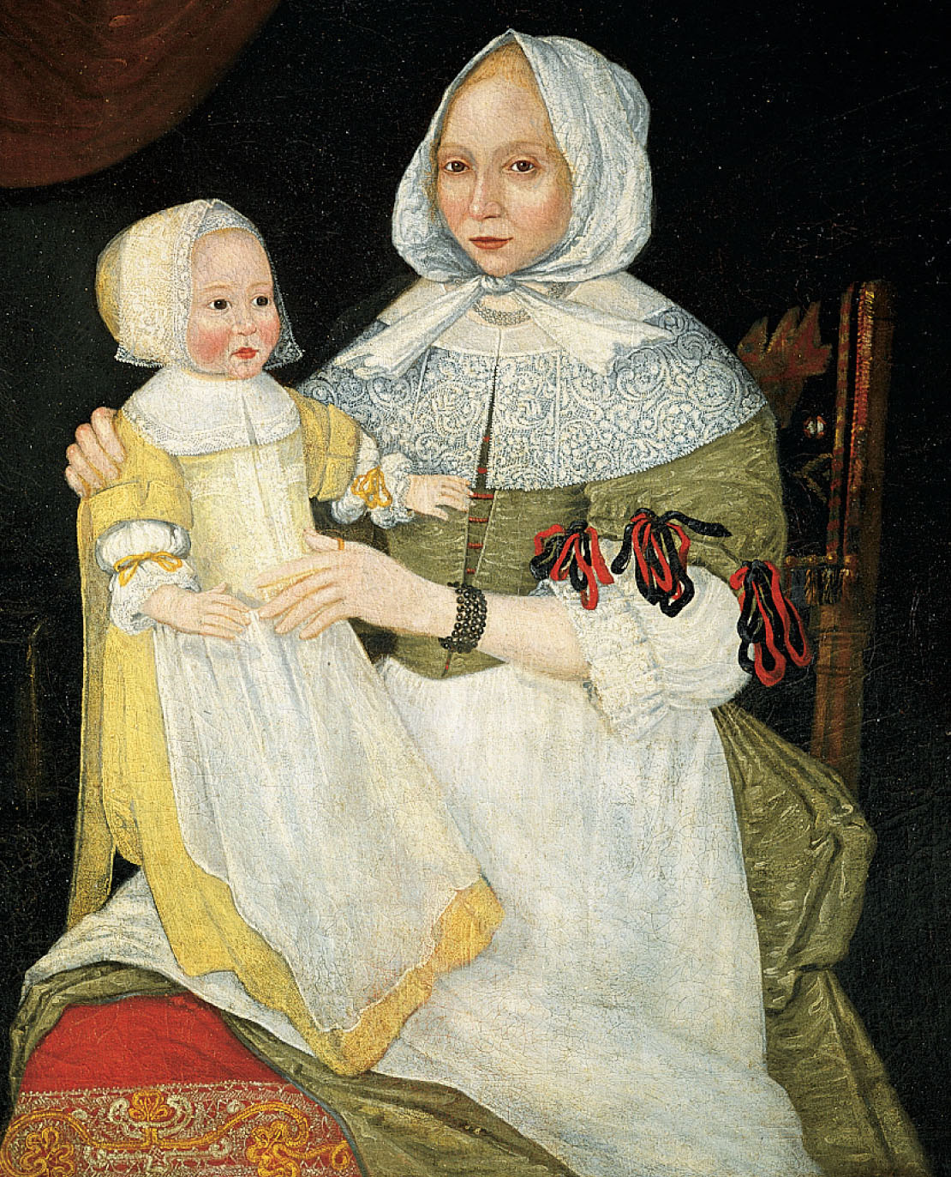
p71
Notes:
Mrs. Elizabeth Freake and Baby Mary This portrait of a
Boston mother and child in about 1674 suggests the strong
family ties that characterized early New England society.

Slide 39
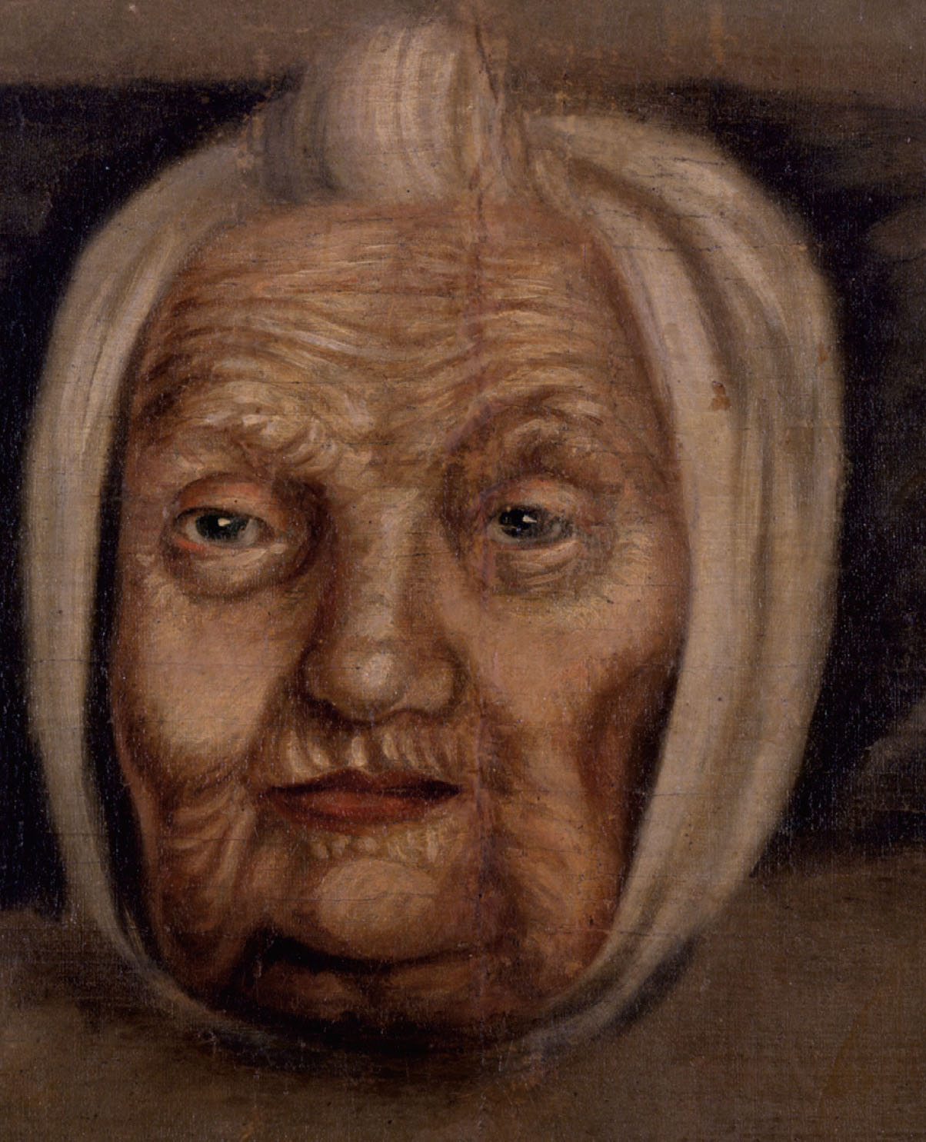
p72
Notes:
Mary Mirick Davie (1635–1752) This woman
exemplified the longevity of New Englanders. She bore
nine children, buried three husbands, and was still
performing household tasks past the age of one hundred.

Slide 40
VIII. Life in the New England Towns
Sturdy New Englanders evolved a tightly knit society—basis of small villages and farms.
Puritanism made of purpose and concern for the moral health of the whole community.
New England society grew in an orderly fashion.
First securing a grant of land from the colonial legislature they laid out their towns.

Slide 41
VIII. Life in the New England
Towns (cont.)
Also marked was a village green, where the militia could drill.
Each family received several parcels of land, including woodlot for fuel, a tract suitable for growing crops and one for pasturing animals.
Towns of more than fifty were required to provide elementary education.

Slide 42
VIII. Life in the New England
Towns (cont.)
1636 Harvard was founded.
  Galileo was still alive, and calculus hadn’t yet been invented
Puritans ran their own churches, and democracy in Congregational Church government.
The town meeting was a showcase and a classroom for democracy—to elect officials, appoint schoolmasters, and discuss mundane matters such as road repairs.

Slide 43
IX. The Half-Way Covenant and the Salem Witch Trials
The passage of time was dampening the first generation’s flaming religious zeal.
At mid-seventeenth century, a new form of sermons—jeremiads—doom-sayings.
Decline in conversion was alarming.
1662 Half-Way Covenant for Congregational Church membership was established, offering partial membership.

Slide 44
IX. The Half-Way Covenant and the Salem Witch Trials (cont.)
The Half-Way Covenant weakened the distinction between the “elect” and others.
The doors of the Puritan churches swung fully open to all comers, whether converted or not.
Strict religious purity was sacrificed to the cause of wider religious participation.
Women were now in the majority.

Slide 45
IX. The Half-Way Covenant and the Salem Witch Trials (cont.)
1692 The Salem Witch trials:
  A group of girls claimed to have bewitched by certain older women
  A hysterical “witch hunt” ensued, leading to the legal lynching of twenty individuals, nineteen of whom were hanged and one pressed to death.
  Two dogs were also hanged.

Slide 46
IX. The Half-Way Covenant and the Salem Witch Trials (cont.)
The reign of horror in Salem grew not only from the turmoil of the wars with the Indians, but also from the unsettled social and religious conditions of evolving Massachusetts.
It also reflected the widening social stratifi-cation of New England, as well as the fear of traditionalists.
Ended in 1693.

Slide 47
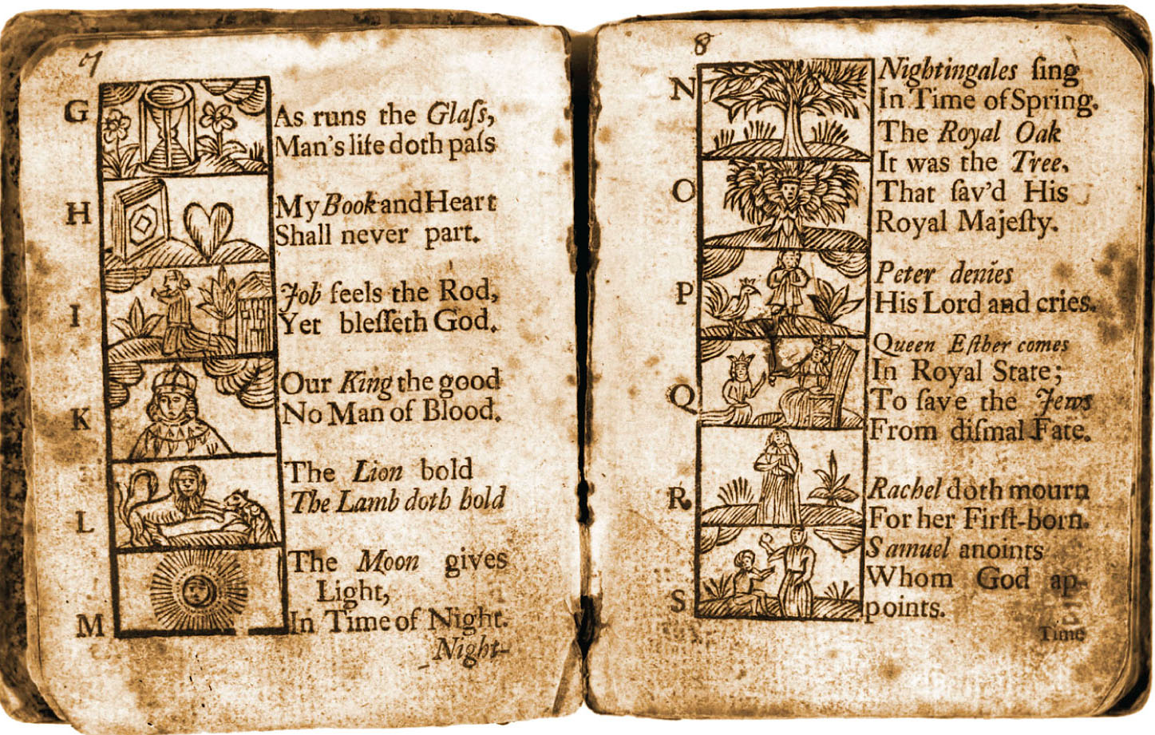
p73
Notes:
A Colonial Primer Religious
instruction loomed large in early
colonial schools. This eighteenth century
textbook from Germantown,
Pennsylvania, taught lessons of social
duty and Christian faith, as well as
reading and writing.

Slide 48
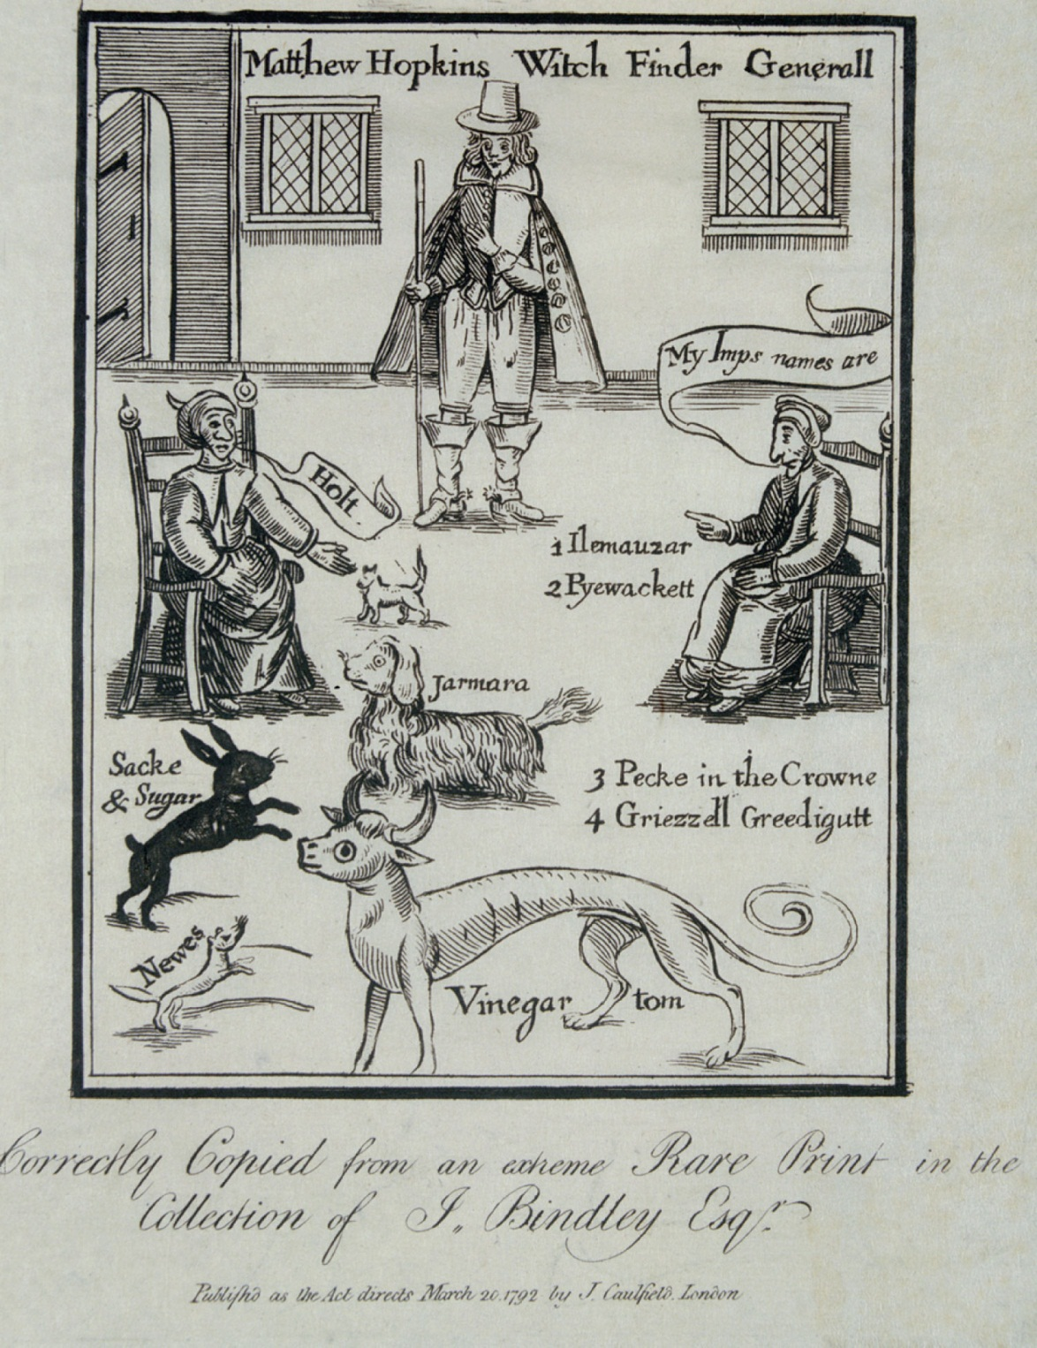
p74
Notes:
Matthew Hopkins’s Witch Finder Hopkins was a
seventeenth-century English witch-hunter whose
techniques included watching suspects to see if diabolical
creatures, in the form of common animals, fed on the
alleged witch’s blood. He also urged that suspected
witches be bound hand and foot and tossed in a pond. The
innocent, he claimed, would sink (and often drown), while
the guilty would float to the surface. His methods brought
death to hundreds of women, men, and children in eastern
England in the 1640s.

Slide 49
X. The New England Way of Life
The story of New England was largely written by rocks:
  The Puritans did not possess the soil; it possessed them by shaping their character
  The grudging land also left colonial New England less ethnically mixed than its southern people
  Climate molded New England

Slide 50
X. The New England Way of Life
(cont.)
Just as the land shaped New Englanders, so they shaped the land:
  The Native Americans left their imprint
  The English settlers were different; they felt a virtual duty to “improve” the land
  Some changes resulted from the introduction of livestock
  Repelled by the rock, the hardy New Englanders turned to their fine natural harbors.

Slide 51
X. The New England Way of Life
(cont.)
The combination of Calvinism, soil, and climate made for energy, purposefulness, sternness, stubbornness, self-reliance, and resourcefulness.
They prided themselves on being God’s chosen people.
New England has had an incalculable impact on the rest of the nation.

Slide 52
XI. The Early Settlers’ Days and Ways
The cycles of the seasons and the sun set the schedules of all the earliest Americans:
  The overwhelming majority of colonists were farmers
  All did the usually duties of mankind
  Life was humble but comfortable, living in affluent abundance
  Land was cheap

Slide 53
XI. The Early Settlers’ Days and
Ways (cont.)
Crude frontier life did not permit flagrant display of class distinctions; simple sameness, more egalitarian.
Some of the upper level people tried to recreate on a modified scale the social structure of the Old World.
To some extent they succeeded.

Slide 54
IX. The Early Settlers’ Days and
Ways (cont.)
1689-1691 Leisler’s Rebellion in New York was caused by animosity between lordly landholders and aspiring merchants.
But efforts to reproduce the finely stratified societies of Europe proved feeble in the early American wilderness, where equality and democracy found fertile soil—at least for white people.

Slide 55
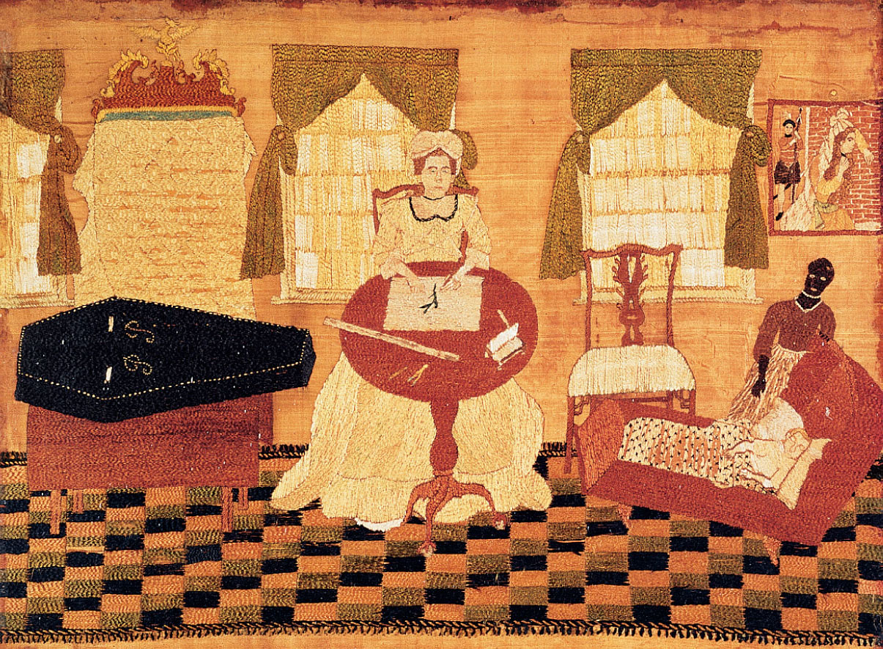
p76
Notes:
Life and Death in Colonial
America, by Prudence
Punderson Note the artist’s
initials, “P.P.,” on the coffin. This
embroidery suggests the stoic
resolve of a colonial woman,
calmly depicting the inevitable
progression of her own life from
the cradle to the grave.

Slide 56
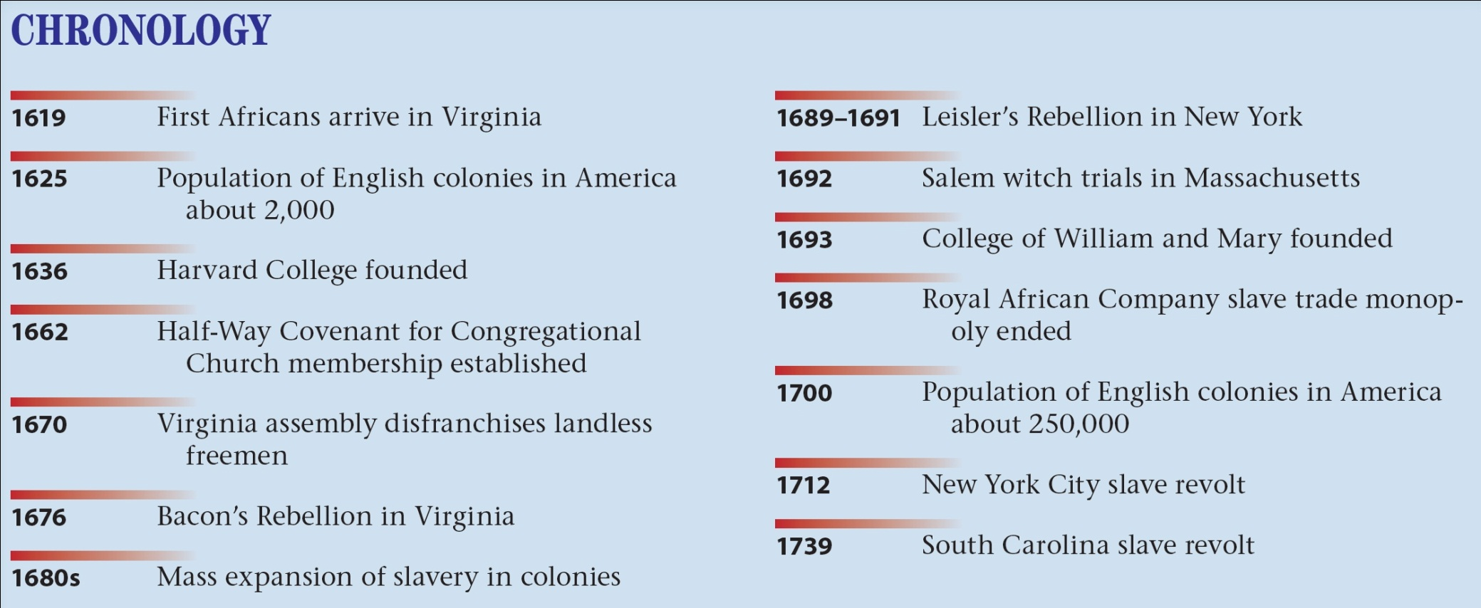
p77

