Slide 1
Chapter 6
The Duel for North America, 1608–1763

Slide 2
I. France Finds a Foothold in Canada
France was a late comer in the scramble for the New World real estate:
  It was convulsed in foreign wars and domestic strife during the 1500s
  It was involved in clashes between Roman Catholics and Protestant Huguenots
  On St. Bartholomew’s Day, 1572, over 10,000 Huguenots-men, women, and children- were butchered in cold blood.

Slide 3
I. France Finds a Foothold in
Canada (cont.)
1598-the era of the Edict of Nantes:
  Issued by the crown, granted limited toleration to French Protestants
  France blossomed, led by brilliant ministers and by King Louis XIV, who reigned for 72 years (1643-1715)
  Fatefully for North America, he took a deep interest in overseas colonies.

Slide 4
I. France Finds a Foothold in
Canada (cont.)
1608 the permanent beginnings of a vast French empire (see Map. 6.1) was established at Quebec:
  Led by Samuel de Champlain-”Father of New France”
  He established friendly relationships with the Huron Indian tribes
  Entered into a treaty with the Huron against the Iroquois tribes of the upper New York area.

Slide 5
I. France Finds a Foothold in Canada (cont.)
The government of New France (Canada) finally fell under the direct control of the king
  This royal regime was almost completely autocratic
  The people elected no representative assemblies
  They did not enjoy the right to trial by jury, as in the English colonies.

Slide 6
I. France Finds a Foothold in Canada (cont.)
The population of Catholic New France grew at a listless pace:
  Late 1750s Catholic New France had only 6,000 or so whites in New France
  Landowning French peasants had little motive to move
  French Huguenots were denied a refuge
  French government favored the Caribbean Islands.

Slide 7
II. New France Fans Out
New France contained one valuable resource—the beaver:
  European fashion-setters valued beaver-pelt hats
  These colorful coureurs de bois were runners of risk:
  They littered the land with scores of place names: Baton Rouge (red stick), Terre Haute (high land), Des Moines (some monks).

Slide 8
II. New France Fans Out
(cont.)
French voyageurs recruited Indians into the fur business:
  The Indian fur flotilla that arrived in Montreal in 1693 numbered 400 canoes
  Many of these Indians were decimated by the white man’s diseases and alcohol
  Slaughtering beaver by the boatload violated many Indians’ religious belief.

Slide 9
II. New France Fans Out
(cont.)
French Catholic missionaries (Jesuits) labored to save the Indians for Christ and from the fur-trappers:
  Jesuits suffered tortures by the Indians
  They had few converts, but did play a vital role as explorers and geographers.
  Other explorers sought neither souls nor fur, but empire.

Slide 10
II. New France Fans Out
(cont.)
French explorers:
  Antoine Cadillac founded Detroit, “the City of Straits”
  Robert de La Salle floated down the Mississippi in 1682 to the point of the Gulf
  He named the interior basin “Louisiana,” after Louis XIV
  He failed to find the Mississippi delta, landed in Spanish Texas and in 1687 was murdered.

Slide 11
II. New France Fans Out
(cont.)
The French planted several fortified posts in what is now Mississippi and Louisiana:
  One was New Orleans in 1718
  They established forts in fertile Illinois country at Kaskaskia, Cahokia, and Vincennes became the garden of France’s North America empire.

Slide 12
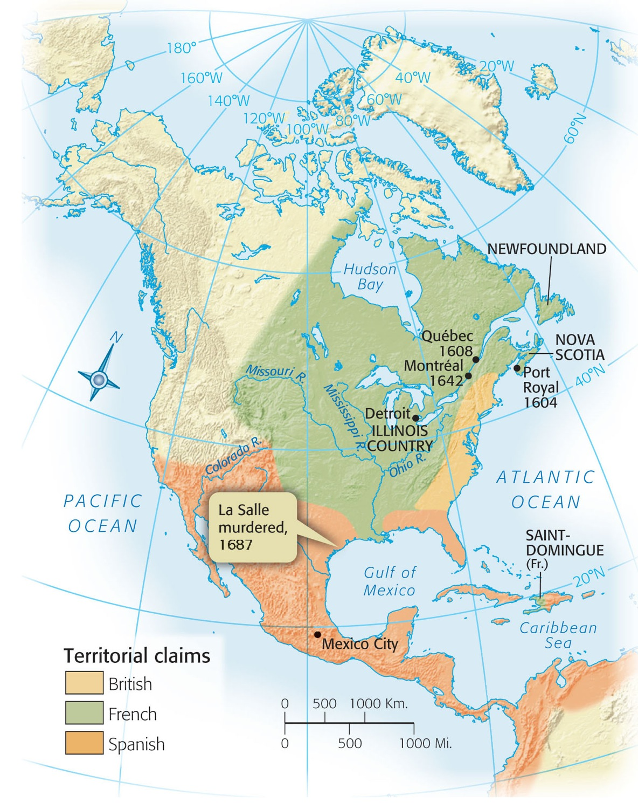
Map 6-1 p99
Notes:
Map 6.1 France’s A merican Empire at Its Greatest Extent,
1700

Slide 13
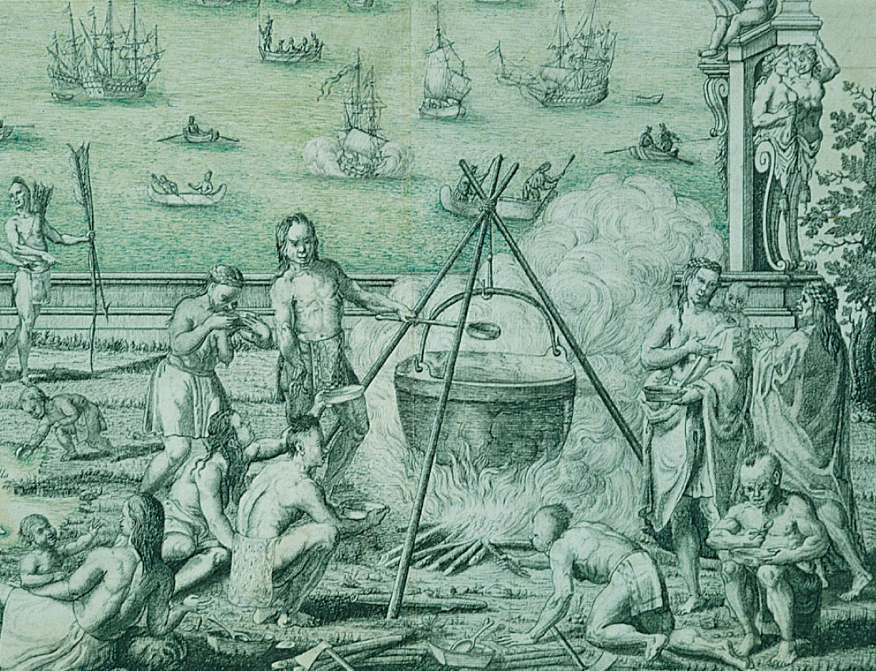
p99
Notes:
Québec Scene, by Jean-Baptiste-Louis Franquelin, ca. 1699 (detail) The metal cooking pot and the Indians’ clothing and blankets show the Native Americans’ growing reliance on European trade goods.

Slide 14
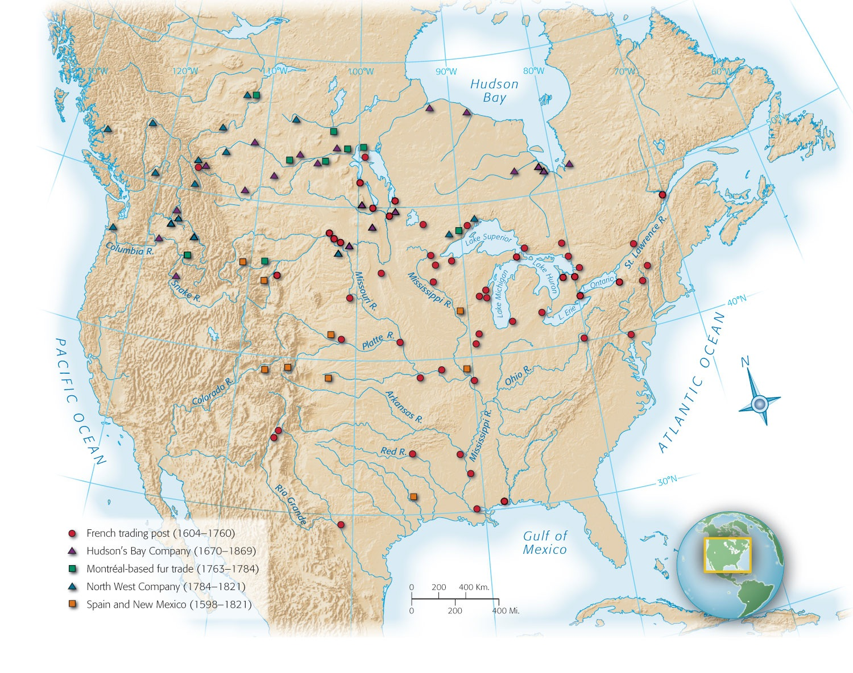
Map 6-2 p100
Notes:
Map 6.2 Fur-Trading Posts To serve the needs of European fashion, fur-traders pursued the beaver for more than two centuries over the entire continent of North America. They brought many Indians for the first time into contact with white culture.

Slide 15
III. The Clash of Empires
The earliest contests among the European powers for control of North America:
  King William’s War (1689-1697) and Queen Anne’s War (1702-1713) (see Table 6.1) British colonists against the French coureurs de bois
  Bloody action on the villages of Schenectady, New York and Deerfield, Massachusetts (see Map 6.3).

Slide 16
III. The Clash of Empires
(cont.)
Peace terms, signed at Utrecht in 1713, revealed how badly France and its Spanish ally had been beaten (see Map. 6.4):
  Britain was awarded French-populated Acadia, which the British renamed Nova Scotia also Newfoundland and Hudson Bay
  France’s settlements pinched by the St. Lawrence set their ultimate doom.

Slide 17
III. The Clash of Empire
(cont.)
The American colonies had decades of “salutary neglect,” fertile soil for the roots of independence.
The British won limited trading rights in Spanish America, which led to smuggling.
Robert Jenkins, British captain, had one ear sliced by a Spanish sword.
This led to the War of Jenkins’s Ear, 1739.

Slide 18
III. The Clash of Empires
(cont.)
The War of Jenkins’s Ear led to the large-scale War of Austrian Succession in Europe (see Table 6.2) called King George’s War in America:
  New Englanders with the help of the British captured the French fortress of Louisbourg and commanded the St. Lawrence River (see Map 6.3) later returned to France by treaty of 1748.
  France still clung to its vast holdings
  6-year pause before next war

Slide 19
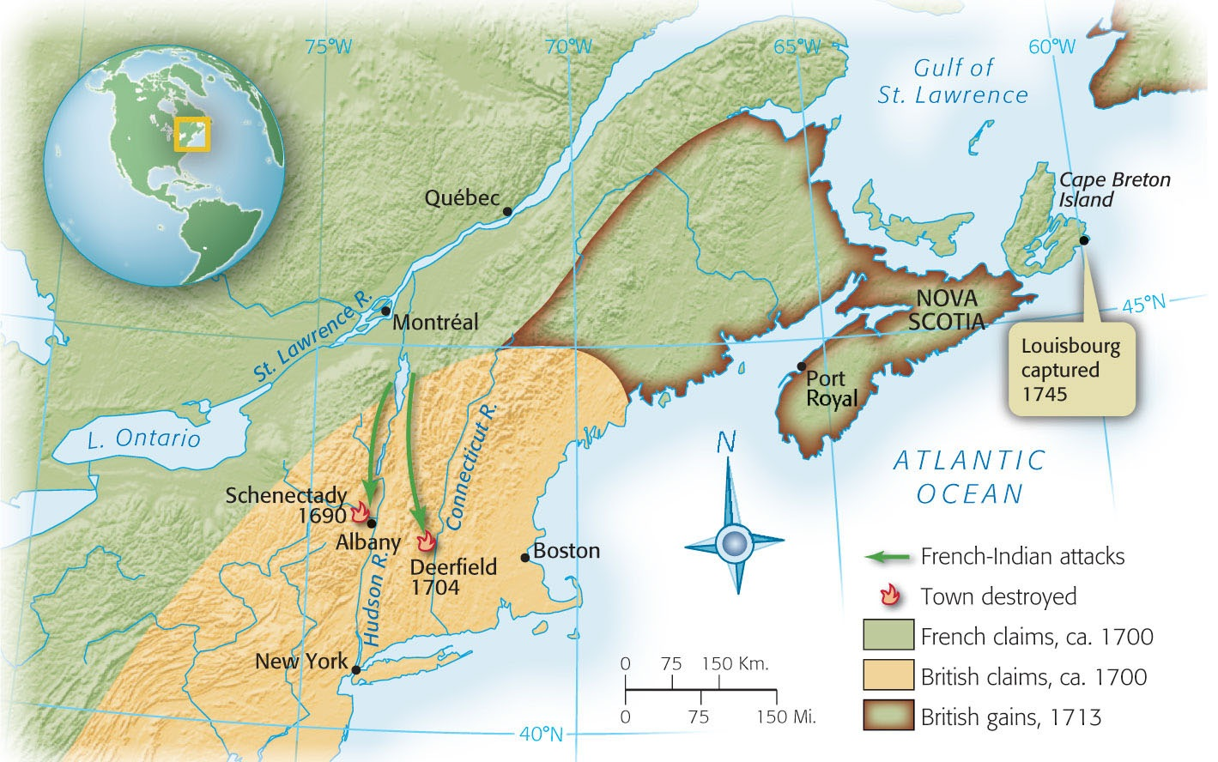
Map 6-3 p101
Notes:
Map 6.3 Scenes of the French Wars The arrows indicate French-Indian attacks. Schenectady was burned to the ground in the raid of 1690. At Deerfield, site of one of the New England frontier’s bloodiest confrontations, invaders killed fifty inhabitants and sent more than a hundred others fleeing for their lives into the winter wilderness. The Indian attackers also took over one hundred Deerfield residents captive, including the child Titus King. He later wrote, “Captivity is an awful school for children, when we see how quick they will fall in with the Indian ways. Nothing seems to be more taking [appealing]. In six months’ time they forsake father and mother, forget their own land, refuse to speak their own tongue, and seemingly be wholly swallowed up with the Indians.”

Slide 20
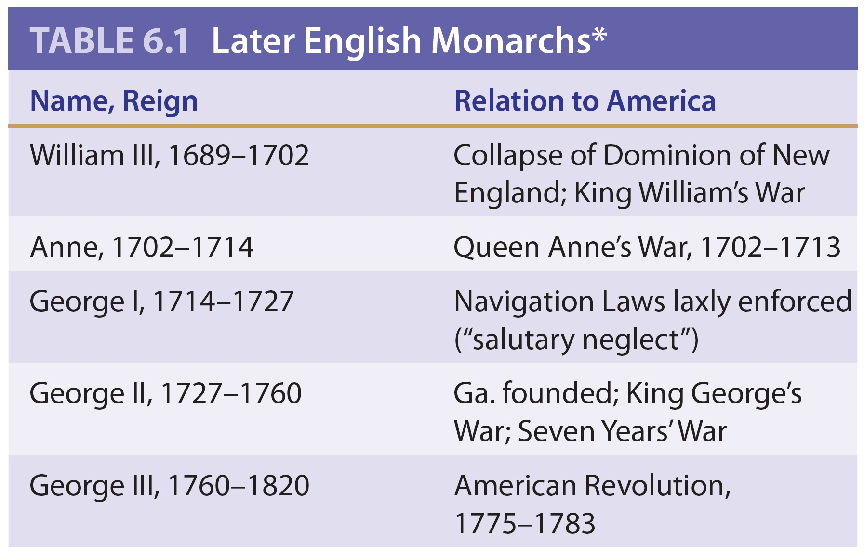
Table 6-1 p101

Slide 21
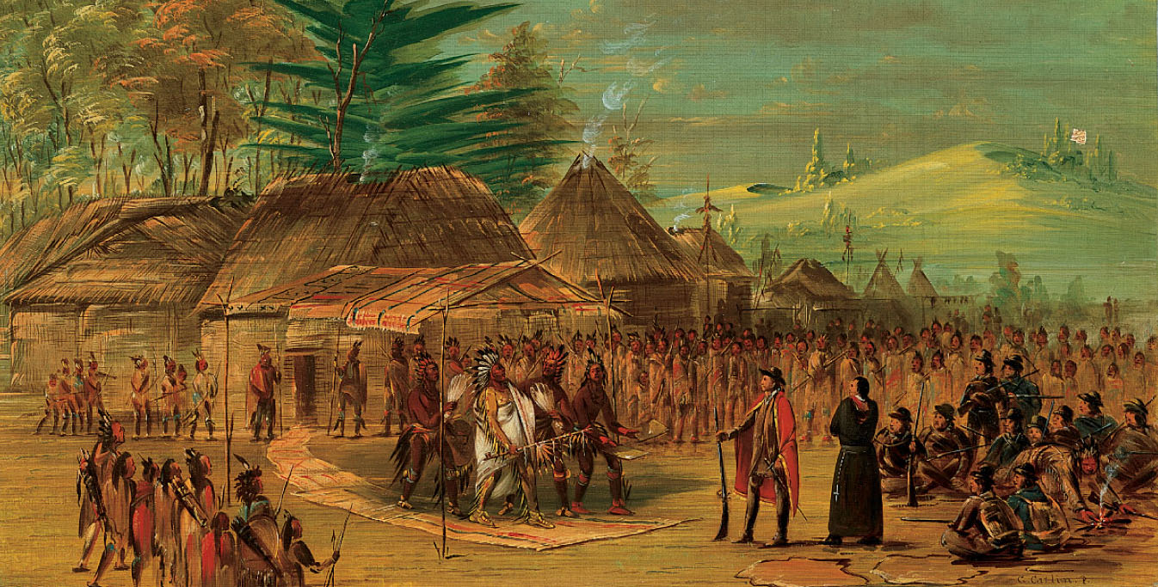
p102
Notes:
Chief of the Taensa Indians Receiving La Salle, March 20, 1682, by George Catlin, 1847–1848 Driven by the dream of a vast North American empire for France, La Salle spent years exploring the Great Lakes region and the valleys of the Illinois and Mississippi Rivers. This scene of his encounter with an Indian chieftain was imaginatively recreated by the nineteenth-century artist George Catlin.

Slide 22
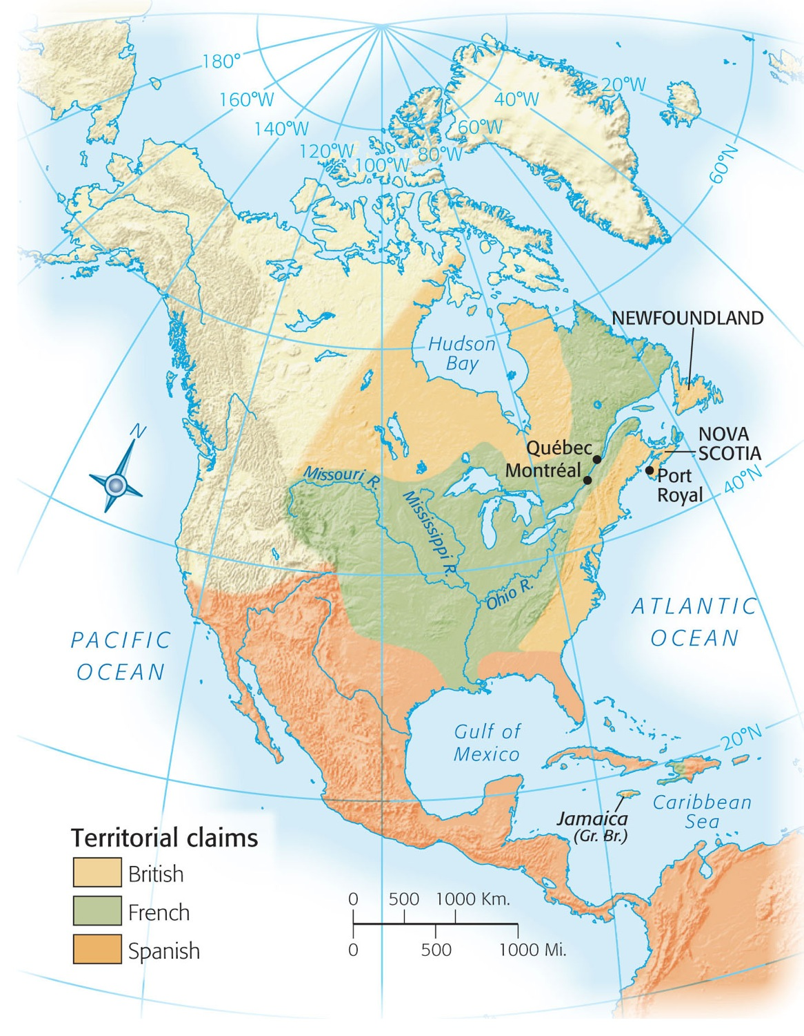
Map 6-4 p102
Notes:
Map 6.4 North America After Two Wars, 1713

Slide 23
IV. George Washington Inaugurates War with France
The Ohio Valley became the chief contention between French and British:
  For the British it was critical area for westward movement
  The French had to retain it if they were going to link their Canadian holdings to those of the lower Mississippi Valley
  The British determined to fight for their economic security and supremacy.

Slide 24
IV. George Washington Inaugurates War with France (cont.)
The Ohio Valley rivalry brought tensions:
  French were in the process of erecting a chain of forts on the Ohio River
  Fort Duquesne was at the pivotal point where the Monongahela and Allegheny River join to form Ohio—the latter site of Pittsburgh
  In 1754 George Washington was ushered onto the stage of history.

Slide 25
IV. George Washington Inaugurates War with France (cont.)
To secure the Virginians’ claim Washington was sent to the Ohio Country:
  Washington encountered a detachment of French troops about 40 miles from Fort Duquesne (see Map 6.5) and fired
  The French leader was killed and his men retreated
  The French returned with reinforcements and surrounded Washington.

Slide 26
IV. George Washington Inaugurates War with France (cont.)
War in the Ohio country:
  Washington, after a ten-hour siege, was forced to surrender July 1754
  He was able to march his troops away with full honor.
  The British brutally uprooted the French Acadians and scattered them as far as Louisiana.

Slide 27
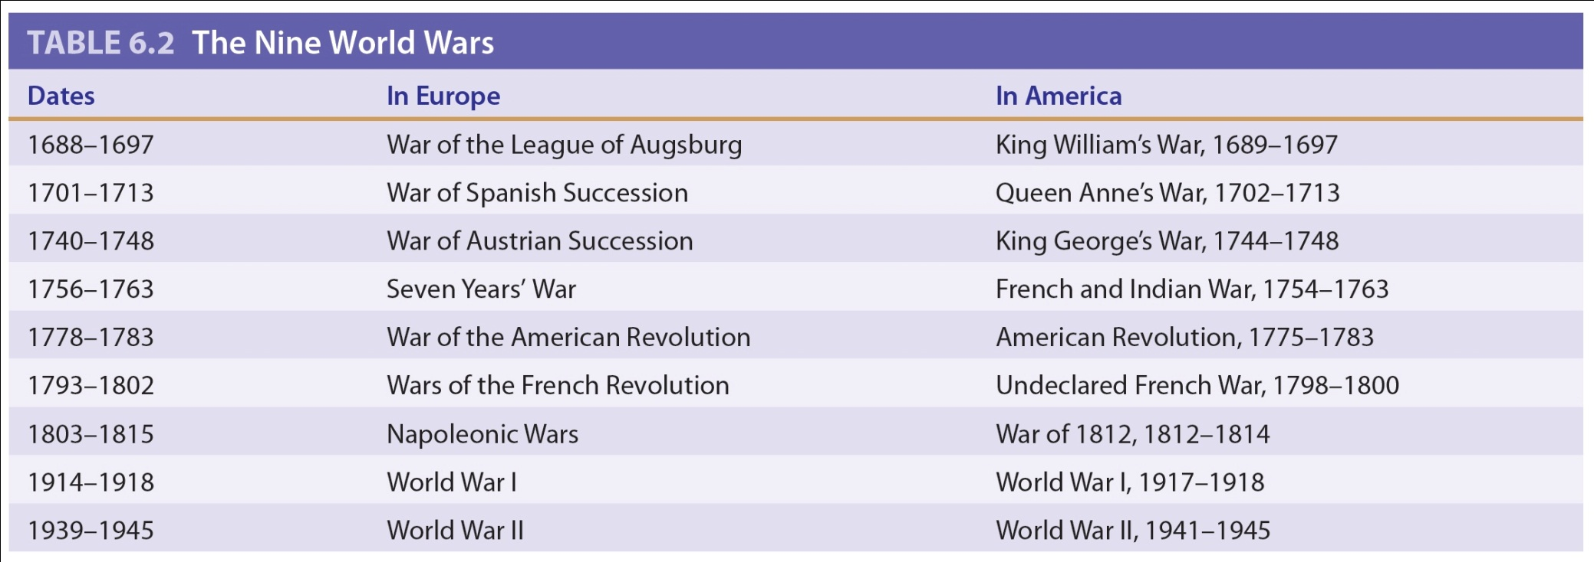
Table 6-2 p103

Slide 28
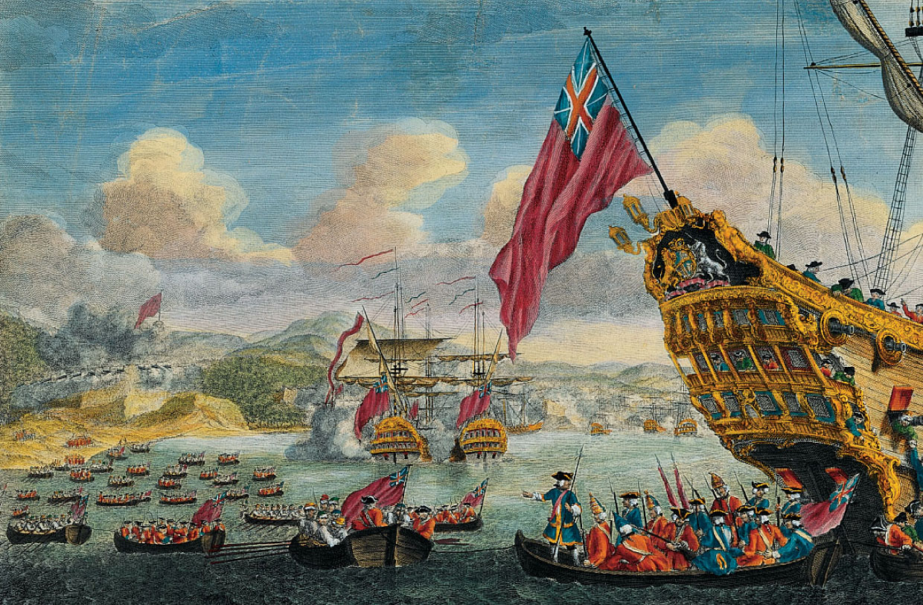
p103
Notes:
New Englanders Capture Louisbourg, 1745 When the final peace settlement of 1748 returned this fortress to France, the American colonists felt betrayed by their British masters.

Slide 29
V. Global War and Colonial Disunity
The three Anglo-French colonial wars had all started in Europe, but now in America:
  French and Indian War– touched off by George Washington in the Ohio Valley 1754 rocked for two years and then widened
  Seven Years’ War—it was fought not only in America but in Europe, West Indies, Africa, Philippines and on the ocean. The Seven Years’ War was a 7-sea war (see Map 6.6).

Slide 30
V. Global War and Colonial Disunity (cont.)
The crisis now demanded concerted action:
  In 1754 the British government summoned an intercolonial congress to met at Albany, N.Y.
  Immediate purpose was to control the Iroquois tribes loyal to Britain
  The longer-range purpose was to achieve greater colonial unity and thus bolster the common defense against France

Slide 31
V. Global War and Colonial
Disunity (cont.)
Role of Benjamin Franklin at Albany:
  First, he published his famous cartoon—Join, or Die
  At Albany, was the leading spirit of the Albany Congress presenting a well-devised but premature scheme for colonial home rule
  The delegates unanimously adopted the plan but individuals spurned it, as well as the London regime.

Slide 32
V. Global War and Colonial Disunity (cont.)
To the colonists, it did not give enough independence, to the British, it gave too much.
Franklin’s observations: all people agreed on the need for union, but their “weak noddles” were “perfectly distracted” when they attempted to agree on details.

Slide 33
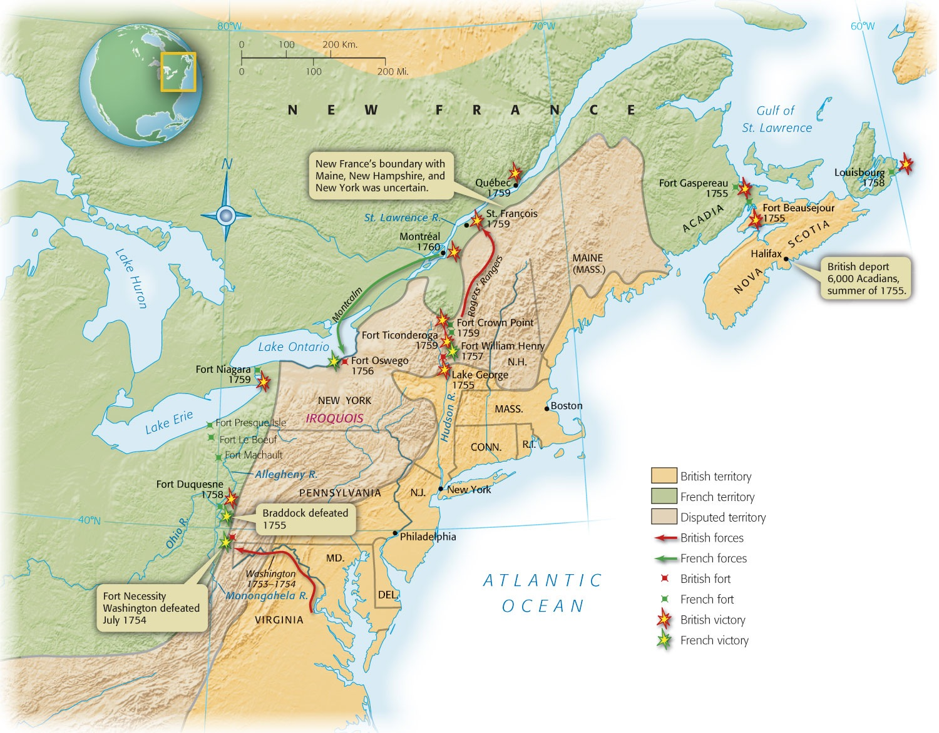
Map 6-5 p104
Notes:
Map 6.5 The French and Indian War in North America, 1754–1760

Slide 34
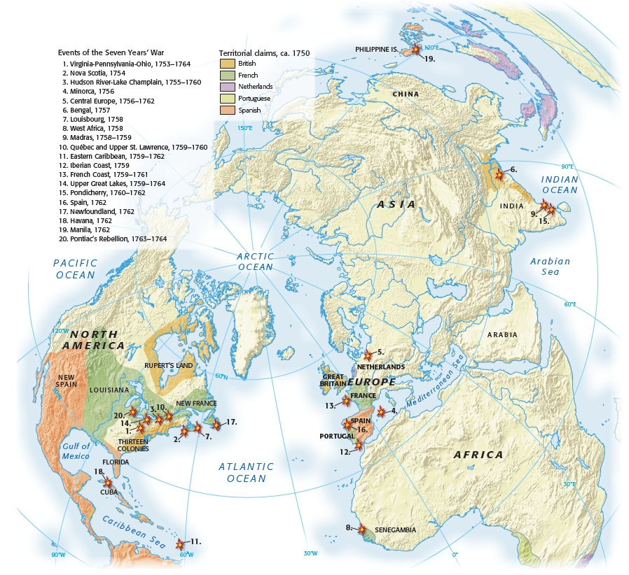
Map 6-6 p105
Notes:
Map 6.6 Global Scale of the Seven Years’ War Among the first of the truly “world wars” of the modern era, the Seven Years’ War sucked in several nations who did battle around the globe.

Slide 35
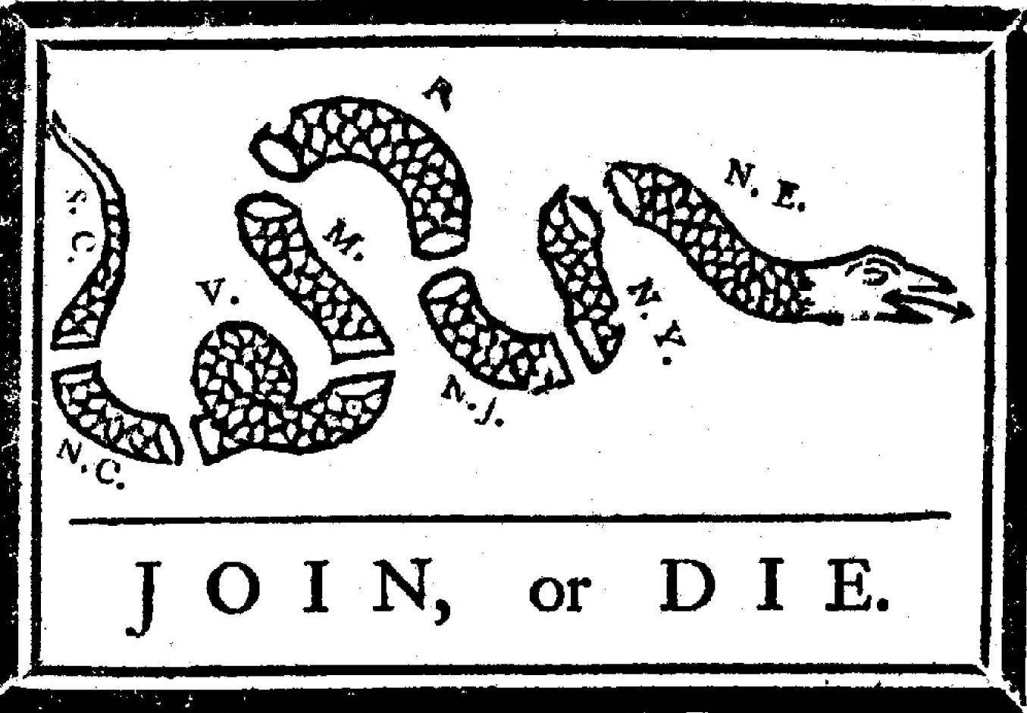
p106
Notes:
Famous Cartoon by Benjamin Franklin Delaware and Georgia were omitted.

Slide 36
VI. Braddock’s Blundering and Its Aftermath
The opening clashes of the war went badly for the British:
  General Edward Braddock was sent to Virginia with a strong detachment of British regulars
  Set out in 1755 with 2000 men to capture Fort Duquesne.
  On his way met smaller French and Indian army.

Slide 37
VI. Braddock’s Blundering and Its
Aftermath (cont.)
  In the ensuing battle, George Washington had two horses shot from under him and four bullets pierced his coat. Braddock was fatally wounded.
  Inflamed by this easy victory, the Indians took a wider warpath, from Pennsylvania to North Carolina.
  Washington with 300 men tried desperately to defend the frontier.
  The British had defeat after defeat.

Slide 38
VII. Pitt’s Palms of Victory
William Pitt, British superlative leader
  He was known as the “Great Commoner.”
  In 1757 he became a foremost leader in the London government:
  He soft-pedaled assaults on the French West Indies and concentrated on the vitals of Canada—the Quebec-Montreal area.
  He picked young and energetic leaders

Slide 39
VI. Pitt’s Palms of Victory
(cont.)
Pitt’s leadership:
  First he dispatched a powerful expedition in 1758 against Louisbourg causing it to fall
  Quebec was next under James Wolfe he met French Marquis de Montcalm on the Plains of Abraham, the outskirts of Quebec. Both commanders fell, fatally wounded
  The French were defeated and the city surrendered.

Slide 40
VI. Pitt’s Palms of Victory
(cont.)
  The Battle of Quebec in 1759 ranks as one of the most significant engagements in British and American history:
  When Montreal fell in 1760, the French flag had fluttered for the last time
  The Peace of Paris in 1763 threw the French off the continent of North America
  The French were able to maintain several small but valuable sugar islands in the West Indies.

Slide 41
VII. Pitt’s Palms of Victory
(cont.)
France was also able to receive two never-to-be-fortified islets in the Gulf of St. Lawrence for fishing stations.
Final blow to the French when they ceded to Spain all trans-Mississippi Louisiana, and the outlet of New Orleans (see Map 6.7).
Great Britain emerged as the dominant power in North America.

Slide 42
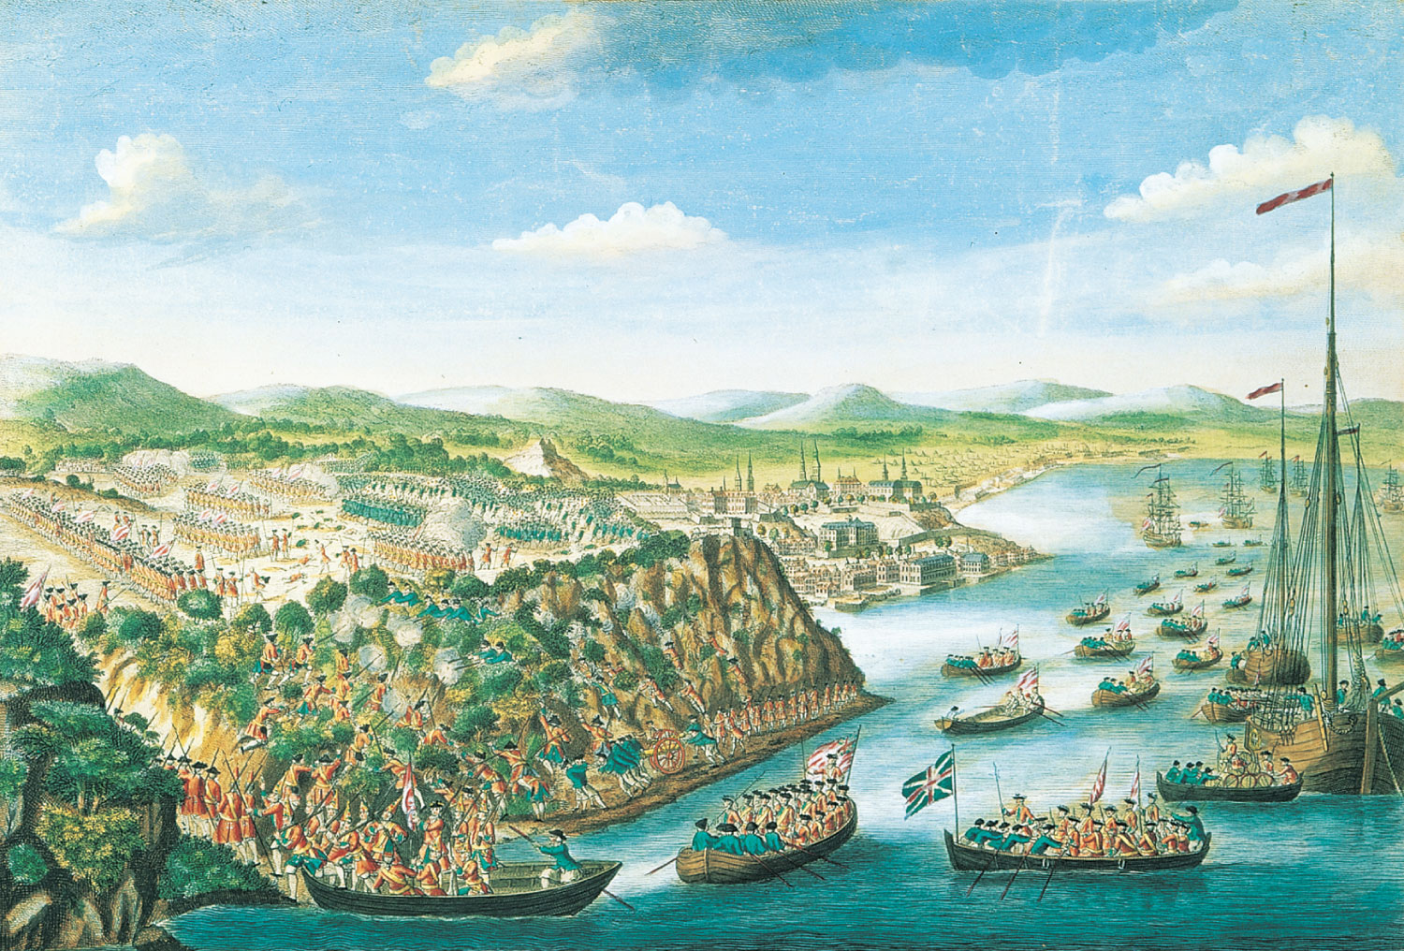
p107
Notes:
View of the Taking of Que´bec, 1759 On the night of September 13, British forces scaled the rocky cliffs of Que´bec and defeated the French army defending the city. The following year, Montréal, France’s last bastion in North America, surrendered. Fighting continued in the Caribbean, Europe, and the Philippines for two more years, until the Treaty of Paris was signed in 1763, eliminating France as a colonial power in North America.

Slide 43
Significance of F&I/7Y war
  War of extraordinary scope
    By far largest, most expensive, most destructive war in Europe between 30 Years war (ended 1648) and Napoleonic Wars of early 19th century
    In age of indecisive warfare, it ended with extinction of French imperial power on N. American continent and severe curtailment of French influence on Indian sub-continent
    Belligerents in Europe, N. America, W. Indies, W. Africa, Philippine Islands, India
      Churchill later called it the first World War
  Grand prize was eastern half of N. America
    Occurred at the mid-point of American history between founding of Jamestown and today
    Before—native powers dominated of N. America
    After—native powers waned and British-American power increased
  America after the war was irrevocably changed
    There is no westward expansion of Anglo-American power without victory in this war

Slide 44
VIII. Restless Colonists
Britain’s colonists emerged with increased confidence in their military strength
  The French and Indiana War, while bolstering colonial self-esteem, simultaneously shattered the myth of British invincibility
  Displaying the contempt of the professional soldiers, the British refused to recognize any American militia commission above the rank of captain.

Slide 45
VIII. Restless Colonists
(cont.)
Britain’s colonists:
  They were distressed by the reluctance of the colonists to support the common cause wholeheartedly
  Some colonists, self-centered and alienated by distance from the war, refused to provide troops and money for the conflict.

Slide 46
VIII. Restless Colonists
(cont.)
Britain’s colonists:
  Unity received some encouragement during the French and Indian War
  When soldiers and statesmen from widely separated colonies met they often agreed
  They discovered that they were all fellow Americans who spoke the same language and shared common ideals
  A coherent nation would emerge.

Slide 47
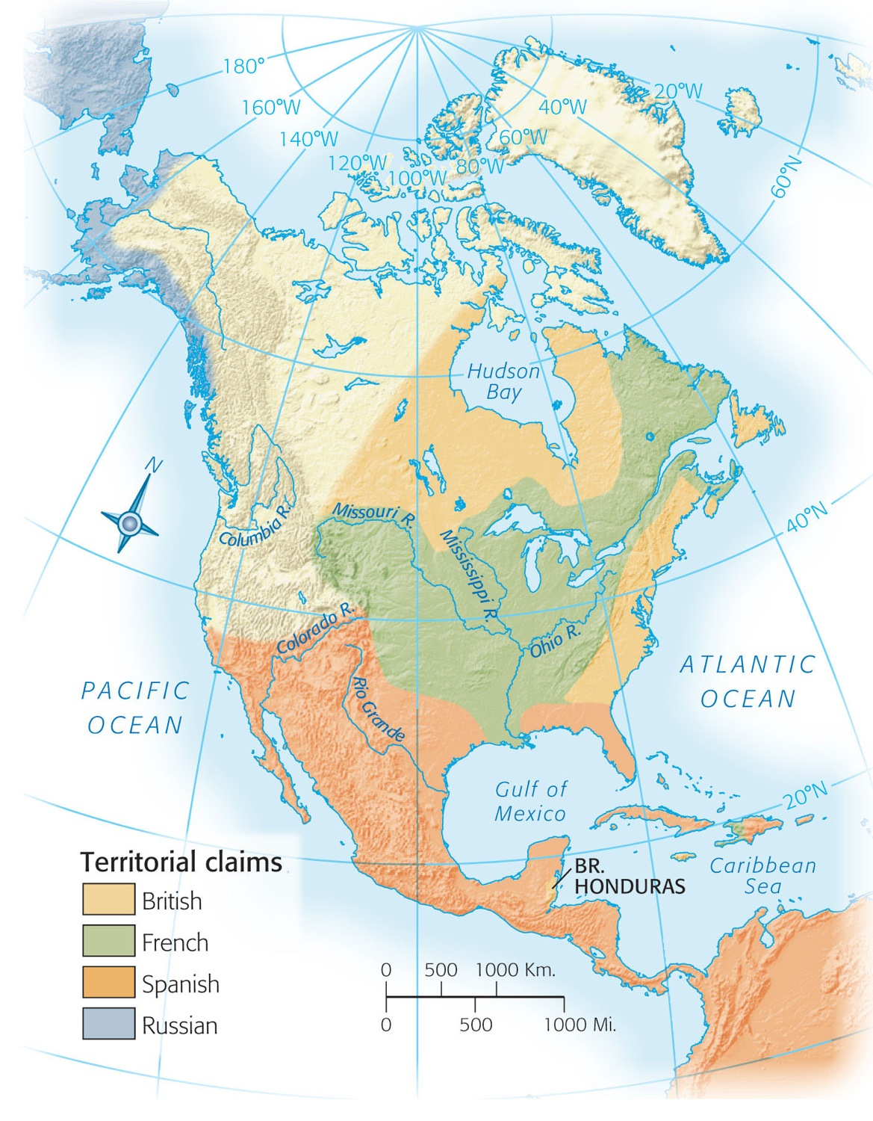
Map 6-7a p108
Notes:
Map 6.7A North America Before 1754

Slide 48
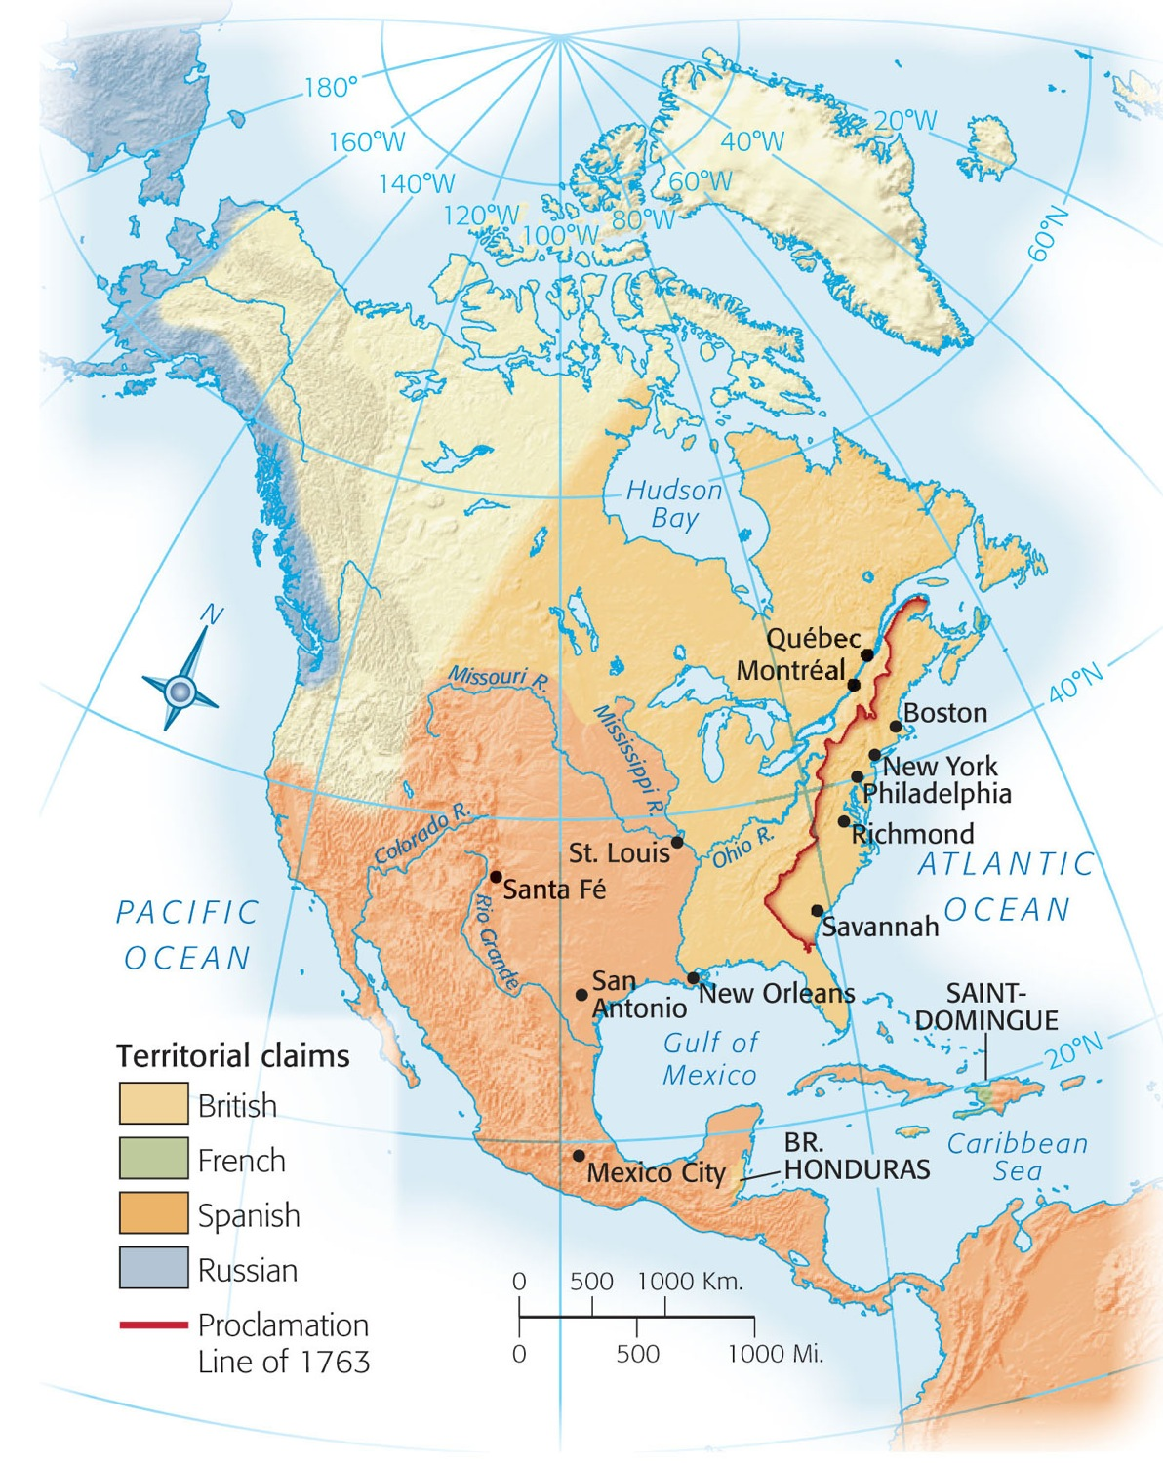
Map 6-7b p108
Notes:
Map 6.7B North America After 1763 (after French losses)

Slide 49
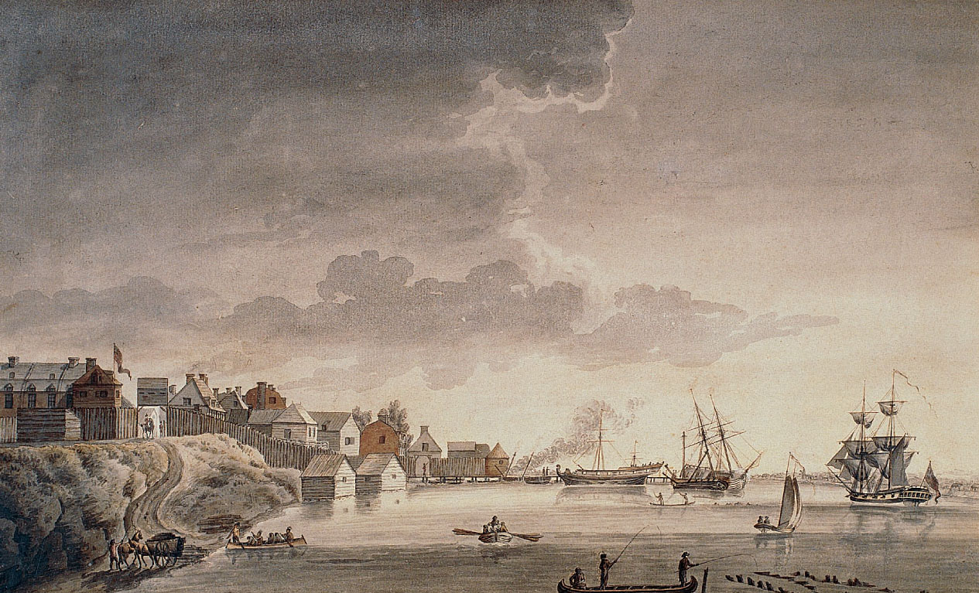
p109
Notes:
Detroit, 1794 A key French outpost from 1701 to 1760, Detroit fell to Britain during the Seven Years’ War. The British remained at Detroit even after the American War of Independence, exciting bitter resentment in the infant American Republic (see pp. 166–167).

Slide 50
IX. War’s Fateful Aftermath
The removal of the French menace in Canada profoundly affected American attitudes:
  In a sense the history of the United States began with the fall of Quebec and Montreal the infant Republic was cradled on the Plains of Abraham.
  The Spanish and Indian menaces were now substantially reduced
  The Spanish removal from Florida and the French removal from Canada deprived the Indians

Slide 51
IX. War’s Fateful Aftermath
(cont.)
Pontiac’s uprising by the Ottawa Chief Pontiac to lay siege to Detroit in spring of 1763 and eventually overran all but three British posts west of the Appalachians, killing some 2000 soldiers and settlers:
  The British retaliated swiftly and cruelly with a primitive version of biological warfare
  Pontiac perished in 1769 at the hands of a rival chieftain.

Slide 52
IX. War’s Fateful Aftermath
(cont.)
The colonists were now free to cover the Appalachian Mountains and take the western lands.
The London government issued its Proclamation of 1763 which flatly prohibited settlement beyond the Appalachians (see Map 6.8).

Slide 53
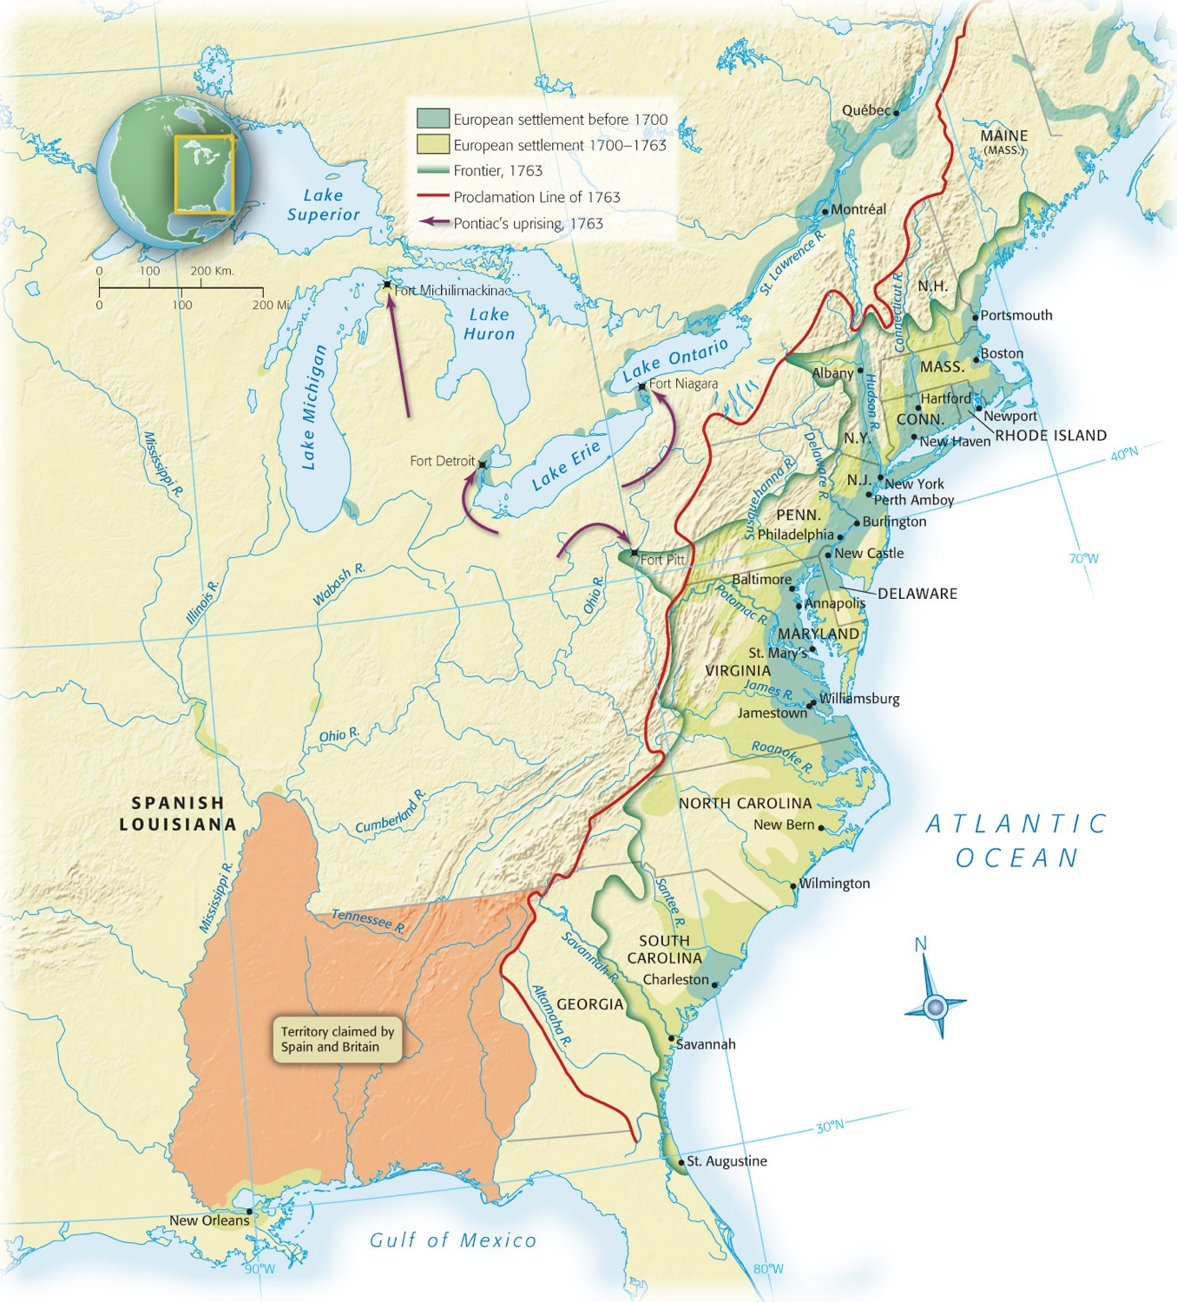
Map 6-8 p110
Notes:
Map 6.8 British Colonies at End of the Seven Years’ War, 1763 This map, showing the colonies thirteen years before the Declaration of Independence, helps to explain why the British would be unable to conquer their offspring. The colonists were spreading rapidly into the backcountry, where the powerful British navy could not flush them out. During the Revolutionary War, the British at one time or another captured the leading colonial
cities—Boston, New York, Philadelphia, and Charleston—but the more remote interior remained a sanctuary for rebels.

Slide 54
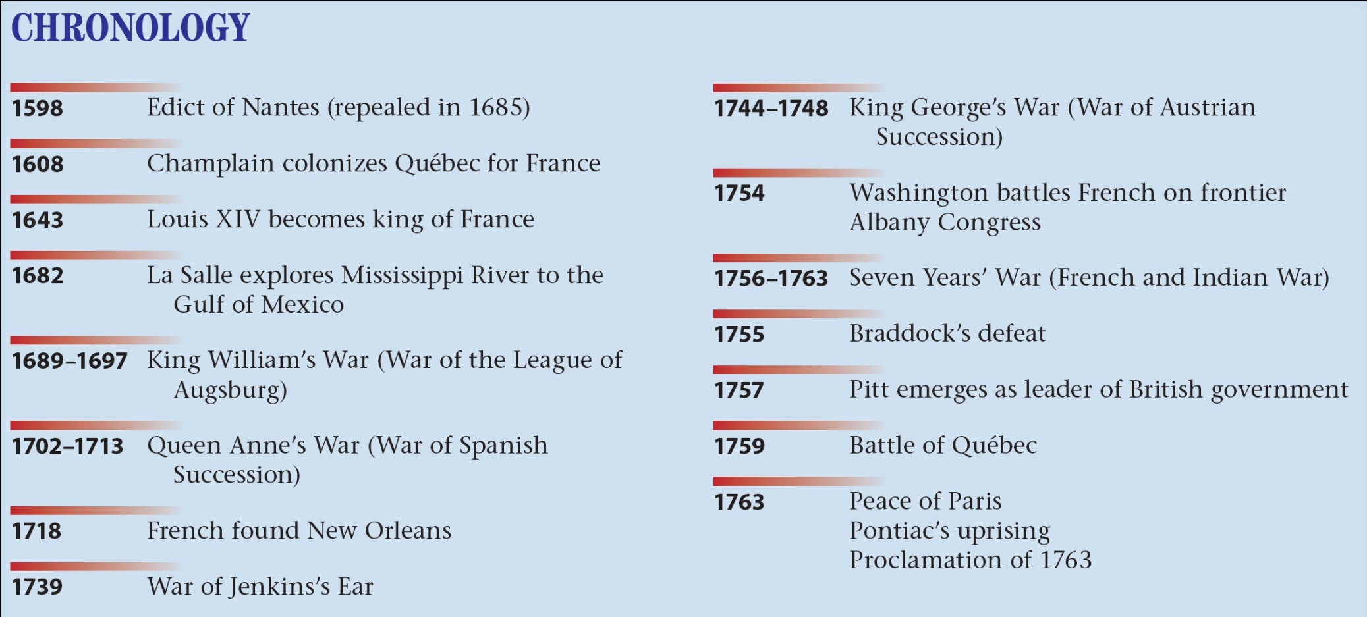
p112

