Slide 1
Chapter 7
The Road to Revolution,
1763–1775

Slide 2
I. The Deep Roots of Revolution
America was a revolutionary force from the day of its discovery by Europeans:
  The New World nurtured new ideas about the nature of society, citizens, and government
  Republicanism—defined a just society as one in which all citizens willingly subordinated their private, selfish interests to the common good.
  Stability and government depended on the virtue of the citizenry.

Slide 3
I. The Deep Roots of Revolution
(cont.)
Virtue of the citizenry—its capacity for selflessness, self-sufficiency, and courage, and its appetite for civic involvement.
Republicanism was opposed to hierarchical and authoritarian institutions such as aristocracy and monarchy.

Slide 4
I. The Deep Roots of Revolution
(cont.)
Radical Whigs: a group of British political commentators and their political thoughts that fundamentally shaped American political thought:
  The Whigs feared the threat to liberty posed by the arbitrary power of the monarch and his ministers relative to elected representatives in Parliament.

Slide 5
I. The Deep Roots of Revolution
(cont.)
Whigs wanted citizens to be guarded against “corruption.”
The Americans had grown accustomed to running their own affairs:
  Distance weakens authority great distance weakens authority greatly

Slide 6
II. Mercantilism and Colonial Grievances
Mercantilism—belief that wealth was power and that a country’s economic wealth (and its military and political power) could be measured by the amount of gold or silver in its treasury.
To amass gold or silver, a country needed to export more than it imported.

Slide 7
II. Mercantilism and Colonial Grievances (cont.)
Mercantilism (cont.)—
Possessing colonies conferred distinct advantages:
  They could supply raw materials to the mother country, reducing the need for foreign imports
  They could provide a guaranteed market for exports.
  The London government looked on the American colonies more or less as tenants.

Slide 8
II. Mercantilism and Colonial Grievances (cont.)
From time to time Parliament passed laws to regulate the mercantilist system:
  Navigation Act (1650)—aimed at Dutch shippers, all commerce flowing to and from the colonies could be transported only in British (including colonial) vessels
  European goods destined for America first had to be landed in Britain, where tariff duties could be collected and British middlemen got profits.

Slide 9
II. Mercantilism and Colonial Grievances (cont.)
Other laws stipulated that American merchants must ship certain “enumerated” products, notably tobacco, exclusively to Britain, even though prices might be better elsewhere.
British policy inflicted a currency shortage on the colonies.
The situation forced the colonies to issue paper money.

Slide 10
II. Mercantilism and Colonial Grievances (cont.)
Parliament prohibited the colonies’ legislatures from printing paper currency.
The British crown reserved the right to nullify any legislation passed by the colonial assemblies if they would harm the mercantilist system. Royal veto.
These were more examples of how principle could weigh more than practice in fueling colonial grievances.

Slide 11
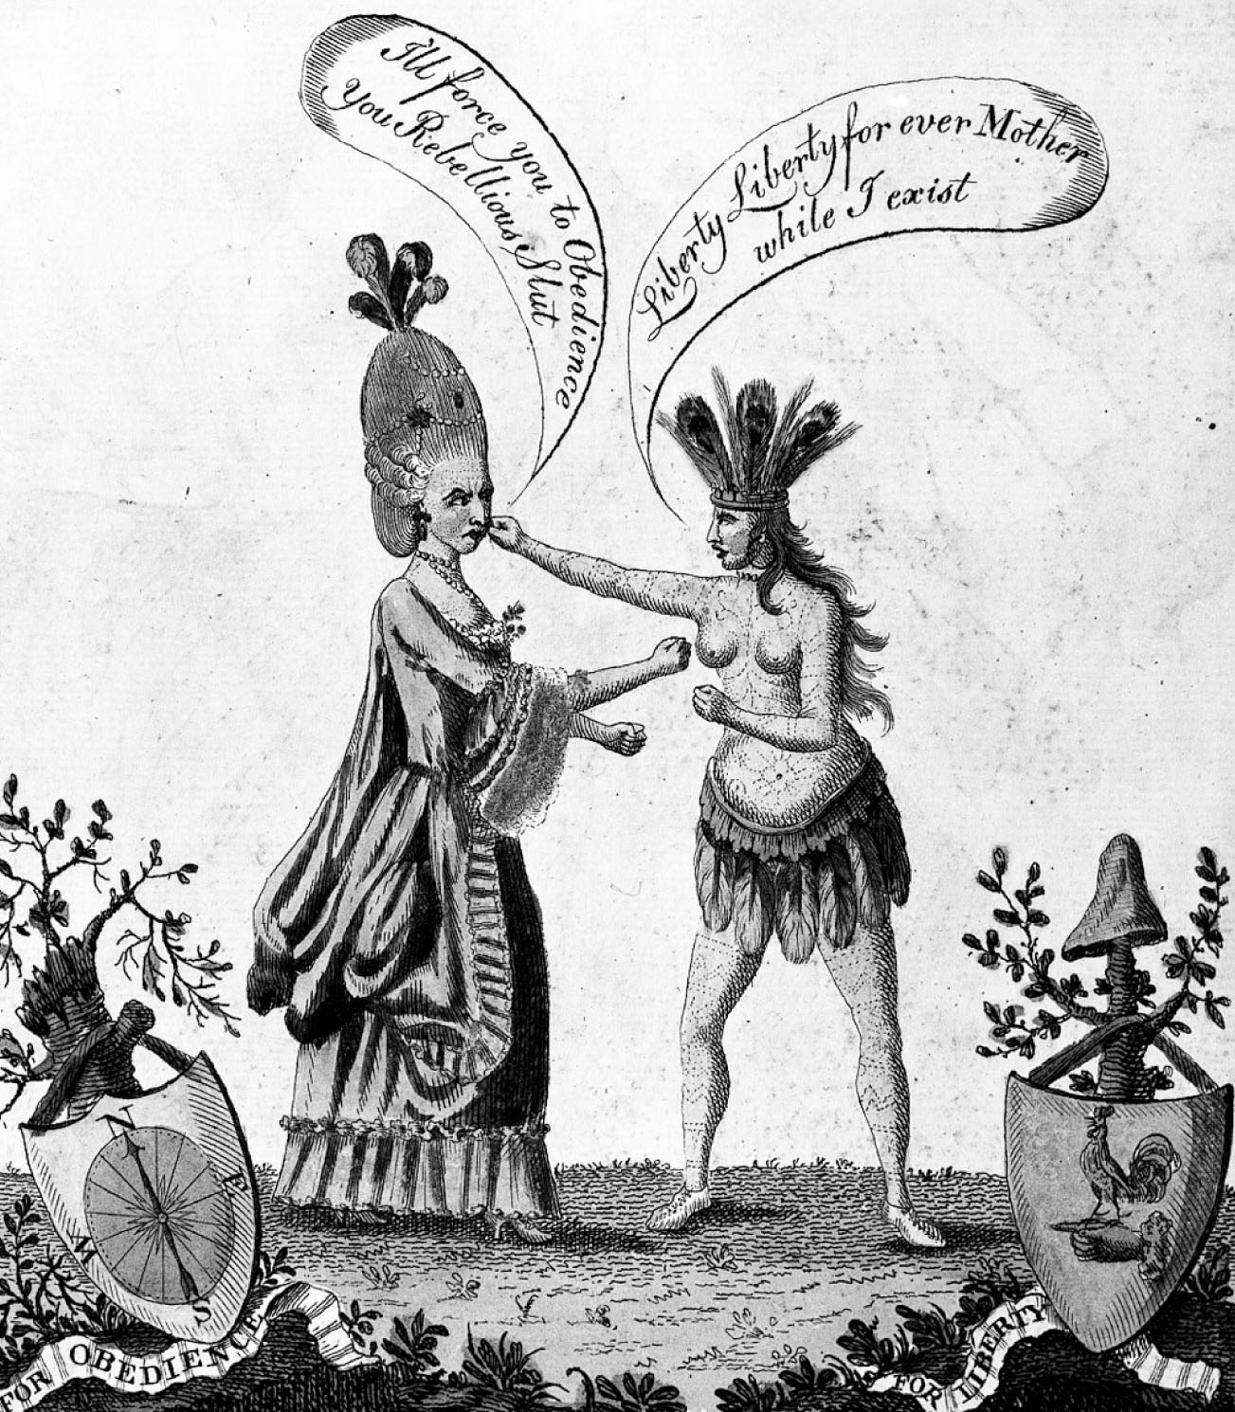
p114
Notes:
The Female Combatants, 1776 Britain is symbolized as
a lady of fashion her rebellious daughter, America, as an
Indian princess. Their shields of Obedience and Liberty
seem mutually exclusive standards. Compare this cartoon
with the one on p. 151.

Slide 12
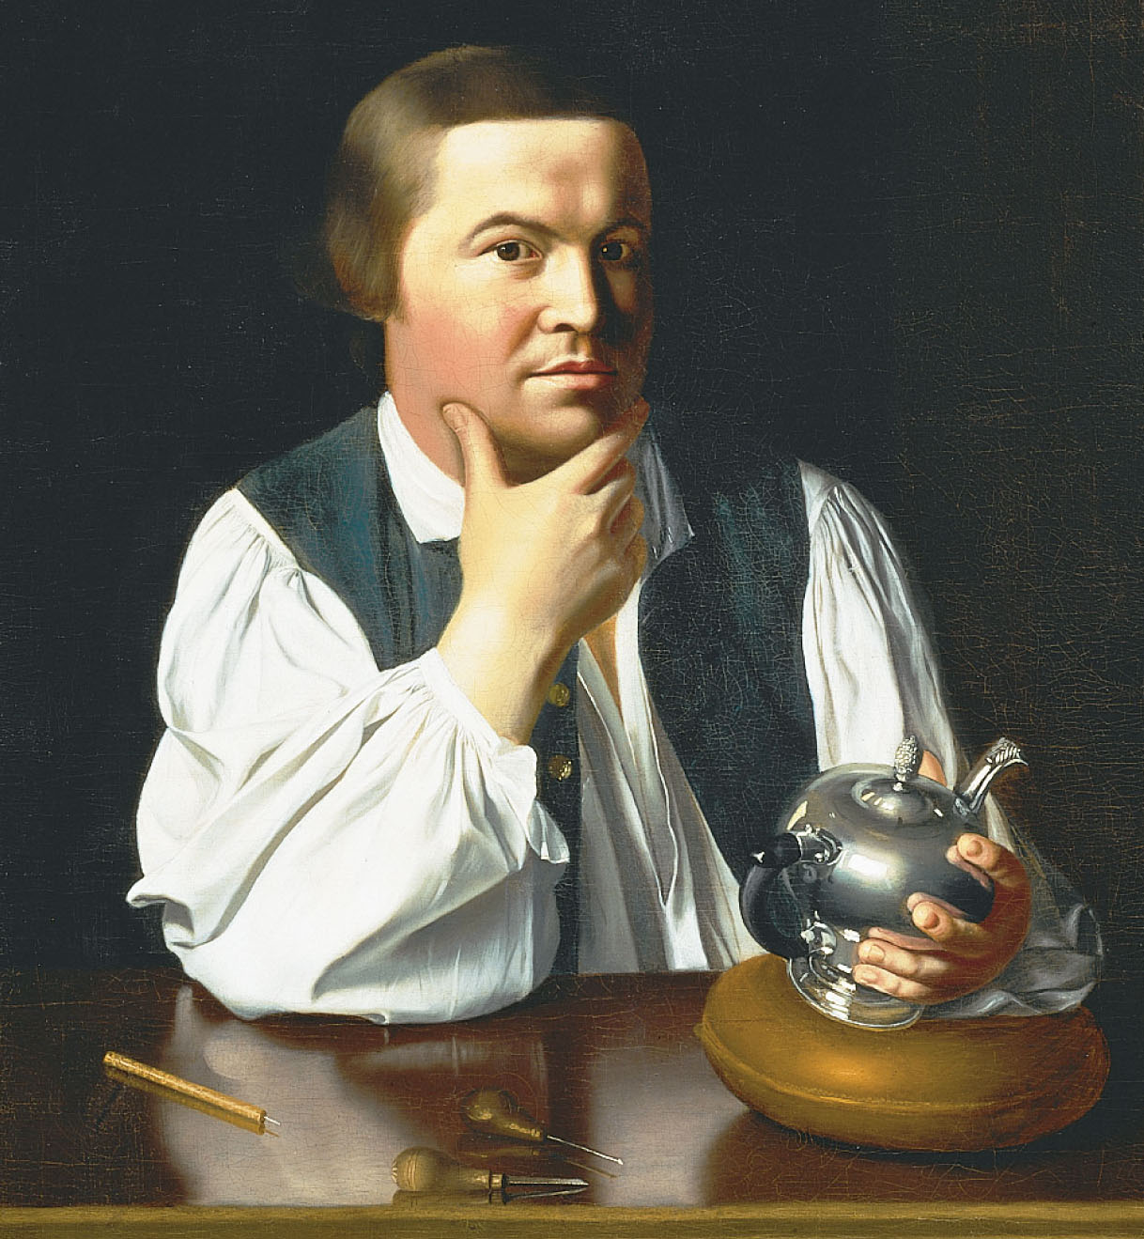
p115
Notes:
Paul Revere, by John Singleton Copley, ca. 1768 This
painting of the famed silversmith-horseman challenged
convention—but reflected the new democratic spirit of
the age—by portraying an artisan in working clothes. Note
how Copley depicted the serene confidence of the master
craftsman and Revere’s quiet pride in his work.

Slide 13
III. The Merits and Menace of Mercantilism
In theory the British mercantile system seemed thoroughly and deliberately oppressive:
  However, they were loosely enforced
  Americans reaped direct benefits from it
  London paid liberal bounties to colonial producers
  Benefited from the protection of world’s most powerful navy and a strong, seasoned army of redcoats.

Slide 14
III. The Merits and Menace of Mercantilism (cont.)
The mercantile system burdened the colonists with annoying liabilities:
  It stifled economic initiative and imposed a rankling dependency on British agents and creditors.
  Colonists found it to be debasing. They felt used, kept in a state of perpetual economic adolescence, and never allowed to come of age.

Slide 15
IV. The Stamp Tax Uproar
After the Seven Years’ War Britain was holding one of the world’s biggest empires along with the biggest debt:
  Britain moved to redefine the colonists’ relationship
  Prime Minister George Grenville ordered its navy to strictly enforce the Navigation Laws
  He secured from Parliament the Sugar Act of 1764.

Slide 16
IV. The Stamp Tax Uproar
(cont.)
Sugar Act (1764)—first law passed by Parliament for raising tax revenue in the colonies for the crown:
  It increased the duty on foreign sugar imported from the West Indies
  After bitter protests, the duties were lowered substantially, and the agitation died down
  Resent continued by the Quartering Act (1765)- required colonies to provide food and quarters.

Slide 17
IV. The Stamp Tax Uproar
(cont.)
Stamp tax:
  To raise revenues to support the new military force
  It mandated the use of stamped paper or the affixing of stamps, certifying payment of tax
  Stamps were required on bills of sale for about 50 trade items
  Grenville regarded all of these measures as reasonable and just.

Slide 18
IV. The Stamp Tax Uproar
(cont.)
Americans were angry at Grenville’s fiscal aggression:
  The new law not only pinched their pocketbooks but was striking at their local liberties
  Some colonists defiantly refused to comply with the Quartering Act, some voted only to supply a fraction of the supplies called for.
  It seemed to jeopardize the basic rights of the colonists as Englishmen.

Slide 19
IV. The Stamp Tax Uproar
(cont.)
Admiralty courts to try offenders where no juries were allowed.
Why was a navy needed at all in the colonies?
  The colonists caught scent of a conspiracy to strip them of their historic liberties
  The Stamp Act became the target of their most ferocious fire.

Slide 20
IV. The Stamp Tax Uproar
(cont.)
The Americans made a distinction between “legislation” and “taxation.”
  They conceded the right of Parliament to legislate about matters that related to the entire empire
  They denied the right of Parliament, in which no Americans were seated, to impose taxes on Americans.
  Such taxes were seen as robbery.

Slide 21
IV. The Stamp Tax Uproar
(cont.)
Grenville used the theory of “virtual representation”—all citizens are represented by Parliament.
This caused the Americans to deny the authority of Parliament and to consider their own political independence—another chain to revolutionary consequences.

Slide 22
V. Forced Repeal of the Stamp Act
Colonial outcries against the hated stamp tax took various forms:
Stamp Act Congress 1765:
  members drew up a statement of their rights and grievances
  beseeched the king and Parliament to repeal the repugnant legislation.
  the Stamp Act Congress was ignored in England.

Slide 23
V. Forced Repeal of the Stamp Act
(cont.)
The congress was one more significant step toward intercolonial unity.
Nonimportation agreements:
  agreement against importing British goods
  was a promising stride toward union
  they spontaneously united the American people for the first time in common action
  gave Americans new opportunities to participate in colonial protests.

Slide 24
V. Forced Repeal of the Stamp Act
(cont.)
Sons of Liberty and Daughters of Liberty:
  Took the law into their own hands
  Cried, “Liberty, Property, and No Stamps.”
Shaken by colonial commotion, the machinery for collecting the tax broke down.
  1765: when the act was to go into effect, the stamp agents were forced to resign
  There was no one to collect the tax.

Slide 25
V. Forced Repeal of the Stamp Act
(cont.)
Parliament in 1766 repealed the Stamp Act:
Grateful residents of New York erected a leaden statue to King George
Parliament then passed the Declaratory Act reaffirming their right” to bind the colonies “in all cases whatsoever.”
The British government drew the line in the sand.

Slide 26
V. Forced Repeal of the Stamp Act
(cont.)
  It defined the constitutional principle: absolute and unqualified sovereignty over the colonies
  The colonies wanted a measure of sovereignty of their own
The stage was set for a continuing confrontation.

Slide 27
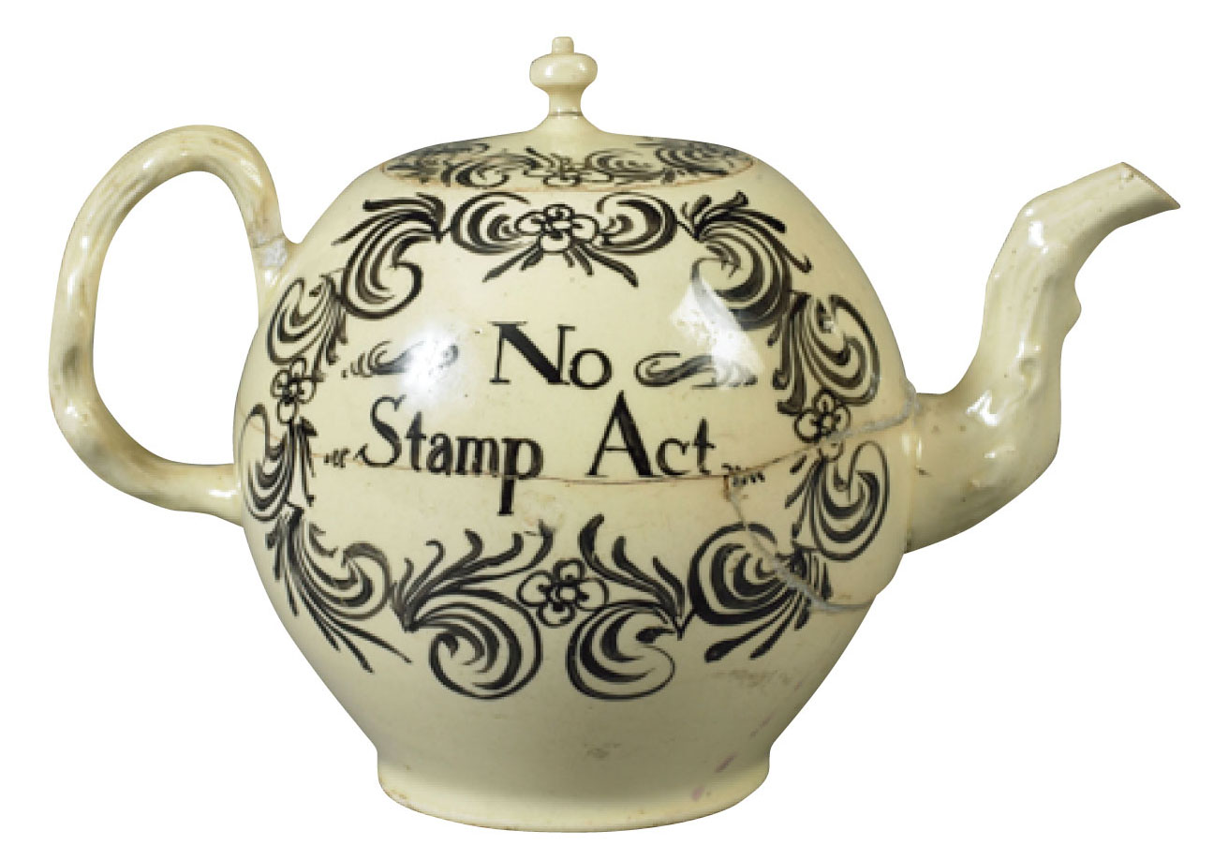
p117
Notes:
Protesting the Stamp Act Even common household wares in the 1760s testified to
the colonists’ mounting rage against the Stamp Act. Many people in Britain sympathized
with the Americans—and sought to profit from their anger, as this English-made teapot
demonstrates.

Slide 28
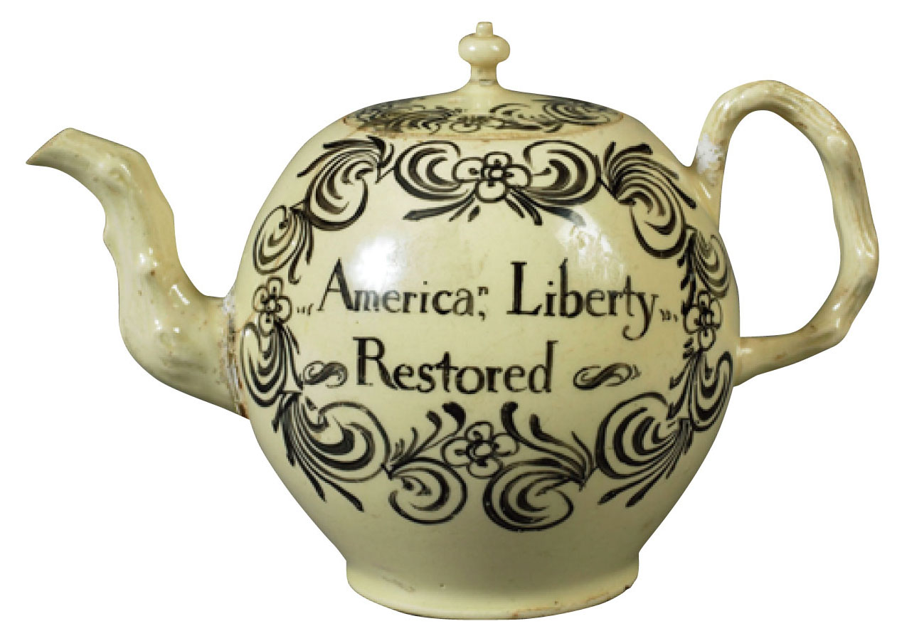
p117
Notes:
Protesting the Stamp Act Even common household wares in the 1760s testified to
the colonists’ mounting rage against the Stamp Act. Many people in Britain sympathized
with the Americans—and sought to profit from their anger, as this English-made teapot
demonstrates.

Slide 29
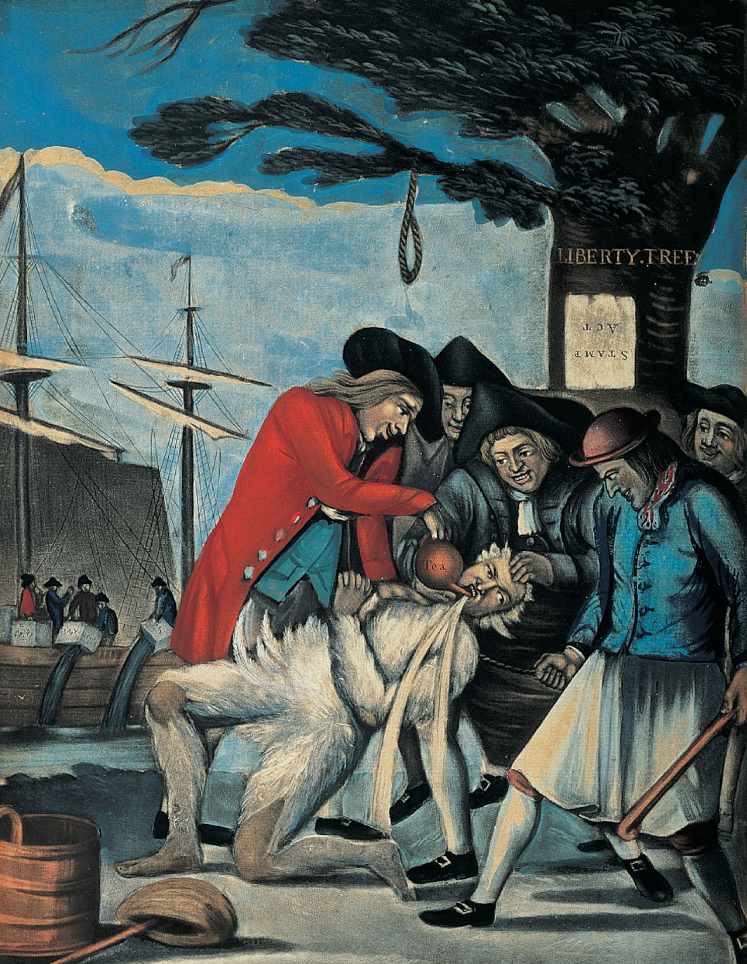
p118
Notes:
Public Punishment for the Excise Man, 1774 T his
popular rendering of the punishment of Commissioner of
Customs John Malcomb shows him tarred and feathered
and forcibly “paid” with great quantities of tea. From the
Liberty Tree in the background dangles the threat of
hanging, all for attempting to collect duties in Boston.

Slide 30
VI. The Townshend Tea Tax and the Boston “Massacre”
Townshend Acts:
  Regulations with a light import duty on glass, white lead, paper, paint, and tea
  They were indirect customs duty payable at American ports
  Taxes in any form—without representation.
Colonists were still in rebellion.
Taxes were to pay salaries of royal governors.

Slide 31
VI. The Townshend Tea Tax and the Boston “Massacre” (cont.)
Nonimportation agreements were revised against the Townshend Acts.
  Colonists took the new tax less seriously
  They found they could secure smuggled tea at a cheaper price.
British landed two regiments of troops in Boston in 1768.
March 5, 1770 a clash took place that became known as the Boston Massacre.

Slide 32
VI. The Townshend Tea Tax and the Boston “Massacre” (cont.)
First to die was Crispus Attucks, a “mulatto” and a leader of the mob.
Only two redcoats were found guilty by defense attorney John Adams.
The soldiers were released after being branded on the hand.

Slide 33
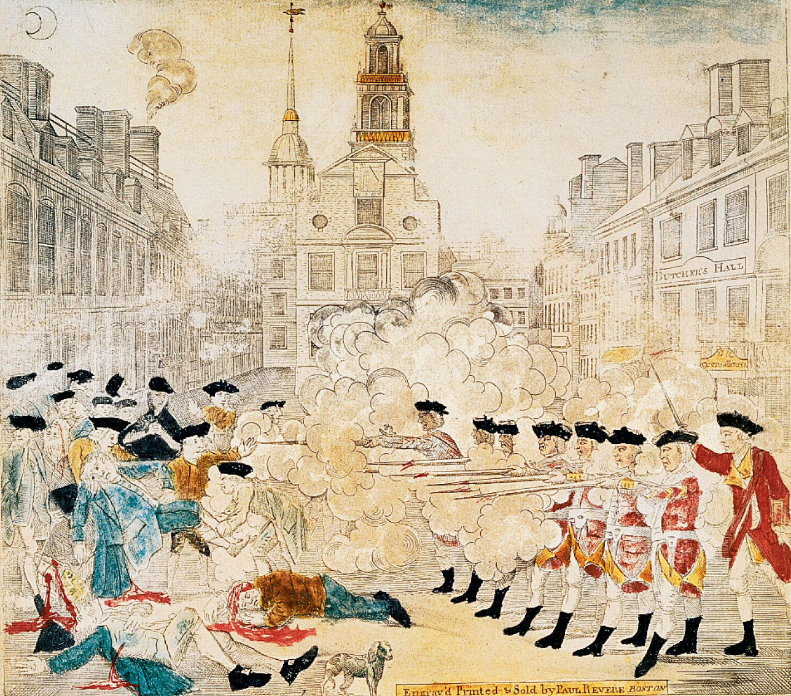
Analyze this document.
p119
Notes:
Two Views of the Boston Massacre, 1770 and 1856 Both of these prints of the Boston Massacre were art as well as propaganda. Paul Revere’s engraving (left) began circulating within three weeks of the event in March 1770, depicting not a clash of brawlers but armed soldiers taking aim at peaceful citizens. Absent also was any evidence of the mulatto ringleader, Crispus Attucks. Revere wanted his print to convince viewers of the indisputable justice of the colonists’ cause. By the mid-1850s, when the chromolithograph (right) circulated, it served a new political purpose. In the era of the abolitionist movement, freedman Crispus Attucks held center place in the print, which portrayed his death as an American martyr in the revolutionary struggle for freedom.

Slide 34
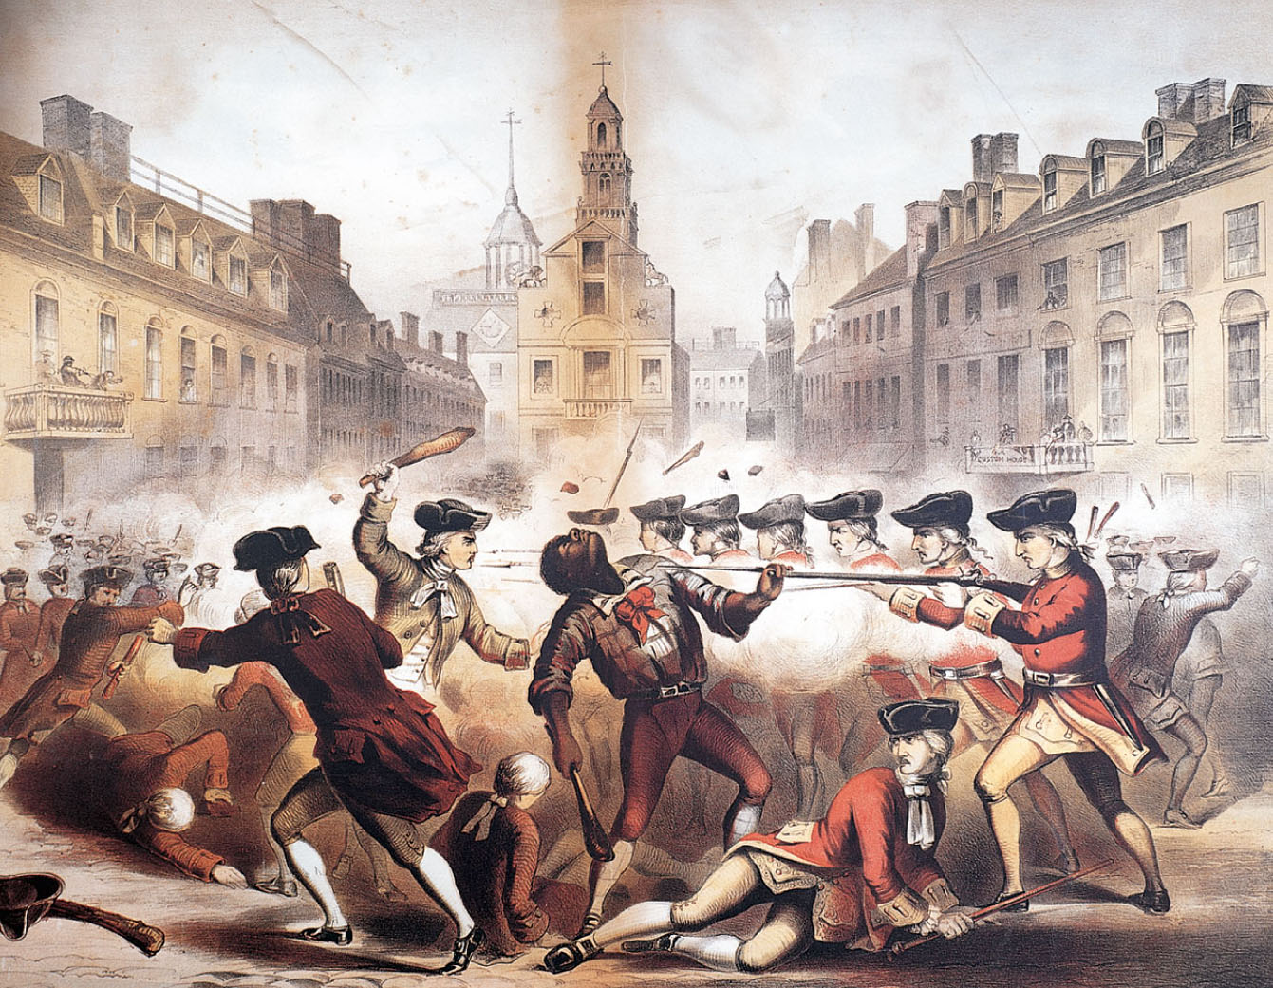
p119
Notes:
Two Views of the Boston Massacre, 1770 and 1856 Both of these prints of the Boston Massacre were art as well as propaganda. Paul Revere’s engraving (left) began circulating within three weeks of the event in March 1770, depicting not a clash of brawlers but armed soldiers taking aim at peaceful citizens. Absent also was any evidence of the mulatto ringleader, Crispus Attucks. Revere wanted his print to convince viewers of the indisputable justice of the colonists’ cause. By the mid-1850s, when the chromolithograph (right) circulated, it served a new political purpose. In the era of the abolitionist movement, freedman Crispus Attucks held center place in the print, which portrayed his death as an American martyr in the revolutionary struggle for freedom.

Slide 35
VII. The Seditious Committees of Correspondence
By 1770 King George III (32 years old) was attempting to assert the power of the British monarchy:
  Surrounded himself with “yes men,” notably his prime minister, Lord North.
The ill-timed Townshend Acts failed to produce revenue
  Though they did produce near-rebellion.

Slide 36
VII. The Seditious Committees of Correspondence (cont.)
Finally Parliament repealed the Townshend revenue duties.
American flames of discontent continued because:
  Redoubled efforts to enforce the Navigation Laws
  Further kindled by Samuel Adams’ appeal to what was called his “trained mob.”

Slide 37
VII. The Seditious Committees of Correspondence (cont.)
Committees of correspondence:
  First organized in Boston in 1772, some 80 towns set up similar organizations
  Chief function to spread the spirit of resistance by exchanging letters keeping alive opposition to British policy
  Intercolonial committees of correspondence were the next logical step
  Virginia led the way in 1773.

Slide 38
VII. The Seditious Committees of Correspondence (cont.)
They were supremely significant in stimulating and disseminating sentiment in favor of united action.
They evolved directly into the first American congresses.

Slide 39
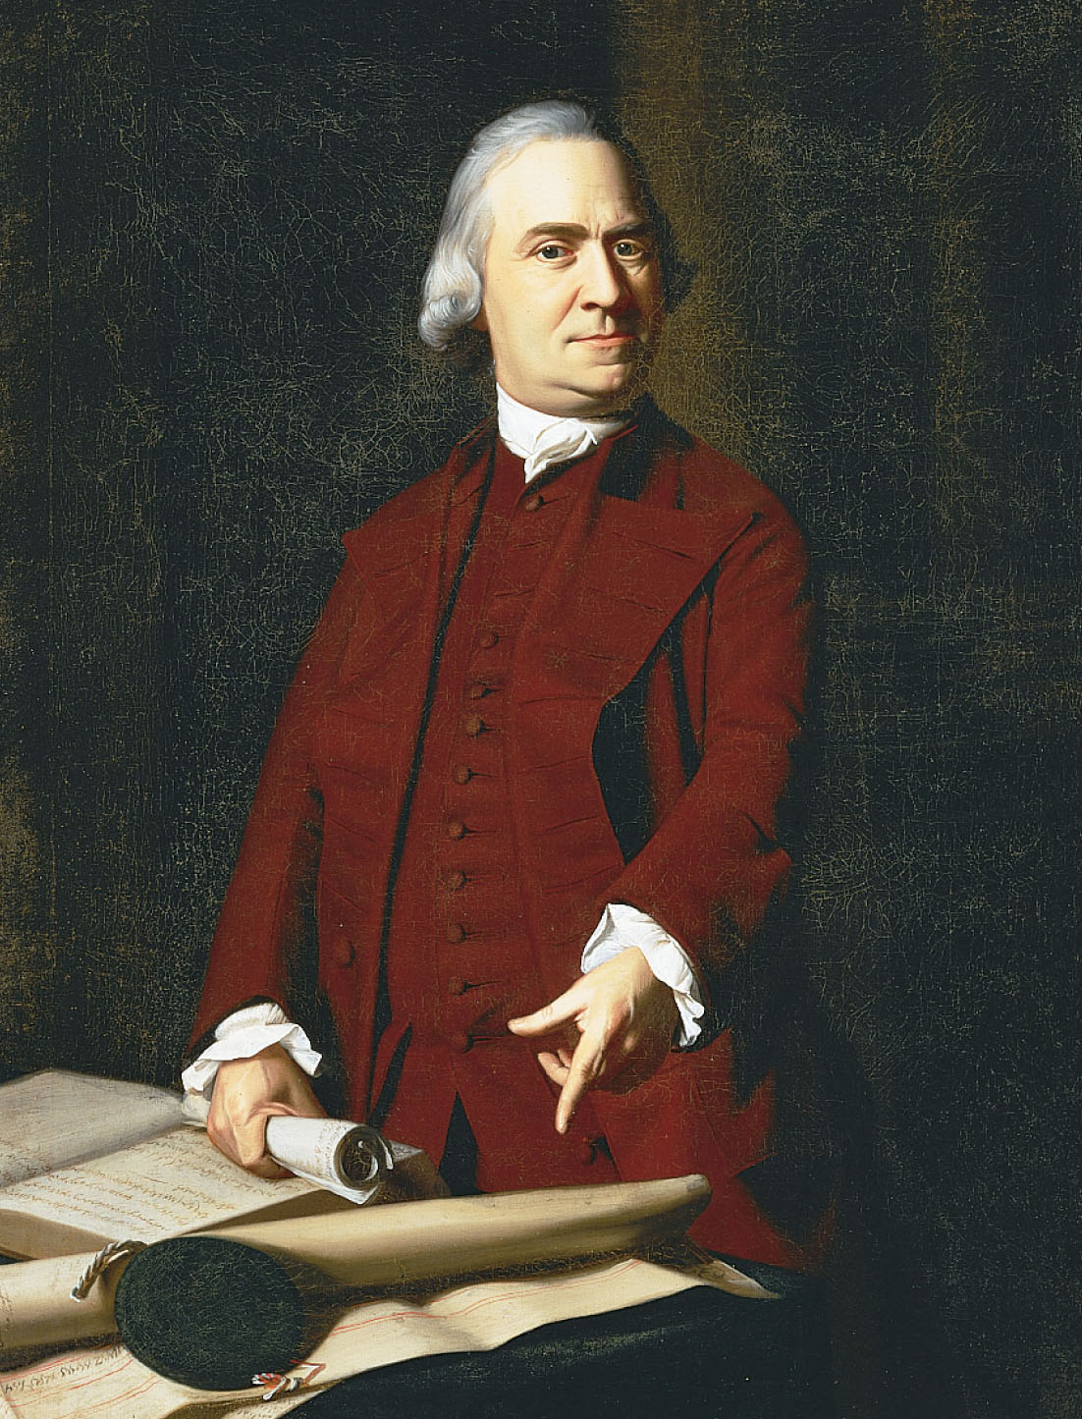
p120
Notes:
Samuel Adams (1722–1803) A second cousin of
John Adams, he contributed a potent pen and tongue
to the American Revolution as a political agitator and
organizer of rebellion. He was the leading spirit in
hosting the Boston Tea Party. A failure in the brewing
business, he was sent by Massachusetts to the First
Continental Congress of 1774. He signed the
Declaration of Independence and served in Congress
until 1781.

Slide 40
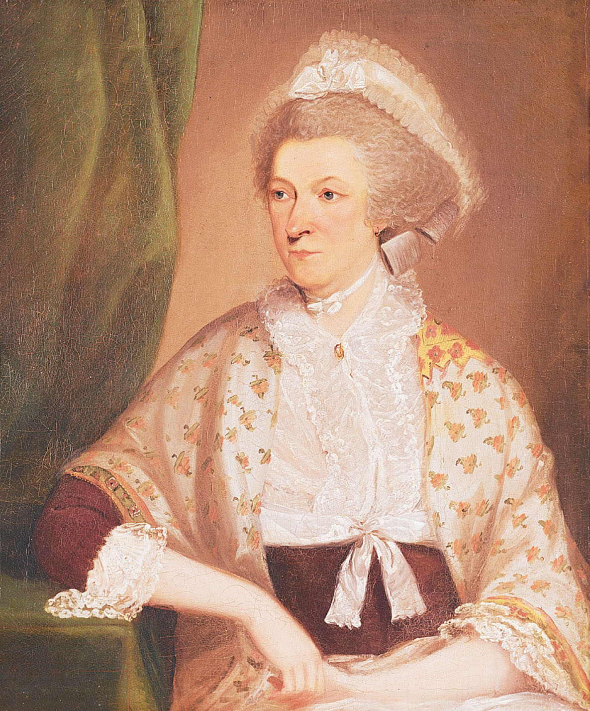
p120
Notes:
Portrait Traditionally Said to Be That of Abigail
Adams (1744–1818) The wife of Revolutionary War
leader and future president John Adams, she was a
prominent Patriot in her own right. She was also
among the first Americans to see, however faintly, the
implications of revolutionary ideas for changing the
status of women.

Slide 41
VIII. Tea Brewing in Boston
1773-the powerful British East India Company was facing bankruptcy:
  Overburdened with 17 million pounds of unsold tea
  British ministry awarded them a complete monopoly of the American tea business
  The Company could now sell the tea cheaper
  The colonists saw this as an attempt to trick the Americans.

Slide 42
VIII. Tea Brewing in Boston
(cont.)
The British colonial authorities decided to enforce the law:
  Colonists rose up in wrath
  Mass demonstrations forced the tea-bearing ships to return to England with their cargo
  Only in Boston did a British official refused to be cowed
  Governor Thomas Hutchinson determined not to budge.

Slide 43
VIII. Tea Brewing in Boston
(cont.)
Hutchinson infuriated Boston’s radicals when he ordered the tea ships not to clear Boston Harbor until they had unloaded the cargoes.
  December 16, 1773 about 100 Bostonians, loosely disguised as Indians, boarded the docked ships
  Smashed open 342 chests of tea, and dumped their contents into the Atlantic
  Action became known as the Boston Tea Party

Slide 44
VIII. Tea Brewing in Boston
(cont.)
Reaction varied:
  Sympathetic colonists applauded
  Referring to tea as “a badge of slavery,” they burned the hated leaves in solidarity with Boston
  Hutchinson, chastened and disgusted, retreated to Britain, never to return
  The British chose the perilous path that led only to reprisals, bitterness, and escalating conflict.

Slide 45
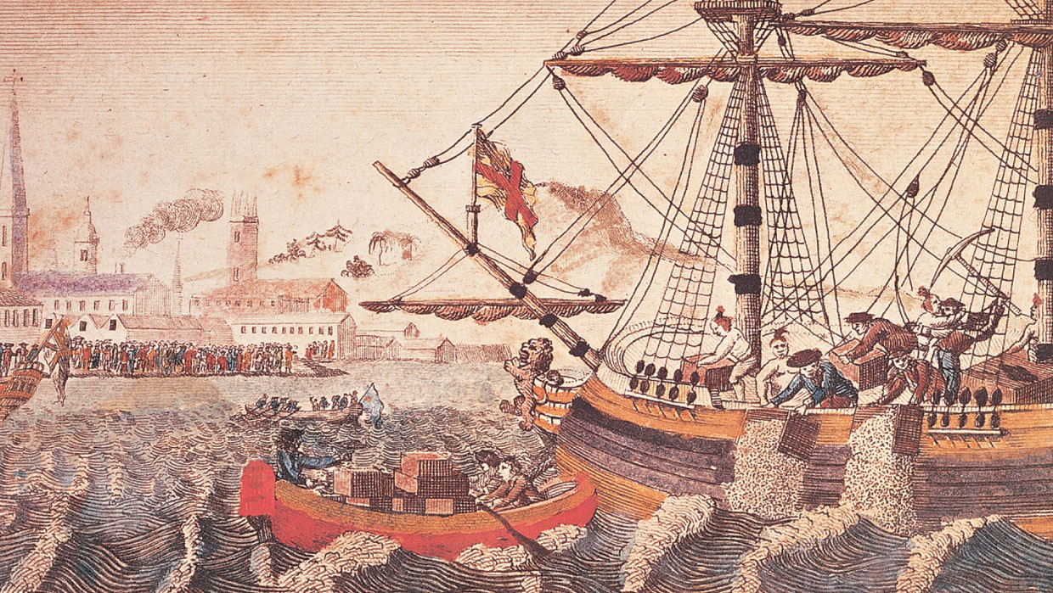
p121
Notes:
The Boston Tea Party,
December 16, 1773 Crying
“Boston harbor a teapot this
night,” Sons of Liberty disguised
as Indians hurled chests of tea
into the sea to protest the tax on
tea and to make sure that its
cheap price did not prove an
“invincible temptation” to the
people.

Slide 46
The Powder Alarm
  A massive popular reaction to the removal of gunpowder from a magazine by British soldiers under orders from General Thomas Gage, royal governor of the Province of Massachusetts Bay, on September 1, 1774.

Slide 47
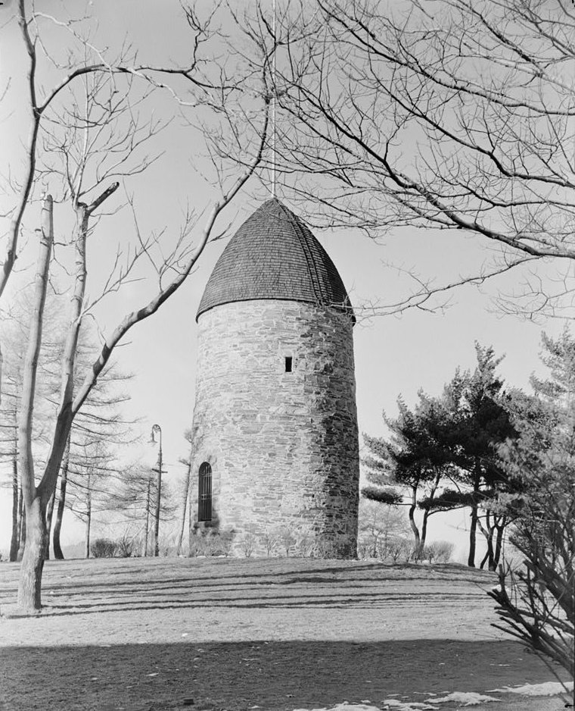
Old Powder House in Somerville, Massachusetts, as it stood in 1935. It was the removal of powder from this magazine by the British regulars that triggered the “Powder Alarm.”

Slide 48
IX. Parliament Passes the “Intolerable Acts”
Parliament responded with measures that brewed a revolution:
  1774 it passed a series of acts designed to chastise the colonists
  They were branded in America as “the massacre of American Liberty”
Most drastic was the Boston Port Act:
  It closed the port until damages were paid, and order could be ensured.

Slide 49
IX. Parliament Passes the “Intolerable Acts” (cont.)
Intolerable Acts:
  Massachusetts colonial chartered rights were swept away:
  Restrictions were placed on the precious town meetings
  Contrary to previous practices, enforcing officials who killed colonists in the line of duty could now be sent to Britain for trial.
  New Quartering Act.

Slide 50
IX. Parliament Passes the “Intolerable Acts” (cont.)
The Quartering Act gave local authorities the power to lodge British soldiers anywhere, even in private homes.
Quebec Act 1774, covering the French subjects in Canada:
  They were guaranteed their Catholic religion
  Could contain most of their customs and institutions
  Quebec boundaries were extended to Ohio River

Slide 51
IX. Parliament Passes the “Intolerable Acts” (cont.)
The Quebec Act, from French viewpoint, was a shrewd and conciliatory measure.
From the American viewpoint:
  The Quebec Act was especially noxious
  This act had a much wider range
  By sustaining unrepresentative assemblies and denials of jury trials, it seemed to set a dangerous precedent in America.

Slide 52
IX. Parliament Passes the “Intolerable Acts” (cont.)
From the American viewpoint (cont.):
  It alarmed land speculators, who were distressed to see the huge trans-Allegheny area snatched from their grasp (see Map 7.1)
  Aroused anti-Catholics, shocked by the extension of Roman Catholic jurisdiction southward into a region earmarked for Protestantism—a region about as large as the 13 colonies.

Slide 53
X. Bloodshed
  American dissenters responded sympathetically to the plight of Massachusetts
  Colonies rallied to send food to the stricken city of Boston
  Rice was shipped from faraway South Carolina.
Most memorable was the summoning of the First Continental Congress in 1774:
  It met in Philadelphia to redress grievances
  12 of 13 colonies, except Georgia, sent 55 men-S. Adams, J. Adams, G. Washington, P Henry.

Slide 54
X. Bloodshed (cont.)
The First Continental Congress:
  Deliberated for 7 weeks, from Sept. 5 to Oct. 26, 1774
  Not a legislative but a consultative body—a convention rather than a congress
  John Adams played a stellar role
  They drew up dignified papers—the Declaration of Rights, and solemn appeal to other British Amer. colonies, to the king, and British people.

Slide 55
X. Bloodshed (cont.)
Most significant action was the creation of The Association:
  It called for a complete boycott of British goods: nonimportation, nonexportation, and nonconsumption.
The delegates were not calling for independence.
They sought merely to appeal the offensive legislation.

Slide 56
X. Bloodshed (cont.)
But the fatal drift toward war continued:
  Parliament rejected the Congress’s petitions
  Violators of The Association were tarred and feathered
  Muskets were gathered, men began to drill openly, and a clash seemed imminent.
  In April 1775, the British commander in Boston sent a detachment of troops to nearby Lexington and Concord.

Slide 57
X. Bloodshed (cont.)
  They were to seize stores of colonial gunpowder and bag the “rebel” ringleaders, Samuel Adams and John Hancock
    Sons of Liberty Paul Revere and William Dawes rode to alert the militia that “the Regulars are out!”
  At Lexington the colonial “Minute Men” refused to disperse and shots were fired, killing eight Americans and wounding several more
    The affair was more the “Lexington Massacre” than a battle
  The redcoats pushed on to Concord, and Britain now had a war on its hands.

Slide 58
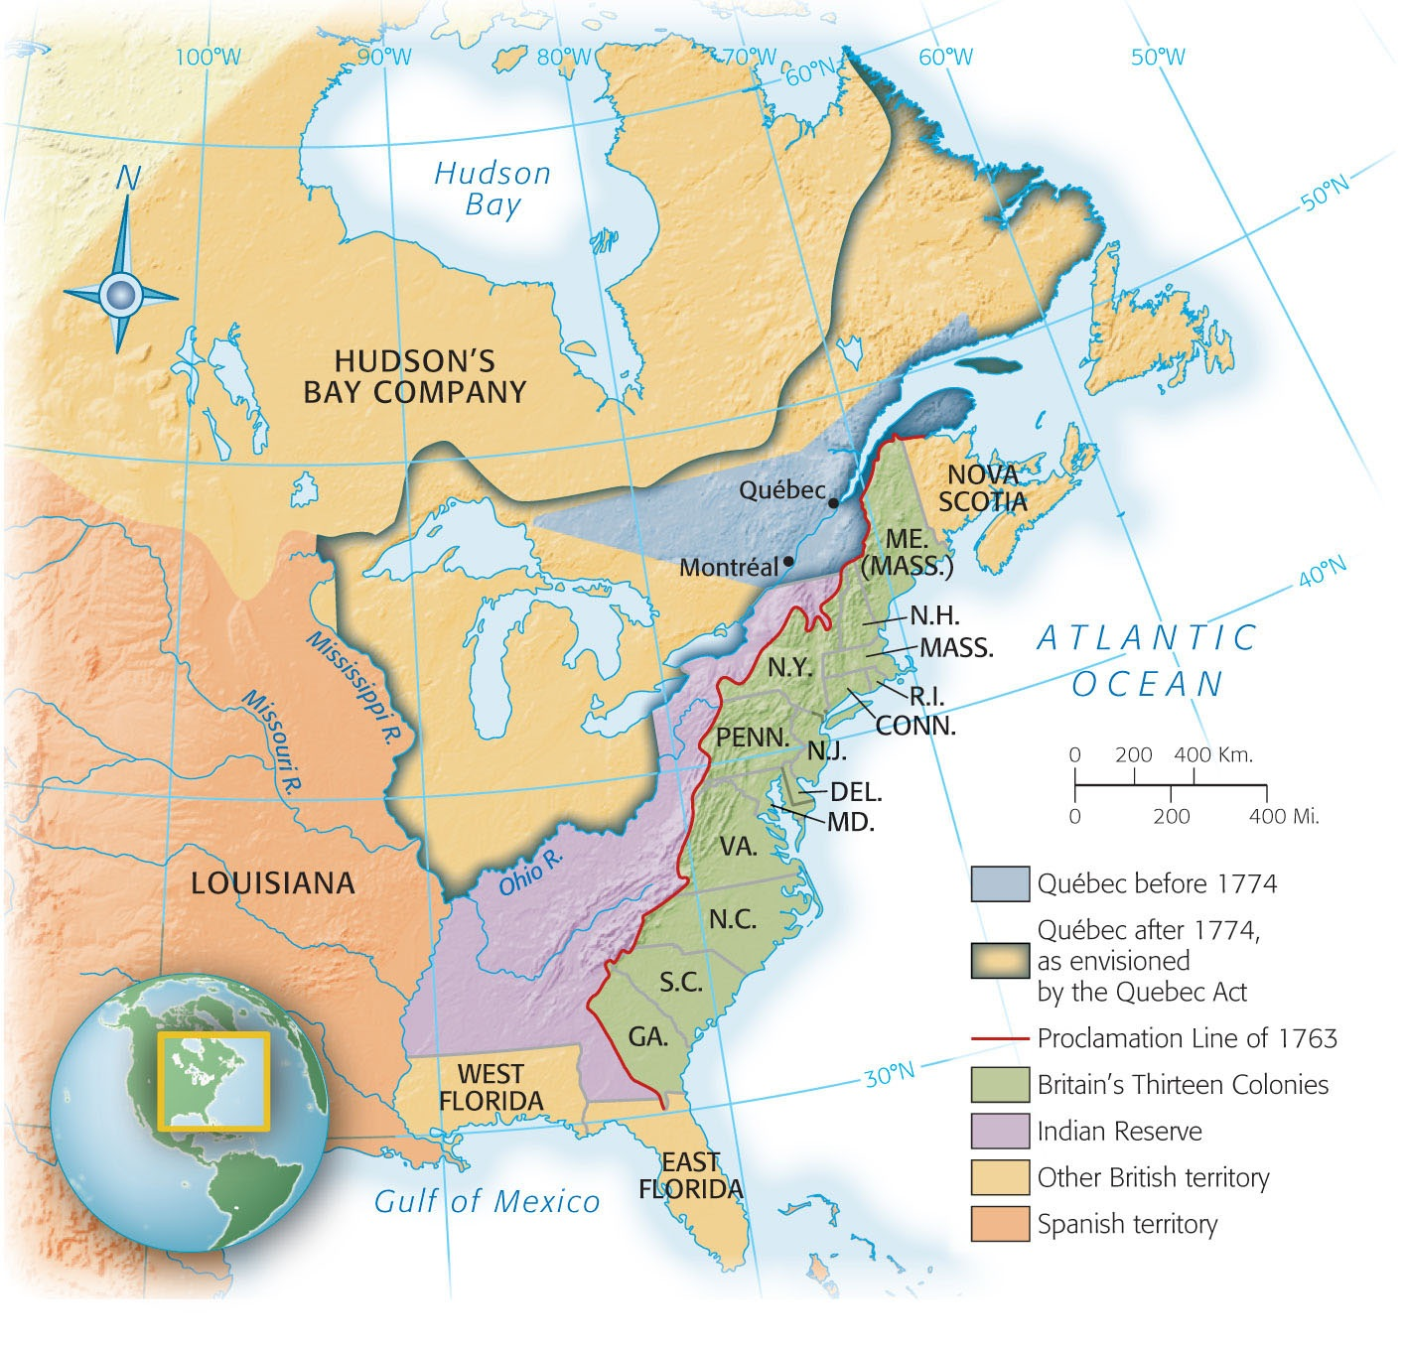
Map 7-1 p123
Notes:
Map 7.1 Québec Before and After 1774 Young Alexander Hamilton voiced the fears
of many colonists when he warned that the Quebec Act of 1774 would introduce “priestly
tyranny” into Canada, making that country another Spain or Portugal. “Does not your
blood run cold,” he asked, “to think that an English Parliament should pass an act for the
establishment of arbitrary power and Popery in such a country?”

Slide 59
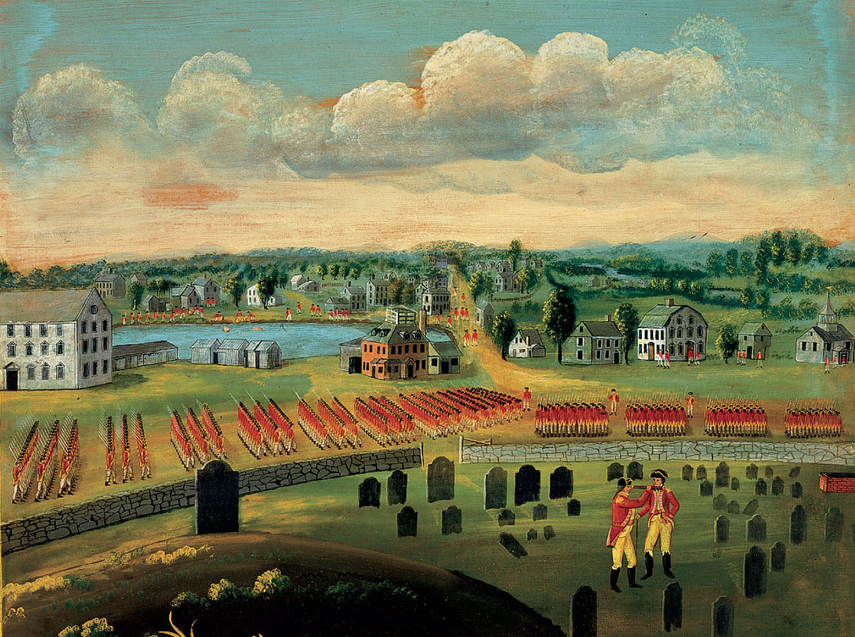
p124
Notes:
A View of the Town of Concord, ca. 1775 Redcoats here drill on the Concord Green,
near where colonial militiamen would soon repel their advance on stores of rebel
gunpowder.

Slide 60
XI. Imperial Strength and Weakness
Aroused Americans had brashly rebelled against a mighty empire:
  Population odds three to one against the rebels-7.5 million Britons to 2.5 million colonists
  The odds in monetary wealth and naval power overwhelmingly favored the mother country
  Britain’s professional army some 50,000, as compared to numerous, but wretchedly trained American militia

Slide 61
XI. Imperial Strength and Weakness (cont.)
  George III hired foreign soldiers, and some 30,000 Germans—so-called Hessians
  The British enrolled about 50,000 American Loyalists and enlisted some Indians.
Yet Britain was weaker than it seemed at first glance:
  Oppressed Ireland was a smoking volcano and British troops detached to watch it
  France was waiting to get even with Britain

Slide 62
XI. Imperial Strength and Weakness (cont.)
  The London government was weak and inept
  There was no William Pitt, “Organizer of Victory” only the stubborn George III and his pliant Tory prime minister, Lord North
  Many earnest and God-fearing Britons had no desire whatever to kill Americans cousins
  The English Whigs opposed Lord North’s Tories
  Tories believed that the battle for British freedom was being fought in America.

Slide 63
XI. Imperial Strength and Weakness (cont.)
Britain’s army in America had to operate under endless difficulties:
  The generals were second-rate the soldiers were brutally treated
  Provisions were often scarce, rancid, and wormy
  The redcoats had to conquer the Americans
  Britain had to operate 3,000 miles from home
  Distance added greatly to delays and uncertainties from storms and mishaps

Slide 64
XI. Imperial Strength and Weakness (cont.)
  Military orders were issued in London that, when received months later, would not fit the changing situation:
  America’s geographical expanse was enormous: roughly 1,000 by 600 miles
  The united colonies had no urban nerve centers
  British armies took every city of any size.
The Americans wisely traded space for time.

Slide 65
XII. American Pluses and Minuses
The American situation:
  They were blessed with outstanding leadership: George Washington, Benjamin Franklin
  Open foreign aid came from France
  Numerous European officials volunteered their swords for pay
  In a class by himself, the Marquis de Lafayette—his service in securing further aid from France was invaluable

Slide 66
XII. American Pluses and Minuses: (cont.)
Other conditions aided the Americans:
  They were fighting defensively, with the odds favoring the defender
  In agriculture, the colonies were mainly self-sustaining
  Americans enjoyed the moral advantage that came from belief in a just cause
  The historical odds were not impossible however, the American rebels were poorly organized.

Slide 67
XII. American Pluses and Minuses:
(cont.)
Economic difficulties:
  Metallic money had been heavily drained away
  A cautious Continental Congress, unwilling to raise taxes, was forced to print “Continental” paper money in great amounts
  Confusion proliferated when the individual states were forced to issue depreciated paper money
  Inflation of the currency skyrocketed price.

Slide 68
XII. American Pluses and Minuses:
(cont.)
  The disorganized colonists fought almost the entire war before adopting a written constitution—the Articles of Confederation—in 1781
  Jealousy everywhere raised its hideous head:
    Individual states, regarding themselves as sovereign, resented the attempts of Congress to exercise its powers
    Sectional jealousy boiled over the appointment of military leaders.

Slide 69
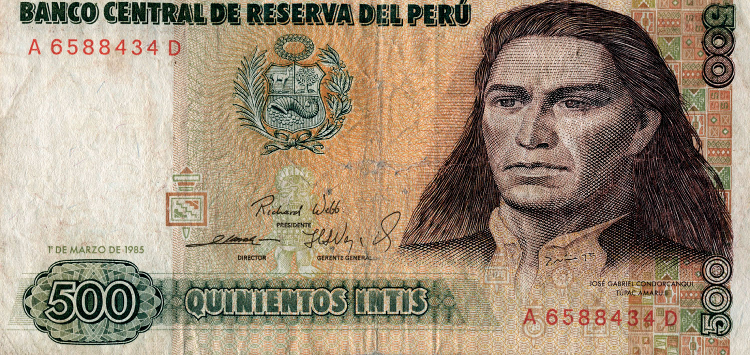
p126
Notes:
Tupac Amaru II A Peruvian national hero, Tupac Amaru II is memorialized to this day with his portrait on the nation’s currency.

Slide 70
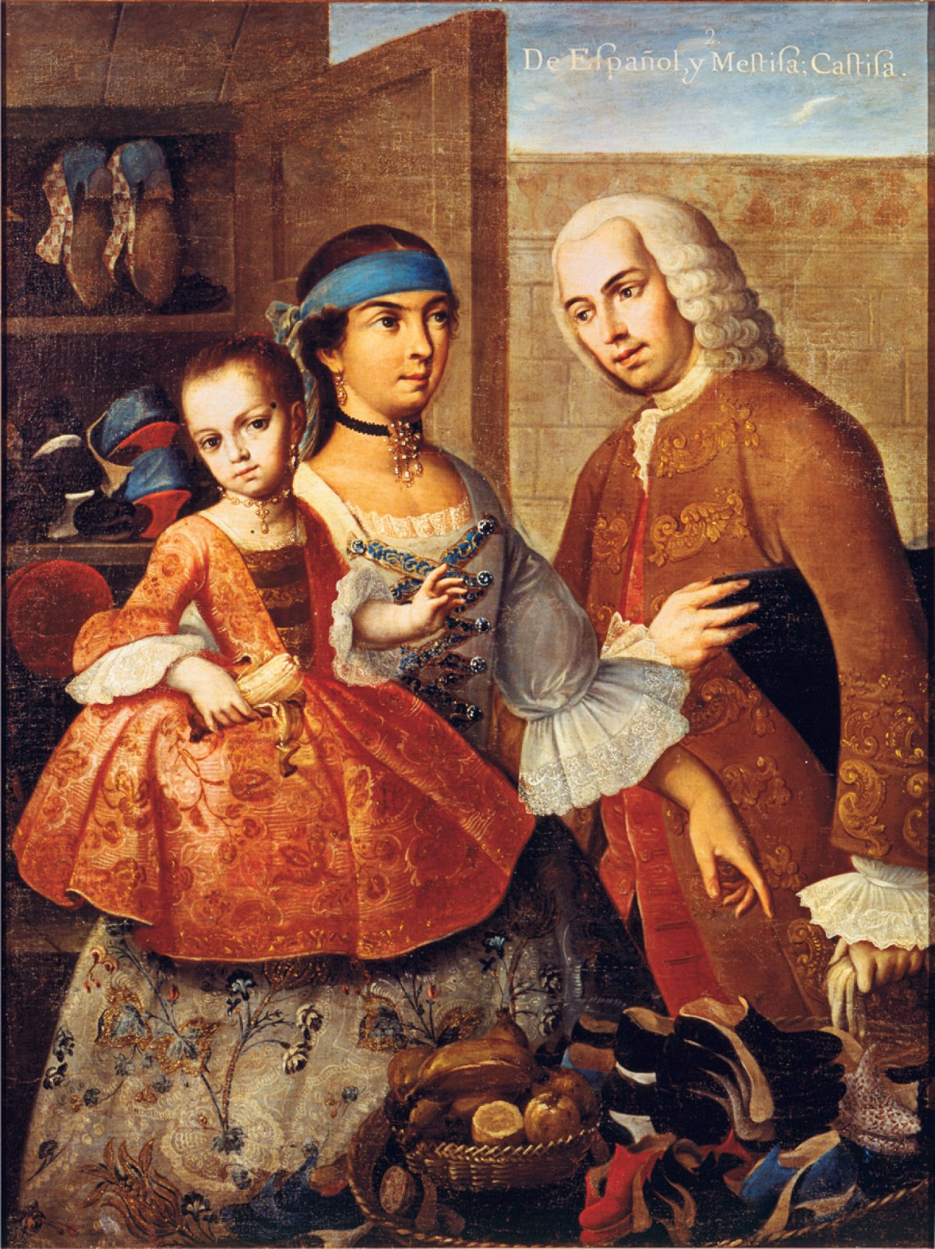
p127
Notes:
Couple with Child by Miguel Cabera This eighteenth-century portrait of a Mexican family illustrates the common intermarriage of Europeans and Indians in the Spanish New World. The ethnic complexity of Spanish America kept colonists there from uniting against imperial authorities as successfully as their northern neighbors.

Slide 71
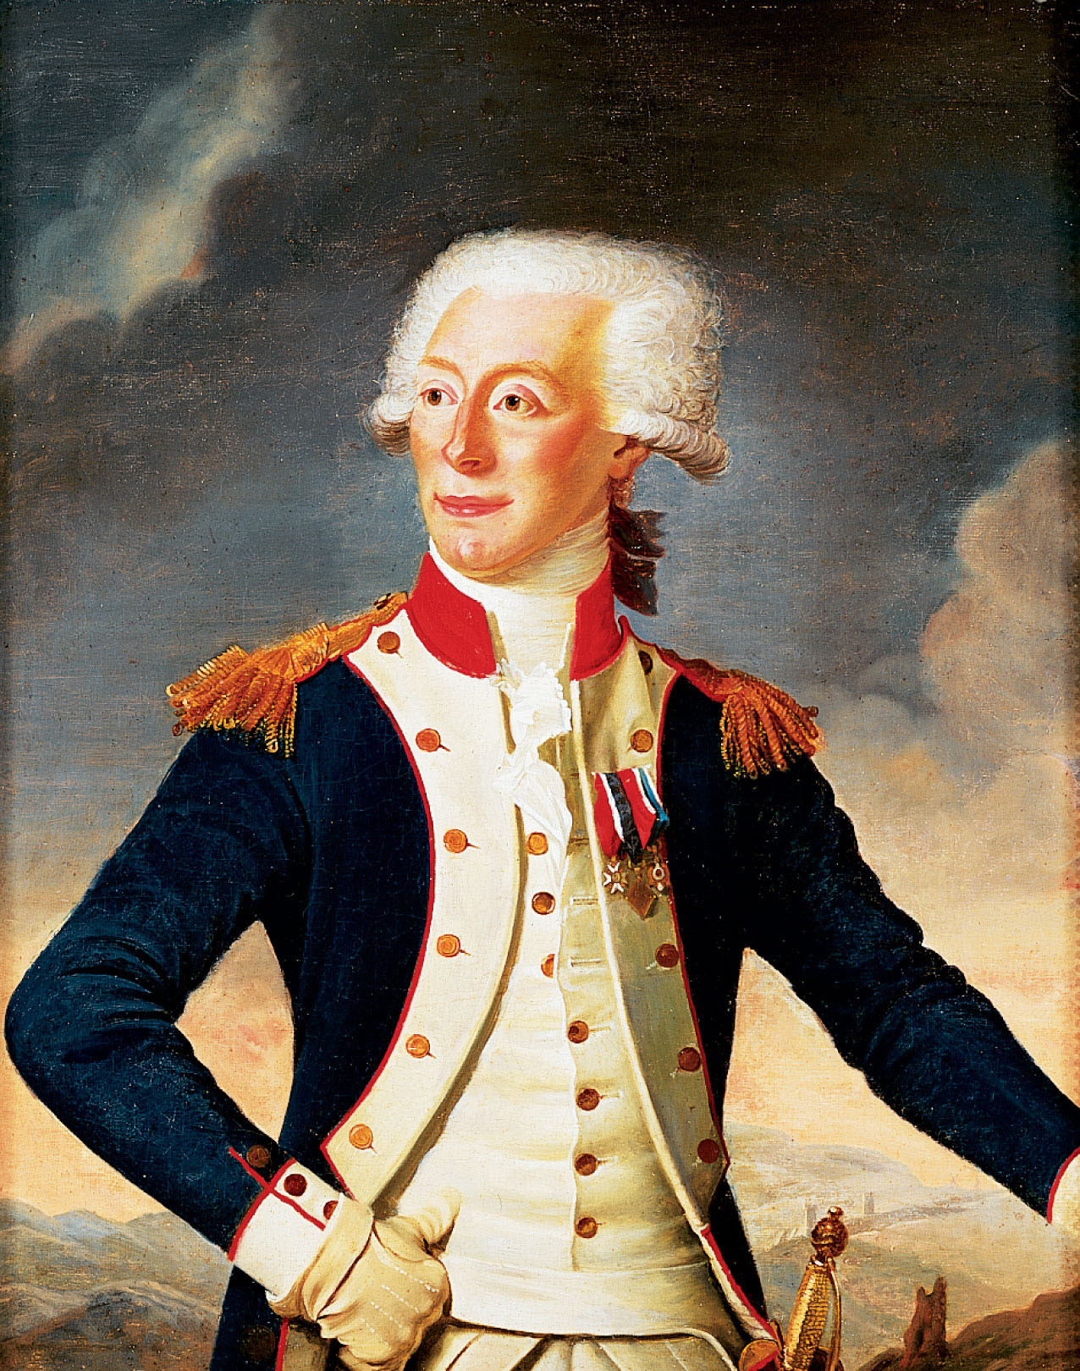
p128
Notes:
Gilbert du Motier, Marquis de Lafayette (1757–1834), by Joseph Boze, 1790 This youthful French officer gave to America not only military service but some $200,000 of his private funds. He returned to France after the American Revolution to play a conspicuous role in the French Revolution.

Slide 72
XIII. A Thin Line of Heroes
Basic military supplies in the colonies were dangerously scanty:
  Widespread militia service meant men needed weapons for training
  The rebels were caught at the very moment that the supply of British funds and war material evaporated, the cost of home defense mounted
  Sufficient stores of gunpowder, cannon, and other armaments could not be found.

Slide 73
XIII. A Thin Line of Heroes
(cont.)
  Among the reasons for the eventual alliance with France was the need for a reliable source of essential military supplies
  At Valley Forge, Pa., American soldiers went without bread for three successive days in the cruel winter of 1777-1778
  In one southern campaign, some men fainted for lack of food.
  Manufactured goods were in short supply

Slide 74
XIII. A Thin Line of Heroes
(cont.)
  Clothing and shoes were appallingly scarce
  American militiamen were numerous but also highly unreliable
  Able-bodied American males—several 100,000s—had received rudimentary training
Women played a significant part in the Revolution:
  Many maintained farms and businesses while their fathers and husbands fought

Slide 75
XIII. A Thin Line of Heroes
(cont.)
  Large numbers of female camp followers accompanied the American army:
    Cooking and sewing for the troops in return for money and rations
    One Massachusetts woman dressed in men’s clothing and served in the army for seventeen months.
A few thousand regulars were finally whipped into shape by stern drillmasters:
  Notable was German Baron von Steuben, an organizational genius.

Slide 76
XIII. A Thin Line of Heroes
(cont.)
The role of Blacks in the American forces who fought and died for the American cause:
  Many states initially barred them from military service, by war’s end more than 5000 blacks had enlisted
  The largest contingents came from the northern states with substantial number of free blacks
  Blacks fought at Trenton, Brandywine, Saratoga, and other important battles

Slide 77
XIII. A Thin Line of Heroes
(cont.)
African Americans also served on the British side:
  In November 1775 Lord Dunmore issued a proclamation promising freedom for any enslaved black in Va. who joined the British army.
  From Va. and Maryland 300 slaves joined
  At the end of the war, the British kept their word: 4000 “Black Loyalists” freed.

Slide 78
XIII. A Thin Line of Heroes
(cont.)
Morale in the Revolutionary army was badly undermined by American profiteers:
  They sold to the British because the invaders could pay in gold
  Speculators forced prices sky-high and some Bostonians made profits of 50 to 200%
  If the rebels had thrown themselves into the struggle with zeal, they could have raised many times that number.

Slide 79
XIII. A Thin Line of Heroes
(cont.)
The brutal truth is that only a select minority of the American colonists attached themselves to the cause of independence with a spirit of selfless devotion.
These were the dedicated souls who bore the burden of battle and the risks of defeat.
Seldom have so few done so much for so many.

Slide 80
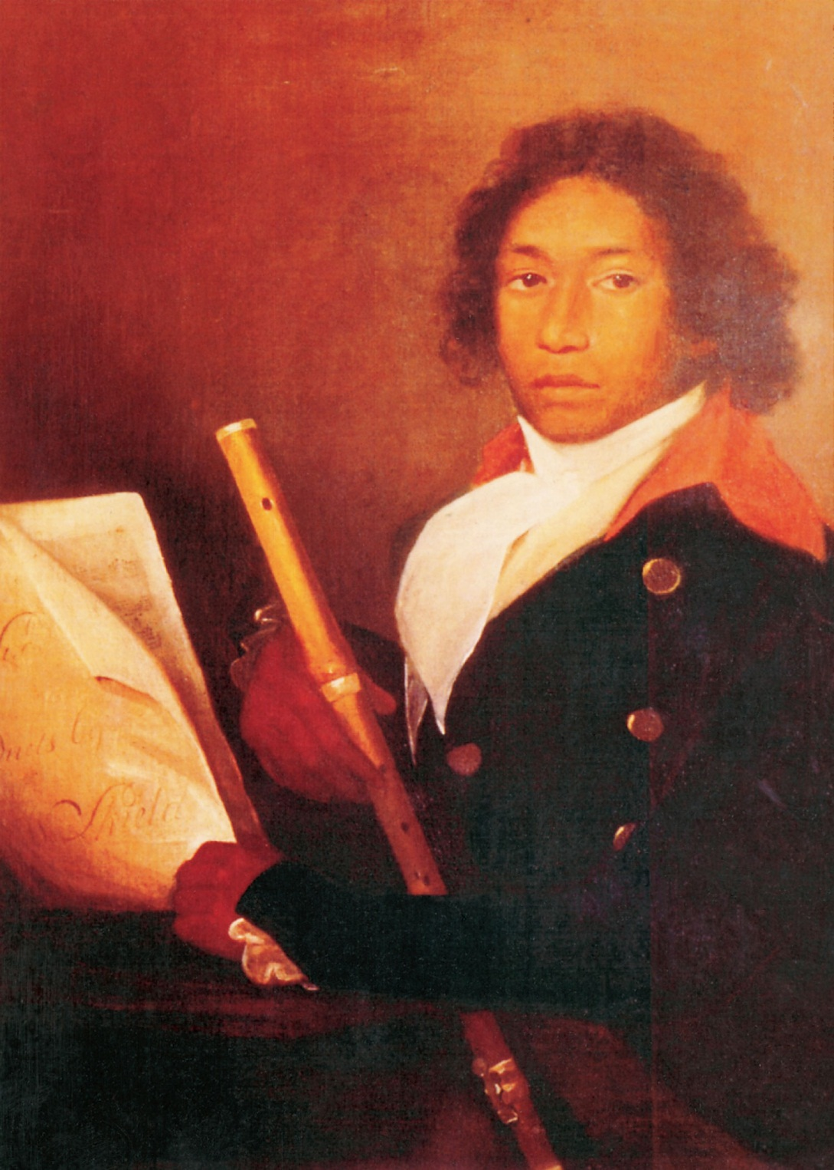
p129
Notes:
The Flutist, by Brazilla Lew This portrait is believed to
be that of an African American fifer in the Revolutionary
War. Lew was a veteran of the Seven Years’ War who had
marched to Ticonderoga and served in the army a full
seven years as frontline soldier, fifer, and drummer. In 1775,
at the age of thirty-two, he fought at Bunker Hill as an
enlistee in the 27th Massachusetts Regiment. A resident of
Chelmsford, Massachusetts, he was said to have taught all
twelve of his children to play musical instruments.

Slide 81
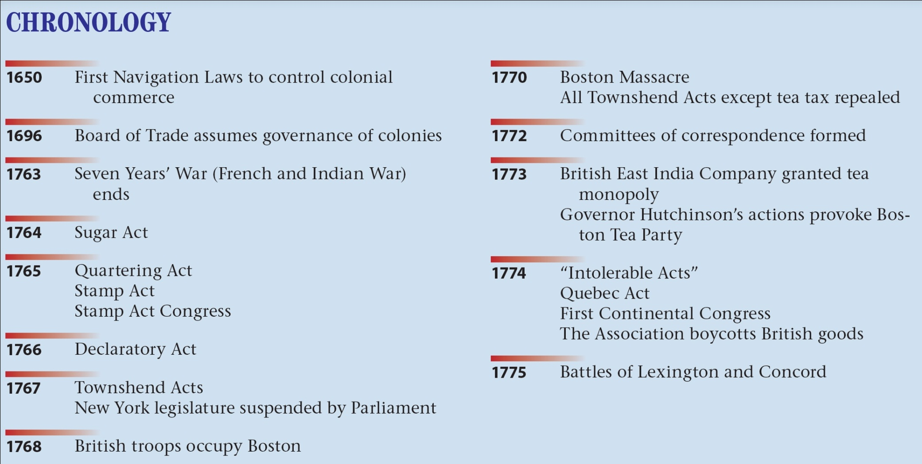
p130

