Slide 1
Chapter 9
The Confederation and the Constitution, 1776–1790

Slide 2
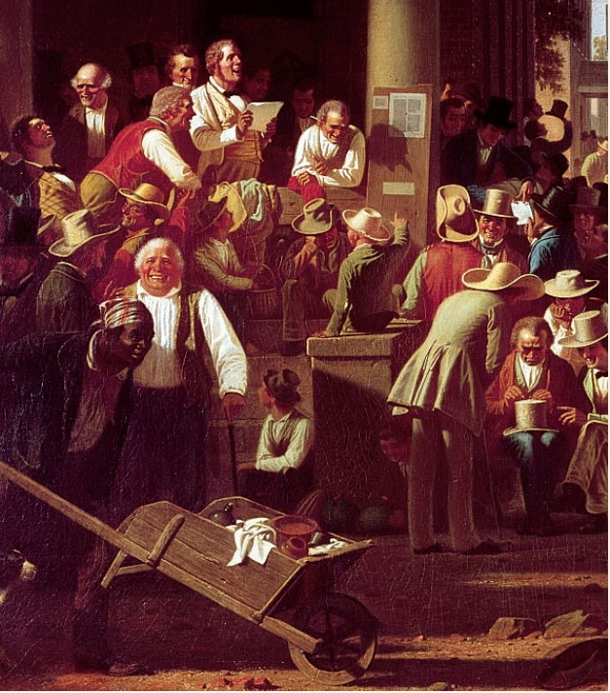
p156
Notes:
The Verdict of the People (detail) This election-day crowd exudes the
exuberant spirit of the era of Andrew Jackson, when the advent of universal
white male suffrage made the United States the modern world’s first mass
participatory democracy. Yet the black man with the wheelbarrow, literally
pushing his way into the painting, is a pointed reminder that the curse of
slavery still blighted this happy scene.

Slide 3
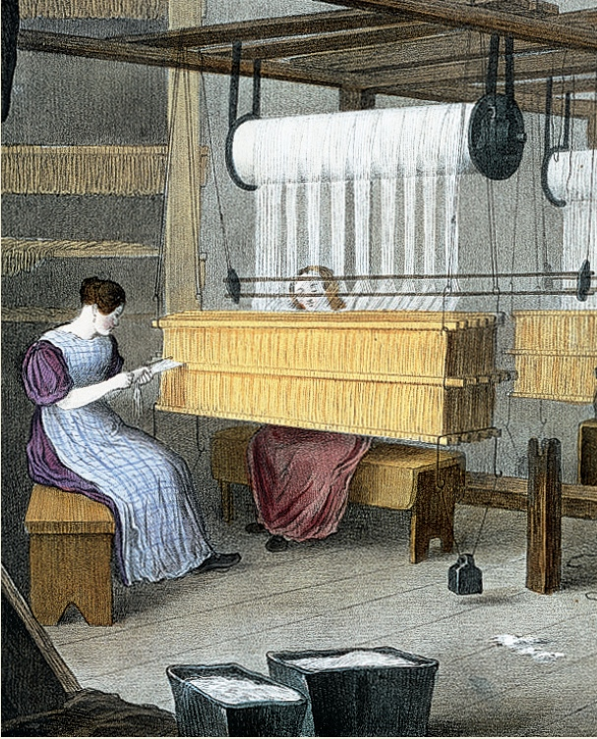
p157
Notes:
Women Weavers at Work
(detail) These simple
cotton looms heralded the
dawn of the Industrial
Revolution, which
transformed the lives of
Americans even more
radically than the events of
1776.

Slide 4

I. The Pursuit of Equality
Equality was the watchword everywhere:
  Most states reduced property-holding requirements for voting
  Ordinary men and women demanded to be addressed as “Mr.” and “Mrs.”
  Employers were now called “boss,” not “master”
  The lordly pretentions of Continental Army officials who formed the Society of the Cincinnati were ridiculed.

Slide 5
I. Pursuit of Equality
(cont.)
A protracted fight for separation of church and state resulted in notable gains:
  The Congregational Church continued to be legal established
  The Anglican Church was de-anglicized, and reformed as the Protestant Episcopal Church
  The struggle for divorce between religion and government proved fiercest in Virginia.

Slide 6
I. Pursuit of Equality
(cont.)
    It was prolonged to 1786, when freethinking Thomas Jefferson and his co-reformers, include the Baptists, won a complete victory with the passage of the Virginia Statute for Religious Freedom (see Table 5.1).
Egalitarian sentiments challenged the institution of slavery:
  Philadelphia Quakers in 1775 founded the first’s antislavery society

Slide 7
I. Pursuit of Equality
(cont.)
      Hostilities hampered the noxious trade in “black ivory”
      The Continental Congress, 1774 called for the complete abolition of the slave trade, a summons to which most states responded positively.
      Several Northern states called for either abolishing slavery outright or providing for the gradual emancipation of blacks
      Even on the plantations of Virginia, a few idealistic masters freed their human chattels
  No state south of Pennsylvania abolished slavery
  In both the North and South the law discriminated against freed blacks and slaves alike

Slide 8
I. Pursuit of Equality
(cont.)
Why not more rapid changes:
  The fledgling idealism of the Founding Fathers was sacrificed to political expediency
  A fight over slavery would fracture the fragile national unity that was needed
    “Great as the evil (of slavery) is, a dismemberment of the union would be worse” James Madison, 1787
  Nearly a century later, the slavery issue did wreck the Union—temporarily.

Slide 9
I. The Pursuit of Liberty
(cont.)
Incomplete was the extension of the doctrine of equality to women:
  Some women did serve in the military
  New Jersey’s new constitution (1776) enabled women to vote
  Most women in the Revolutionary era were still doing traditional women’s work.

Slide 10
I. The Pursuit of Equality
(cont.)
Central to republican ideology was:
  Civic virtue—the notion that democracy depended on the unselfish commitment of each citizen to the public good
    And who could better cultivate the habits of a virtuous citizenry than mothers, to whom society entrusted the moral education of the young?
    The idea of “republican motherhood” elevated women to a newly prestigious role as special keepers of the nation’s conscience.

Slide 11
I. The Pursuit of Equality
(cont.)
  Educational opportunities for women expanded, in the expectation that wives and mothers could better cultivate the virtues demanded by the Republic
  Republican women now bore responsibility for the survival of the nation.

Slide 12
II. Constitution Making in the States
The Constitutional Congress, 1776, called for the colonies to draft a new constitution:
  Asking the colonists to summon themselves into being as new states
  The sovereignty of the new states would rest on the authority of the people
  The states of Connecticut and Rhode Island merely retouched their constitutions
  Other colonies would write new constitutions.

Slide 13
II. Constitution Making in the States (cont.)
Massachusetts called for a special convention to draft its constitution and then submitted the final draft to the people for ratification
  Once adopted the constitution could only be changed by another constitutional convention
  Its constitution remained the longest-lived constitution in the world.

Slide 14
II. Constitution Making in the
States (cont.)
Common constitutional features:
  As written documents the state constitutions were intended to represent a fundamental law, superior to the whims of ordinary legislation
  Most contained bills of rights—long-prized liberties against later legislative encroachment.
  Most required the annual election of legislators
  All deliberately created weak executive and judicial branches.

Slide 15
II. Constitution Making in the States (cont.)
In the new government, the legislatures were given sweeping powers:
  The democratic character was reflected by the presence of many members of the recently enfranchised poorer western districts
  Their influence was felt in the moving of many state capitals
  In many states capitals were moved westward.

Slide 16
III. Economic Crosscurrents
Economic changes:
  States seized control of former crown lands
  Land was cheap and easily available
  In America economic democracy preceded political democracy
  A sharp stimulus was given to manufacturing.

Slide 17
III. Economic Crosscurrents
(cont.)
Economic independence had drawbacks:
  Much of British commerce was reserved for the loyal parts of the empire
  American ships were now barred from British and British West Indies harbors
  Fisheries were disrupted
  New commercial outlets compensated partially for the loss of old ones.

Slide 18
III. Economic Crosscurrents
(cont.)
  Americans could now trade freely with foreign nations
    War had spawned demoralizing extravagance, speculation, and profiteering
    State governments had borrowed more during the war then they could ever hope to repay
    Runaway inflation had been ruinous to many citizens.
The average citizen was worse off financially at the end of the shooting than at the start.

Slide 19
III. Economic Crosscurrents
(cont.)
The whole economic and social atmosphere was unhealthy:
  A newly rich class of profiteers was conspicuous
  Once-wealthy people were destitute
  The controversy leading to the Revolutionary War had bred a keen distaste for taxes and encouraged disrespect for the majesty of the law generally.

Slide 20
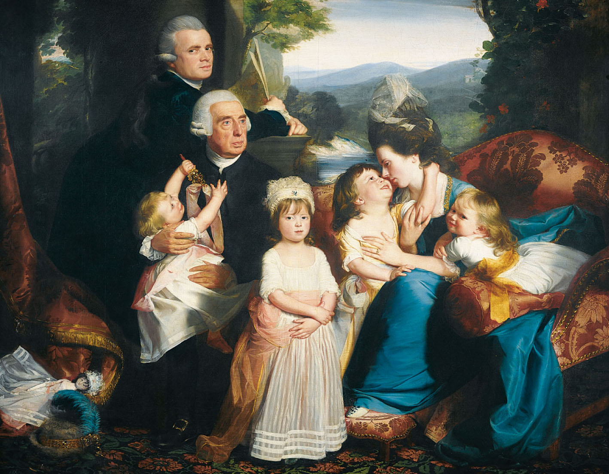
p161

Slide 21
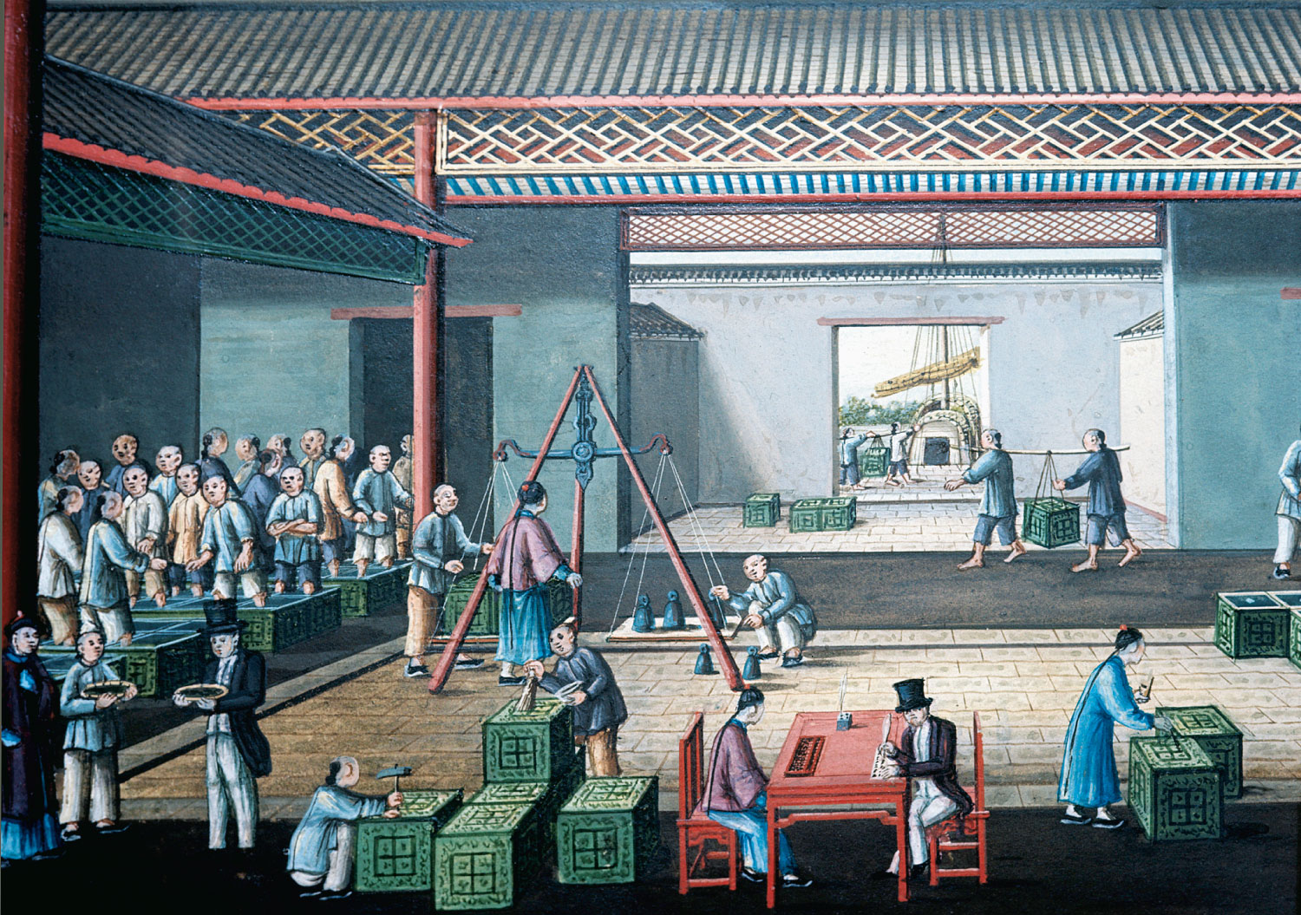
p162
Notes:
Western Merchants Negotiating for Tea in Hong Kong, ca. 1800 Yankee merchants
and shippers figured prominently in the booming trade with China in the late
eighteenth century. Among the American entrepreneurs who prospered in the China
trade was Warren Delano, ancestor of President Franklin Delano Roosevelt.

Slide 22
IV. A Shaky Start Toward Union
The Revolution placed the responsibility of creating and operating the new government squarely on the people
  What were they to do about “natural rights?”
  Disruptive forces stalked the land
  Departed Tories left the political system inclined toward experimentation and innovation
    Yet the 13 sovereign states, basically similar, enjoyed a rich political inheritance and were blessed with good political leaders.

Slide 23
V. Creating a Confederation
The Second Continental Congress:
  Little more than a conference of ambassadors
  It was totally without constitutional authority
  It did only what it dared to do
  It asserted some control over the military and foreign power.
In all respects, the 13 states were sovereign:
    They coined money, raised armies and navies, erected tariff barriers.

Slide 24
V. Creating a Confederation
(cont.)
The Articles of Confederation:
  Adopted by Congress in 1777, but were not ratified by the states until 1781
  Chief point of contention was the western lands
    6 states had no holdings beyond the Allegheny Mountains
    7, notably New York and Virginia, were favored with enormous acreage
    The land-rich states could use the trans-Allegheny tracts and pay off pensions and other debts.

Slide 25
V. Creating a Confederation
(cont.)
  Unanimous approval of the Articles by the 13 states was required:
    Starved Maryland held out until March 1, 1781, on agreement of New York to surrender its western land
    Congress pledged itself to dispose of these vast areas for the “common benefit.”
    It also promised to carve a number of “republican” states, which with time would be admitted to the union
    The pledge was fully redeemed in the Northwest Ordinance of 1787 (see Map 9.1).

Slide 26
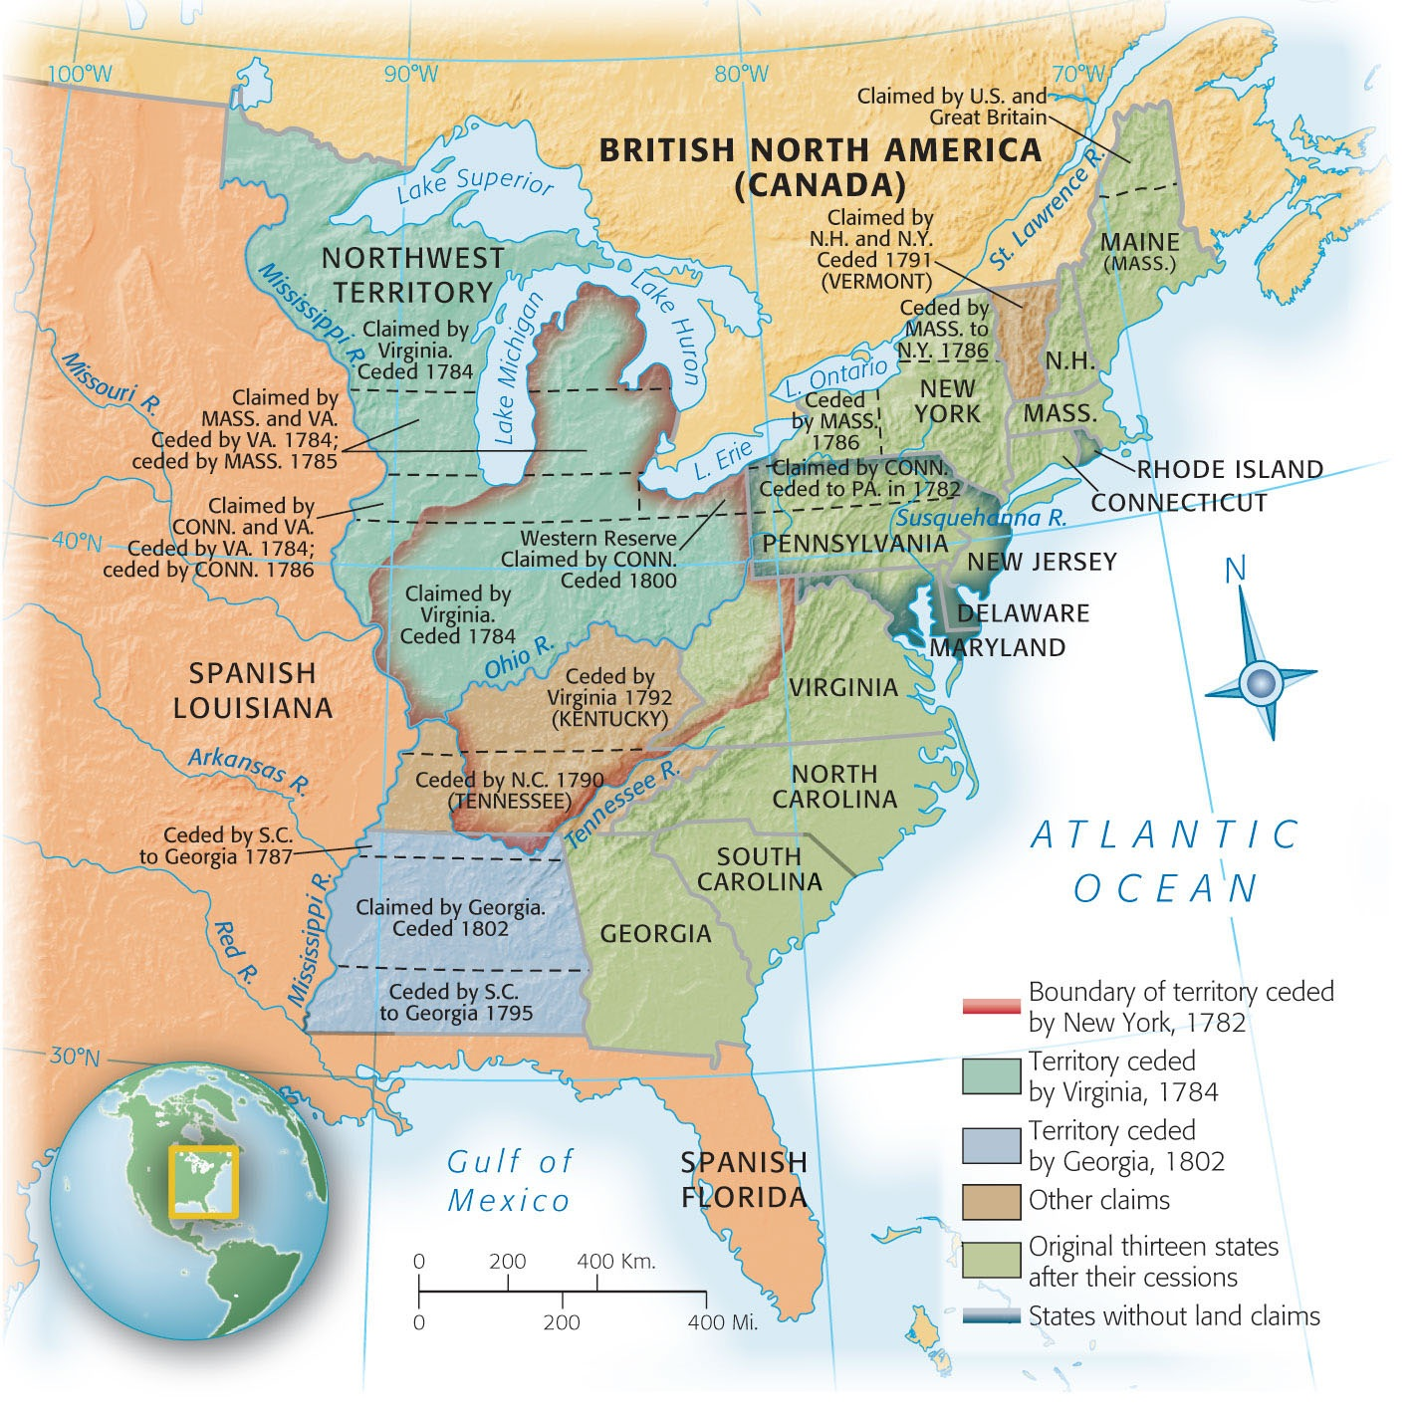
Map 9-1 p163
Notes:
Map 9.1 Western Land Cessions
to the United States, 1782–1802

Slide 27
VI. The Articles of Confederation: America’s First Constitution
The Articles of Confederation:
  Had some “Articles of Confusion”—provided for a loose confederation or “firm league of friendship”
    13 independent states were linked together to deal with common problems, such as foreign affairs
    A clumsy Congress was to be the chief agency
    There was no executive branch
    The judicial was left almost exclusively to the states.

Slide 28
VI. The Articles of Confederation: America’s First Constitution (cont.)
Congress, though dominant, was severely hobbled:
  Each state had a single vote
  All bills dealing with subjects of importance required the support of nine states
  Any amendment of the Articles themselves required unanimous ratification.
  Congress was weak—and was purposely designed to be weak.

Slide 29
VI. The Articles of Confederation: America’s First Constitution (cont.)
Two major weakness of The Articles:
  Congress had no power to regulate commerce
  Congress could not enforce its tax-collection programs.
The new government could advise, advocate and appeal:
  In dealing with independent states, it could not coerce or control.
  Nor act directly towards individual citizens.

Slide 30
VI. The Articles of Confederation: America’s First Constitution (cont.)
The new Congress, with paper power, was less effective than the Continental Congress.
  Yet, the Articles proved to be a landmark
  They were a model of a loose confederation
  The states would need to yield their sovereignty to a new recast government, that would leave them free to control their local affairs.
  The anemic Articles were a significant stepping stone toward a new constitution.

Slide 31
VI. The Articles of Confederation: America’s First Constitution (cont.)
The Articles:
  Were the first written constitution of the Republic
  Kept alive the ideal of union and held the states together
  Great leap from the old boycott Association of 1774 and the Constitution of the United States.

Slide 32
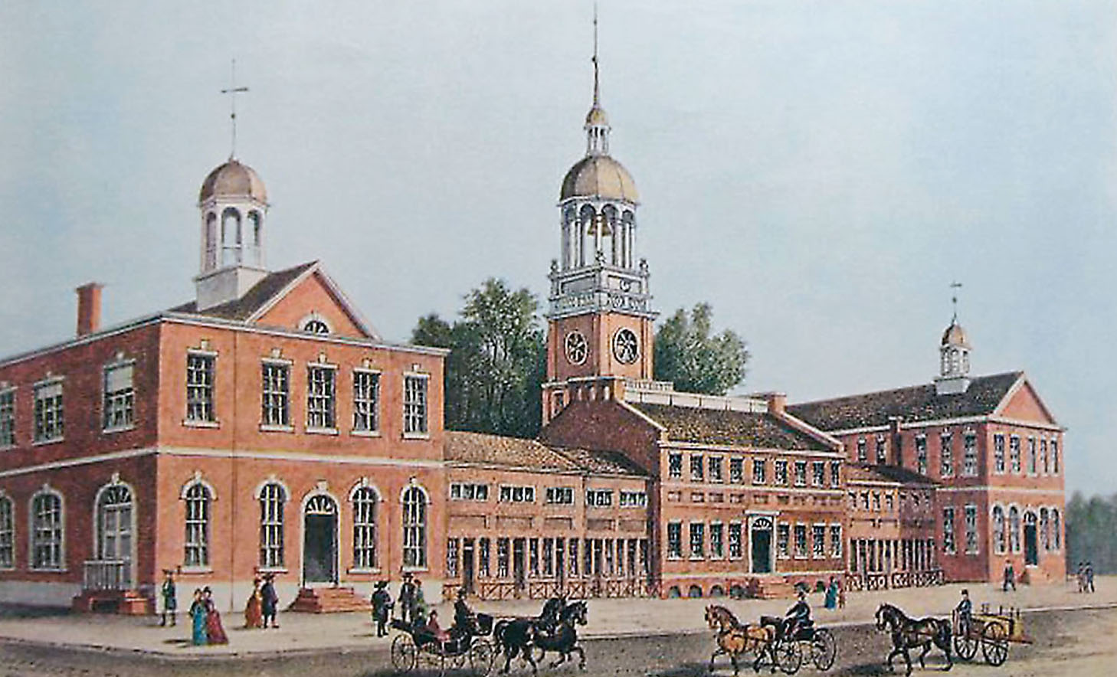
p164
Notes:
Independence Hall, Philadelphia, 1776 Originally built in the 1730s as a meeting place for
the Pennsylvania colonial assembly, this building witnessed much history: here Washington was
given command of the Continental Army, the Declaration of Independence was signed, and the
Constitution was hammered out. The building began to be called “Independence Hall” in the
1820s and is today a major tourist destination in Philadelphia.

Slide 33
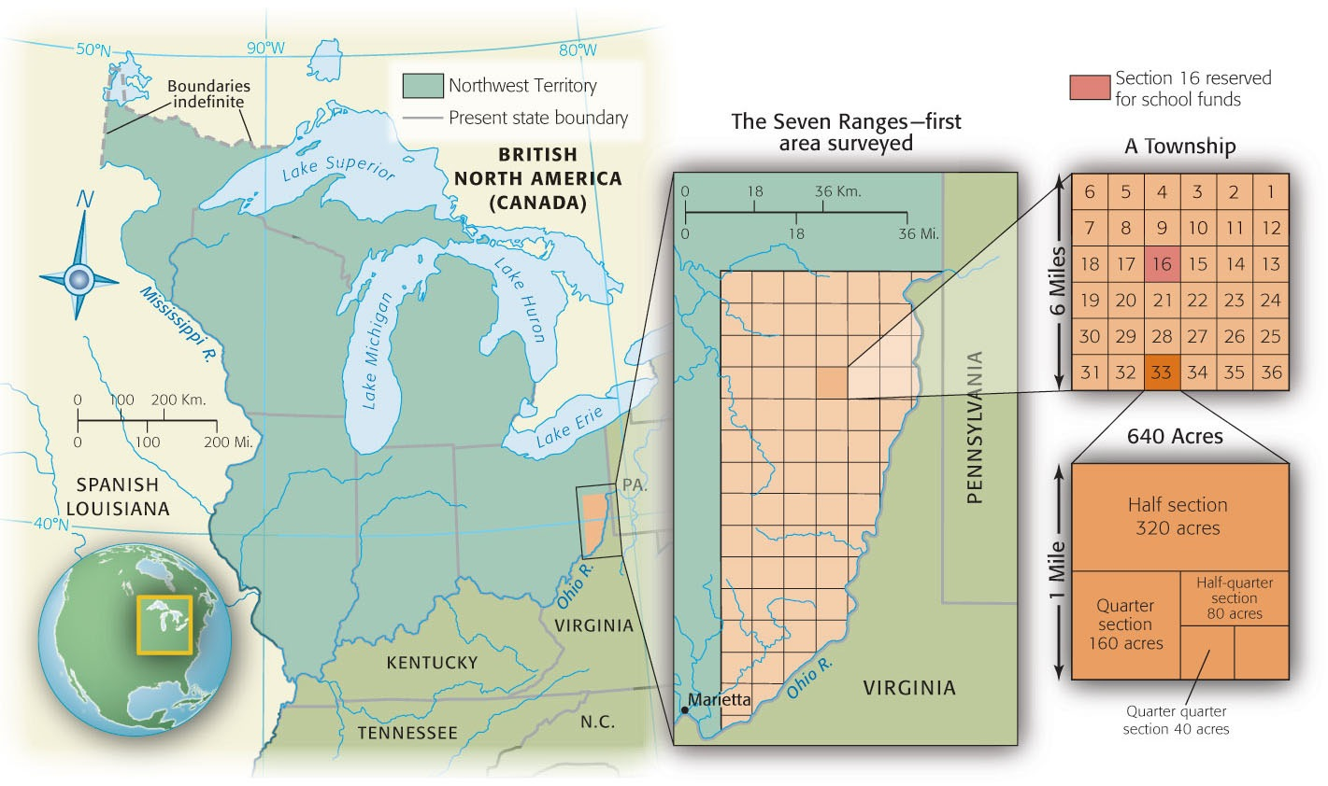
Map 9-2 p165
Notes:
Map 9.2 Surveying the Old Northwest Under the Land Ordinance of 1785 Sections
of a township under the Land Ordinance of 1785.

Slide 34
VII. Landmarks in Land Laws
Passages of public domain legislation:
  Old Northwest area northwest of the Ohio River, east of the Mississippi River, of the Great Lakes
  Land Ordinance of 1785 (see Map 9.2) provided for the acreage of the Old Northwest to be sold and the proceeds to pay the national debt
    Surveyed, then divided into townships, and finally into sections
    Sixteen sections for education.

Slide 35
VII. Landmarks in Land Laws
(cont.)
Northwest Ordinance of 1787:
  This ordinance related to the governance of the old Northwest: how a nation should deal with its colonies
    First temporary tutelage, then permanent equality
    First, two evolutionary territorial stages under the subordination of the federal government
    When a territory had 60,000 inhabitants, it might be admitted by Congress as a state
    The Ordinance forbid slavery.

Slide 36
VIII. The World’s Ugly Duckling
Foreign relations with Britain:
  Remained troubling
    Refused to send a minister to America
    Declined to make a commercial treaty or to repeal its ancient Navigation Laws
    Closed the profitable West Indies trade to the states
    Sought, with the help of the Allen brothers of Vermont, to annex that rebellious area to Britain
    The redcoats maintained a chain of trading posts
    Maintained fur trading with the Indians.

Slide 37
VIII. The World’s Ugly Duckling:
(cont.)
Spain was openly hostile to the new Republic
    She controlled the all-important Mississippi River, forcing the pioneers to float their produce
    In 1784 Spain closed the river to American commerce threatening the West with strangulation
    She claimed a large area north of the Gulf of Mexico
    Schemed with the Indians to hem in the Americans east of the Appalachians.
    Spain and Britain influenced the Indians, preventing America from exercising effective control over half of its territory (see Map 9.3).

Slide 38
VIII. The World’s Ugly Duckling
(cont.)
France, America’s friend, cooled off now that it had humbled Britain
Pirates of North Africa ravaged America’s Mediterranean commence
Britain purchased protection for their own subjects, but not for independent Americans.

Slide 39
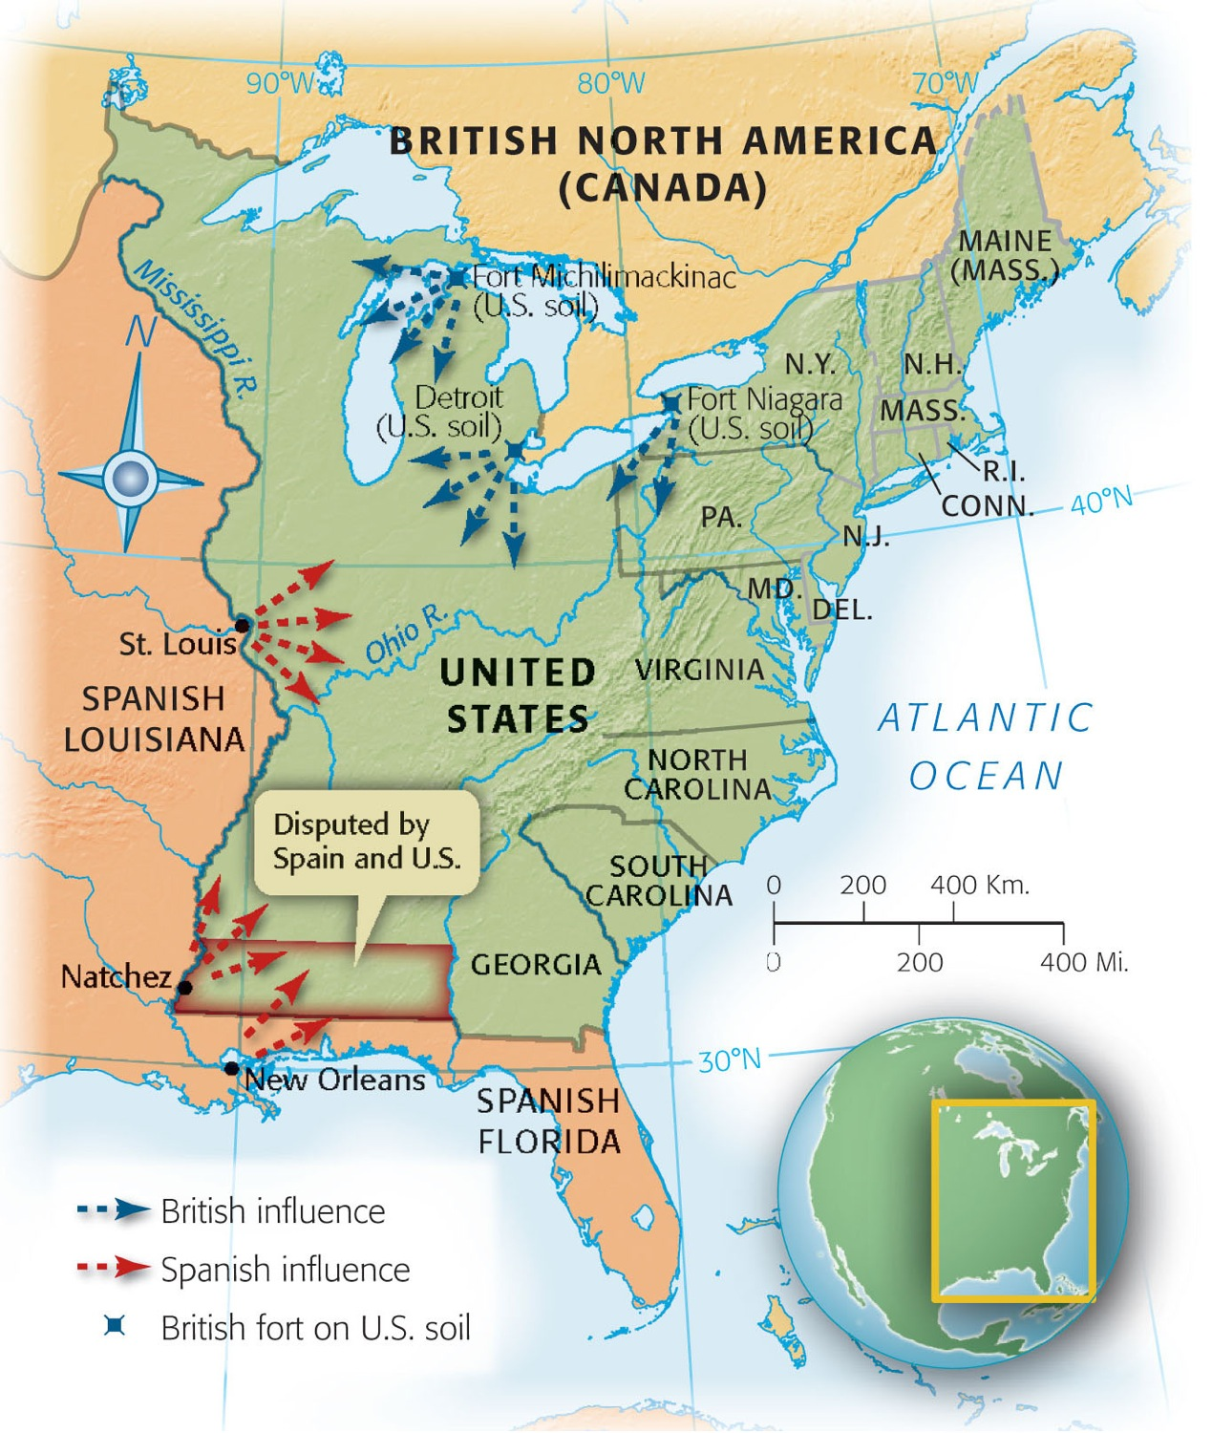
Map 9-3 p167
Notes:
Map 9.3 Main Centers of Spanish and British Influence
After 1783 This map shows graphically that the United
States in 1783 achieved complete independence in name
only, particularly in the area west of the Appalachian Mountains.
Not until twenty years had passed did the new Republic,
with the purchase of Louisiana from France in 1803, eliminate
foreign influence from the east bank of the Mississippi
River. Much of Florida remained in Spanish hands until the
Adams-Oni´s Treaty of 1819 (see p. 239–240).

Slide 40
IX. The Horrid Specter of Anarchy
Economic clouds of mid-1780s:
  Requisition of raising money was broken down
  Interest on the public debt was piling up
  Individual states were getting out of hand
  Some states were levying their own duties
  Some were printing depreciated paper money.

Slide 41
IX. The Horrid Specter of Anarchy
(cont.)
Shays’ Rebellion in western Massachusetts:
    Impoverished farmers were losing their farms through mortgage foreclosures and tax delinquencies
    Led by Captain Daniel Shays, these desperate debtors demanded:
      That the state issue paper money, lighten taxes, and suspend property takeovers
    Hundreds of angry agitators attempted to enforce these demands.
    Massachusetts authorities responded with drastic action by raising a small army skirmishes occurred, 3 Shaysites were killed 1 wounded—the movement collapsed.

Slide 42
IX. The Horrid Specter of Anarchy
(cont.)
Shays’ followers were crushed, but the nightmarish memory continued:
    The Massachusetts legislature passed debtor-relief laws
    Shays’ outburst caused fear for the propertied class
    Civic virtue was no longer to rein in self-interest and greed

Slide 43
IX. The Horrid Specter of Anarchy
(cont.)
How critical were conditions under the Confederation?
    Conservatives, protecting their wealth, exaggerated the seriousness of the nation’s plight
    They thought to amend the Articles of Confederation in favor of a muscular central government
    Some feared that a powerful federal government would force them to pay their creditors
    Both friends and critics of the Confederation agreed that it needed to be strengthened.

Slide 44
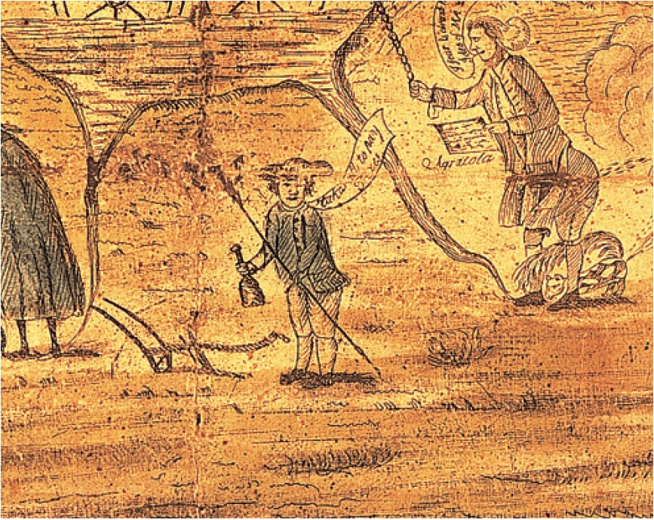
p168
Notes:
Debtors Protest, 1787 This drawing done on the eve of
the writing of the U.S. Constitution features a farmer with a
plow, a rake, and a bottle complaining, “Takes all to pay
taxes.” The discontent of debt-rich and currency-poor
farmers alarmed republican leaders and helped persuade
them that the Articles of Confederation needed to be
replaced with a new constitution.

Slide 45
X. A Convention of “Demigods”
Annapolis convention of 1786:
  Nine states appointed delegates, only 5 attended
  Alexander Hamilton saved the convention:
    He called for a convention in Philadelphia 1787
    To deal with commerce and to bolster the entire fabric of the Articles of Confederation
      Eventually Congress called for a convention “for the sole and express purpose of revising” the Articles.
    Each state chose representatives, except for independent-minded Rhode Island.

Slide 46
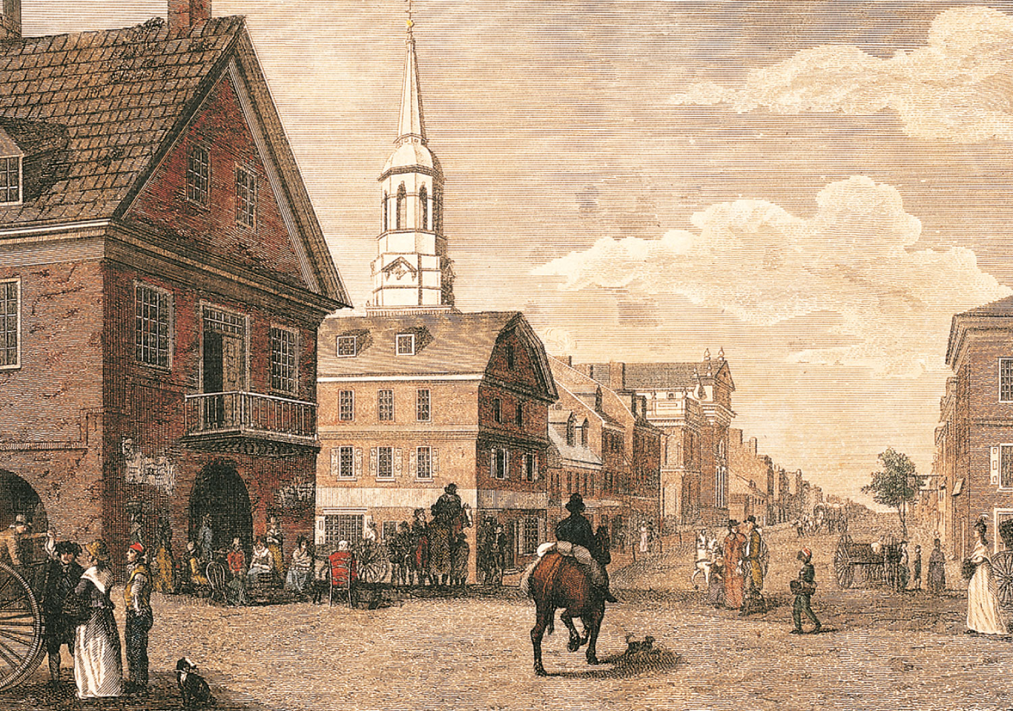
p3
Notes:
Philadelphia, Corner of Second and High Streets Delegates to the Constitutional Convention in 1787 gathered in Philadelphia, the largest city in North America, a vivid symbol of the rise of American society from its precarious beginnings at Jamestown and Plymouth nearly two centuries earlier.

Slide 47
X. A Convention of “Demigods”
(cont.)
    A quorum of 55 emissaries from 12 states convened in Philadelphia on May 25, 1787
    Sessions were held in secrecy, with armed sentinels posted at the doors.
    The caliber of the participants was extraordinarily high—“demigods,” Jefferson called them
    Most were lawyers with experience at constitution-making in their own states
    George Washington was elected chairman
    Benjamin Franklin added the urbanity of an elder statesman.

Slide 48
X. A Convention of “Demigods”
(cont.)
    James Madison’s contributions were so notable he was dubbed “the Father of the Constitution”
    Alexander Hamilton was an advocate for super- powerful central government
    Most Revolutionary leaders of 1776 were absent
    Jefferson, J. Adams and Thomas Paine in Europe
    Samuel Adams, John Hancock were not elected
    Patrick Henry was elected from Virginia, but declined, declaring he “smelled a rat.”
  The time had come to fashion a solid political system.

Slide 49
XI. Patriots in Philadelphia
The 55 delegates:
    Were a conservative, well-to-do body of lawyers, merchants, shippers, land speculators, moneylenders
    Not a single person spoke for the debtor groups
    Young (average age 42) but experienced statesmen
    Nationalists, interested in preserving the young Republic then stirring popular democracy
    Hoped to crystallized the last evaporating pools of Revolutionary idealism into a stable political structure that would endure.

Slide 50
XI. Patriots in Philadelphia
(cont.)
    Strongly desired a firm, dignified, and respected government
    Believed in republicanism but sought to protect the American experiment from weakness abroad and excesses at home
    Wanted the central government to control tariffs in order to secure commercial treaties from foreign nations
    Were determined to preserve the union, forestall anarchy, and ensure security of life and property against dangerous uprisings by the “mobocracy.”

Slide 51
XI. Patriots in Philadelphia
(cont.)
    Above all—they sought to curb the unrestrained democracy rampant in several states
    Grinding necessity extorted the Constitution from a reluctant nation
    Fear occupied the fifty-sixth chair.

Slide 52
XII. Hammering Out a Bundle of Compromises
Some delegates decided to completely scrap the old Articles of Confederation
  Despite explicit instructions from Congress to revise
  They were determined to overthrow the existing government by peaceful means (see Table 9.1).

Slide 53
XII. Hammering Out a Bundle of Compromises (cont.)
Proposals:
    Virginia Plan—“the large-state plan”: representation in both houses of a bicameral Congress should be based on population—an arrangement that was to the larger states’ advantage
    New Jersey Plan—“the small-state plan”: provided for equal representation in a unicameral Congress, regardless of size and population
  The weaker states feared that the Virginia scheme would lord it over the rest.

Slide 54
XII. Hammering Out a Bundle of Compromises (cont.)
The Great Compromise:
    The larger states were conceded representation by population in the House of Representatives (Art. I, Sec. II, para. 3 see the Appendix)
    The smaller states wee appeased by equal representation in the Senate (Art. I, Sec. III, para. 1)
    Agreed that all tax bills or revenue measures must originate in the House, where population counted more heavily (Art. I, Sec. VII, para. 1).
    The critical compromise broke the logjam.

Slide 55
XII. Hammering Out a Bundle of Compromises (cont.)
The final Constitution was:
    Short because it grew out of Anglo-American common law legal tradition which made it unnecessary to be specific
    It mostly provided a flexible guide to broad rules of procedures rather than detailed laws
    The original (unamended) Constitution contained just 7 articles and ran about 10 pages to print.

Slide 56
XII. Hammering Out a Bundle of Compromises (cont.)
The President:
    Was to have broad authority to make appointments to domestic officers—including judgeships
    Was to have veto power of legislation
    Was not to have absolute power to wage war—Congress retained the crucial right to declare war
The Constitution as drafted was a bundle of compromises
  Method of electing the president indirectly by the Electoral College rather than direct means

Slide 57
XII. Hammering Out a Bundle Compromises (cont.)
  State’s share of electors was based on the total of its senators and representatives in Congress (see Art. II, Sec. I, para. 2)
  How should slaves be counted:
    The compromise was a slave might count as three-fifths of a person—three-fifths compromise (see Art. I, Sec. II, para. 3):
    Slave trade might continue until the end of 1807 (see Art. I, Sec. IX, para 1).

Slide 58
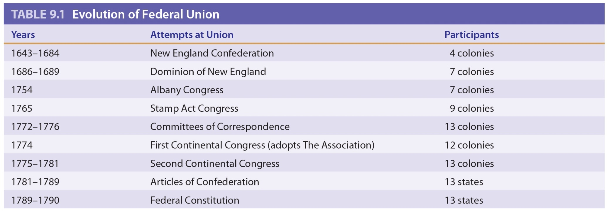
Table 9-1 p170

Slide 59
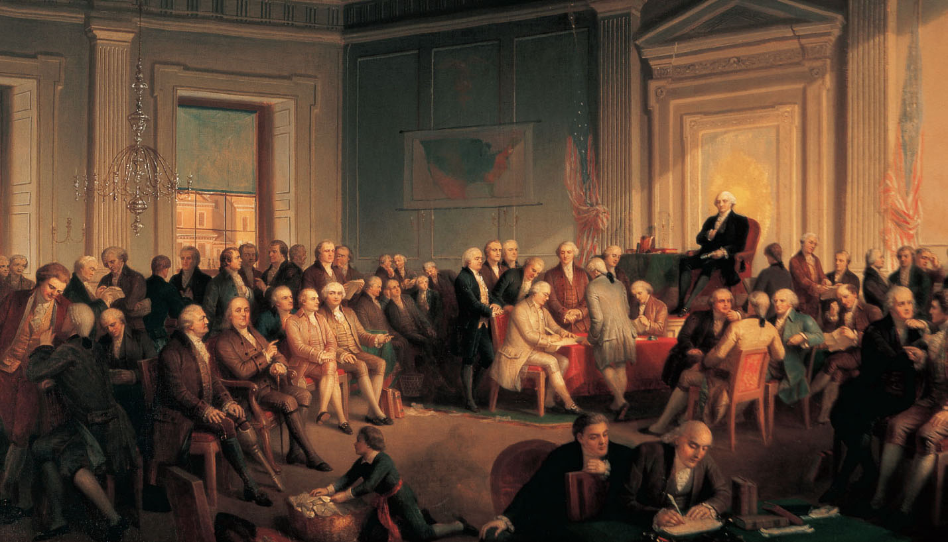
p171
Notes:
Signing of the Constitution of the United States, 1787 George Washington
presided from the dais as the Constitutional Convention’s president. At a table in the
front row sat James Madison, later called the Father of the Constitution, who recorded
the proceedings in shorthand. Daily from 10 a.m. to 3 p.m., from late May through mid-
September 1787, the fifty-five delegates wrangled over ideas for a new federal
government.

Slide 60
XIII. Safeguards for Conservatism
Agreement among delegates was large:
  Economically they generally saw eye to eye:
    They demanded sound money and the protection of private property
  Politically they were in basic agreement:
    They favored a strong government, with three branches and with checks and balances

Slide 61
XIII. Safeguards for Conservatism
(cont.)
  Other safeguards:
    The federal judges were to be appointed for life
    The powerful president was to be elected indirectly by the Electoral College
    The senators were to be chosen indirectly by state legislatures (see Art. I, Sec. III, para. 1)
    The House of Representatives—were qualified (propertied) citizens permitted to choose their officials by direct vote (see Art. 1, Sec. II, para. 1).

Slide 62
XIII. Safeguards for Conservatism
(cont.)
Democratic elements in the new charter:
  Stood on two great principles of republicanism
    That the only legitimate government was one based on the consent of the governed
    That the powers of government should be limited—in this case to a written constitution
    The virtue of the people, not the authority of the state, was to be the ultimate guarantor of liberty, justice, and order.
      After 17 weeks—May 25 to September 17, 1787—only 42 of the original 55 remained to sign the Constitution.

Slide 63
XIV. The Clash of Federalists and Antifederalists
The Framing Fathers early foresaw that nationwide acceptance of the Constitution would not be easy to obtain:
    Unanimous ratification by all 13 states according to the still-standing Articles of Confederation
    Since Rhode Island was certain to veto, the delegates stipulated when 9 states had approved through specifically elected conventions, the Constitution would be the supreme law of the land in those states ratifying (see Art. VII).

Slide 64
XIV. The Clash of Federalists and Antifederalists (cont.)
The American people were now handed a new document (see Table 9.2):
  The antifederalists—those who opposed the stronger federal government
  The federalists—those supported a strong federal government.
    Antifederalists—Samuel Adams, Patrick Henry, Richard Henry Lee were states’ rights devotees (see Map 9.4), also backcountry dwellers, one-horse farmers, paper-moneyites and debtors.

Slide 65
XIV. The Clash of Federalists and Antifederalists (cont.)
  Federalists were George Washington, Benjamin Franklin, those who lived on the seaboard, wealthy, educated, better organized.
  The antifederalists voiced vehement objections to the “gilded trap” known as the Constitution.

Slide 66
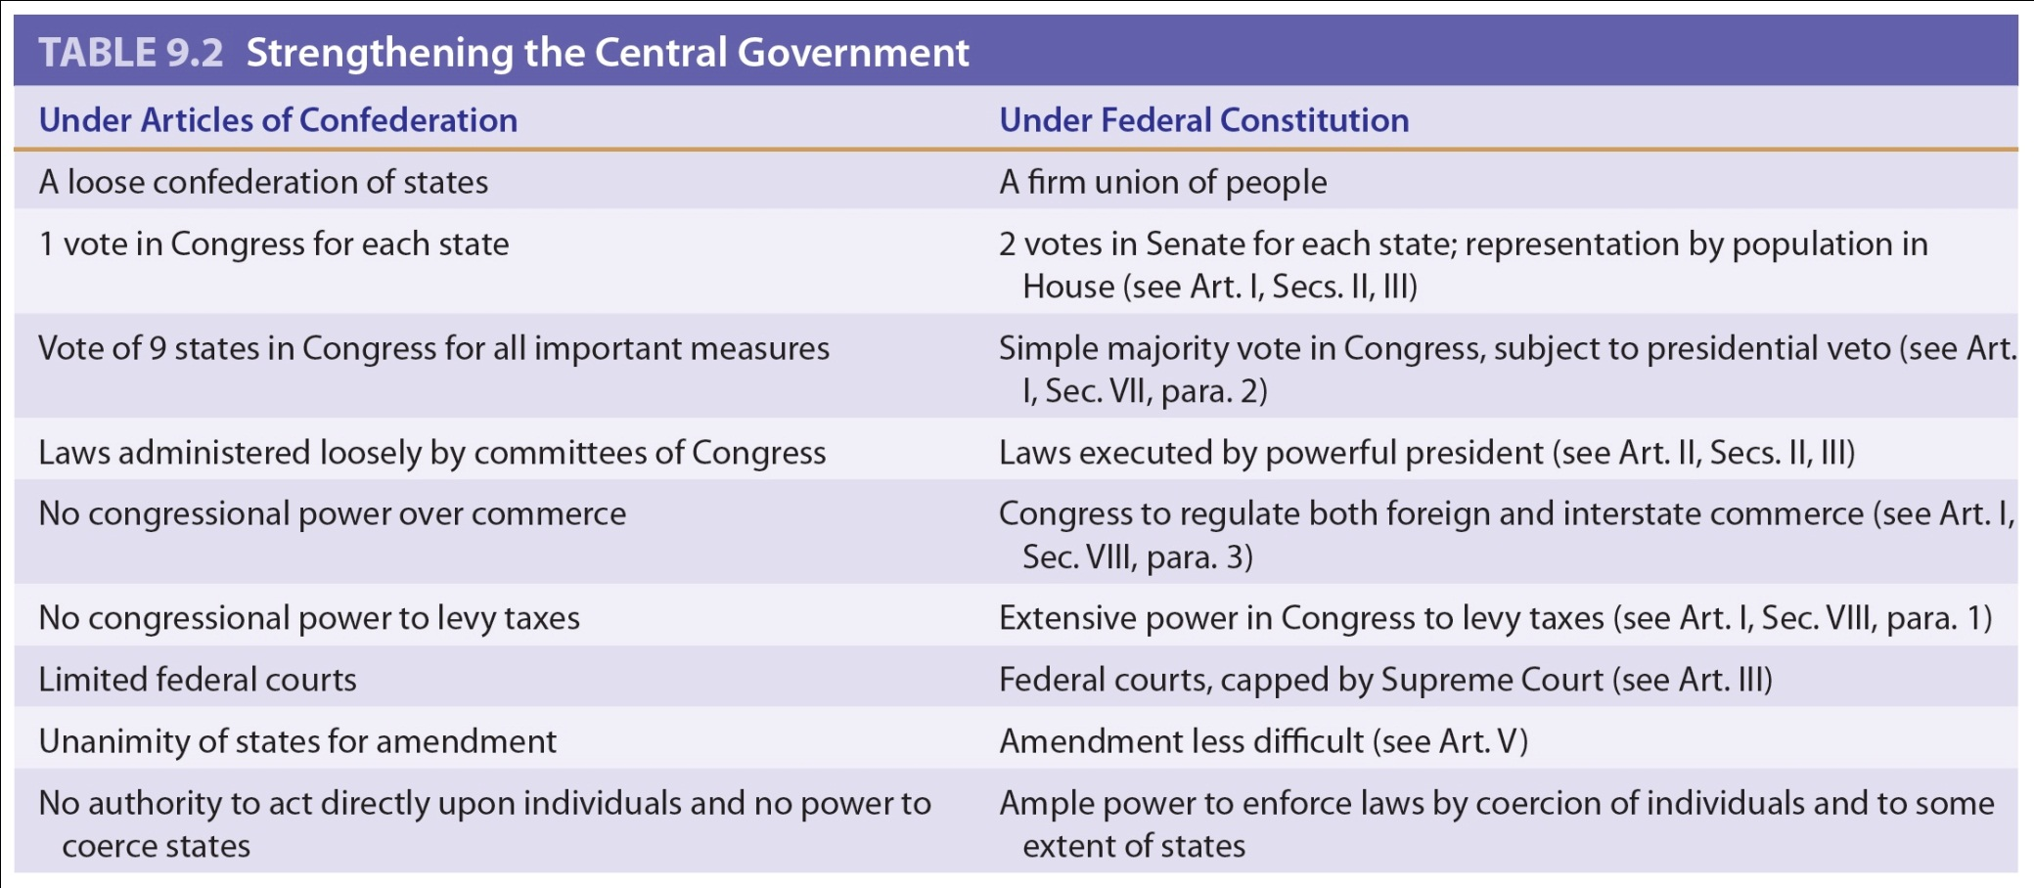
Table 9-2 p173

Slide 67
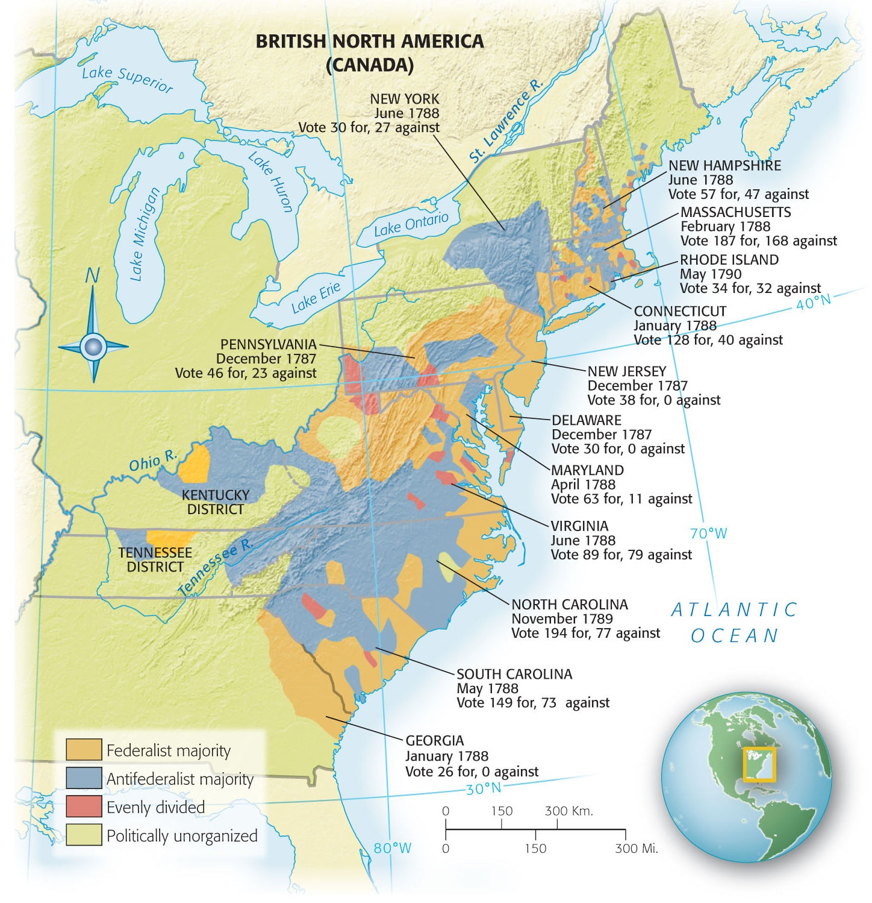
Map 9-4 p174
Notes:
Map 9.4 The Struggle over
Ratification This mottled map
shows that federalist support
tended to cluster around the
coastal areas, which had enjoyed
profitable commerce with the
outside world, including the
export of grain and tobacco.
Impoverished frontiersmen,
suspicious of a powerful new
central government under the
Constitution, were generally
antifederalists.

Slide 68
XV. The Great Debate in the States
Special elections were held for members of the ratifying conventions (see Table 9.3)
  The candidates—federalist or antifederalist—were elected based on whether they were for or against the Constitution
    Four small states quickly accepted the Constitution
    Pennsylvania was number two to ratify
    Massachusetts prevented challenges, one of many was the demand for a bill of rights.

Slide 69
XV. The Great Debate in the States
(cont.)
  Massachusetts ratified by a margin of 187 to 168
  Three more states signed
  New Hampshire was the last.
  All, but Virginia, New York, North Carolina, and Rhode Island had taken shelter under the “new federal roof”
  The document was officially signed on June 21, 1788.

Slide 70
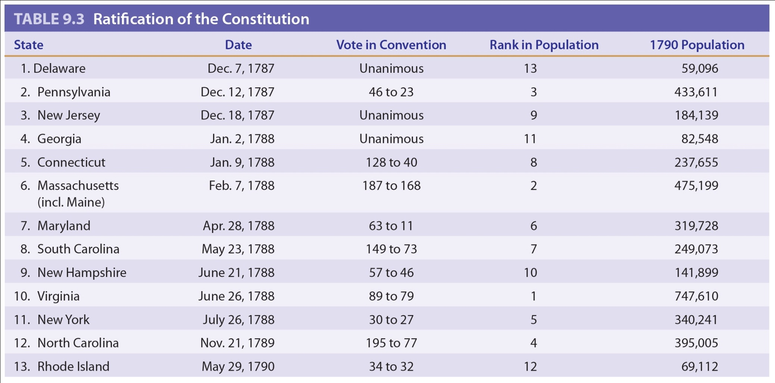
Table 9-3 p175

Slide 71
XVI. The Four Laggard States
Virginia:
    Provided fierce antifederalist opposition
    They saw in the fearsome document the death warrant of liberty
    G. Washington, J. Madison, and John Marshall, federalists lent influential support
New Hampshire:
    After exciting debate in the state convention, ratified it 89 to 79.

Slide 72
XVI. The Four Laggard States
(cont.)
New York:
    Alexander Hamilton finally supported the federalism as framed
    He joined John Jay and James Madison in a series of articles for the New York newspapers
    Called The Federalist Papers, were the most penetrating commentary ever written on the Constitution.
    The most famous one is Madison’s Federalist No. 10.
    It brilliantly refuted that it was impossible to extend a republican form of government over a large territory.

Slide 73
XVI. The Four Laggard States
(cont.)
  New York finally yielded, ratifying by the close count of 30 to 27
  North Carolina, after a hostile convention, adjourned without taking a vote
  Rhode Island didn’t summon a ratifying convention, rejected the Constitution by popular referendum
  The two most ruggedly individualist centers remained true to form.

Slide 74
XVI. The Four Laggard States
(cont.)
No lives were lost, but riotous disturbances broke out in New York and Pennsylvania.
There was much behind-the-scenes pressure on delegates who had promised their constituents to vote against the Constitution.
The last four states ratified, not because they wanted to but because they had to
They could not safely exist outside the fold.

Slide 75
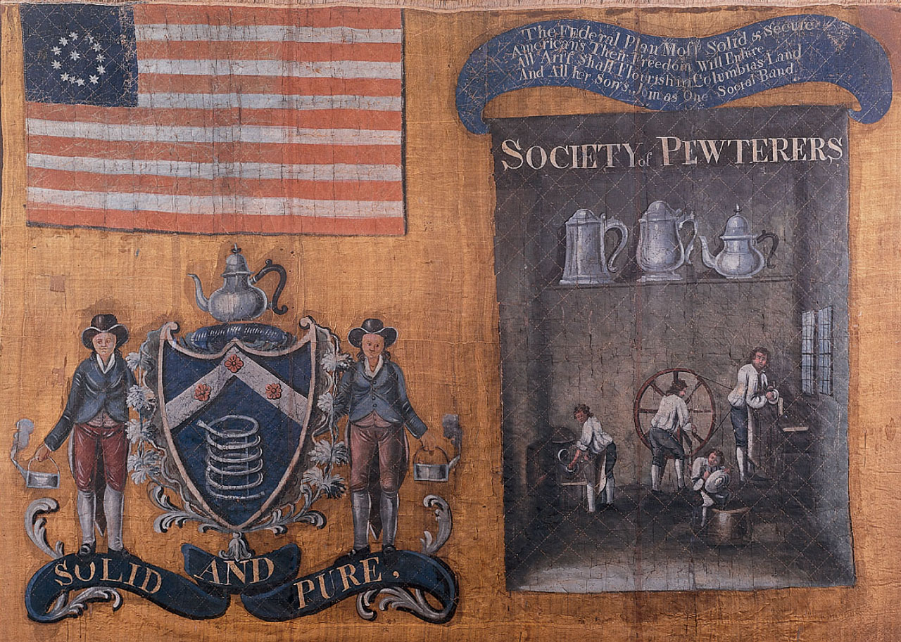
p176
Notes:
Banner Paraded by the Society
of Pewterers in New York City,
1788 This silk banner was carried
by members of the Society of
Pewterers in a parade in New York
City, on July 23, 1788, to celebrate
the impending ratification of the
United States Constitution by New
York State. The enthusiasm of these
craftsmen for the Constitution
confirms that not all federalists
were well-to-do.

Slide 76
XVII. A Conservative Triumph
The minority had triumphed—twice:
  A militant radical minority engineered the military Revolution that cast off the British constitution
  A militant minority of conservatives had engineered the peaceful revolution that overthrew the inadequate Articles of Confederation.
  A majority had not spoken.

Slide 77
XVII. A Conservative Triumph
(cont.)
    Only ¼ adult white males had voted for delegates to the ratifying conventions
    Conservatism was victorious
    The principles of republican government were conserved through a redefinition of popular sovereignty
    There was a self-limiting system of checks and balances among the branches and the Constitution reconciled the conflicting principles of liberty and order.
    A marvelous achievement.

Slide 78
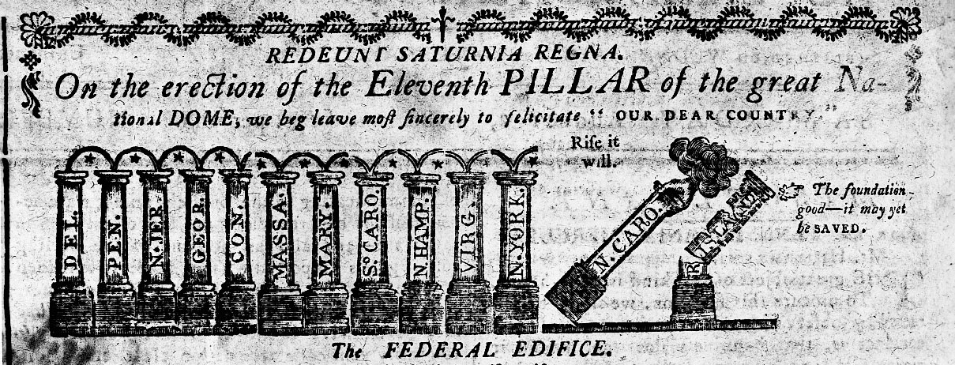
p176
Notes:
A Triumphant Cartoon
This cartoon appeared in the
Massachusetts Centinel on
August 2, 1788. Note the two
laggards, especially the sorry
condition of Rhode Island.

Slide 79
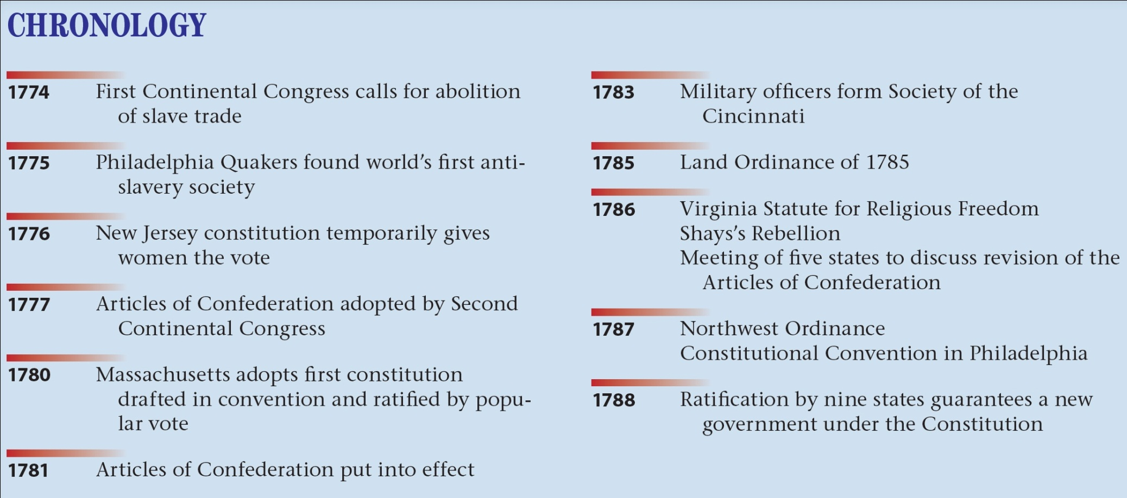
p179

