Slide 1
Chapter 11
The Triumphs and Travails of the Jeffersonian Republic, 1800–1812

Slide 2
I. Federalist and Republican Mudslingers
  In fighting for survival, the Federalists labored under heavy handicaps:
    Alien and Sedition Acts aroused a host of enemies
    The refusal of Adams to give them a rousing fight with France
    Their feverish war preparations had swelled the federal debt and required new taxes including a stamp tax

Slide 3
I. Federalist and Republican Mudslingers (cont.)
    The war scare had petered out, and the country was left with an all-dressed-up-but-no-place-to-go feeling
    Military preparations were not only unnecessary but extravagant
  The Federalists concentrated their fire on Jefferson himself:
    He became the victim of rumors:
      Robbing a widow and her children of a trust fund
      Fathering numerous mulatto children by his slave women
      Long intimacy with Sally Hemings.

Slide 4
I. Federalist and Republican Mudslingers (cont.)
  A liberal in religion, supported separation of church and state in his native Virginia
  He did believe in God, but preachers throughout New England thundered against his atheism.

Slide 5
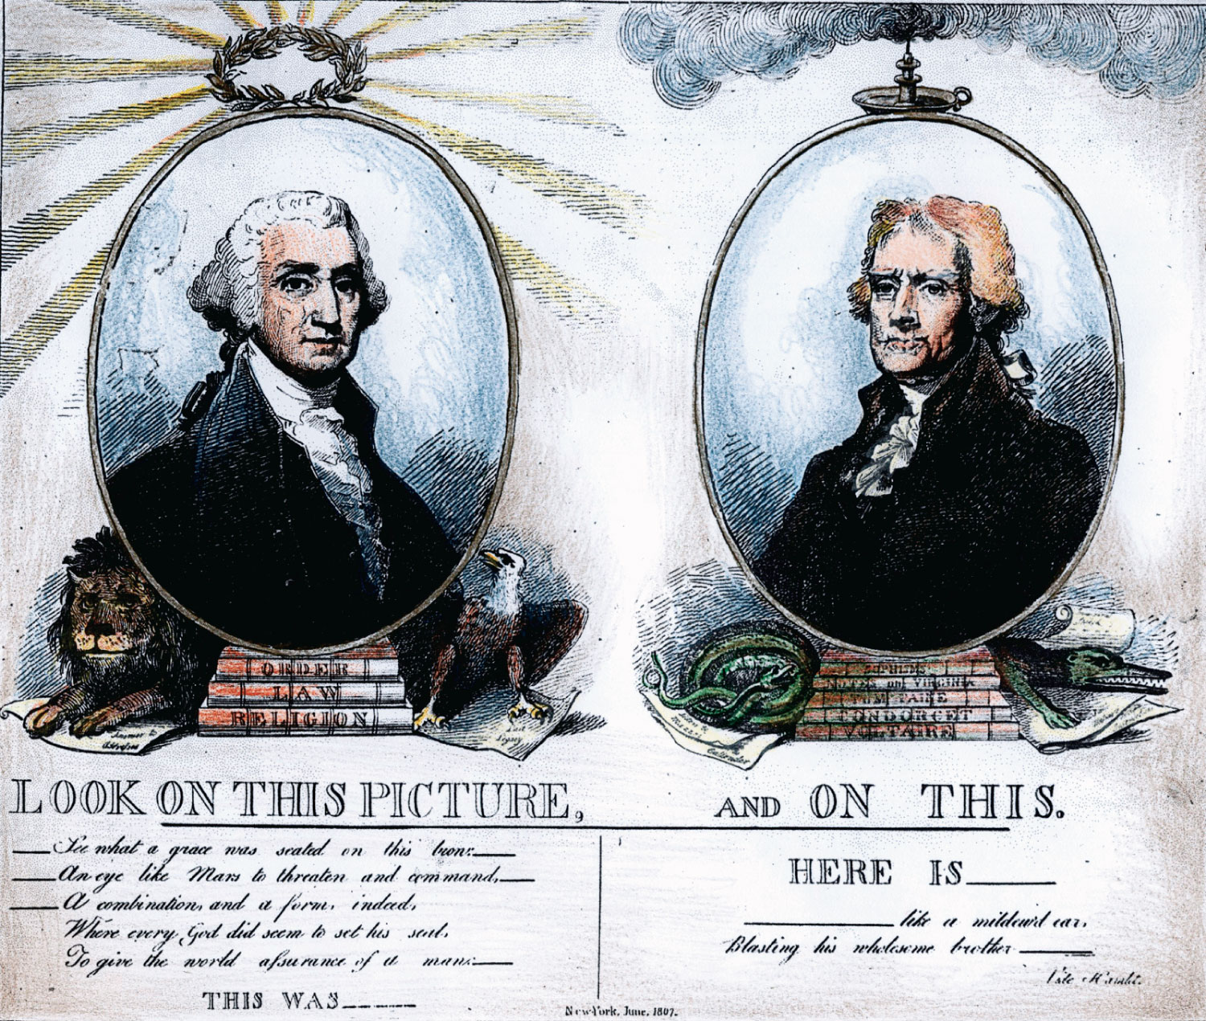
p203
Notes:
Washington and
Jefferson Compared,
1807 This pro-
Federalist, anti-Jefferson
cartoon accuses Jefferson
of sympathizing with
French Revolutionary
despotism.

Slide 6
II. The Jeffersonian “Revolution of 1800”
Jefferson won by a majority of 73 electoral votes to 65 (see Map 11.1)
  New York fell in Jeffersonian basket, largely because of Aaron Burr
  Pull the most of his strength in the South and West
  Decisive in Jefferson’s victory was the 3/5 clause of the Constitution

Slide 7
II. The Jeffersonian “Revolution of 1800” (cont.)
  Jefferson’s victory was dampened by an unexpected deadlock:
    Jefferson, the presidential candidate, and Burr, the vice-presidential candidate, received the same number of electoral votes for the presidency
    Under the Constitution the tie could be broken only by the House of Representatives (see Art. II, Sec. I. para. 2)
      House was controlled by Federalists who preferred Burr
      Jefferson, after some time and changing thinking, won the vote to make him the president.

Slide 8
II. The Jeffersonian “Revolution of 1800” (cont.)
Sometimes referred to as the Revolution of 1800:
  It was no revolution in the sense of the word
  Jefferson narrowly squeaked to victory
  He saw his mission:
    to restore the republican experience
    To check the growth of government power
    To halt the decay of virtue

Slide 9
II. The Jeffersonian “Revolution of 1800” (cont.)
  No less “revolutionary” was the peaceful and orderly transfer of power:
    This was a remarkable achievement for a raw young nation
    It was particularly remarkable in that comparable act would not have taken place in Britain
  Americans could take justifiable pride in the vigor of their experiment in democracy.

Slide 10
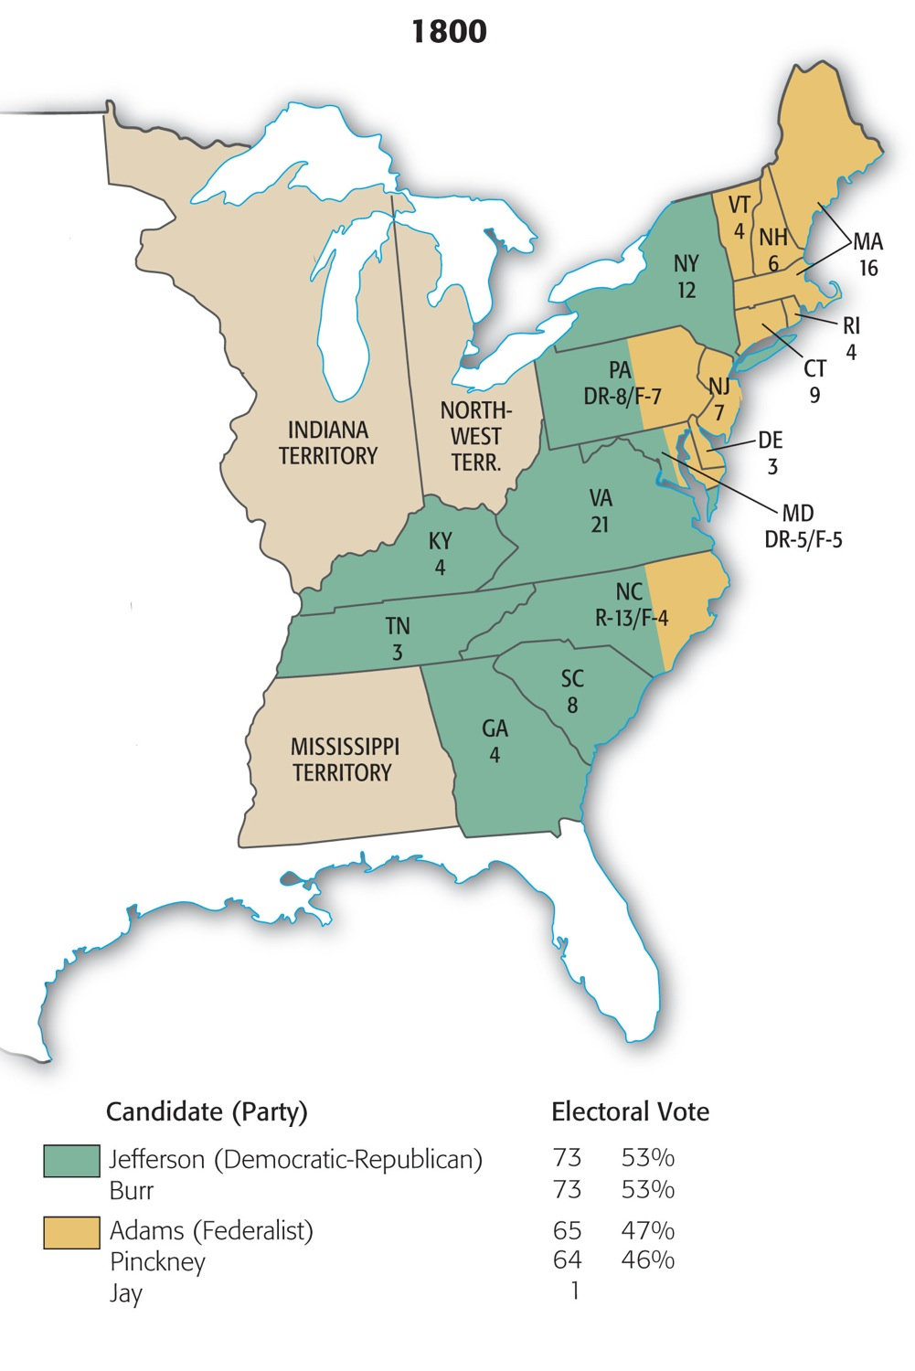
Map 11-1 p204
Notes:
Map 11.1 Presidential Election of 1800 (with electoral
vote by state) New York was the key state in this election,
and Aaron Burr helped swing it away from the Federalists
with tactics that anticipated the political “machines” of a later
day. Federalists complained that Burr “travels every night
from one meeting of Republicans to another, haranguing . . .
them to the most zealous exertions. [He] can stoop so low as
to visit every low tavern that may happen to be crowded with
his dear fellow citizens.” But Burr proved that the price was
worth it. “We have beat you,” Burr told kid-gloved Federalists
after the election, “by superior Management.”

Slide 11
III. Responsibility Breeds Moderation
“Long Tom” Jefferson was inaugurated president on March 4, 1801:
  In the swampy village of Washington, the crude new national capital
  He spurned a horse-drawn coach and strode by foot to the Capitol from his boardinghouse
  His inaugural address:
    Beautifully phrased, was a classic statement of democratic principles

Slide 12
III. Responsibility Breeds Moderation (cont.)
  Washington lent itself admirably to the simplicity and frugality of the Jeffersonian Republicans:
    Contrasted to the elegant atmosphere of Federalist Philadelphia, the former temporary capital
    He extended democratic principles to etiquette
      Established the rule of pell-mell at official dinners—that is, seating without regard to rank.
    He was shockingly unconventional in receiving guests
    He started the precedent of sending messages to Congress to be read by a clerk

Slide 13
III. Responsibility Breeds Moderation (cont.)
Jefferson was forced to reverse many of the political principles he had so vigorously championed:
  One was the scholarly private citizen, who philosophized in his study
  The other was the harassed public official
  The open-minded Virginian was therefore consistently inconsistent; it is easy to quote one Jefferson to refute the other.

Slide 14
III. Responsibility Breeds Moderation (cont.)
Jefferson’s Democratic-Republicans and the eviction of Federalists marked the first party overturn in American history.
  Jefferson showed unexpected moderation
  He dismissed few public servants for political reasons
  Patronage-hungry Jeffersonians watched the Federalist appointees grow old in office and “few die, none resign”

Slide 15
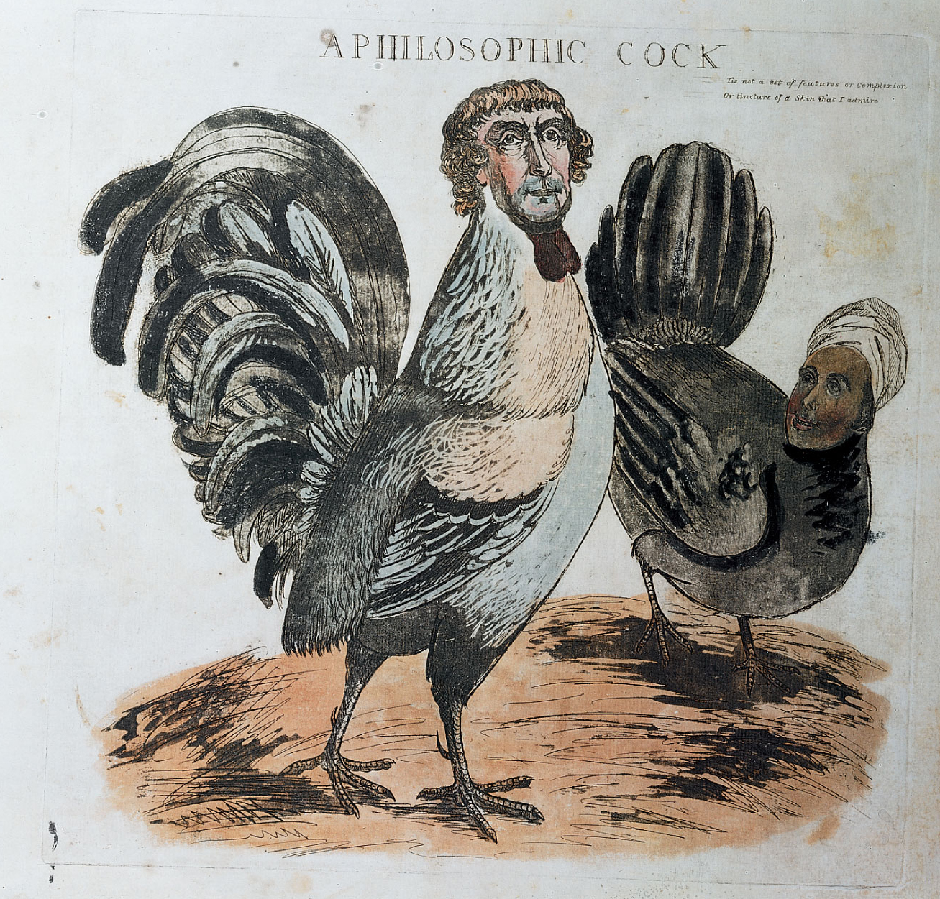
p205

Slide 16
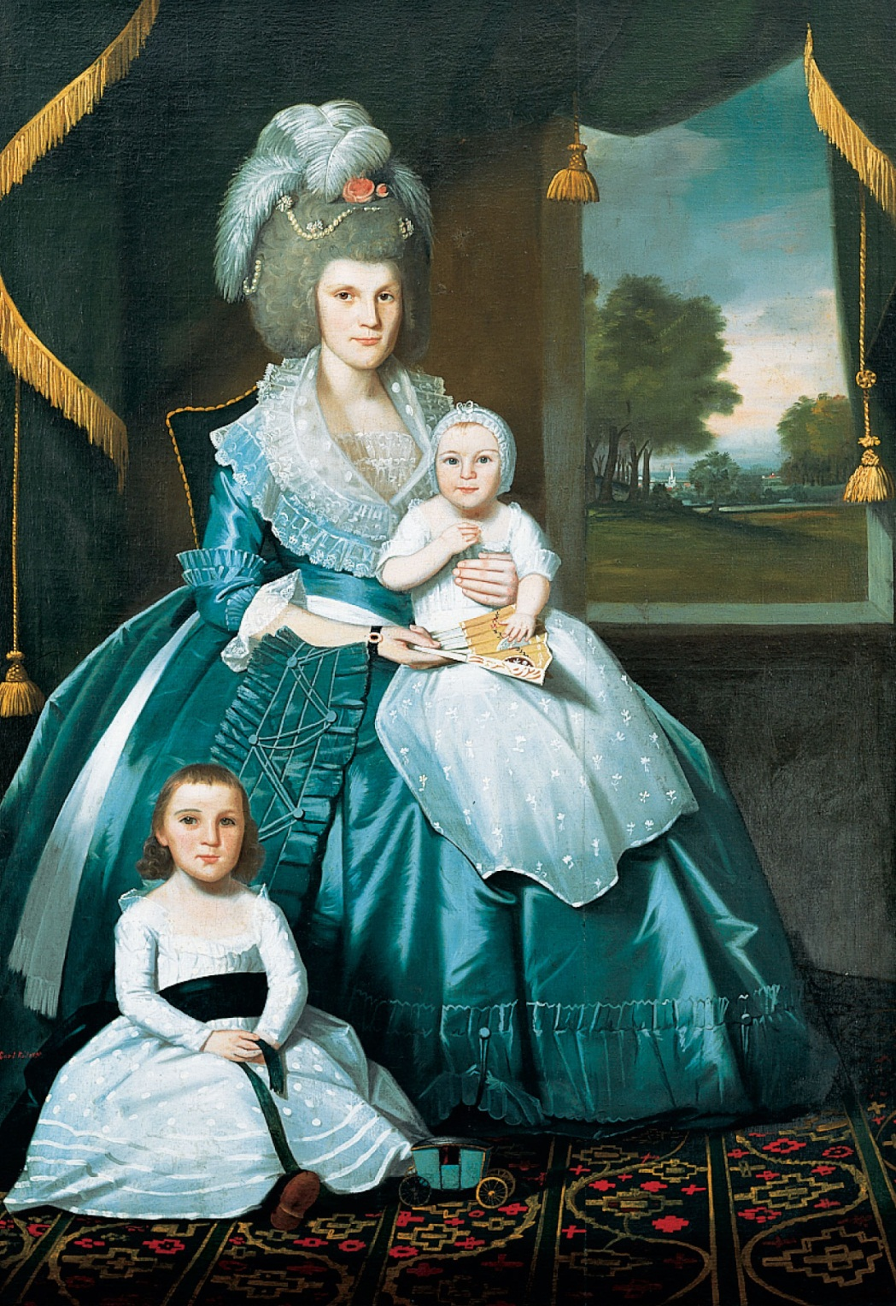
p206
Notes:
Mrs. Benjamin Tallmadge and Son Henry Floyd and Daughter Maria Jones
Colonel Benjamin Tallmadge and Son William Tallmadge, by Ralph Earl, 1790
The Tallmadges were among the leading citizens of Litchfield, a Federalist stronghold in
the heavily Federalist state of Connecticut. Colonel Benjamin Tallmadge served with
distinction in the Revolutionary War, became a wealthy merchant and banker, and
represented his state in Congress from 1801 to 1817. Mary Floyd Tallmadge, like her
husband, came from a prominent Long Island family. The opulence of the Tallmadges’
clothing and surroundings in these paintings abundantly testifies to the wealth, and the
social pretensions, of the Federalist elite. Note the toy carriage near the feet of the
Tallmadge daughter—a replica of the actual, and elegant, carriage owned by the
Tallmadge family.

Slide 17
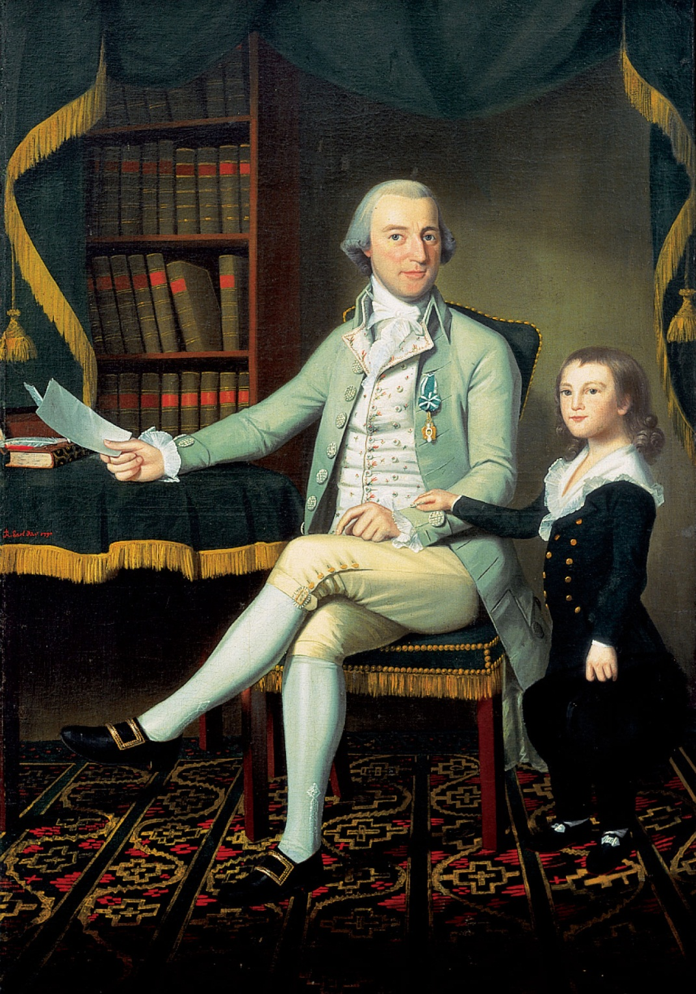
p206
Notes:
Mrs. Benjamin Tallmadge and Son Henry Floyd and Daughter Maria Jones
Colonel Benjamin Tallmadge and Son William Tallmadge, by Ralph Earl, 1790
The Tallmadges were among the leading citizens of Litchfield, a Federalist stronghold in
the heavily Federalist state of Connecticut. Colonel Benjamin Tallmadge served with
distinction in the Revolutionary War, became a wealthy merchant and banker, and
represented his state in Congress from 1801 to 1817. Mary Floyd Tallmadge, like her
husband, came from a prominent Long Island family. The opulence of the Tallmadges’
clothing and surroundings in these paintings abundantly testifies to the wealth, and the
social pretensions, of the Federalist elite. Note the toy carriage near the feet of the
Tallmadge daughter—a replica of the actual, and elegant, carriage owned by the
Tallmadge family.

Slide 18
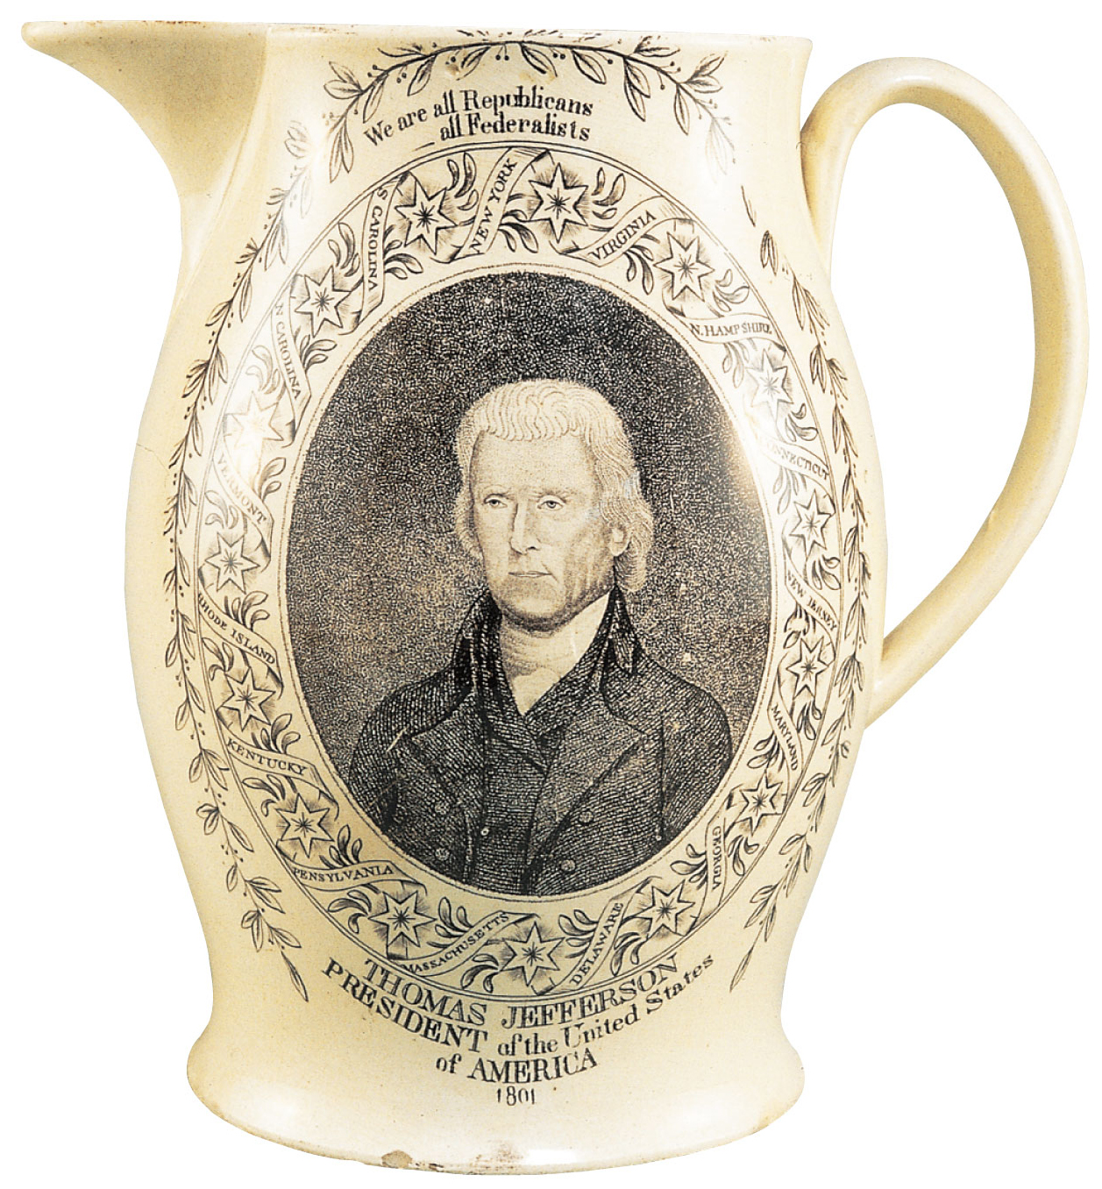
p207
Notes:
Jefferson Inaugural Pitcher, 1801 This memento from
the election of 1800 immortalized President Thomas
Jefferson’s words, “We are all Republicans, we are all
Federalists,” which turned out to be more hopeful than
true. Jefferson was portrayed in the plain attire he favored,
shunning the sartorial pretensions affected by many
Federalists, such as the elegantly dressed Tallmadges
shown on p. 206.

Slide 19
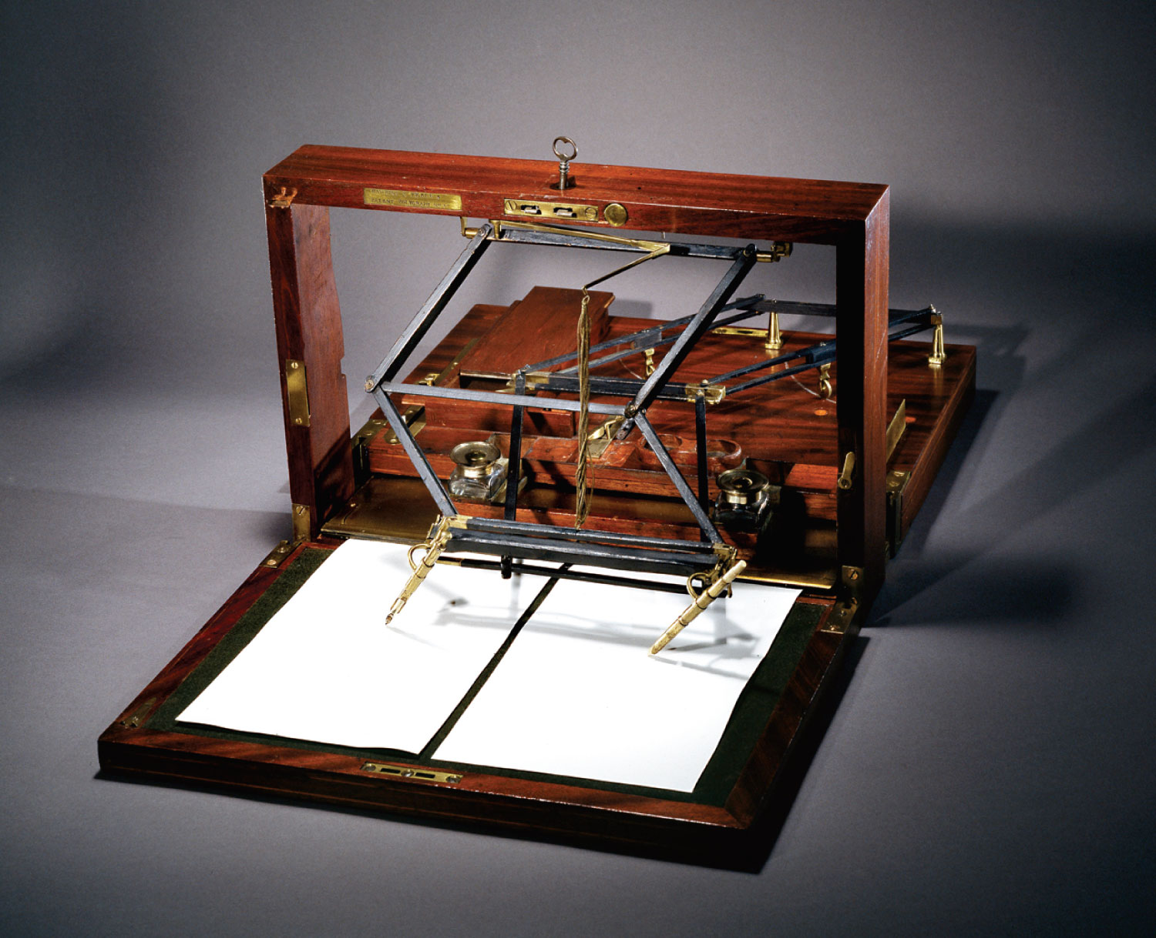
p207
Notes:
Thomas Jefferson’s Polygraph, 1806 Jefferson’s study
reflected his fondness for ideas and inventions. One of his
favorite devices was this polygraph, which Jefferson used
to make copies of the letters he penned. It was patented in
London in 1803. Jefferson acquired one the following year.
“From sun-rise to one or two o’clock,” he noted, “I am
drudging at the writing table.” Jefferson wrote almost
20,000 letters in his lifetime. He told John Adams that he
suffered “under the persecution of letters,” calculating that
he received 1,267 letters in the year 1820, “many of them
requiring answers of elaborate research, and all to be
answered with due attention and consideration.” The
polygraph allowed him to keep duplicates of his letters,
which he tied into bundles organized alphabetically and
chronologically. Jefferson was thereby able to locate any
given letter and even send for a particular one when he
was away from his Monticello home.

Slide 20
IV. Jeffersonian Restraint
At the outset Jefferson was determined to undo the Federalist abuses:
  The hated Alien and Sedition Acts had expired
  Pardoned the “martyrs” who were serving sentences under the Sedition Act
    and the government remitted many fines
  Jeffersonians enacted the new naturalization law of 1802:
      It reduced the requirement of 14 years of residence back to the requirement of 5 years.

Slide 21
IV. Jeffersonian Restraint
(cont.)
He had Congress repeal the excise tax.
Albert Gallatin proved to be an able secretary of the Treasury
  He agreed with Jefferson that a national debt was a bane rather than a blessing
  By strict economy they reduced substantially the debt while balancing the budget
  The Jeffersonians left the Hamiltonian framework essentially intact.

Slide 22
IV. Jeffersonian Restraint
(cont.)
  They did not temper with the Federal program for funding the national debt at par and assuming the Revolutionary War debts of the states
  They launched no attack on the Bank of the United States, nor did they repeal the mildly protective Federal tariff
    In future years Federalism rechartered a bigger bank and bolstered the protective tariff to higher levels.
    Jefferson’s moderation furthered the “Revolution.”

Slide 23
V. The “Dead Clutch” of the Judiciary
Judiciary Act of 1801
  One of the last laws passed by the Federalists
    It created sixteen new federal judgeships and other judicial offices
    Adams remained until he signed the commission for the Federalist “midnight judges.”
  It aroused bitter resentment:
    “Packing” lifetime posts with anti-Jeffersonians.
  The new elected Congress repealed the Judiciary Act of 1801 the year after its passage.

Slide 24
V. The “Dead Clutch” of the Judiciary (cont.)
Jeffersonians were also after Chief Justice John Marshall:
  He had dominated the Supreme Court with his powerful intellect and personality
  He shaped the American legal tradition more profoundly than any other single figure
  He was committed to strengthen the power of the federal government
  He served 34 years under various presidents

Slide 25
V. The “Dead Clutch” of the Judiciary (cont.)
The “midnight judges” presented Marshall with a historical opportunity:
    William Marbury was appointed a justice of the peace by Adams
    He sued when he learned that his commission would not be delivered
    Chief Justice Marshall dismissed Marbury’s suit
    Marbury v. Madison (1803) clouded the question of who had the final authority to determine the meaning of the Constitution

Slide 26
V. The “Dead Clutch” of the Judiciary (cont.)
  Marshall promoted the principle of “judicial review”—
    The idea that the Supreme Court alone had the last word on the question of constitutionality
    Marshall inserted the keystone into the arch that supports the tremendous power of the Supreme Court in American life
  Jefferson urged the impeachment of Supreme Court justice Samuel Chase on “high crimes.”
  The impeachment failed, no future attempts.

Slide 27
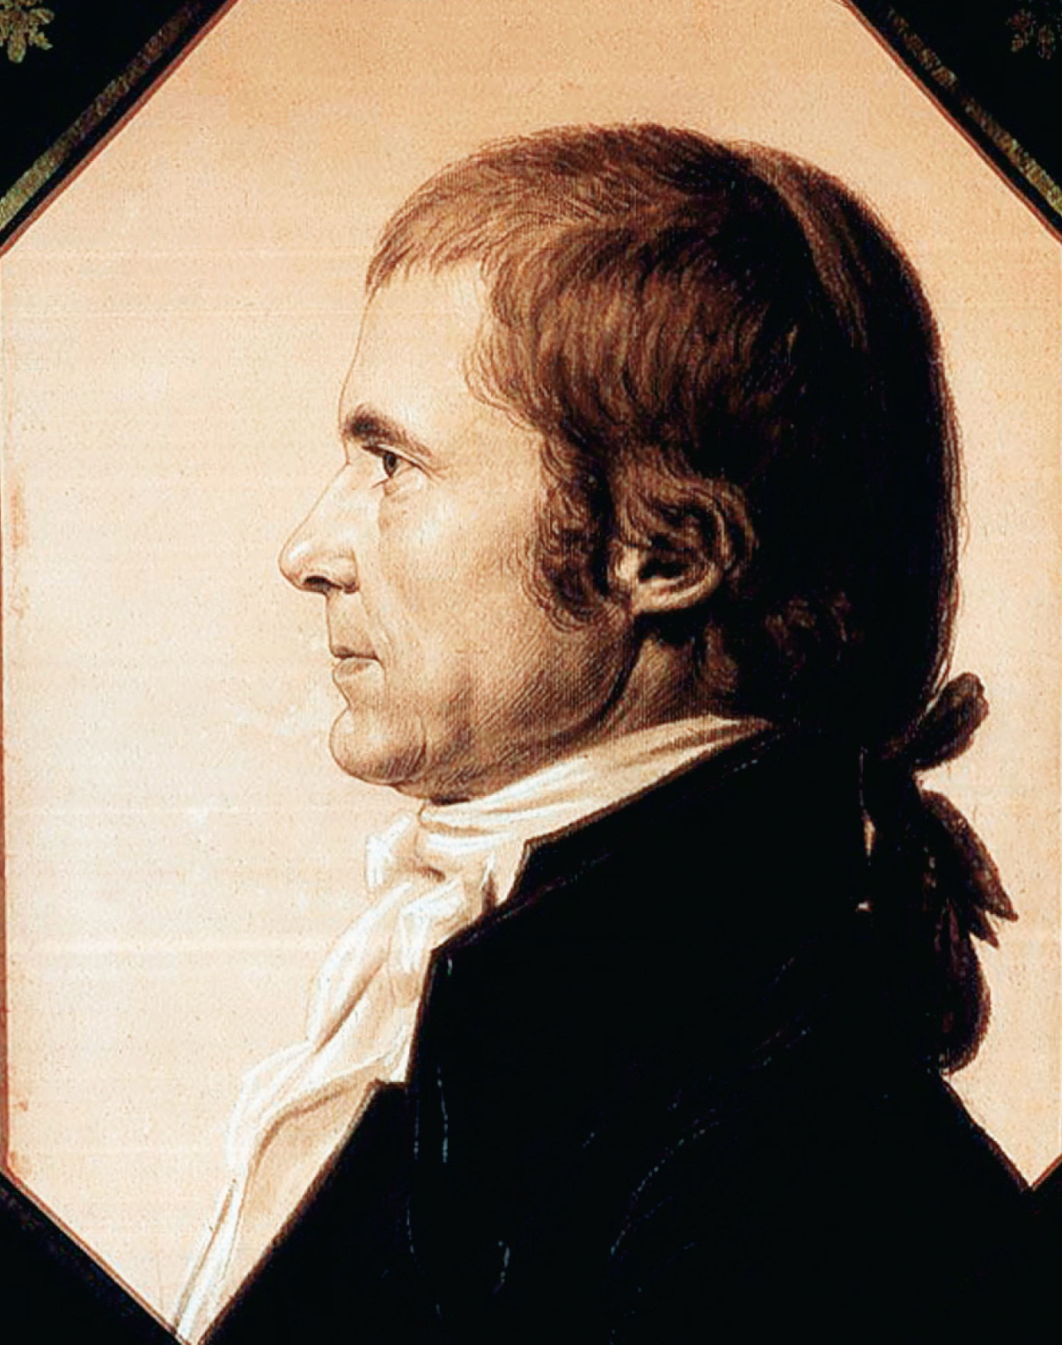
p209
Notes:
John Marshall on Assuming the Chief Justiceship,
1801 Depicted here as a young man, Marshall was
destined to serve on the Supreme Court for thirty-four
years and deeply molded constitutional law. Born in a log
cabin on the Virginia frontier, he attended law lectures for
just a few weeks at the College of William and Mary—his
only formal education. Yet Marshall would go on to prove
himself a brilliant chief justice. One admiring lawyer wrote
of him, “His black eyes . . . possess an irradiating spirit,
which proclaims the imperial powers of the mind that sits
enthroned therein.”

Slide 28
VI. Jefferson, a Reluctant Warrior
First action of Jefferson was to reduce the military establishment:
    To a mere police force of 25,000 officers and men
    He wanted to forgo the military and win friends through “peaceful coercion”
    Pirates of the North African Barbary States (see Map 11.2) made a national industry of blackmailing and plundering merchant ships that ventured into the Mediterranean.
    War across the Atlantic was not part of Jefferson’s vision.

Slide 29
VI. Jefferson, a Reluctant Warrior
(cont.)
The showdown came in 1801-1805, the Tripolitan War:
    He sent the infant army to the “shores of Tripoli”
    Four years of intermittent fighting
    He succeeded in extorting a treaty of peace from Tripoli in 1805; bargain price of $60,000—a sum representing ransom payment for captured Americans
    He advocated a large number of little coastal craft
    Also 200 tiny gunboats were constructed

Slide 30
VII. The Louisiana Godsend
1800 a secret pact was signed:
    Napoleon Bonaparte induced the king of Spain to cede to France the immense trans-Mississippi region of Louisiana, including New Orleans area
    The Spaniards at New Orleans withdrew the right to deposit guaranteed America by Pinckney’s Treaty of 1795 (see p. 193)
    Hoping to quiet the clamor of the West, Jefferson in 1803 sent James Monroe to Paris to join with Robert R. Livingstone, the regular minister there

Slide 31
VII. The Louisiana Godsend
(cont.)
  They were instructed to buy New Orleans and as much land as possible for $10 million
  Napoleon suddenly decided to sell all Louisiana and abandon his dream of a New World empire
      He failed in his efforts to reconquer the sugar-rich island of Santo Domingo (Haiti)
      Rebellious enslaved Africans had struck for their freedom in 1791. Their revolt was ultimately broken, but the island’s second line of defense—mosquitoes carrying yellow fever—had swept away thousands of crack French troops.

Slide 32
VII. The Louisiana Godsend
(cont.)
After the Haitian Revolution Santo Domingo could not be had, except at a staggering cost, hence there was no need for Louisiana’s food supplies
    To keep Louisiana from the British Napoleon decided to sell it to the Americans and pocket the money for his schemes nearer to home.
    Robert Livingston was busy negotiating , when the French foreign minister asked him what he would give for all of Louisiana.

Slide 33
VII. The Louisiana Godsend
(cont.)
On April 30, 1803, treaties were signed ceding Louisiana to the United States for about $15 million
  Plus additional treaties for an immeasurable tract entirely to the west—an area that would more than double the size of the United States.
  Once again the two Jeffersons wrestled with each other:
      The theorist and former strict constructionist versus the democratic visionary. Jefferson submitted the treaties to the Senate, while admitting the purchase unconstitutional.

Slide 34
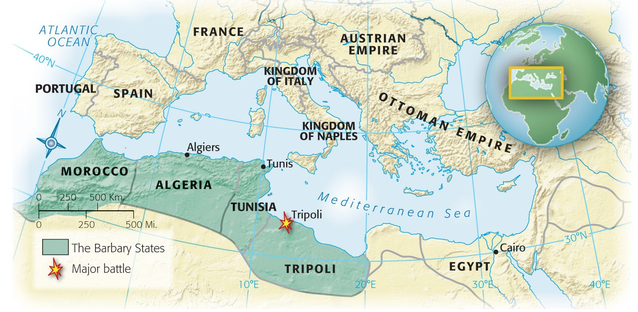
Map 11-2 p211
Notes:
Map 11.2 The Barbary States
of North Africa and the Burning
of the Frigate Philadelphia,
1804 The Tripolitan pirates had
captured the U.S. ship Philadelphia
(see p. 195) and were preparing
to use it against the Americans. In
a daring exploit that ensured his
lasting fame, twenty-four-year-old
U.S. naval officer Stephen Decatur
slipped into the harbor of Tripoli
and burned the frigate to the
waterline, denying it to the
pirates.

Slide 35
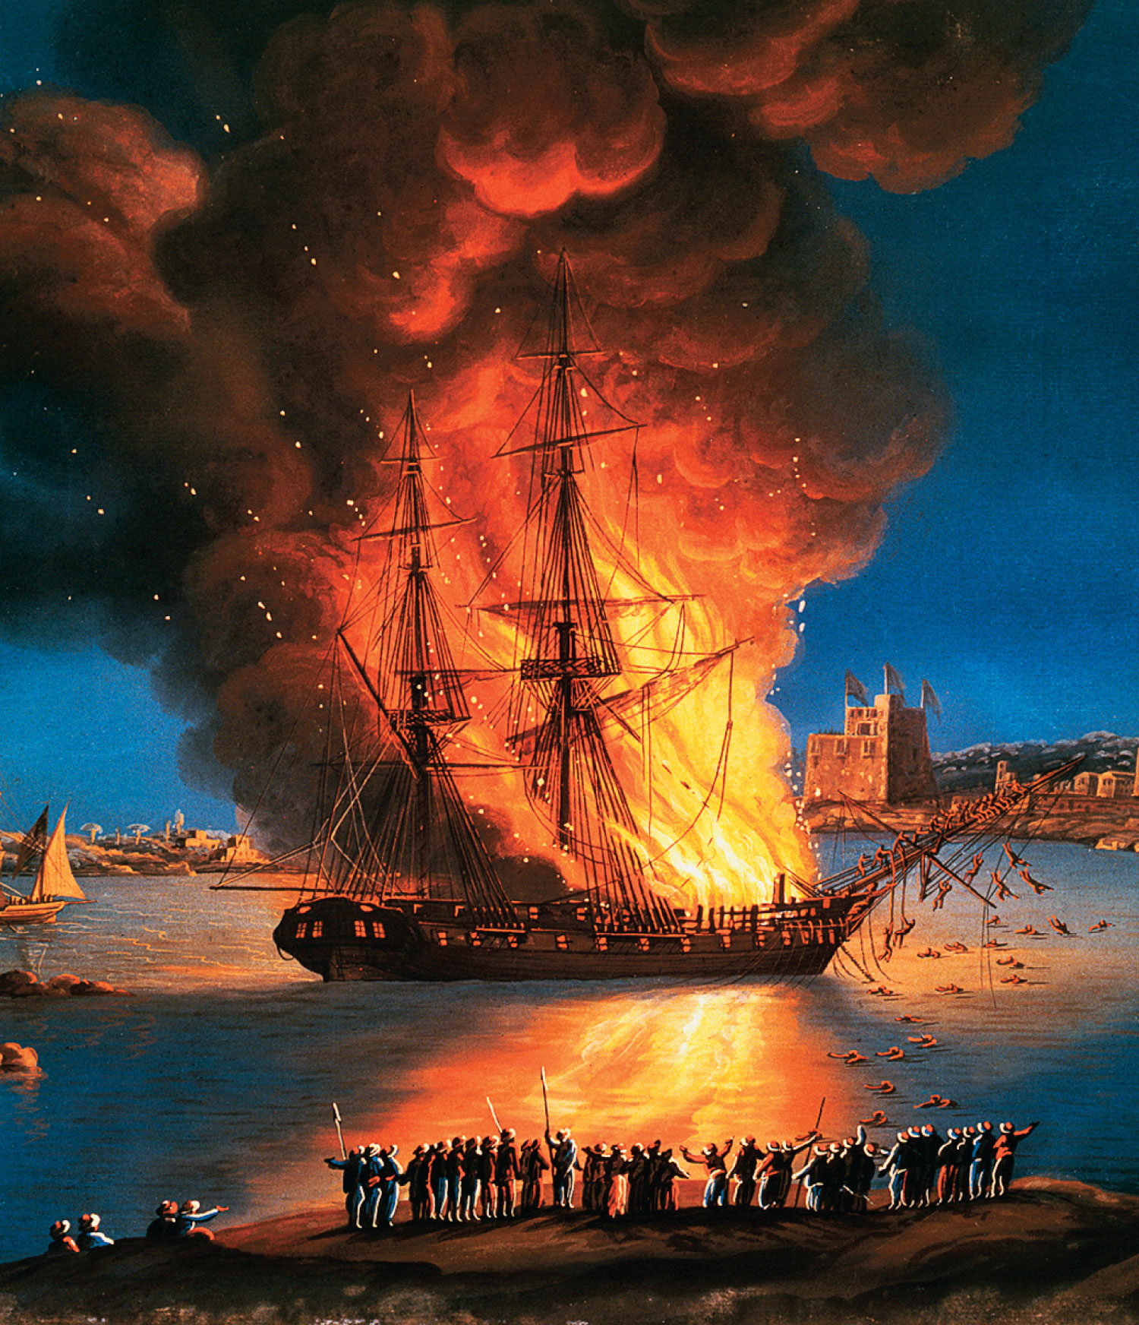
p211
Notes:
Map 11.2 The Barbary States
of North Africa and the Burning
of the Frigate Philadelphia,
1804 The Tripolitan pirates had
captured the U.S. ship Philadelphia
(see p. 195) and were preparing
to use it against the Americans. In
a daring exploit that ensured his
lasting fame, twenty-four-year-old
U.S. naval officer Stephen Decatur
slipped into the harbor of Tripoli
and burned the frigate to the
waterline, denying it to the
pirates.

Slide 36
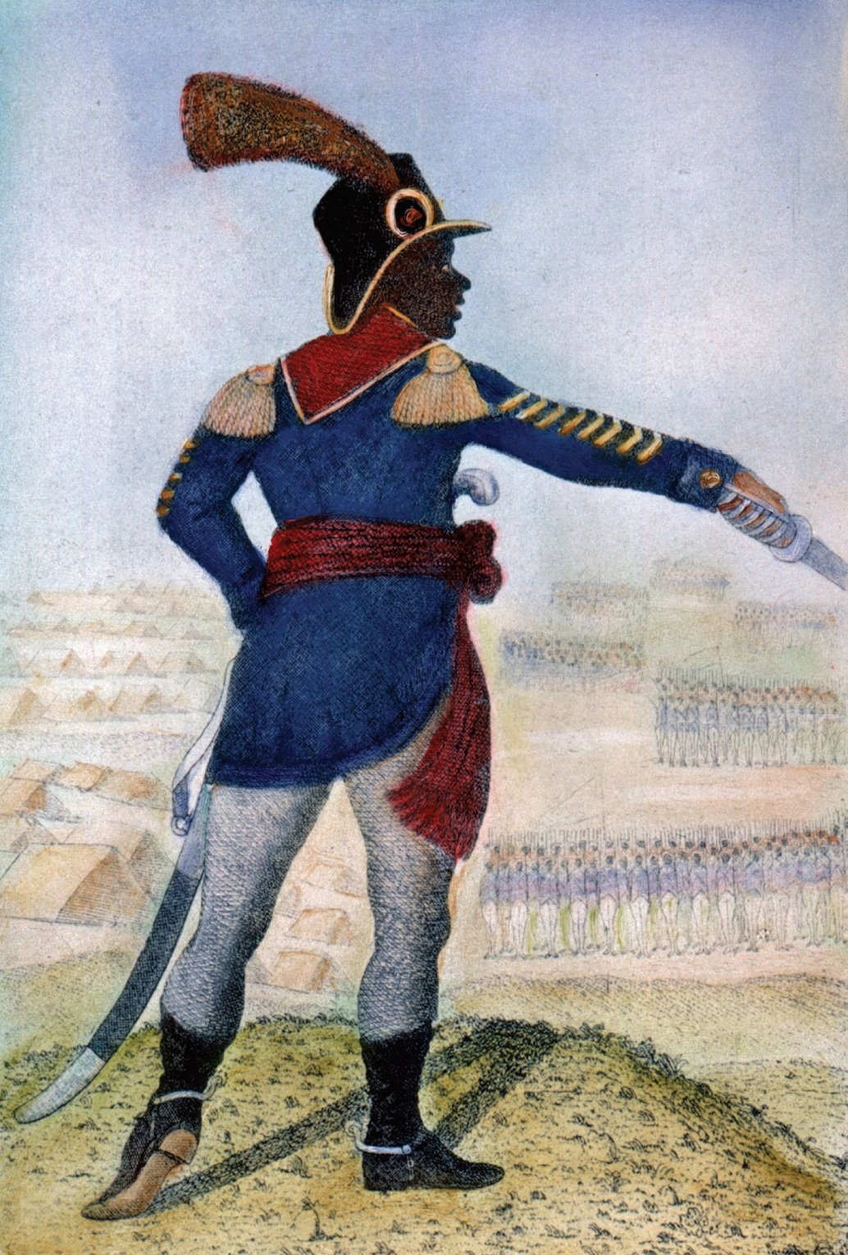
p212
Notes:
Toussaint L’Ouverture (ca. 1743–1803) A self-educated
ex-slave and military genius, L’Ouverture was finally
betrayed by the French, who imprisoned him in a chilly
dungeon in France, where he coughed his life away.
Indirectly, he did much to set up the sale of Louisiana to
the United States. His slave rebellion in Haiti also (briefly)
established the first black government in the New World,
striking fear into the hearts of slave owners throughout the
Western Hemisphere.

Slide 37
VIII. Louisiana in the Long View
Louisiana Purchase—
    America secured the western half of the richest river valley in the world
    And laid the foundation of a future major power
    The transfer established valuable precedents for future expansion on the basis of equal membership
    This was imperialism with a new and democratic face
    It also contributed to making operational the isolationist principles of Washington’s Farewell Address.

Slide 38
VIII. Louisiana in the Long View
(cont.)
The Lewis and Clark’s Corps of Discovery:
    1804 Jefferson sent his personal secretary, Meriwether Lewis, and army officer William Clark to explore the northern part of the Louisiana Purchase
    The exploration took 2 ½ years and yielded a rich harvest of scientific observation, maps, knowledge of the Indians in the region, and hair-raising wilderness adventure stories
    The explorers demonstrated the viability of an overland trail to the Pacific

Slide 39
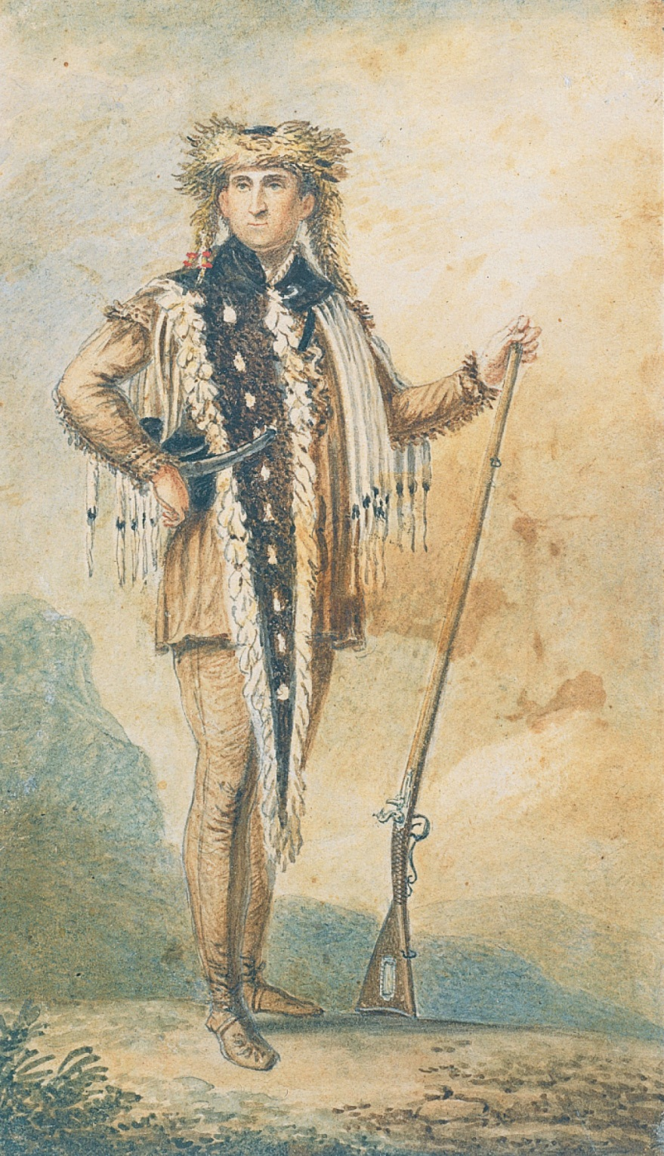
p213
Notes:
Meriwether Lewis Lewis is portrayed in this painting as
he looked on his return from the great expedition through
the Louisiana Purchase and the West.

Slide 40
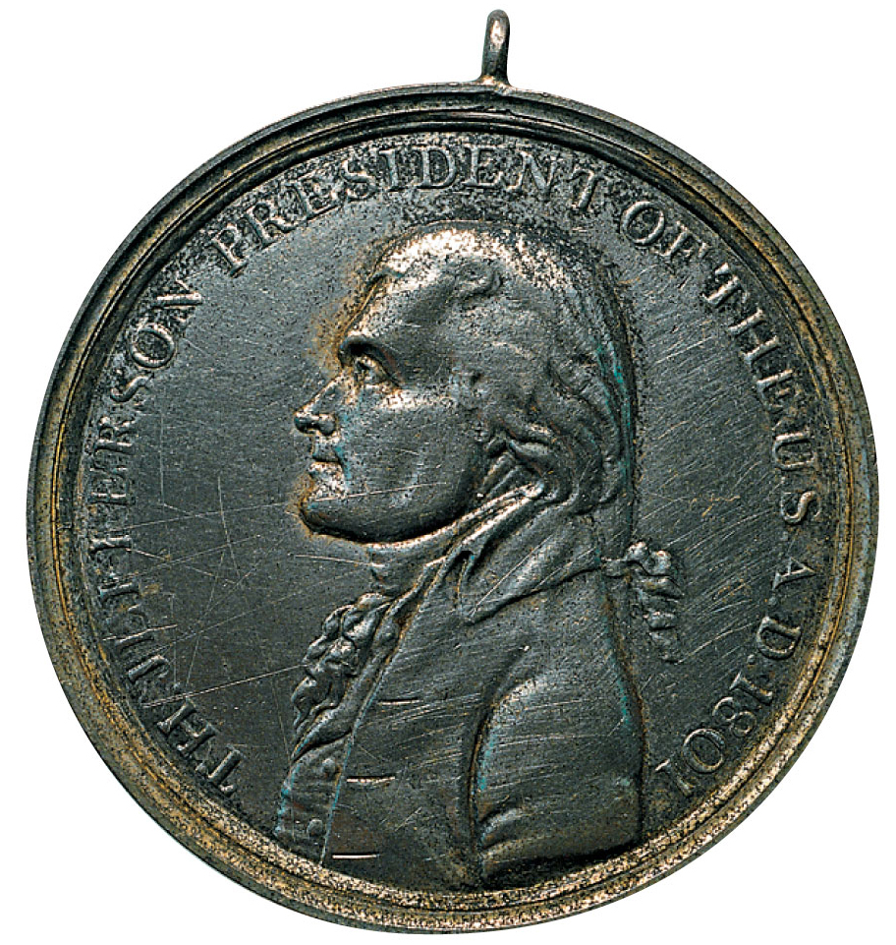
p214
Notes:
Gifts from the Great White Chief Among the objectives of the Lewis and Clark expedition was to establish good relations with the Indians in the newly acquired Louisiana Purchase. The American explorers presented all chiefs with copies of these medals, showing President Jefferson on one side and the hands of an Indian and a white man clasped in “peace and friendship” under a crossed “peace pipe” and hatchet on the other. All chiefs also received an American flag and a military uniform jacket, hat, and feather.

Slide 41
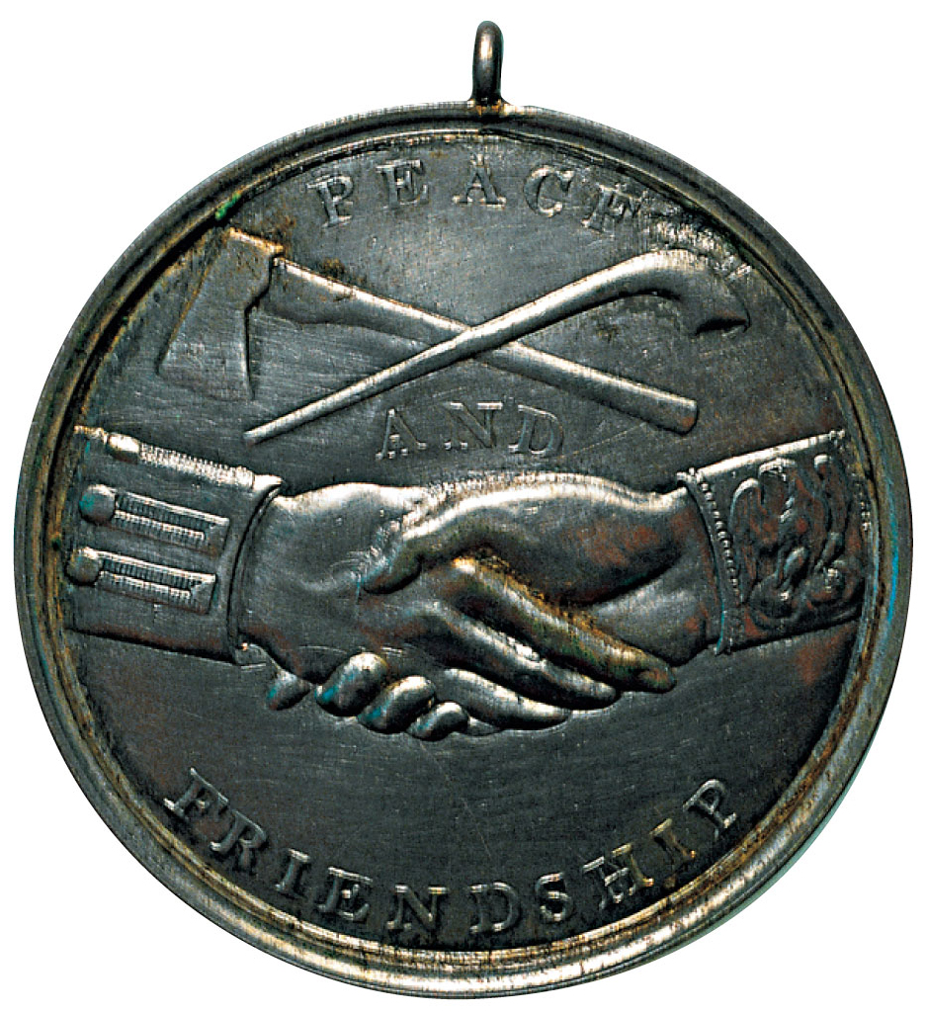
p214
Notes:
Gifts from the Great White Chief Among the objectives of the Lewis and Clark expedition was to establish good relations with the Indians in the newly acquired Louisiana Purchase. The American explorers presented all chiefs with copies of these medals, showing President Jefferson on one side and the hands of an Indian and a white man clasped in “peace and friendship” under a crossed “peace pipe” and hatchet on the other. All chiefs also received an American flag and a military uniform jacket, hat, and feather.

Slide 42
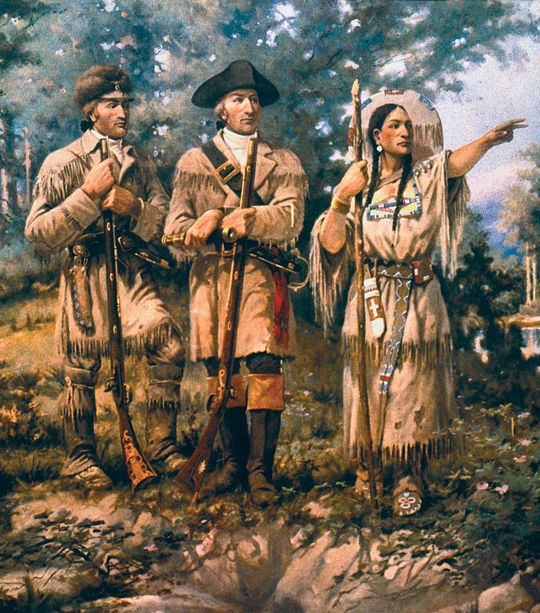
Notes:
Detail of "Lewis & Clark at Three Forks" by Edgar Samuel Paxson, mural in lobby of Montana House of Representatives.

Slide 43
VIII. Louisiana in the Long View
(cont.)
    Thousands of missionaries, fur-traders, and pioneering settlers made their way to claim the Oregon Country
    Zebulon M. Pike trekked to the headwaters of the Mississippi River in 1805-1806
    The next year Pike ventured into the southern portion of Louisiana Territory, where he sighted the Colorado peak that bears his name.

Slide 44
IX. The Aaron Burr Conspiracies
    The Louisiana Purchase greatly expanded the fortunes of the United States and the power of the federal government
    In the short term, the vast expanse of territory and the feeble reach of the government obliged to control it raised fears of secession and foreign intrigue (see Map 11.3)
    Aaron Burr, Jefferson’s first-term vice president, provoked and justified such fears
    Burr joined a group of Federalist extremists to plot the secession of New England and New York

Slide 45
IX. The Aaron Burr Conspiracies
(cont.)
    Alexander Hamilton exposed and foiled the conspiracy
    Incensed, Burr challenged Hamilton to a duel
    Burr killed Hamilton with one shot. Burr’s pistol blew the brightest brain out of the Federalist party and destroyed the only hope of effective leadership.
    Burr turned his disunionist plottings to the trans-Mississippi West.
    There he struck up an allegiance with General James Wilkinson, the unscrupulous military governor of Louisiana Territory and a secret agent for Spain.

Slide 46
IX. The Aaron Burr Conspiracies
(cont.)
    Wilkinson’s army was to meet Burr and 60 followers at Natchez
    However, when Wilkinson learned that Jefferson had gotten wind of the plot, Wilkinson betrayed Burr and fled to New Orleans
    Burr was arrested and tried for treason
    Chief Justice John Marshall, strictly interpreting the Constitution, insisted that a guilty verdict required proof of overt acts of treason, not merely treasonous intentions (see Art. III, Sec. III)
    Burr was acquitted and fled to Europe

Slide 47
IX. The Aaron Burr Conspiracies
(cont.)
  Burr urged Napoleon to make peace with Britain and launch a joint invasion of America.
  Burr’s insurrectionary brashness demonstrated that it was one thing for the United States to purchase large expanses of western territory but quite another for it to govern them effectively.

Slide 48
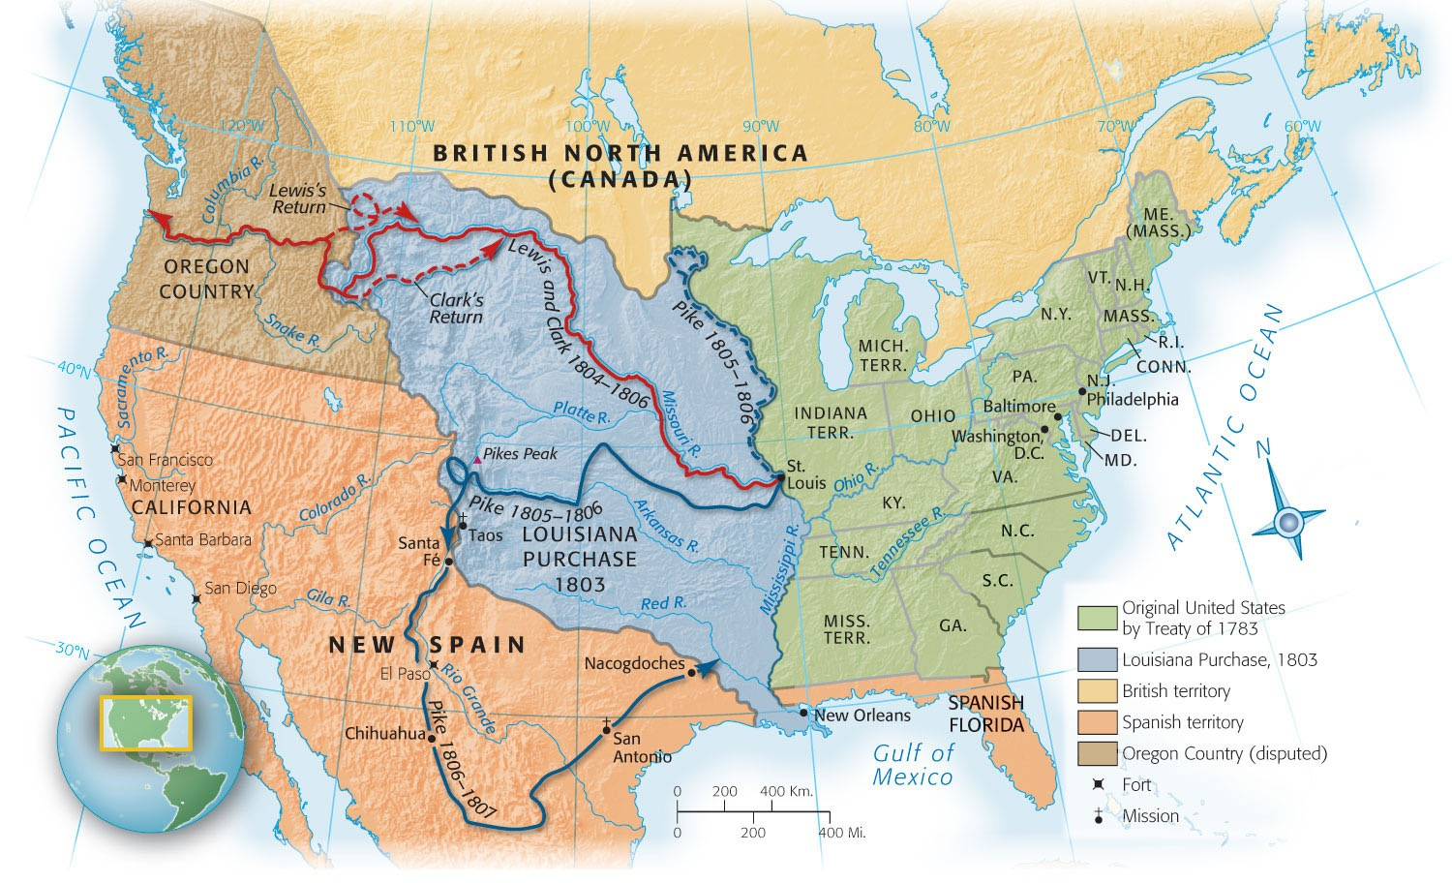
Map 11-3 p215
Notes:
Map 11.3 Exploring the Louisiana Purchase and the West Seeking to avert friction with France by purchasing all of Louisiana, Jefferson bought trouble because of the vagueness of the boundaries. Among the disputants were Spain in the Floridas, Spain and Mexico in the Southwest, and Great Britain in Canada.

Slide 49
X. A Precarious Neutrality
Jefferson was triumphantly reelected in 1804:
  162 electoral votes to only 14 votes for his Federalist opponent
  Napoleon deliberately provoked a renewal of his war with Britain–an awesome conflict that raged on for eleven long years.
  The first two years of war a maritime United States enjoyed commercial pickings.

Slide 50
X. A Precarious Neutrality
(cont.)
1805 the Battle of Trafalgar:
  Lord Nelson smashed the combined French and Spanish fleets of the coast of Spain
  This ensured Britain’s supremacy on the sea
The Battle of Austerlitz in Austria—The Battle of the Three Emperors—Napoleon crushed the combined Austrian and Russian armies
  Ensuring his mastery of the land
  France and Britain now reigned supreme

Slide 51
X. A Precarious Neutrality
(cont.)
1806 London issued a series of Orders in Council:
    Closed the European ports under French control to foreign shipping, including American, unless the vessels stopped at a British port
    Napoleon struck back, ordering the seizure of all merchant ships, including American, that entered British ports
    They was no way to trade with either nation
    American vessels were caught

Slide 52
X. A Precarious Neutrality
(cont.)
Impressment—
  the forcible enlistment of sailors:
  Crude form of conscription by the British
  Had been employed for years
  Some 6000 bona fide U.S. citizens were impressed by the “piratical man-stealers” of Britain from 1808 to 1811

Slide 53
X. A Precarious Neutrality
(cont.)
The Chesapeake affair:
    A royal frigate overhauled a U.S. frigate, the Chesapeake, ten miles of the coast of Virginia
    The British captain bluntly demanded the surrender of four alleged deserters
    London had never claimed the right to seize sailors from a foreign warship
    The American commander, though totally unprepared to fight, refused the request
    The British warship fired three devastating broadsides at close range

Slide 54
X. A Precarious Neutrality
(cont.)
    Three Americans were killed and 18 wounded
    Four deserters were dragged away, and the bloody hulk called the Chesapeake limped back to port
    Britain was clearly in the wrong, as the London Foreign Office admitted
    But London’s contrition availed little
    A roar of national wrath went up from infuriated Americans
    Jefferson, the peace lover, could easily have had war if he had wanted it

Slide 55
XI. The Hated Embargo
(cont.)
National honor would not permit a slavish submission to British and French mistreatment:
    The warring European nations depended heavily on United States for raw materials and foodstuffs
    Jefferson thought that if America voluntarily cut off its exports, the offending powers would have to bow
    Congress issued the Embargo Act late in 1807:
      The law forbade the export of all goods from the United States, whether in American or foreign ships

Slide 56
XI. The Hated Embargo
(cont.)
      This embargo embodied Jefferson’s idea of “peaceful coercions”
      The American economy staggered under the effect of the embargo long before Britain or France began to bend
      An enormous illicit trade mushroomed in 1808, especially along the Canadian border
      The embargo had the effect of reviving the moribund Federalist party
      On March 1, 1809 , three days before Jefferson retired, Congress repealed the embargo.
    The Non-Intercourse Act formally opened trade with all nations, except Britain and France

Slide 57
XI. The Hated Embargo
(cont.)
  Why the embargo act failed after 15 months:
    Jefferson underestimated the determination of the British and overestimated the dependence of both belligerents on America’s trade
    Jefferson miscalculated the unpopularity of such a self-crucifying weapon and the difficulty of enforcing it.
  New England plucked a new prosperity from the ugly jaws of the embargo.

Slide 58
XI. The Hated Embargo
(cont.)
The resourceful Yankees reopened old factories and erected new ones:
    The real foundations of modern America’s industrial might were laid behind the protective wall of the embargo
    Followed by nonintercourse and the War of 1812
    Jefferson, the avowed critic of factories, may have unwittingly done more for American manufacturing than Alexander Hamilton, industry’s outspoken friend.

Slide 59
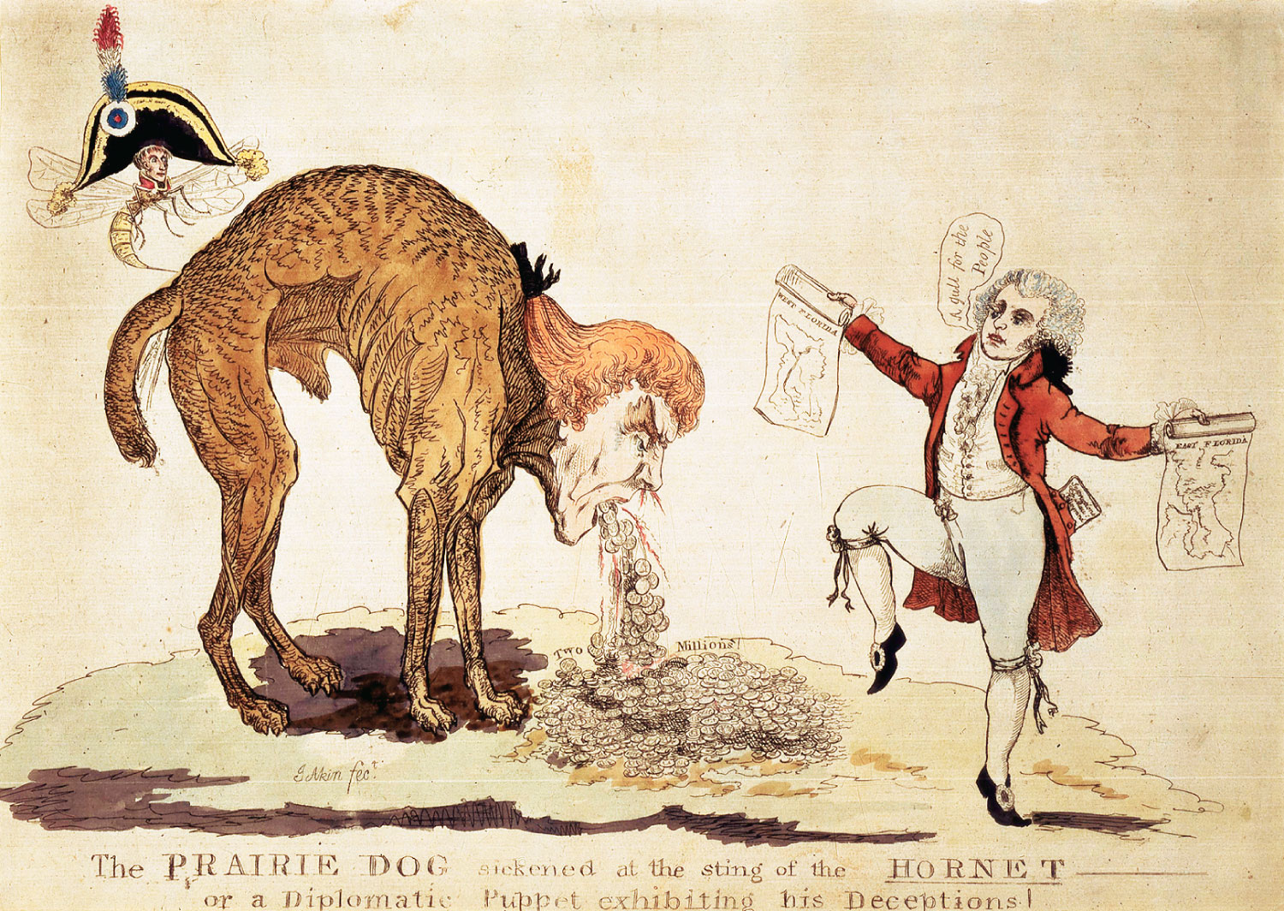
p216
Notes:
The Prairie Dog Sickened at the Sting of the Hornet, 1806 In this anti-Jefferson satire criticizing his negotiations for the purchase of West Florida in 1804, Napoleon, in the form of a hornet, stings Jefferson and makes him “cough up” $2 million in gold coins—the amount of the secret appropriation that Jefferson sought from Congress. The negotiations eventually failed.

Slide 60
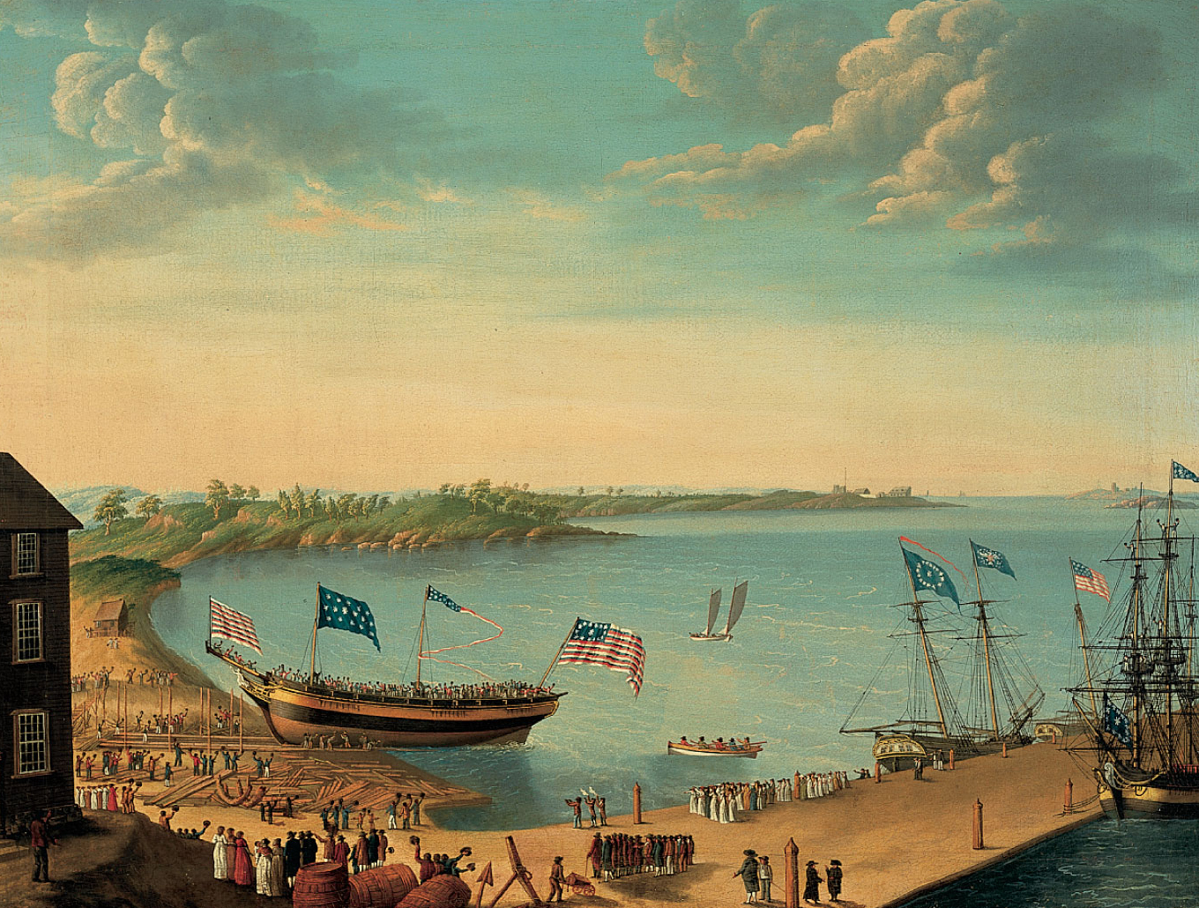
p217
Notes:
Launching of the Ship Fame, by George Ropes, Jr., 1802 Jefferson’s embargo
throttled thriving New England shipyards like this one, stirring bitter resentment.

Slide 61
20 Reasons why Jefferson would oppose today’s liberalism
1. The spirit of resistance to government is so valuable on certain occasions, that I wish it to be always kept alive. It will often be exercised when wrong, but better so than not to be exercised at all. I like a little rebellion now and then. It is like a storm in the atmosphere.
2. It is error alone which needs the support of government. Truth can stand by itself. Subject opinion to coercion: whom will you make your inquisitors?
3. A free people [claim] their rights as derived from the laws of nature, and not as the gift of their chief magistrate.
4. If people let the government decide what foods they eat and what medicines they take, their bodies will soon be in as sorry a state as are the souls of those who live under tyranny.

Slide 62
20 Reasons why Jefferson would oppose today’s liberalism
5. The multiplication of public offices, increase of expense beyond income, growth and entailment of a public debt, are indications soliciting the employment of the pruning knife.
6. And can the liberties of a nation be thought secure when we have removed their only firm basis, a conviction in the minds of the people that these liberties are the gift of God? That they are not to be violated but with his wrath? Indeed I tremble for my country when I reflect that God is just: that his justice cannot sleep forever.
7. No freeman shall be debarred the use of arms [within his own lands or tenements].

Slide 63
20 Reasons why Jefferson would oppose today’s liberalism
8. The principle of spending money to be paid by posterity, under the name of funding, is but swindling futurity on a large scale.
9. Laws that forbid the carrying of arms… disarm only those who are neither inclined nor determined to commit crimes… Such laws make things worse for the assaulted and better for the assailants; they serve rather to encourage than to prevent homicides, for an unarmed man may be attacked with greater confidence than an armed man.
10. In questions of power, then, let no more be heard of confidence in man, but bind him down from mischief by the chains of the Constitution.

Slide 64
20 Reasons why Jefferson would oppose today’s liberalism
11. I hold it that a little rebellion now and then is a good thing, & as necessary in the political world as storms in the physical.
12. It is of great importance to set a resolution, not to be shaken, never to tell an untruth. There is no vice so mean, so pitiful, so contemptible; and he who permits himself to tell a lie once, finds it much easier to do it a second and a third time, till at length it becomes habitual; he tells lies without attending to it, and truths without the world’s believing him. This falsehood of the tongue leads to that of the heart, and in time depraves all its good disposition.

Slide 65
20 Reasons why Jefferson would oppose today’s liberalism
13. I am not among those who fear the people. They, and not the rich, are our dependence for continued freedom. And to preserve their independence, we must not let our rulers load us with perpetual debt. We must make our election between economy and liberty, or profusion and servitude.
14. The disease of liberty is catching; those armies will take it in the south, carry it thence to their own country, spread there the infection of revolution and representative government, and raise its people from the prone condition of brutes to the erect altitude of man.
15. Every government degenerates when trusted to the rulers of the people alone. The people themselves, therefore, are its only safe depositories.

Slide 66
20 Reasons why Jefferson would oppose today’s liberalism
16. Still one thing more, fellow-citizens — a wise and frugal Government, which shall restrain men from injuring one another, shall leave them otherwise free to regulate their own pursuits of industry and improvement, and shall not take from the mouth of labor the bread it has earned. This is the sum of good government, and this is necessary to close the circle of our felicities.
17. A private central bank issuing the public currency is a greater menace to the liberties of the people than a standing army. We must not let our rulers load us with perpetual debt.

Slide 67
20 Reasons why Jefferson would oppose today’s liberalism
18. Born in other countries, yet believing you could be happy in this, our laws acknowledge, as they should do, your right to join us in society, conforming, as I doubt not you will do, to our established rules. That these rules shall be as equal as prudential considerations will admit, will certainly be the aim of our legislatures, general and particular.
19. I have been happy … in believing that … whatever follies we may be led into as to foreign nations, we shall never give up our Union, the last anchor of our hope, and that alone which is to prevent this heavenly country from becoming an arena of gladiators.

Slide 68
20 Reasons why Jefferson would oppose today’s liberalism
20. I know no safe depository of the ultimate powers of the society but the people themselves; and if we think them not enlightened enough to exercise their control with a wholesome discretion, the remedy is not to take it from them, but to inform their discretion by education. This is the true corrective of abuses of constitutional power.

Slide 69
XII. Madison’s Gamble
Madison took the presidential oath on March 4, 1809:
  As the awesome conflict in Europe was roaring to a climax
  The Non-Intercourse Act of 1809 was to expire in 1810
    Congress dismantled the embargo completely with a bargaining measure—Macon’s Bill No. 2.

Slide 70
XII. Madison’s Gamble
(cont.)
Macon’s Bill No. 2:
    A dangle—if either Britain or France repealed its commercial restrictions, America would restore its embargo against the nonrepealing nations
    To Madison the bill was a shameful capitulation
    Word came from Napoleon’s foreign minister that the French decrees might be repealed if Britain also lifted it Orders in Council
    Madison knew not to trust Napoleon, but he gambled.

Slide 71
XII. Madison’s Gamble
(cont.)
Madison’s gamble:
    That the threat of seeing the United States trade exclusively with France would lead the British to repeal their restrictions—and vice versa
    The terms of Macon’s Bill gave the British 3 months to live up to their promise of revoking the Orders in Council and reopening the Atlantic to neutral trade
    They did not. Madison’s gamble failed.

Slide 72
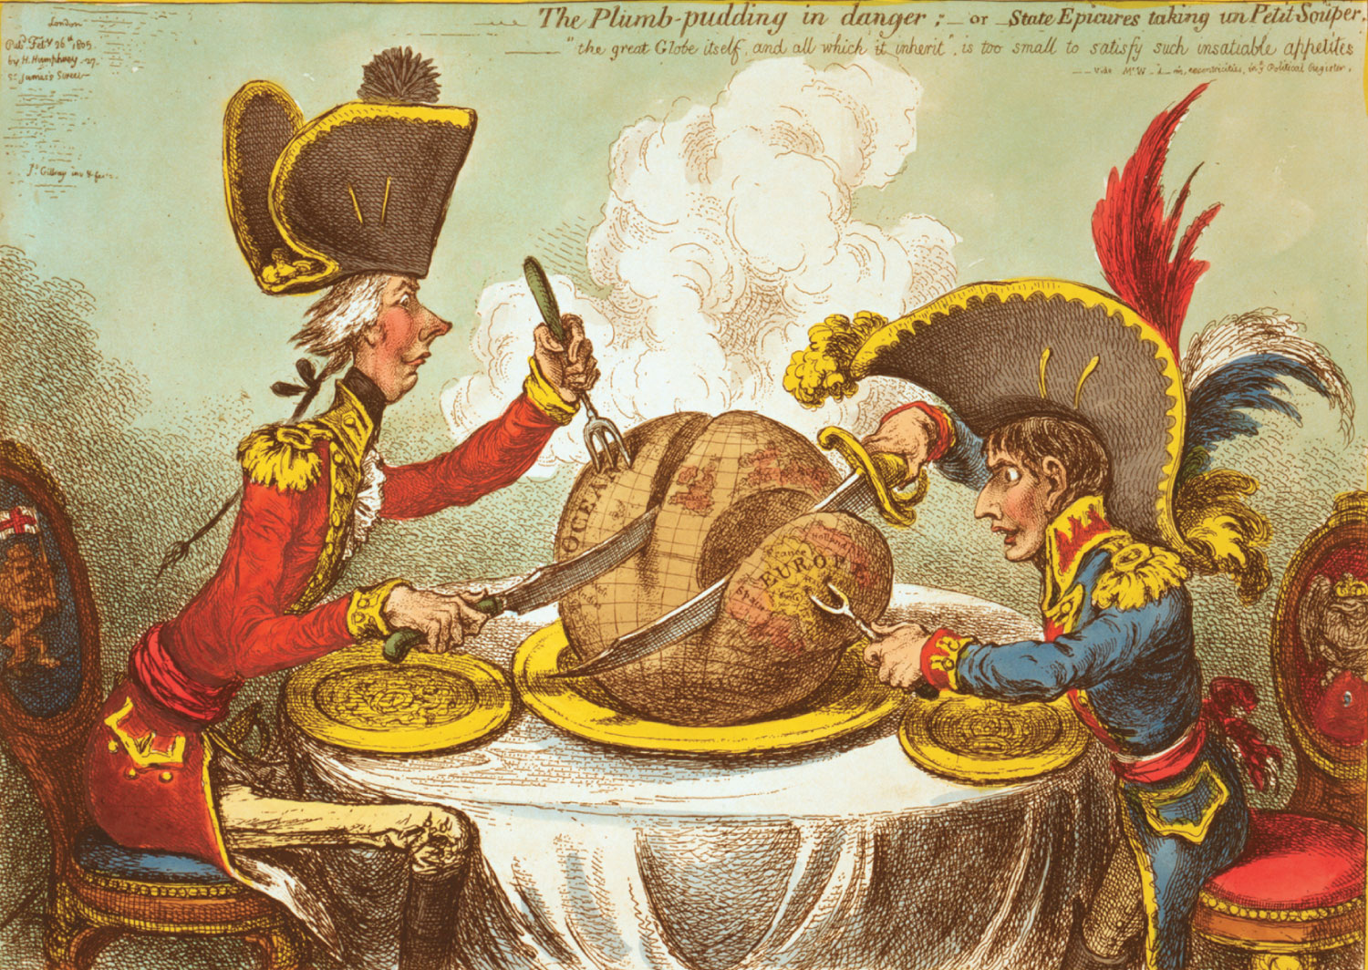
p219
Notes:
Britain and France Divide Up the World, 1805 The great-power rivalry symbolized
here by British prime minister William Pitt and French emperor Napoleon wreathed the
planet in years of warfare. When it ended with Napoleon’s final defeat in 1815, Britain
was the unchallenged mistress of the world’s oceans.

Slide 73
XIII. Tecumseh and the Prophet
Twelfth Congress met late 1811
  The older “submission men” had been replaced with young hotheads, many from the South and West:
    Dubbed war hawks by their Federalist opponents, the newcomers were on fire for a new war
    They also wanted to wipe out the renewed Indian threat for pioneer settlers coming into the trans-Allegheny wilderness

Slide 74
XIII. Tecumseh and the Prophet
(cont.)
    Two Shawnee brothers, Tecumseh and Tenskwatawa, known to non-Indians as “the Prophet,” concluded the time had come to stem this onrushing tide
    They began to weld together a confederacy of all the tribes west of the Mississippi
    Frontiersmen and their war-hawk spokesmen became convinced that the British “scalp buyers” in Canada were nourishing the Indians’ growing strength
    In the fall of 1811, William Henry Harrison gathered an army and advanced on Tecumseh’s headquarters.

Slide 75
XIII. Tecumseh and the Prophet
(cont.)
  Tecumseh was absent, but the Prophet attacked Harrison’s army, with a small force of Shawnees
    The Shawnees were routed and their settlement was burned
    The Battle of Tippecanoe made Harrison a national hero
    It discredited the Prophet and drove Tecumseh into an alliance with the British.
      When America’s war with Britain came, Tecumseh fought for the redcoats until his death in 1813 at the Battle of the Thames. With him perished the dream of an Indian confederacy.

Slide 76
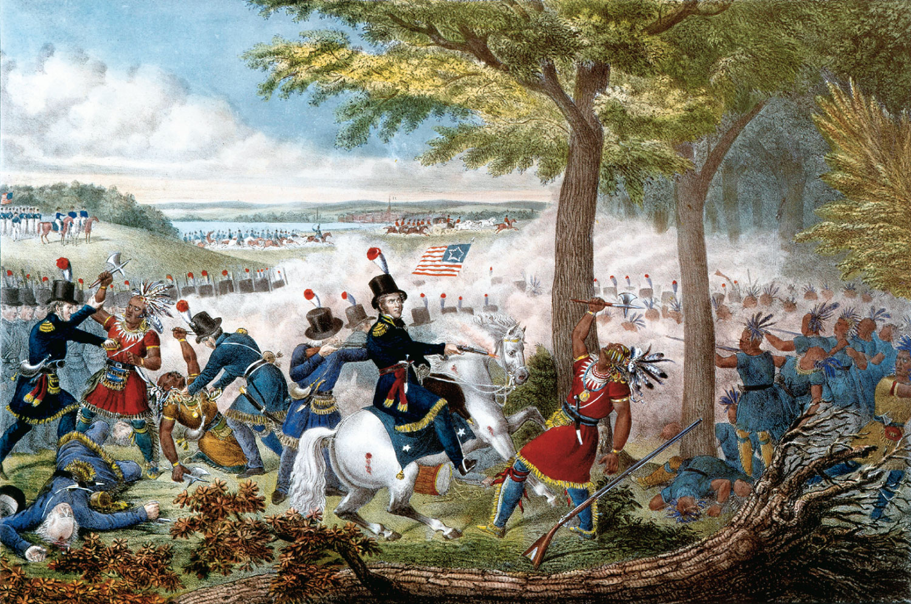
p220
Notes:
The Battle of the
Thames, 1813 Here
the Shawnee leader
Tecumseh stood his
ground against the
superior American force
and died. A gifted
organizer and military
chieftain, he had
denounced the tribal
custom of torturing
prisoners and opposed
the practice of allowing
any one tribe to sell land
that, he believed,
belonged to all Indians.

Slide 77
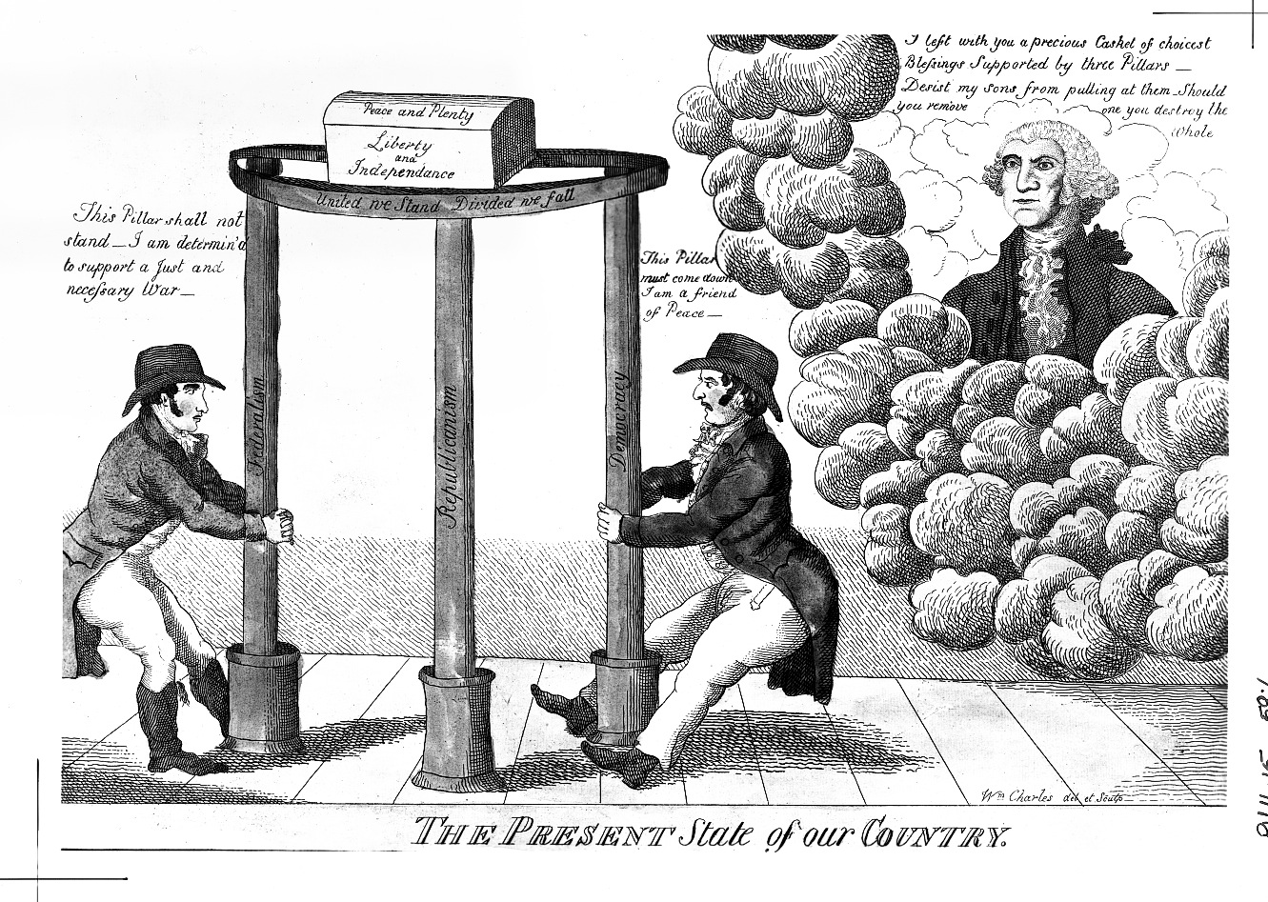
p221
Notes:
The Present State of Our Country Partisan disunity over the War of 1812 threatened the nation’s very existence. The
prowar Jeffersonian at the left is attacking the pillar of federalism the antiwar Federalist at the right is trying to pull down
democracy. The spirit of Washington warns that the country’s welfare depends on all three pillars, including republicanism.

Slide 78
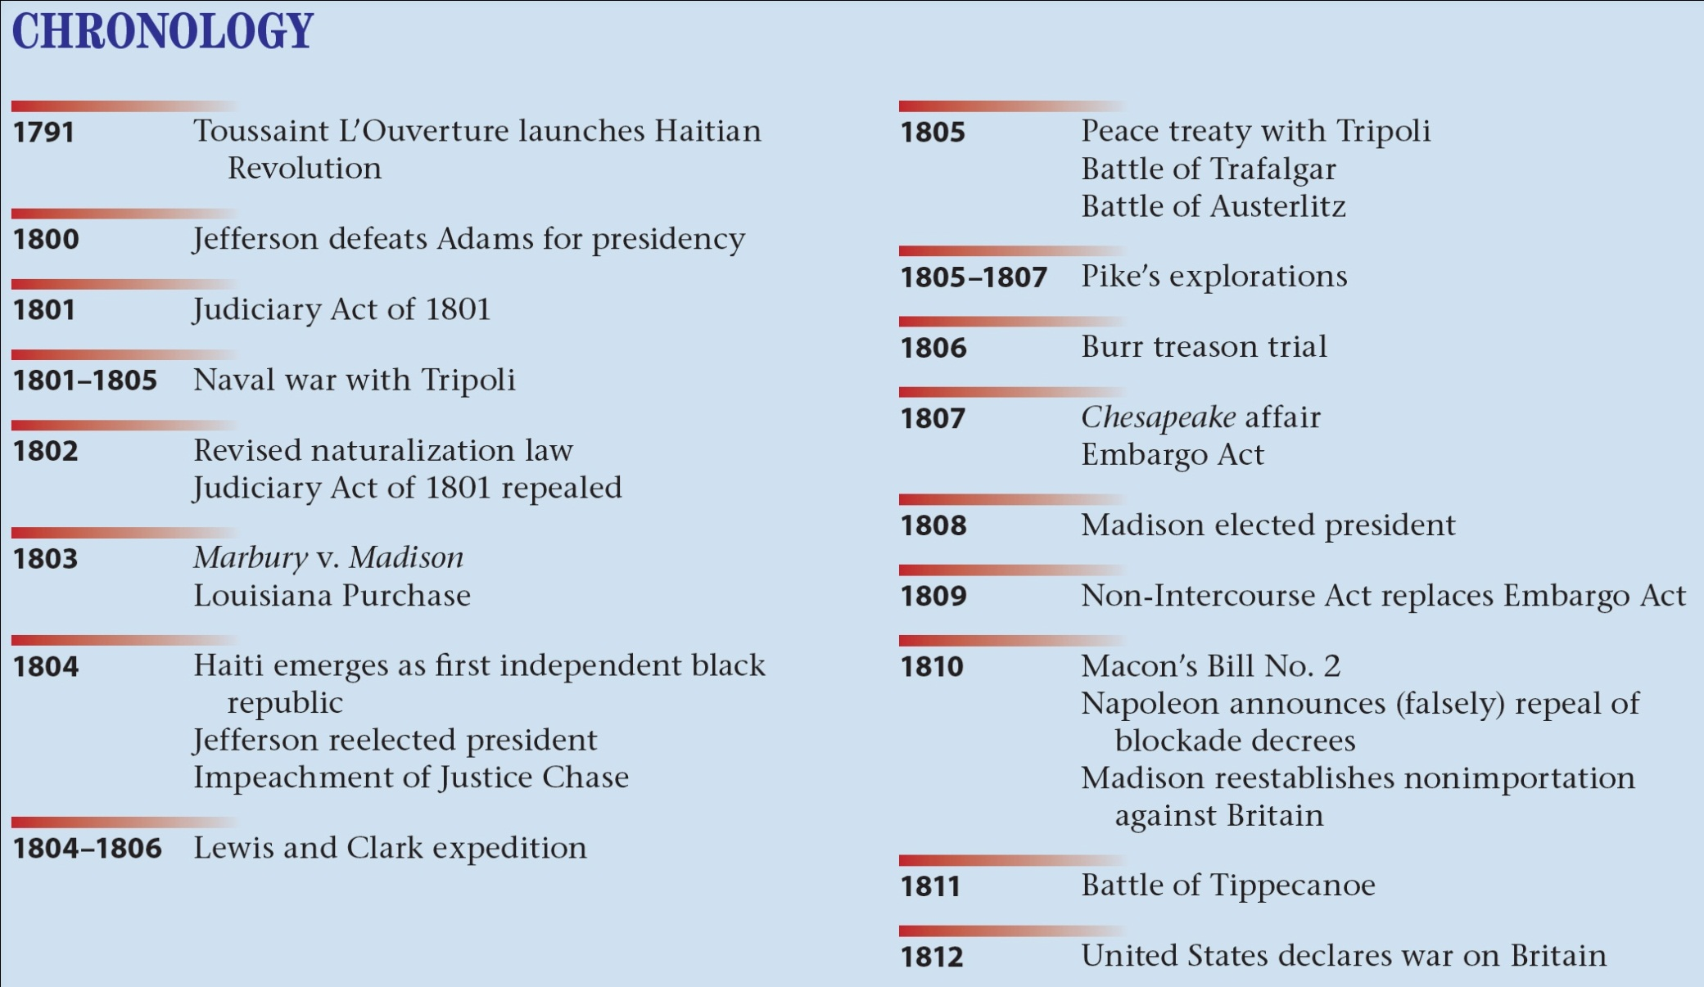
p222

