Slide 1
Chapter 1
New World Beginnings, 33,000 B.C.E.–1769 C.E.

Slide 2
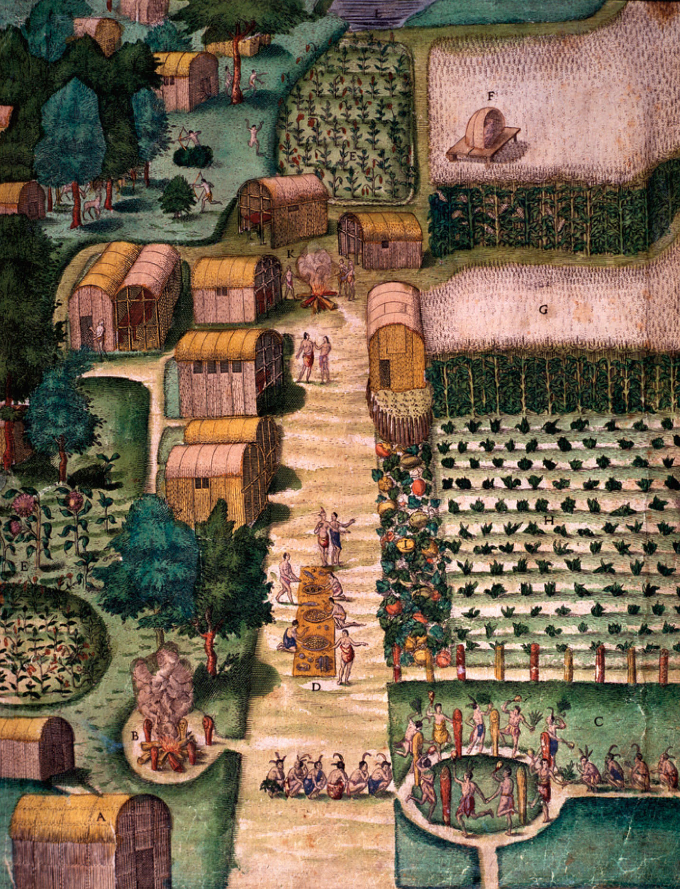
p2
Notes:
The Town of Secota, Engraving, by Theodore de Bry, 1590, after John White Painting John White was an English watercolorist who accompanied the first English expedition to Roanoke Island (later parts of Virginia) in 1585. His paintings faithfully recorded the Indian way of life that was now imperiled by the arrival of the Europeans.

Slide 3
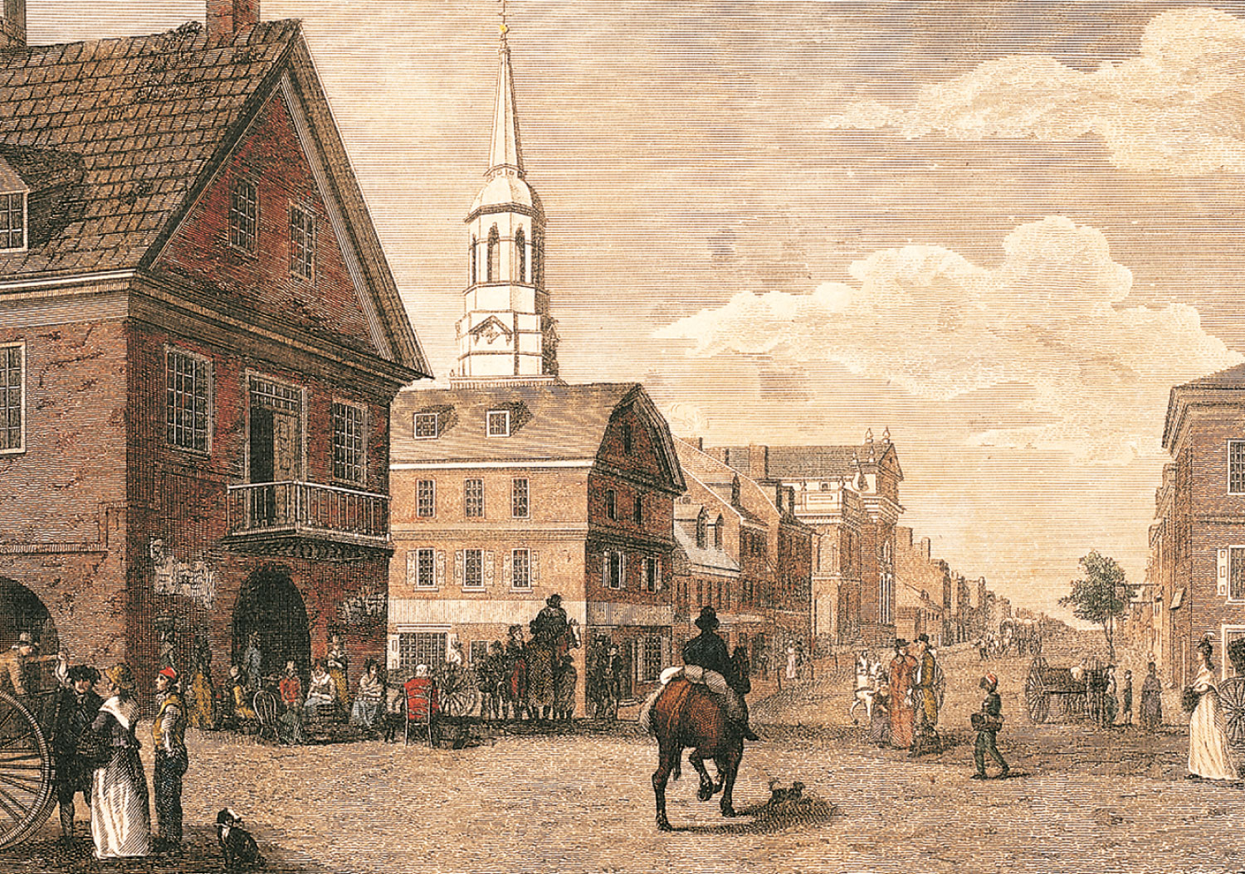
p3
Notes:
Philadelphia, Corner of Second and High Streets Delegates to the Constitutional Convention in 1787 gathered in Philadelphia, the largest city in North America, a vivid symbol of the rise of American society from its precarious beginnings at Jamestown and Plymouth nearly two centuries earlier.

Slide 4
I. The Shaping of North America
The planet earth took on its present form slowly.
Over time the great continents of Eurasia, Africa, the Indian Ocean and the Pacific Ocean were formed.
The majestic ranges of western North America—the Rockies, the Sierra, Nevada, the Cascades and the Coast Ranges formed.

Slide 5
The Shaping of North America (cont.)
Canadian Shield—a zone undergirded by rocks became part of the North American landmass.
Other mountain ranges were formed, along with rivers and valleys.
After the glaciers retreated the North American landscape was transformed.

Slide 6
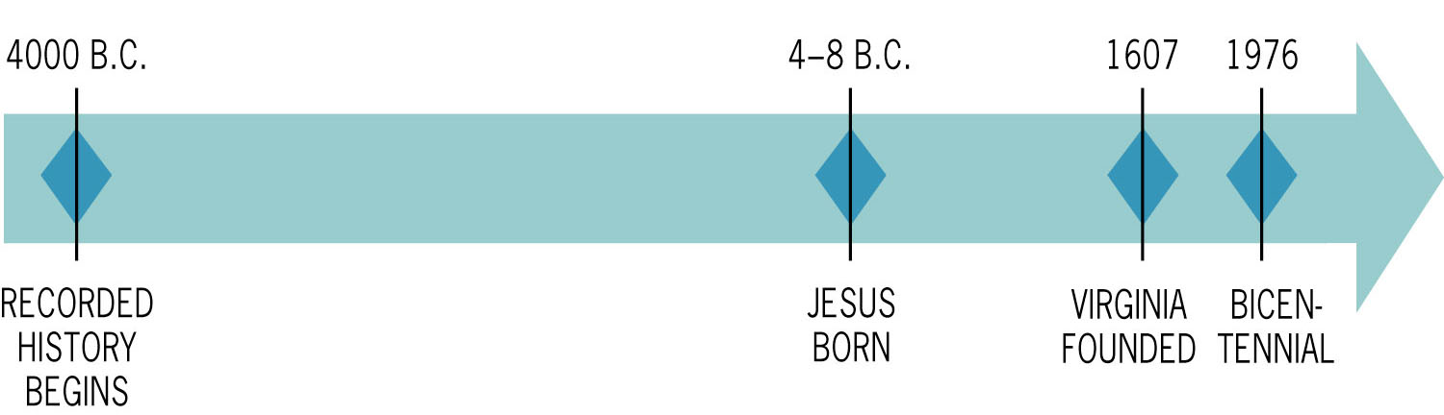
Figure 1-1a p5
Notes:
Figure 1.1 The Arc of Time

Slide 7
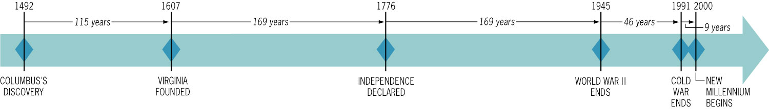
Figure 1-1b p5
Notes:
Figure 1.1 The Arc of Time

Slide 8
II. Peopling the Americas
North American continent's human history was beginning to be formed, perhaps by people crossing over land.
A land bridge connected Eurasia with North America creating the Bering Sea between Siberia and Alaska.
This brought the “immigrant” ancestors of Native America. See Map 1.1

Slide 9
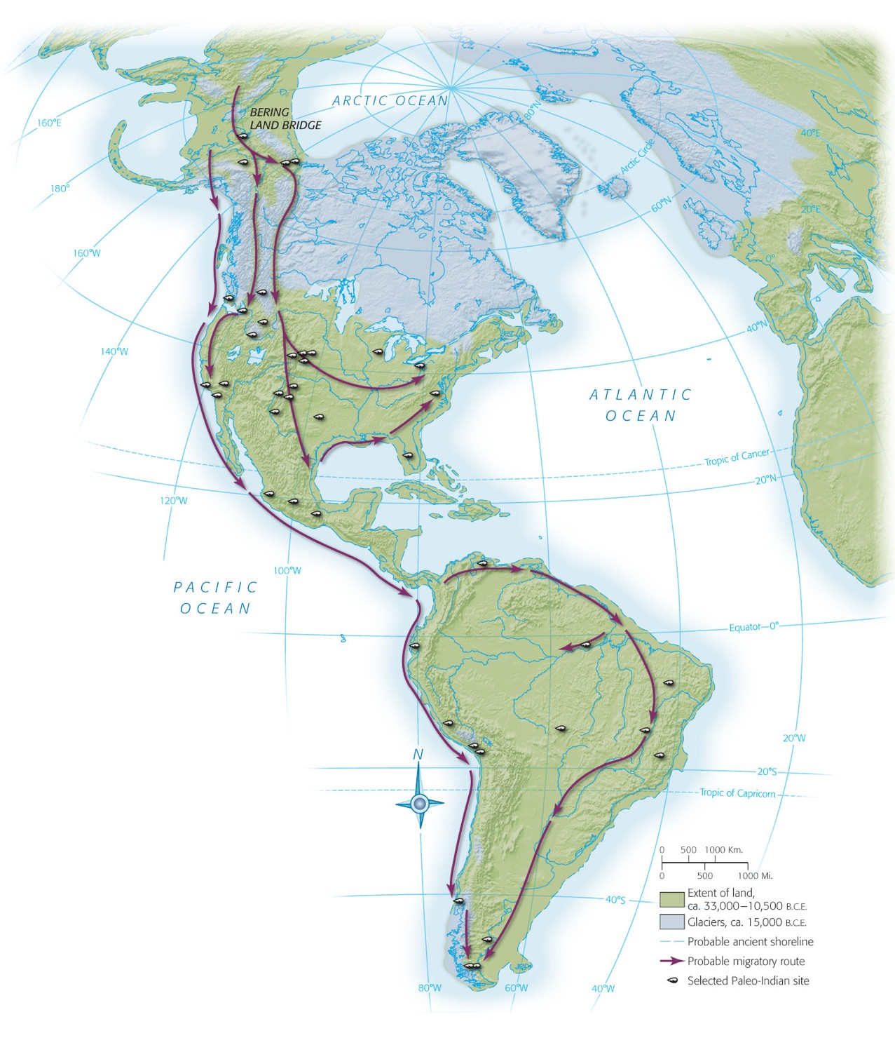
Map 1-1 p6
Notes:
MAP 1.1 The First Discoverers of America The origins of the first Americans remain something of a mystery. According to the most plausible theory of how the Americas were populated, for some 25,000 years people crossed the Bering land bridge from Eurasia to North America. Gradually they dispersed southward down ice-free valleys, populating both the American continents.

Slide 10
Peopling the Americas
(cont.)
The Incas of Peru, Mayans in Central America, and Aztecs in Mexico shaped the Mexico area:
  These people built elaborate cities and carried on far-flung commerce
  They were talented mathematicians
  They offered human sacrifices to their gods.

Slide 11
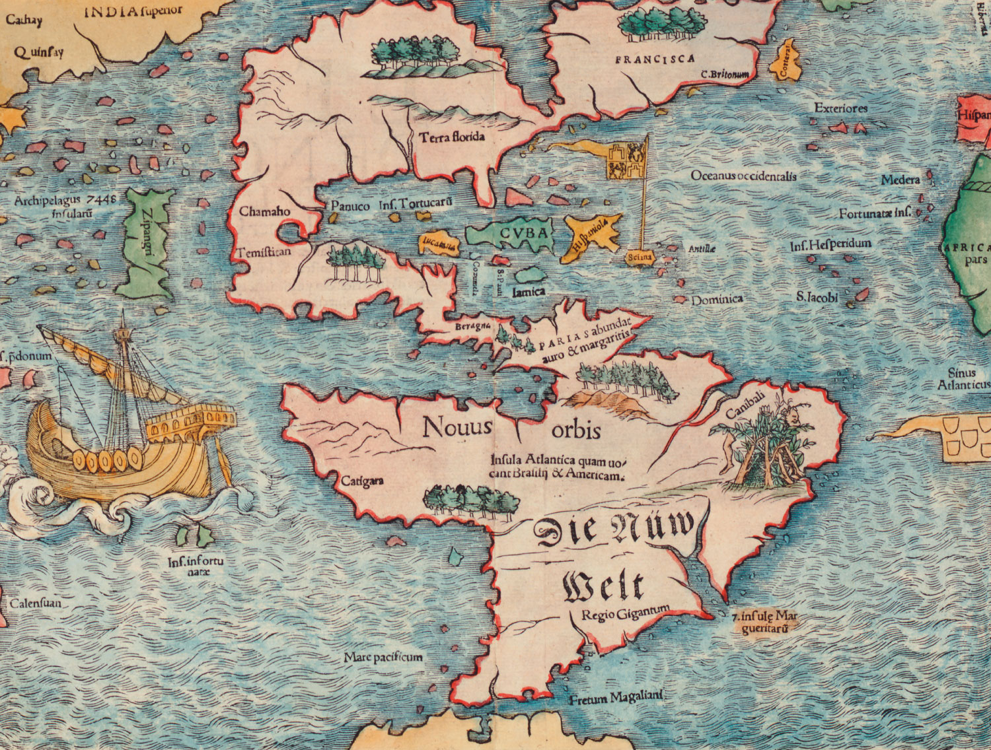
p7

Slide 12
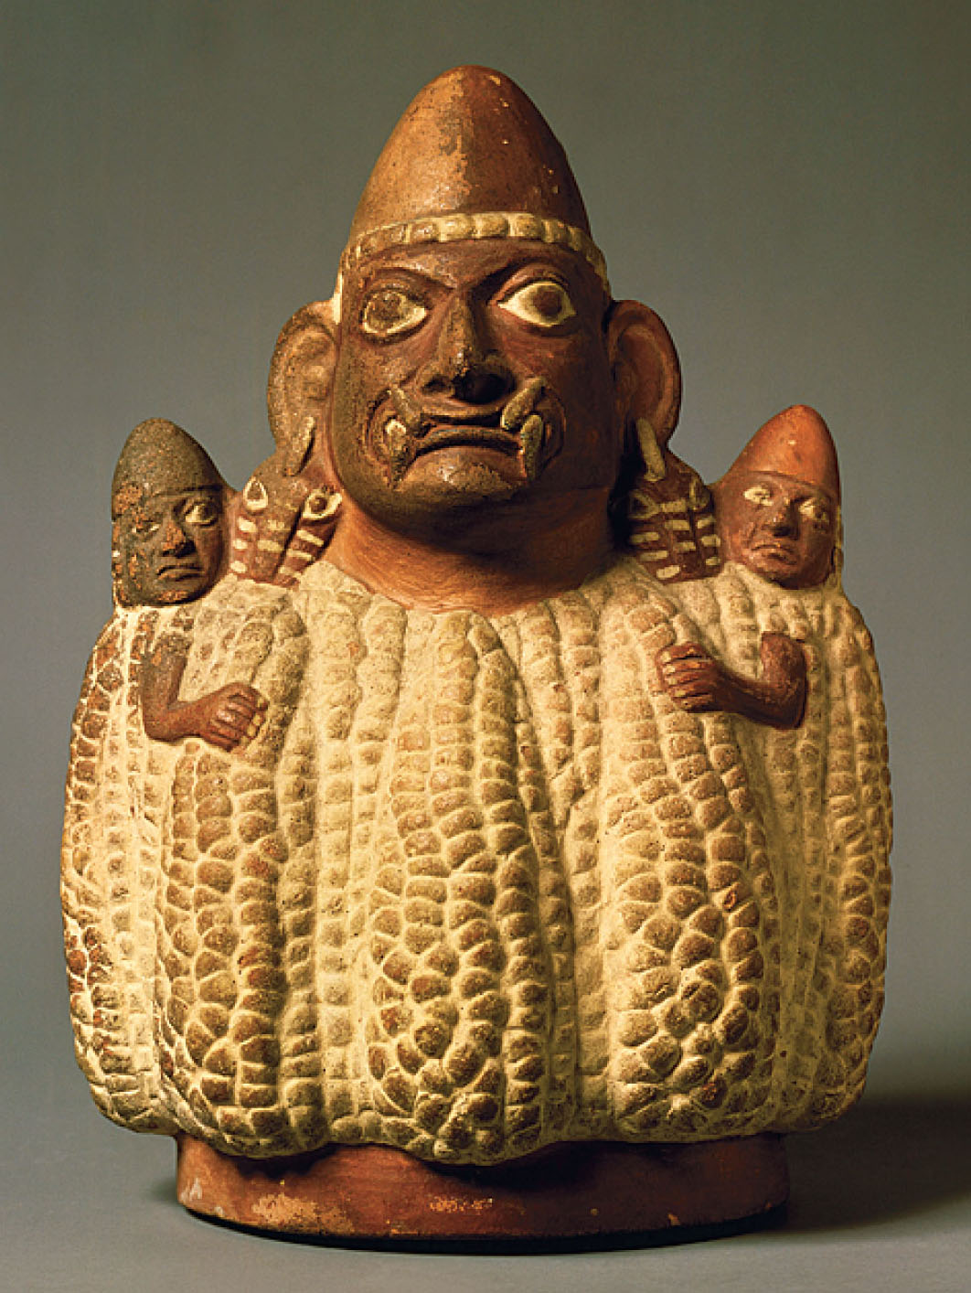
p8
Notes:
Corn Culture This statue of a corn goddess from the Moche culture of present-day coastal Peru, made between 200 and 600 b.c.e., vividly illustrates the centrality of corn to Native American peoples, a thousand years before the rise of the great Incan and Aztec empires that the Europeans later encountered.

Slide 13
The Earliest Americans
Agriculture, especially corn growing, became part of Native American civilizations in Mexico and South America.
Large irrigation systems were created.
Villages of multistoried, terraced buildings began to appear (Pueblo means “village” in Spanish).
Map 1.2 –Native American Indian peoples.

Slide 14
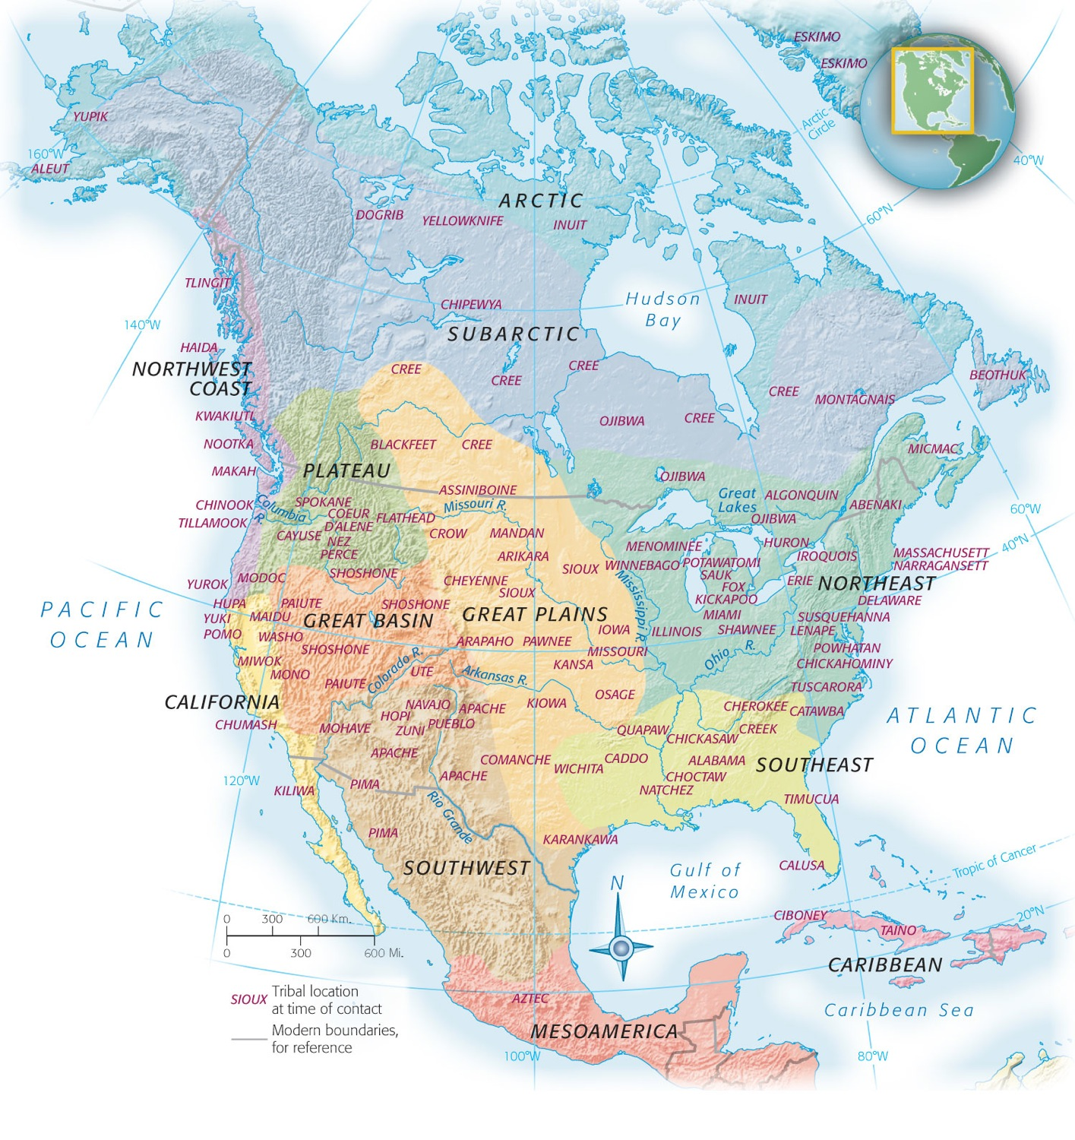
Map 1-2 p9
Notes:
MAP 1.2 North American Indian Peoples at the Time of First Contact with Europeans Because this map depicts the location of various Indian peoples at the time of their first contact with Europeans, and because initial contacts ranged from the sixteenth to the nineteenth centuries, it is necessarily subject to considerable chronological skewing and is only a crude approximation of the “original” territory of any given group. The map also cannot capture the fluidity and dynamism of Native American life even before Columbus’s “discovery.” For example, the Navajo and Apache peoples had migrated from present-day northern Canada only shortly before the Spanish first encountered them in the present-day American Southwest in the 1500s. The map also places the Sioux on the Great Plains, where Europeans met up with them in the early nineteenth century—but the Sioux had spilled onto the plains not long before then from the forests surrounding the Great Lakes. The indigenous populations of the southeastern and mid-Atlantic regions are especially difficult to represent accurately in a map like this because pre-Columbian intertribal conflicts had so scrambled the native inhabitants that it is virtually impossible to determine which groups were originally where.

Slide 15
The Earliest Americans
(cont.)
Social life was less elaborately developed.
Nation-states did not exist, except the Aztec empire.
The Mound Builders were in the Ohio River Valley.
The Mississippian settlement was at Cahokia.

Slide 16
The Earliest Americans
(cont.)
Three-sister farming—maize, beans and squash.
Iroquois Confederacy developed political and organizational skills.
The natives had neither the desire nor the means to manipulate nature aggressively.

Slide 17
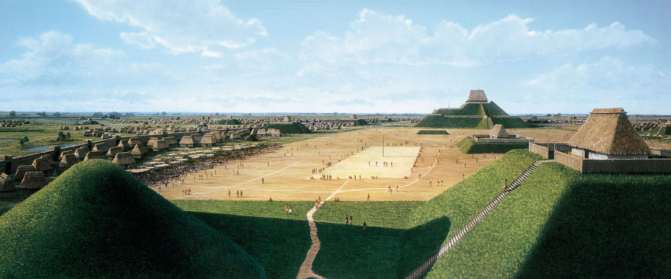
p10
Notes:
Cahokia This artist’s rendering of Cahokia, based on archaeological excavations, shows the huge central square and the imposing Monk’s Mound, which rivaled in size the pyramids of Egypt.

Slide 18
IV. Indirect Discoverers of the New World
Norse seafarers from Scandinavia came to the northeastern shore of North America, near present-day Newfoundland, spot called Vinland.
There was the chain of events that led to a drive toward Asia, the penetration of Africa, and the completely accidental discovery of the New World.

Slide 19
Indirect Discoverers of the New World (cont.)
The Christian crusaders rank high among America’s indirect discoverers.
The pursuit of the luxuries of the East from the Spice Islands (Indonesia), China, and India; Muslim middlemen exacted a heavy toll en route
See Map 1.3—Major Trade Routes with Asia, 1492.

Slide 20
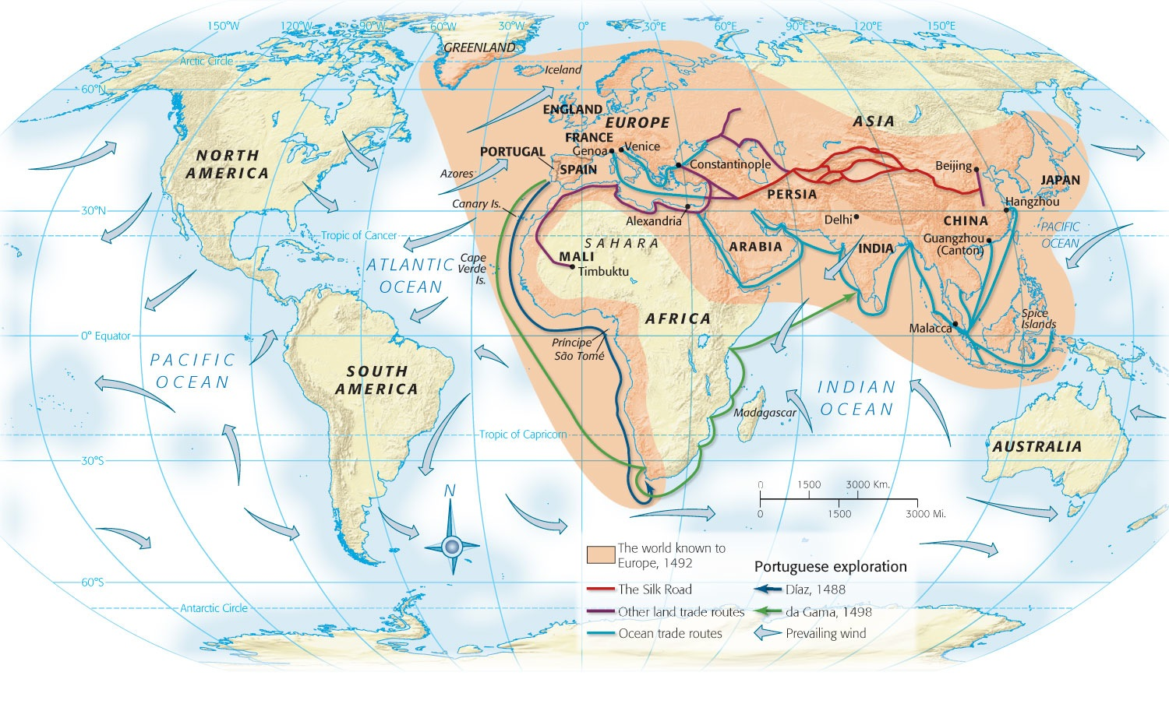
Map 1-3 p11
Notes:
MAP 1.3 The World Known to Europe and Major Trade routes with Asia, 1492 Goods on the early routes passed through so many hands along the way that their ultimate source remained mysterious to Europeans.

Slide 21
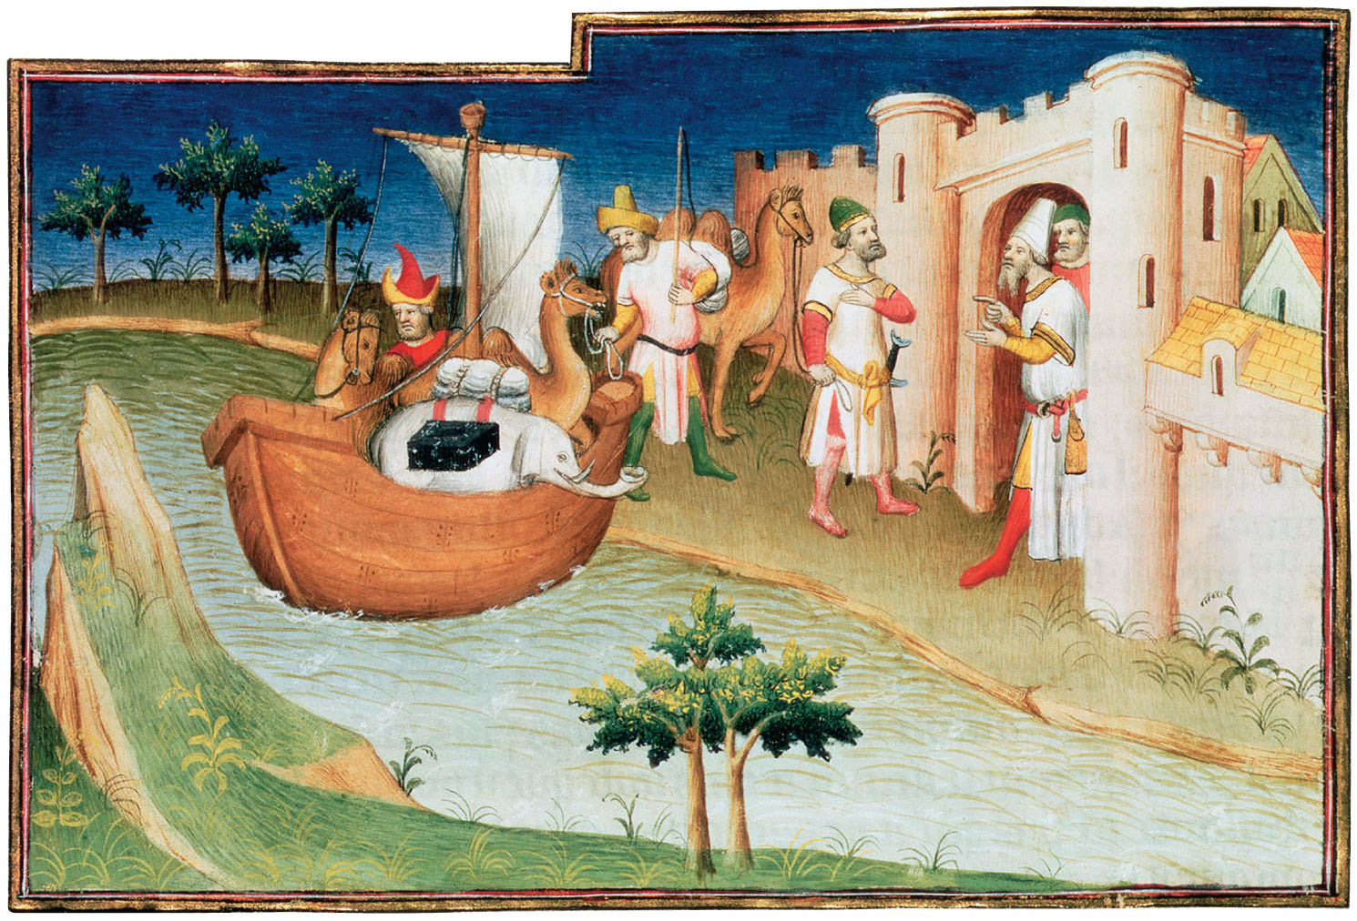
p12
Notes:
Marco Polo Passing Through the Strait of Hormuz This illustration, from the first printed edition of The Travels of Marco Polo in 1477, shows the traveler crossing the Persian Gulf between the Arabian Peninsula and Persia (present-day Iran).

Slide 22
V. Europeans Enter Africa
Marco Polo telling tales stimulated European desire for a cheaper route to the treasures of the East.
Spurred by the development of the caravel, Portuguese mariners began to explore Sub-Saharan Africa.
They founded the modern plantation system.
They pushed further southward.

Slide 23
European Enter Africa
(cont.)
Spain united by the marriage of Ferdinand of Aragon and Isabella of Castile, and the expulsion of the “infidel” Muslim Moors.
The Spanish were ready to explore the wealth of India.
Portugal controlled the south and east African coast, thus forcing Spain to look westward.

Slide 24
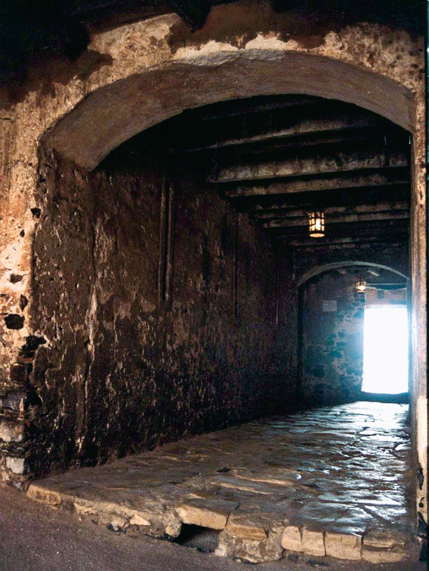
p13
Notes:
Gorée island Slave Fortress From this holding station off the coast of Senegal, thousands of African captives passed through the “Door of No Return” into a lifetime of slavery in the New World.

Slide 25
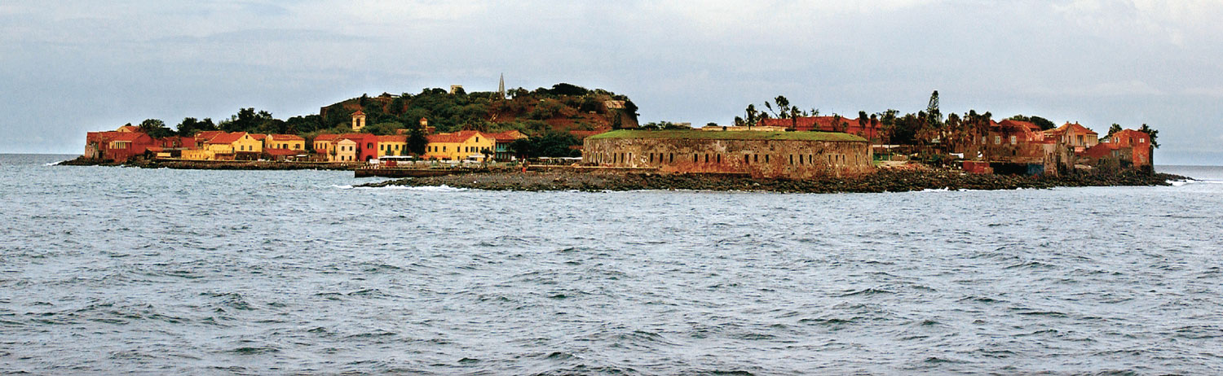
p13
Notes:
Gorée island Slave Fortress From this holding station off the coast of Senegal, thousands of African captives passed through the “Door of No Return” into a lifetime of slavery in the New World.

Slide 26
VI. Columbus Comes upon a New World
Christopher Columbus persuaded the Spanish to support his expedition on their behalf.
On October 12, 1492, he and his crew landed on an island in the Bahamas.
A new world was within the vision of Europeans.

Slide 27
Columbus Comes upon a New World (cont.)
Columbus called the native peoples “Indians.”
Columbus’s discovery convulsed four continents—Europe, Africa, and the two Americas.
An independent global economic system emerged.
The world after 1492 would never be the same.

Slide 28
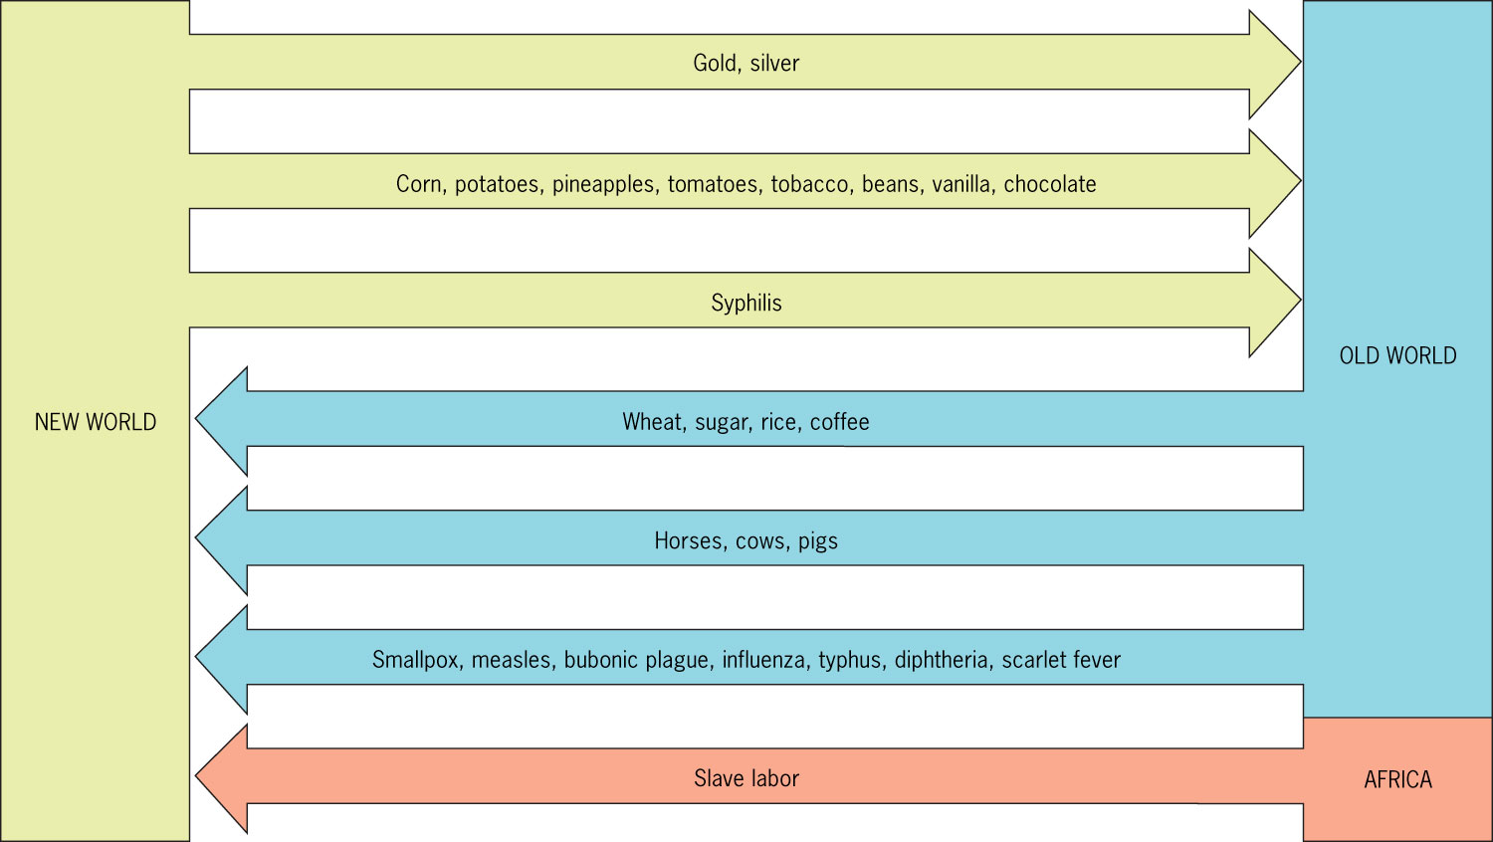
Figure 1-2 p14
Notes:
Figure 1.2 The Columbian Exchange Columbus’s discovery initiated the kind of explosion in international commerce that a later age would call “globalization.”

Slide 29
VII. When Worlds Collide
The clash reverberated in the historic Columbian exchange (see Figure 1.2).
While the European explorers marveled at what they saw, they introduced Old World crops and animals to the Americas.
Columbus returned in 1493 to the Caribbean island of Hispaniola.

Slide 30
When Worlds Collide
(cont.)
A “sugar revolution” took place in the European diet, fueled by the forced migration of millions of Africans to work the canefields and sugar mills of the New World.
An exchange of diseases between the explorers and the natives took place.

Slide 31
VIII. The Spanish Conquistadores
Spain secured its claim to Columbus’s discovery in the Treaty of Tordesillas (1494) dividing with Portugal the New World.
See Map 1.4.
In service of God, in search of gold and glory, Spanish conquistadores (conquerors) came to the New World.

Slide 32
VIII. The Spanish Conquistadores
(cont.)
Other explorers that came to the New World:
1513—Balboa discovered the Pacific Ocean
1519—Magellan around the tip of South America
1513 and 1521—Ponce de Leon to Florida
1540-1542—Coronado to Arizona and New Mexico

Slide 33
VIII. The Spanish Conquistadores
(cont.)
1539-1542 de Soto discovered the Mississippi River
1532 Francisco Pizarro crushed the Incas of Peru.
The economic system of capitalism fueled the growth of the New World.

Slide 34
VIII. The Spanish Conquistadores
(cont.)
The encomienda allowed the government to “commend” Indians to certain colonists in return for the promise to try to Christianize them.
Spanish missionary Bartolomé de Las Casas called it “a moral pestilence invented by Satan.”

Slide 35
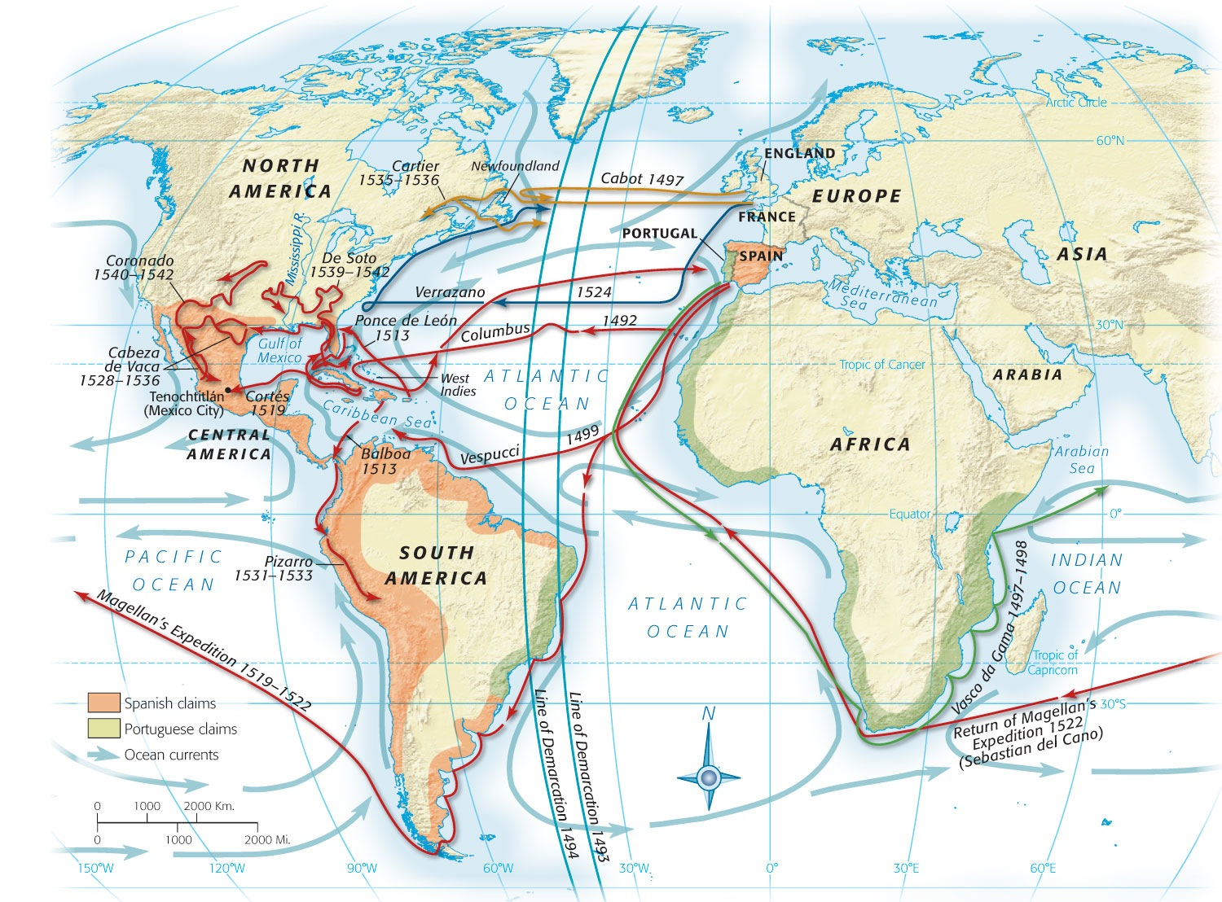
Map 1-4 p16
Notes:
MAP 1.4 Principal Voyages of Discovery Spain, Portugal, France, and England reaped the greatest advantages from the New World, but much of the earliest exploration was done by Italians, notably Christopher Columbus of Genoa. John Cabot, another native of Genoa (his original name was Giovanni Caboto), sailed for England’s King Henry VII. Giovanni da Verrazano was a Florentine employed by France.

Slide 36
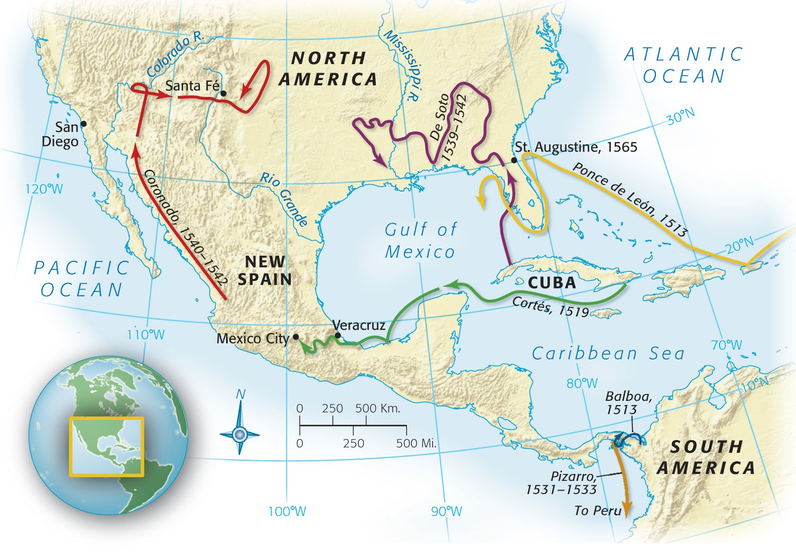
Map 1-5 p17
Notes:
MAP 1.5 Principal Early Spanish Explorations and Con-quests Note that Coronado traversed northern Texas and Oklahoma. In present-day eastern Kansas, he found, instead of the great golden city he sought, a drab encampment, probably of Wichita Indians

Slide 37
IX. The Conquest of Mexico
1519 Hernan Cortés set sail with eleven ships for Mexico and her destiny.
Along the way he rescued several people who would be important for his success.
Near present-day Veracruz, Cortés made his final landfall.
He determined to capture the coffers of the Aztec capital at Tenochtitlan.

Slide 38
IX. The conquest of Mexico
(cont.)
Aztec chieftain Moctezuma sent ambassadors to greet Cortés and invite Cortés and his men to the capital city.
On June 30, 1520, noche triste (sad night); the Aztec attacked Cortés.
On August 13, 1521, Cortés laid siege to the city and the Aztec capitulated. The combination of conquest and disease took its toll.

Slide 39
IX. The conquest of Mexico
(cont.)
The invaders brought more than conquest and death.
They intermarried with the surviving Indians, creating a distinctive culture of mestizos, people of mixed Indian and European heritage.
Mexican civilization is a unique blend of the Old World and the New.

Slide 40
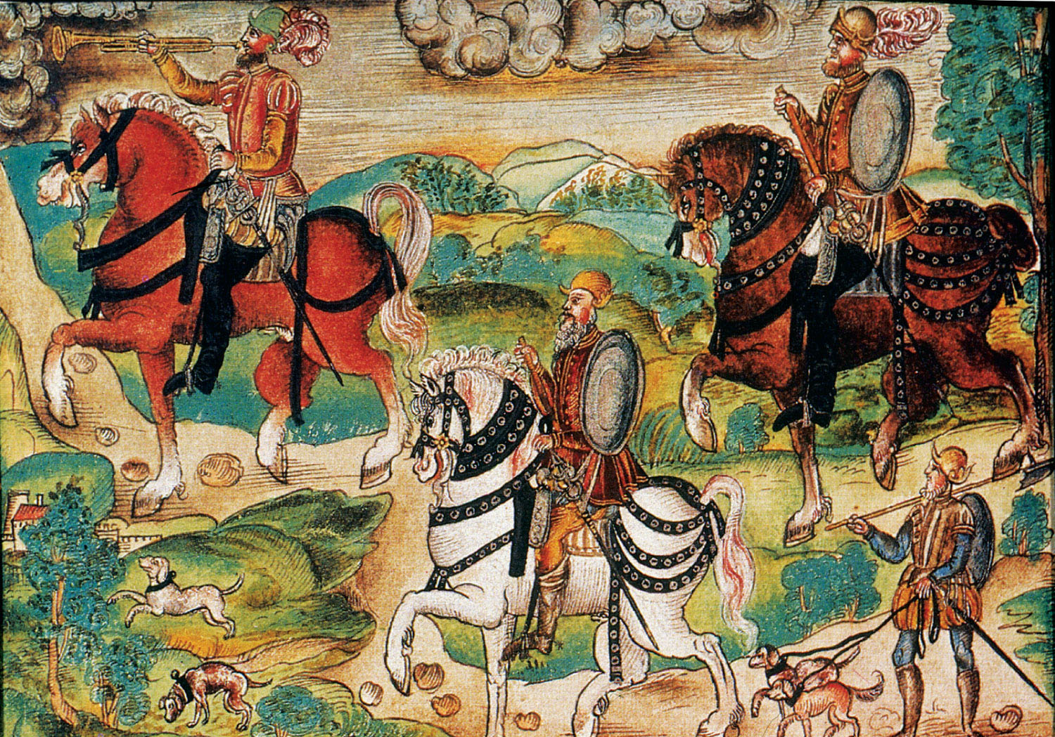
p18
Notes:
Conquistadores, ca. 1534 This illustration for a book called the Köhler Codex of Nuremberg may be the earliest depiction of the conquistadores in the Americas. It portrays men and horses alike as steadfast and self-assured in their work of conquest.

Slide 41
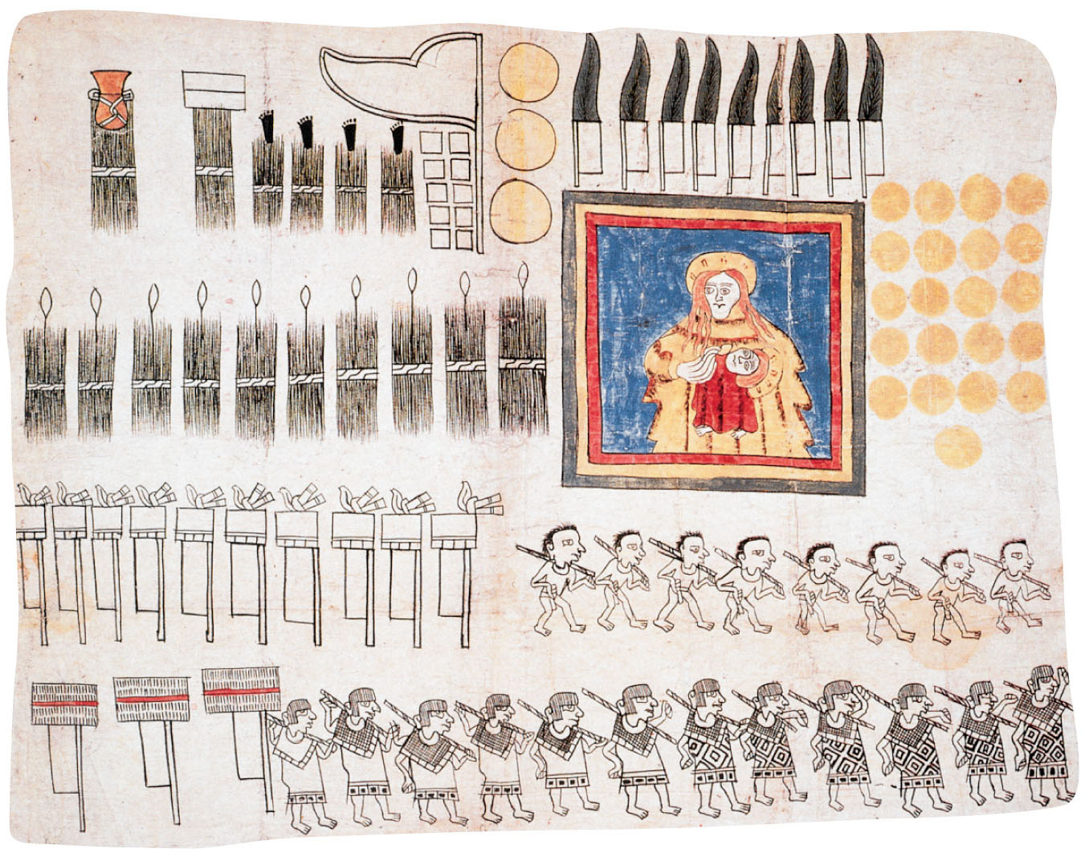
p19
Notes:
An Aztec View of the Conquest, 1531 Produced just a dozen years after Cortés’s arrival in 1519, this drawing by an Aztec artist pictures the Indians rendering tribute to their conquerors. The inclusion of the banner showing the Madonna and child also illustrates the early incorporation of Christian beliefs by the Indian

Slide 42
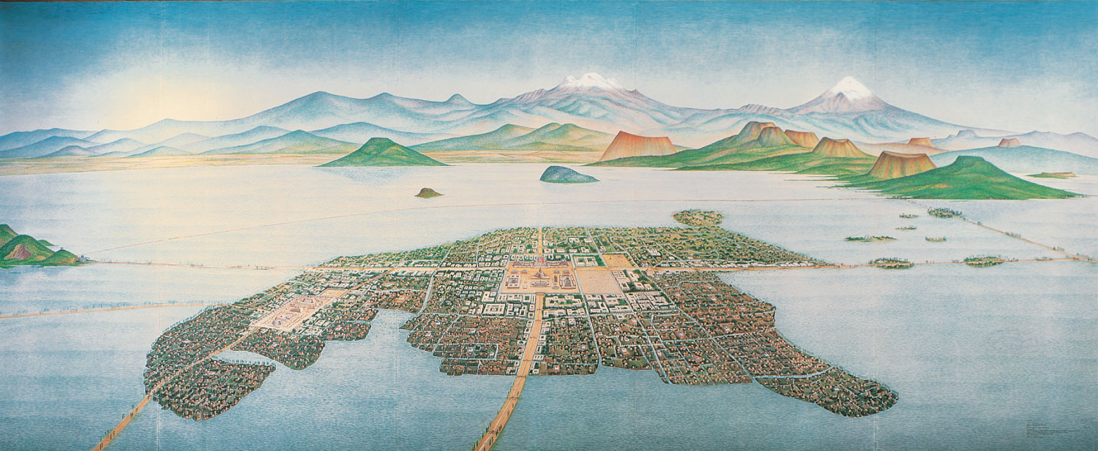
p20
Notes:
Artist’s rendering of Tenochtitlán Amid tribal strife in the fourteenth century, the Aztecs built a capital on a small island in a lake in the central Valley of Mexico. From here they oversaw the most powerful empire yet to arise in Mesoamerica. Two main temples stood at the city’s sacred center, one dedicated to Tlaloc, the ancient rain god, and the other to Huitzilopochtli, the tribal god, who was believed to require human hearts for sustenance.

Slide 43
X. The Spread of Spanish America
Spain’s colonial empire grew swiftly and impressively. Other explorers began to come.
1497-1498 Giovanni Caboto (known as John Cabot) to the northeastern coast of North America.
1524 Giovanni da Verrazano probed the eastern seaboard.
1534 Jacques Cartier to the St. Lawrence R.

Slide 44
X. The Spread of Spanish America
(cont.)
The Spanish began to build forts to protect their territories.
The Spanish cruelly abused the Pueblo peoples in the Battle of Acoma.
1609 The province of New Mexico and its capital was founded. (see Map 1.6).
The Roman Catholic mission became the central institution in colonial New Mexico.

Slide 45
X. The Spread of Spanish America
(cont.)
1680 The native Indians rose up against the missionaries in Popé’s Rebellion.
1680 Robert de La Salle’s expedition down the Mississippi River.
1716 The Spanish settled in Texas.
1769 Spanish missionaries led by Father Junipero Serra founded San Diego and 21 mission stations.

Slide 46
X. The Spread of Spanish America
(cont.)
The Black Legend is a false record of the misdeeds of the Spanish in the New World.
While there were Spanish misdeeds, the Spanish invaders laid the foundations for a score of Spanish-speaking nations.

Slide 47
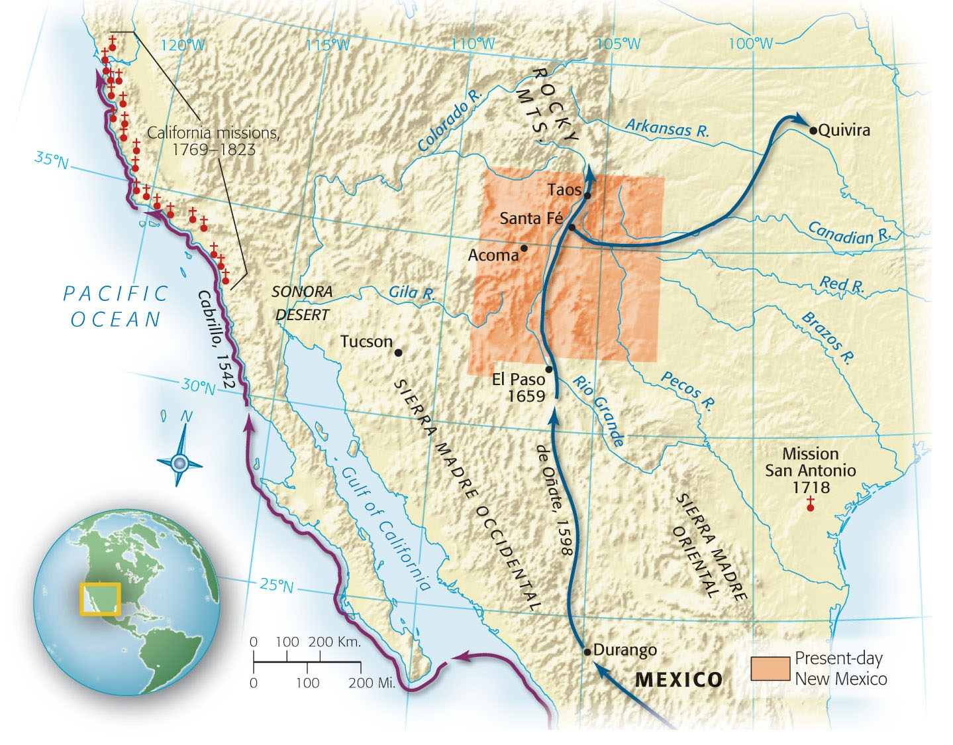
Map 1-6 p21
Notes:
MAP 1.6 Spain’s North American Frontier, 1542–1823

Slide 48
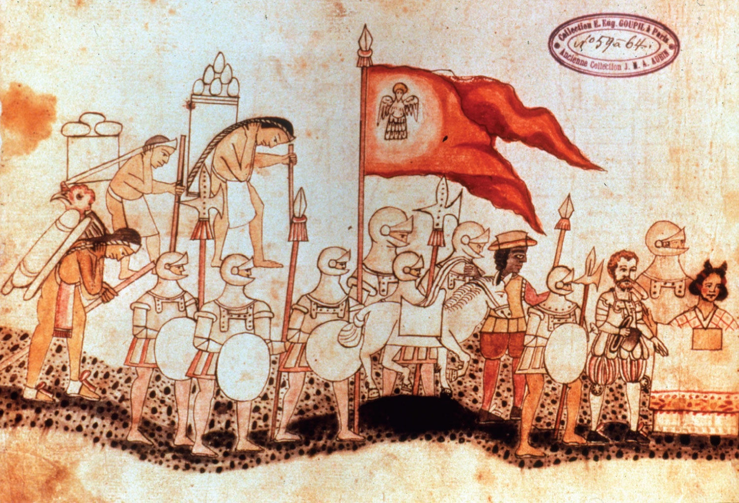
p21
Notes:
Arrival of Cortés, with Dona Marina, at Tenochtitlán in 1519 This painting by a Mexican artist depicts Cortés in the dress of a Spanish gentleman. His translator Malinche, whose Christian name was Marina, is given an honorable place at the front of the procession. She eventually married one of Cortés’s soldiers, with whom she traveled to Spain and was received by the Spanish court.

Slide 49
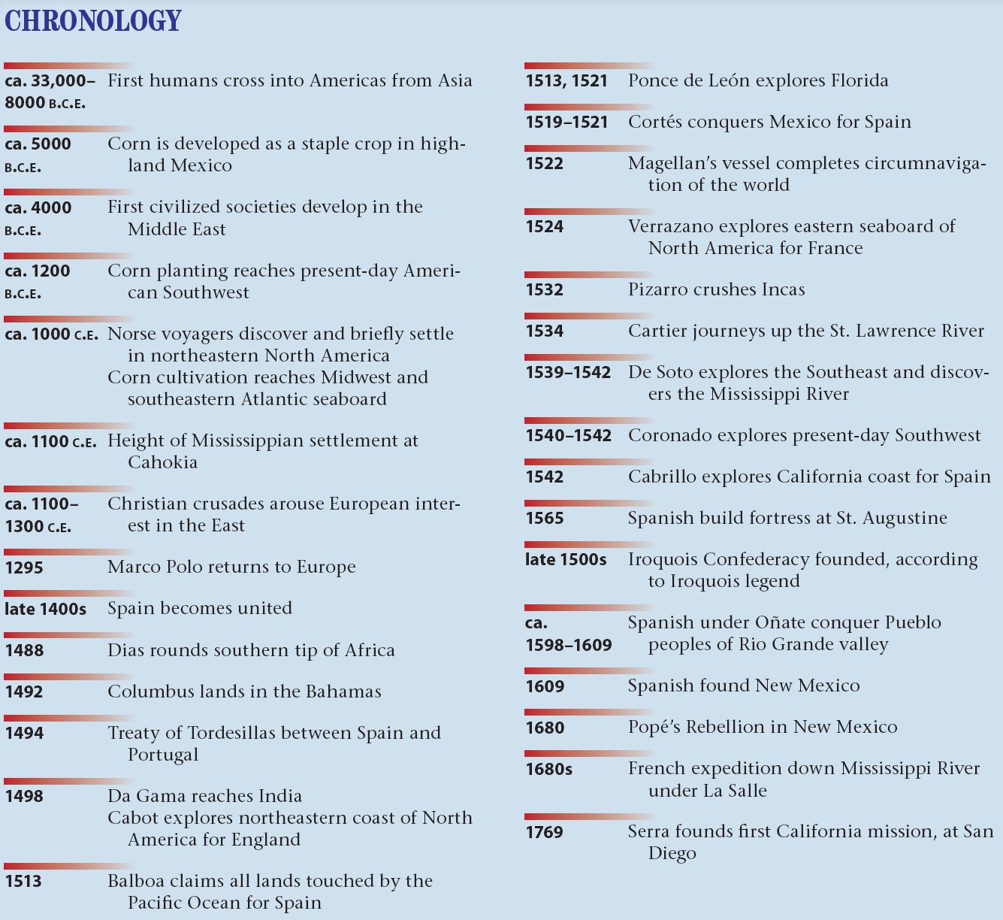
p23

